Slide 1






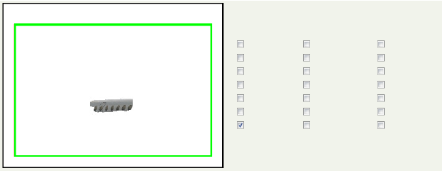
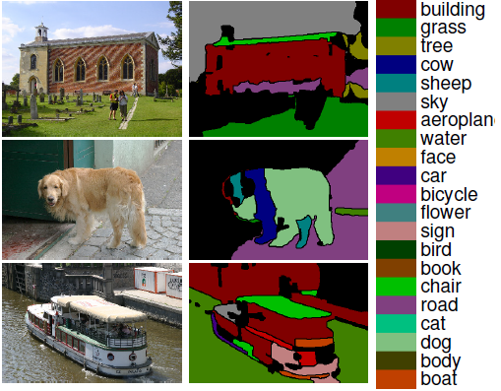

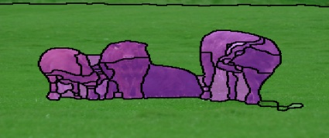

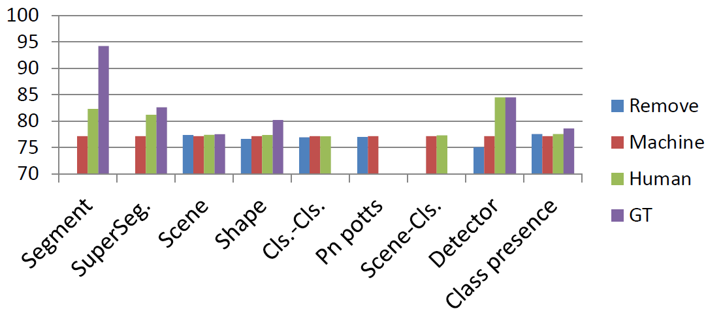
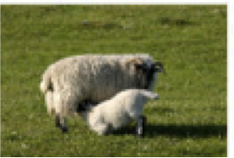
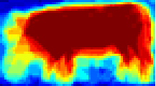
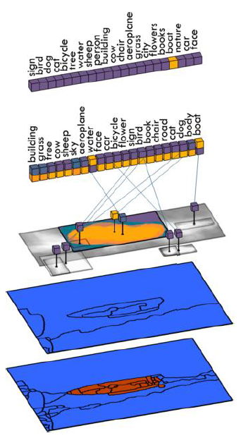

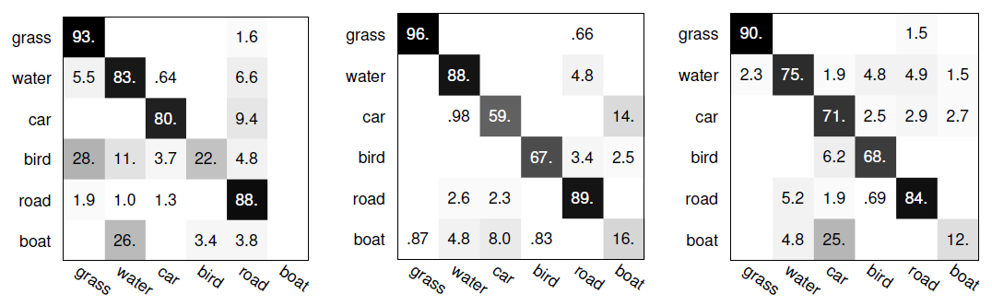


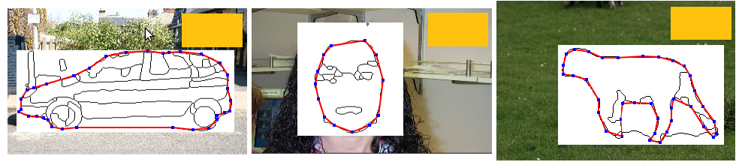

Analyzing Semantic Segmentation Using Hybrid Human-Machine CRFs
Roozbeh Mottaghi¹, Sanja Fidler², Jian Yao², Raquel Urtasun², Devi Parikh³
¹ UCLA ² TTI Chicago ³ Virginia Tech
Summary
Segment & Super-segment Potentials:
Machine: TextonBoost classifier
Humans:
Scene Potential:
Machine: Spatial Pyramid Match over SIFT, RGB, GIST, … (81.8%)
Humans: We asked the human subjects to classify the images into one of 21 scene classes.
Our goal is to identify bottlenecks in holistic scene understanding models for semantic segmentation.
We compute CRF potentials based on:
- Responses of human subjects
- Ground Truth
- Machine
- Removing components
Findings from our human studies inspire an approach that results in state-of-the-art accuracy on MSRC.
Human
Machine
Remove
Ground
Truth
Recognize this
Building
Water
Book
Grass
Human Face
Chair
Tree
Car
Road
Context
Cow
Bicycle
Cat
Sheep
Flower
Dog
boat
sky
Sky
Sign
Body
water
bird
Aeroplane
Bird
Boat
90.4%
89.8%
86.8%
85.3%
Segmentation
CRF
Scene recognition
Machine Accuracy: 77.4 > Human Accuracy: 72.2
Experiments with Human-Machine CRFs
Class Unary: Likelihood of presence of a certain class
Machine: Frequency in training data
Humans: Given a pair of categories, we asked “Which category is more likely?”
Average Recall
inconsistent
Object detection
Object shape
Holistic CRF Model
Class-class Co-occurrence:
Machine: Co-occurrence matrix from training data
Humans: We asked “Which scenario is more likely to occur in an image? Observing (cow and grass) or (cow and airplane)?”
The CRF model performs better with the less accurate human segment potential. Goal of subsequent analysis is to explain the boost.
Which scene is depicted?
Plug-and-Play architecture
No restrictions on the form of the potentials
grass
face
book
grass
We tried several hypotheses including incorporating scale, handling overfitting, predicting human potentials from machine potentials, etc., but none of them explained the boost.
Which classes are present?
sky
tree
cat
cow
sheep
flower
chair
building
bicycle
car
face
tree
building
cow
sheep
flower
bird
car
bicycle
chair
aeroplane
water
bird
dog
road
body
sign
book
body
sky
sign
road
Humans and machines make complementary mistakes:
True/False detection?
aeroplane
water
dog
cat
Breaking the connection between layers causes a significant decrease in accuracy when we have human at one level and machine at another.
H: Human
M: Machine
cow, sheep, aeroplane, face, car, bicycle, flower, sign, bird, book, chair, cat, dog, body, boat
boat
Human
boat
Machine
S: Segment
SS: Supersegment
Super-segment labeling
J. Yao, S. Fidler and R. Urtasun, Describing the Scene as a Whole: Joint Object Detection, Scene Classification and Semantic Segmentation, CVPR 2012.
Object Detection:
Machine: DPM (Felzenszwalb et al.)
Humans: Ground truth which is provided by humans.
w/o
Segment labeling
Human and machine errors become similar when we reduce the window size for TextonBoost:
Human & Machine Potentials
Shape Prior:
Machine: Per component average mask of examples. (78.2%)
Humans: We asked them to draw object contour along the boundary of superpixels (80.2%)
We used Amazon Mechanical Turk to produce human potentials.
10 subjects participated in our study for each task (total of 500 subjects).
In total, we had ~300K tasks.
We used MSRC dataset for our experiments.
car
face
sheep
Machine: 200x200 windows
Human
Machine: 30x30 windows
Bird
Cow
Chair
A simple change of using multiple window sizes in the segment classifier provides a significant improvement.
The type of mistakes are more important than the number of mistakes.
2.4%
interface used by human subjects
Car, cmp. 1
Car, cmp. 3

