Slide 1
Roles of local and global information in image classification
Devi Parikh

Slide 2


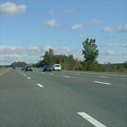
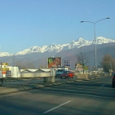
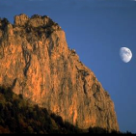


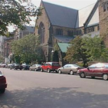
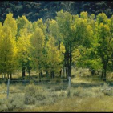
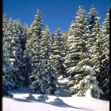
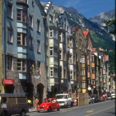
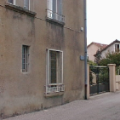
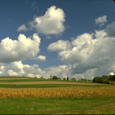


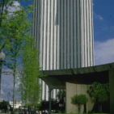






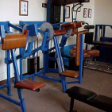
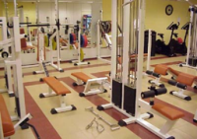

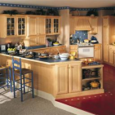
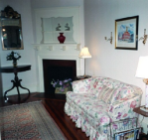
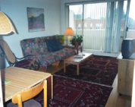
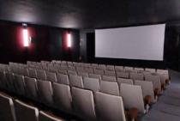
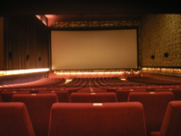

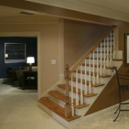
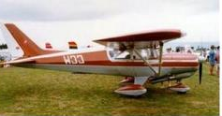
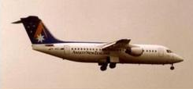
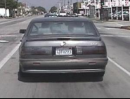
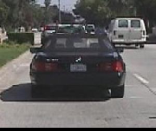





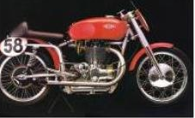


Coast
Highway
Mountain
Street
OSR
Forest
Inside city
Open country
Tall buildings
Bathroom
Bedroom
Dining room
Gym
ISR
Kitchen
Living room
Movie theater
Stair case
Aeroplane
Car-rear
Face
CAL
Ketch
Motorbike
Watch

Slide 3
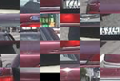

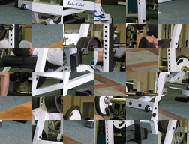
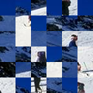
Jumbled Images

Slide 4
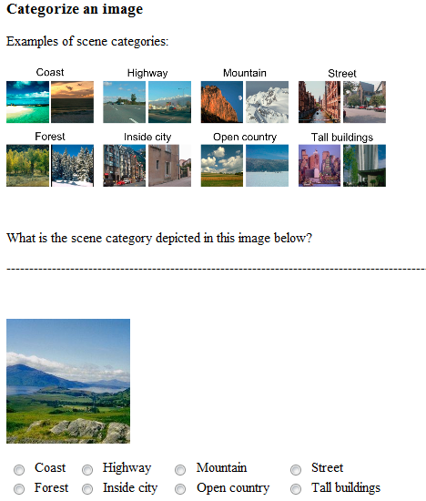
Human Study: Intact Images

Slide 5
Human Study: Jumbled Images

Slide 6
Human Recognition of Jumbled Images
Accuracy

Slide 7
How do we recognize them?
…
Majority Vote of Local Independent Decisions?
MRF Inference?
Are existing machine implementations of this model good enough?

Slide 8
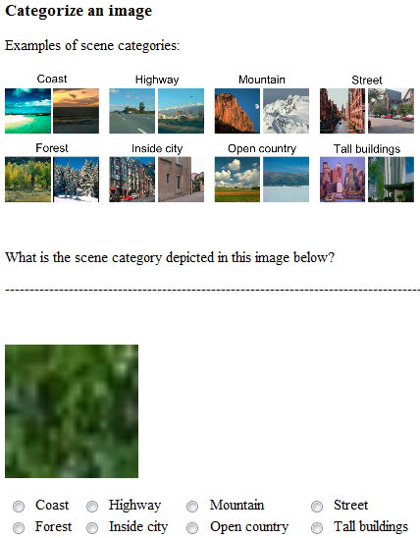
Human Studies: Individual Blocks

Slide 9
Human Recognition of Individual Blocks
Accuracy

Slide 10
Machine Experiments
Assign blocks to codewords
Accumulate p(scene|codewords)
Pick class with highest votes

Slide 11
Majority Vote Results
Proportion of matched responses

Slide 12
Classification of Jumbled Images
Accuracy
Need advanced modeling of global information

