Slide 1
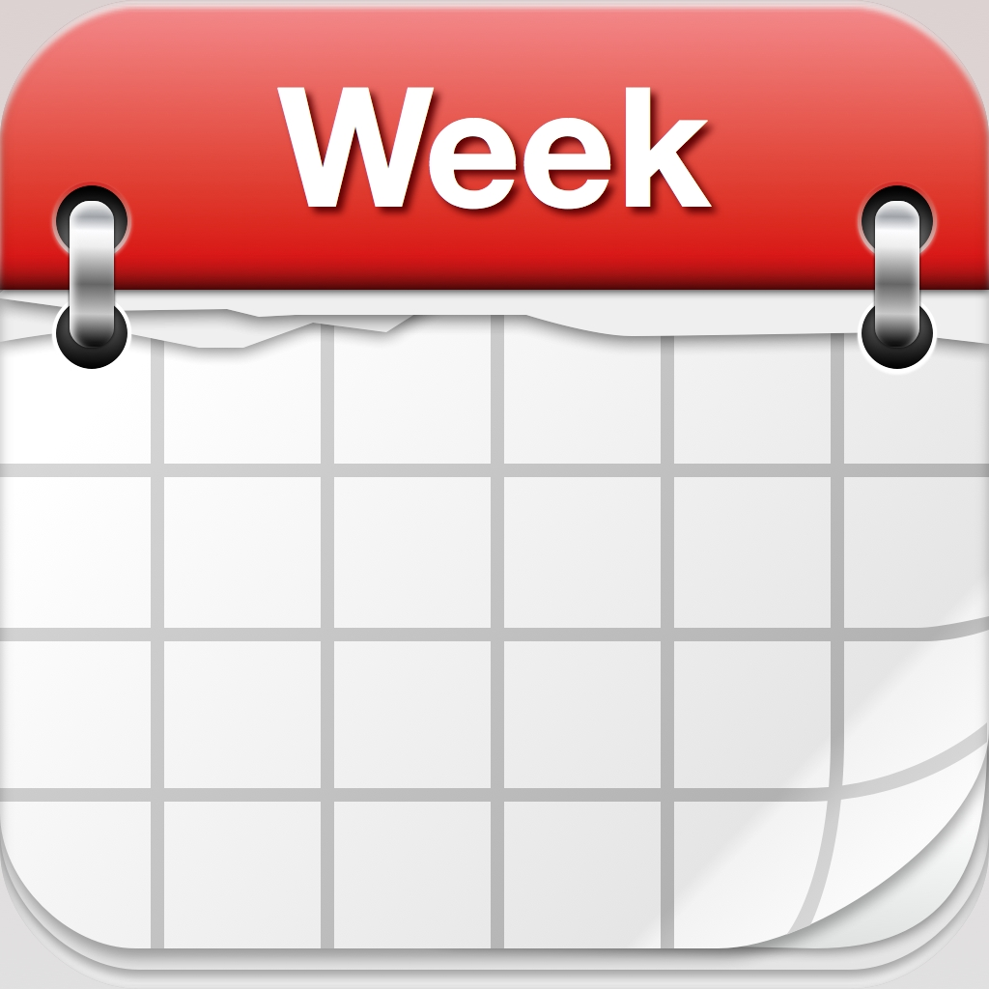
Calendar. Not to-do lists.
Devi Parikh

Slide 2

Goal
Be on top of things
Avoid drama and stress

Slide 3

Assumption
Your bottleneck is time management, and not motivation

Slide 4

Philosophy
Calendars convert time to space
Finiteness of time becomes apparent
Just like physical space constraints are apparent

Slide 5

Methodology
Make every task a calendar entry
Do the task at that time
Move the task to a “done” calendar
Go to bed with an empty “to do” calendar
Either you got everything done
Or you re-planned

Slide 6

Principle 1
Everything takes time
Everything needs to be on your calendar

Slide 7

Principle 1: Everything on your calendar
Time is always ticking
Time is finite
Time is your bottleneck
Plan with time being central
Calendars. Not lists.
Everything on your calendar
Personal (routine, fun, errands, doing nothing)
Professional (meetings, tasks, thinking, emails)
Long term, recursive
Nothing is too trivial
Bonus: Nothing will get dropped

Slide 8

Principle 2
Incorporate your multiplier factor

Slide 9

Principle 2: Incorporate your multiplier factor
What is a multiplier factor?
Measuring it is easier than fixing it
Measure it, incorporate it
It will feel like an overkill, don’t ignore the data
Your plan is now a feasible one
If everything doesn’t fit, prioritize
Don’t be delusional
Bonus: Measuring the multiplier is a first step towards approaching 1.0

Slide 10

Principle 3
Incorporate your patterns

Slide 11

Principle 3: Incorporate your patterns
Unexpected things tend to happen at work
Kids
Not a morning person
Friends tend to make impromptu plans on Saturdays
Tend to be too tired on Sundays
Give yourself plenty of buffer
Don’t mix in other battles

Slide 12

Principle 4
Re-plan

Slide 13

Principle 4: Re-plan
Plan is feasible, but not guaranteed
Move things to other open slots
Ripple effect based on urgency
After re-planning, you once again have a feasible plan
Rinse and repeat
A successful day is not when you get everything you planned to do that day done. It is one when you can go to bed with a feasible plan for every day ahead.
Re-planning is not failure. Re-planning is part of the plan.
Bonus: The high of the “done” move

Slide 14

Principle 5
Break it down

Slide 15

Principle 5: Break it down
Not everything comes in calendar-sized chunks
Break it down
Pro-tip: Make making a plan a calendar entry

Slide 16

Principle 6
Backtrack
Foresee

Slide 17

Principle 6: Backtrack. Foresee.
Backtrack:
A conference deadline is 3 months out...
Foresee:
A week before the conference deadline tends to be crazy
You can’t get work done when family is visiting
Surfaces when things are more urgent than they seem to be
You’ll know. Things won’t “fit”!
Pro-tip: Backtracking tells you the *latest* by when you need to get something done!
Pro-tip: You need buffers to be able to re-plan.

Slide 18

Principle 7
Visualize your time

Slide 19

Principle 7: Visualize your time
Every night
What is tomorrow going to be like?
Every Sunday
What is next week going to be like?

Slide 20

Summary: Methodology
Backtrack, foresee
Make every task a calendar entry
Incorporate multiplier and patterns
Break it down
Do the task at that time
Move the task to a “done” calendar
Visualize your tomorrow
Go to bed with an empty “to do” calendar
Either you got everything done
Or you re-planned

Slide 21
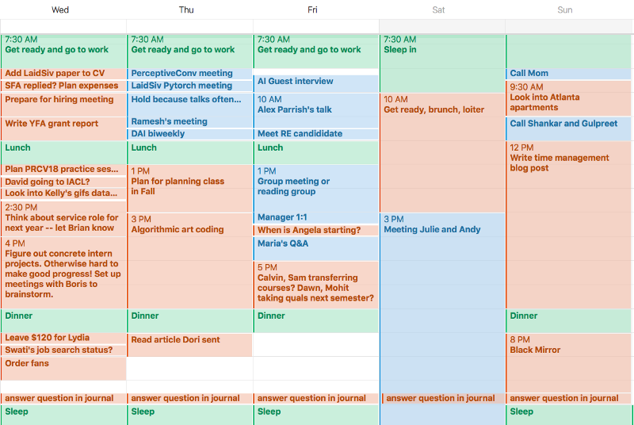
Calendar. Not to do lists. https://blog.usejournal.com/calendar-in-stead-of-to-do-lists-9ada86a512dd

Slide 22

Emails
Goal: Zero inbox
When you first see an email, read it entirely
If nothing needs to be done: archive it
If you need to reply and can do it now: reply and archive
If you need to do something before you can reply: put that task on your calendar, archive the email
So only emails in your inbox are ones you haven’t read
(or are emails you read in a rush – e.g., walking between meetings)

Slide 23


Calendar. Not to do lists. https://blog.usejournal.com/calendar-in-stead-of-to-do-lists-9ada86a512dd

