Slide 1
Advanced Java Programming
Servlets Introduction

Slide 2
Client – Server Architecture
At the beginning stages of computers we have client server architecture. Where the main purpose of the server is to share the static resources to the client requirements. In this case when we send a request to the server machine, server will identify the requested resource and send back to the client machine as a response. Here server is generating the response without executing any application at server machine so that this kind of response is called as static response. As per the application requirements we need to get dynamic response from server machine. To generate dynamic response server must execute some applications at server machine, for this we should provide server side applications.

Slide 3

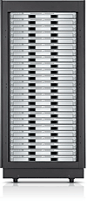
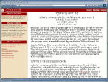
Static Pages:
Request file
Retrieve file
Send file

Slide 4
Dynamic Pages
Request service
Do Computation
Generate HTML
page with results
of computation
Return dynamically generated HTML file

Slide 5
To provide server side programming for the sake of dynamic response we should use the fallowing server side technologies.
CGI
Servlets
JSP …. Etc

Slide 6
Common Gateway Interface (CGI)
CGI can be implemented
in an interpreted language such as PERL
in a compiled language such as C
Any program can be converted to a CGI program
It just has to follow the CGI rules
The rules define
How programs get and sends data (i.e., communication protocol)
How to make sure Web server knows that a program is a CGI program.

Slide 7
CGI
A CGI program is
Stored on the server,
Executed on the server,
Executed in response to request from client.
By running a CGI program, rather than delivering a static HTML page, the server can:
Put dynamic and updated information on web page (e.g., weather forecast, stocks price, product availability, etc…).
Respond appropriately to user input.
Store user data on server-side in a file or DB.

Slide 8
Dynamic Pages
Request service
Run CGI program
…
…
…
print $result
Return dynamically generated HTML file
<HEADER>
<BODY
</BODY>

Slide 9
To generate dynamic response we have already CGI technology then why you go for Servlets technology?
CGI is a technology which was designed on the basis of ‘C’ technology and some scripting technology. As we know ‘C’ technology is a process based technology.
If we deploy any CGI application at server for every new request came from client automatically server will create a separate process at server machine.
Process is a heavy weight component that’s why to handle it system must consume more number of system resources.
In the above situation if we increase more number of requests to the same CGI application then server will create more number of processes. This approach will increase burden to the server machine as a result application quality could be degraded.

Slide 10
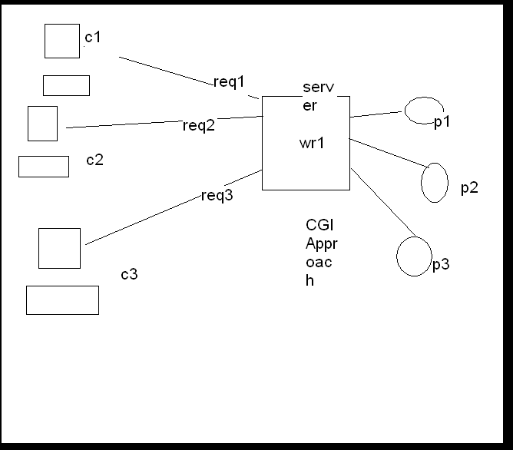

Slide 11
SERVLETS:
Servlets is a server side technology which was designed on the basis of Java Technology. As we know Java is a Thread Based Technology that’s why Servlets is also a Thread Based Technology.
If we deploy any Servlets application at server machine then for every new request came from clients automatically servlet may create a separate thread on the servlet object.
If we increase more number of client requests then more number of threads will be created instead of process.
Thread is a light weight component when compare to process that’s why this approach will not increase burden to the server machine.

Slide 12
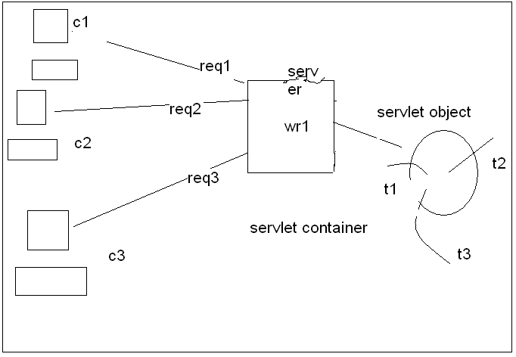

Slide 13
Write the differences between Servlets and Jsp’s?
a) To design any web application if we use Servlets as a technology then we should require minimum java knowledge.
To design the same web application if we use JSP as a technology then it is not at all require to have java knowledge.
b) Servlets are good at the time of pickup the request and process the requests.
Jsp’s are good at the time of delivering the dynamic response to client with very good look and feel.
c) In case of Servlets we are enable to separate presentation logic and business logic.
But in case of Jsp’s we are able to separate both presentation logic and business logic due to the availability of separate tags for presentation and separate tags for business logic.

Slide 14
d) If we made any modifications on the existed servlet then we should require recompiling and reloaded to server explicitly.
If we made any modifications on the existed Jsp’s is it not require to recompiling and reloaded to server explicitly. Why bcz JSP pages are auto compiled and auto loaded.
e) If we go for any MVC Based Web applications where we should use Servlets as a Controller and Jsp’s as a View Part.
Eg: In Struts Frame Work we will use ActionServlet as a controller and some set of and some set of Jsp’s as a view part.
Eg: In case of JSF Frame Work we should use FacesServlet as a controller and some set of Jsp’s as a view part.

Slide 15
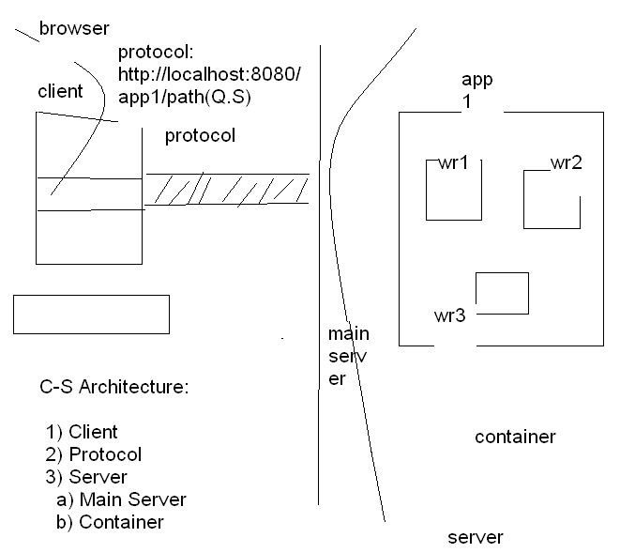

Slide 16
Client Server Architecture:
To design any web application minimum we should require 2-tier architecture i.e. client server architecture. In this c-s architecture we have mainly three components are there. They are given bellow.
CLIENT
PROTOCOL
SERVER

Slide 17
CLIENT:
The job of the client machine in client server architecture is to send request and to get the responses from the server machine.
From client machine to send request and to get the responses we should use a tool at client machine called as Browser, here Browser is acting like a Client.
In client server architecture we will send request from client to the server by specifying a string at clients address bar called as URI.

Slide 18
PROTOCOL:
It is a set of rules and regulations, which can be used to carry the data from one machine to another machine over the network.
The main purpose of protocol in the client server architecture is to carry request from client to the server and to carry response from server to the client. TCP, IP, UDP, HTTP, ARP, RARP…… etc
In general we will use Http protocol in our web applications why?
In general web application requires a protocol and it must satisfy the fallowing properties.
1) Connection less protocol: Not to have physical connection, to have a logical connection.
2) Stateless protocol: Not to remember the previous request data at the time of processing the later request.
3) A compatible protocol should carry hypertext data: In general we will carry only hypertext data as a request from client to server and as a response from server to client.
Http protocol is a connection less, stateless and a compatible protocol to carry hypertext data from client to server and from server to client.

Slide 19
SERVER:
To the job of the server in Client Server Architecture is to get the request and to generate the response. If we want to make a machine as a server machine then we need to install a piece of software called as server software.
Eg:
Apache Tomcat
BEA Web logic (Oracle)
IBM Web sphere
Macromedia JRUN
Sun Micro Systems J2EE, SUNONE, Glass Fish ……….. etc..
There are two types of servers are there.
Web Servers
Application Servers

Slide 20
Steps to Design Web Application :
To design any Web Application we should use the fallowing steps.
1) Prepare Web Applications Directory Structure
2) Design Deployment Descriptor
3) Design the Web Resources as per the Application Requirements
4) Start the server and execute the Web Application

Slide 21
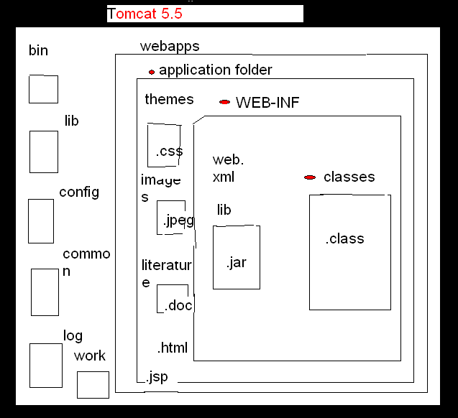

Slide 22
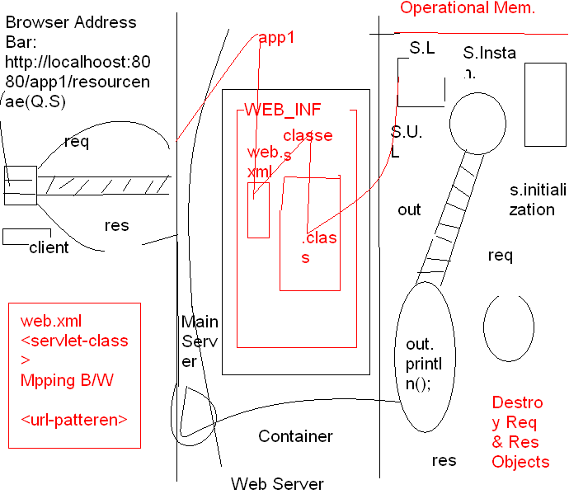
Calling of init()
Calling of service()

Slide 23

Questions?

