Slide 1
Introduction to JSP
By CSREDDY

Slide 2
Java Server Pages (JSP) is a server side component for the generation of dynamic information as the response. Best suitable to implement view components (presentation layer components). It is part of SUN’s J2EE platform.
Advantages of JSP over Servlet:
Best suitable for view components
we can separate presentation and business logic
The JSP author not required to have strong java knowledge
If we are performing any changes to the JSP, then not required to recompile and reload explicitly
We can reduce development time.
What is JSP:

Slide 3
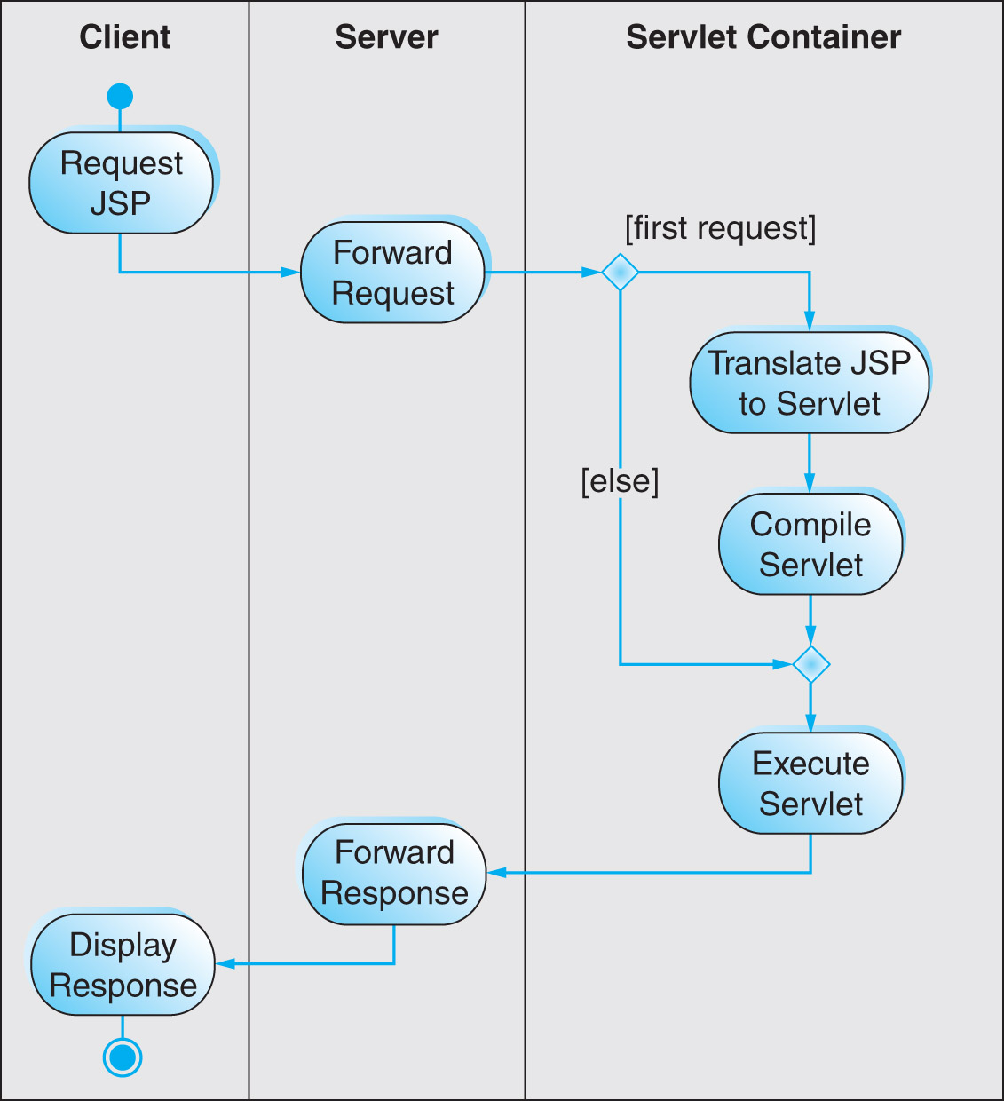
JSP Life-Cycle

Slide 4
JSP Lifecycle
JSP to Servlet
Translation
Servlet
Compiled
Servlet
Loaded
jspInit()
called
_jspService()
called

Slide 5
How Does JSP Work?
JSP

Slide 6
What are the lifecycle phases of a JSP?
Life cycle of JSP contains the following phases:
1. Page translation: -converting from .jsp file to .java file
2. Page compilation: converting .java to .class file
3. Page loading: This class file is loaded.
4. Create an instance: - Instance of servlet is created
5. jspInit() method is called
6. _ jspService() is called to handle service calls
7. jspDestroy() is called to destroy it when the servlet is not required.

Slide 7
Explain JSP API?
The JSP API contains only one package: javax.servlet.jsp It contains the following 2 interfaces:
JspPage:
This interface defines the two life cycle methods jspInit() and jspDestroy().
HttpJspPage:
This interface defines only one life cyle method _jspService() method.
Every generated servlet for the jsps should implement either JspPage or HttpJspPage interface either directly or indirectly.

Slide 8
What is the jspInit() method? The jspInit() method of the javax.servlet.jsp.JspPage interface is similar to the init() method of servlets. This method is invoked by the container only once when a JSP page is initialized. It can be overridden by a page author to initialize resources such as database and network connections, and to allow a JSP page to read persistent configuration data.

Slide 9
What is the _jspService() method?
The _jspService() method of the javax.servlet.jsp.HttpJspPage interface is invoked every time a new request comes to a JSP page.
This method takes the HttpServletRequest and HttpServletResponse objects as its arguments. A page author cannot override this method, as its implementation is provided by the container.

Slide 10
What is the jspDestroy() method?
The jspDestroy() method of the javax.servlet.jsp.JspPage interface is invoked by the container when a JSP page is about to be destroyed.
This method is similar to the destroy() method of servlets. It can be overridden by a page author to perform any cleanup operation such as closing a database connection.

Slide 11
What JSP lifecycle methods can I override?
We can override jspInit() and jspDestroy() methods but we cannot override _jspService() method.
How can I override the jspInit() and jspDestroy() methods within a JSP page?
By using JSP declation tag
<%! public void jspInit() { . . . } %> <%! public void jspDestroy() { . . . } %>

Slide 12
The entire JSP Life Cycle could be divided into the fallowing two phases. 1) Translation Phase 2) Request Processing Phase Where Translation phase is nothing but all the steps included up to servlets.class file generation . Where Request processing phase will include the rest of the JSP Life Cycle.

Slide 13
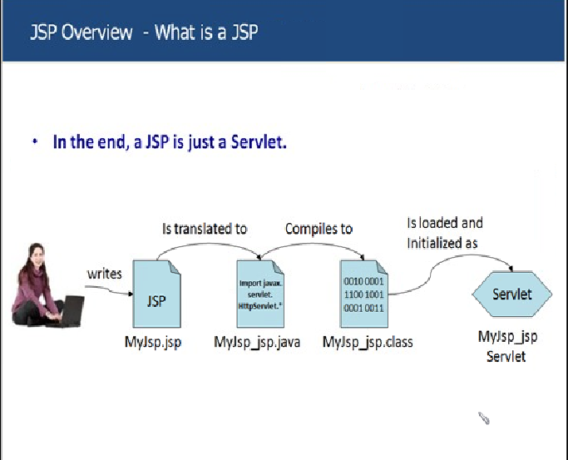

Slide 14
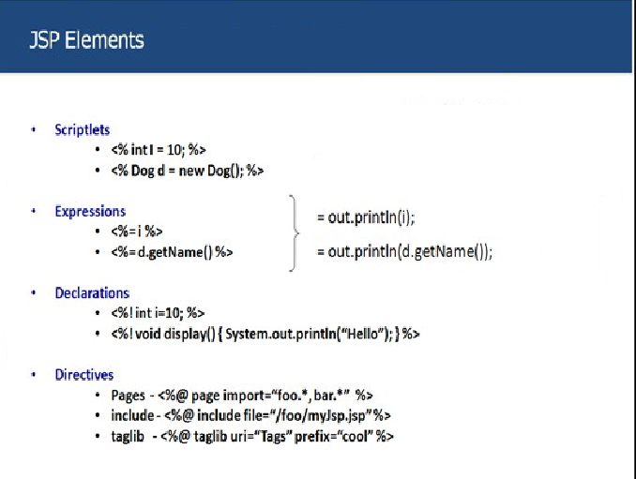

Slide 15
