Slide 1
Facial Emotion Recognition using CNN, HOG-CNN and SIFT-CNN
Kartik Srivastava – 2024dss1008
Devipriya A – 2024dss1005
MSDSM-02, IIM Amritsar
2025
Kartik Srivastava (MSDSM, IIM Amritsar) Facial Emotion Recognition using CNN, HO
2025
G-CNN and SIFT-CNN

Slide 2
Motivation
FER is widely used in healthcare, security, education, gaming, and HCI.
Deep CNNs work well for large, noisy datasets (FER2013).
Handcrafted features (HOG, SIFT) capture gradients, edges, and local facial geometry.
Small datasets like CK-Extended benefit from handcrafted + CNN hybrid models.
Goal: Build a unified FER system combining both deep and handcrafted features.
Kartik Srivastava (MSDSM, IIM Amritsar) Facial Emotion Recognition using CNN, HO
2025
G-CNN and SIFT-CNN

Slide 3
Problem Statement
FER2013 images are low-resolution and noisy → CNN struggles to learn fine facial details.
CK-Extended is small → pure CNN risks overfitting. Need a hybrid method to:
Extract useful gradients textures (HOG/SIFT) Use CNN to learn high-level structure
Achieve strong accuracy on both small large datasets
Kartik Srivastava (MSDSM, IIM Amritsar) Facial Emotion Recognition using CNN, HO
2025
G-CNN and SIFT-CNN

Slide 4
Datasets Used
FER2013
48×48 grayscale
35k+ images, 7 emotions
Real-world, noisy, in-the-wild dataset
CK-Extended
48×48 grayscale
Clean, controlled lab environment 8 emotions (includes contempt)
Kartik Srivastava (MSDSM, IIM Amritsar) Facial Emotion Recognition using CNN, HO
2025
G-CNN and SIFT-CNN

Slide 5
CNN Architecture for FER2013
3 convolutional blocks: 64 → 128 → 256 filters Batch Normalization + MaxPool + Dropout Dense: 512 neurons + Softmax (7 classes) Accuracy achieved: 65.01 %
Kartik Srivastava (MSDSM, IIM Amritsar) Facial Emotion Recognition using CNN, HO
2025
G-CNN and SIFT-CNN

Slide 6
HOG Feature Extraction
Computes histogram of oriented gradients. Captures:
facial edges muscle contours
eyebrow/eye/mouth shapes
Works exceptionally well for CK-Extended.
Kartik Srivastava (MSDSM, IIM Amritsar) Facial Emotion Recognition using CNN, HO
2025
G-CNN and SIFT-CNN

Slide 7
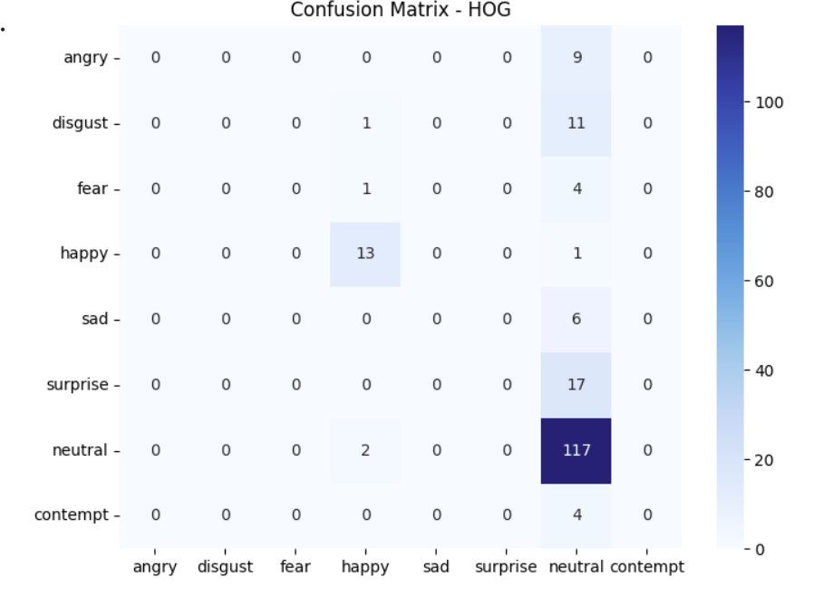
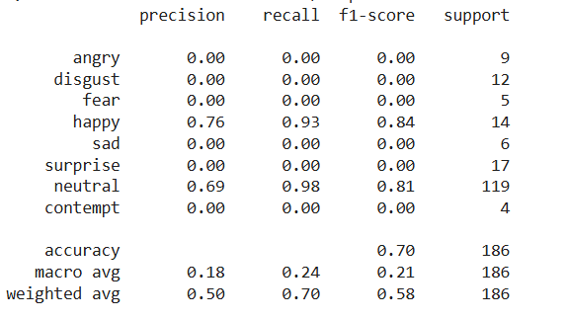

Slide 8
SIFT Feature Extraction
Detects local keypoints and creates 128-D descriptors. Robust to rotation and scale.
Slightly sensitive to low-res grayscale images.
Kartik Srivastava (MSDSM, IIM Amritsar) Facial Emotion Recognition using CNN, HO
2025
G-CNN and SIFT-CNN

Slide 9
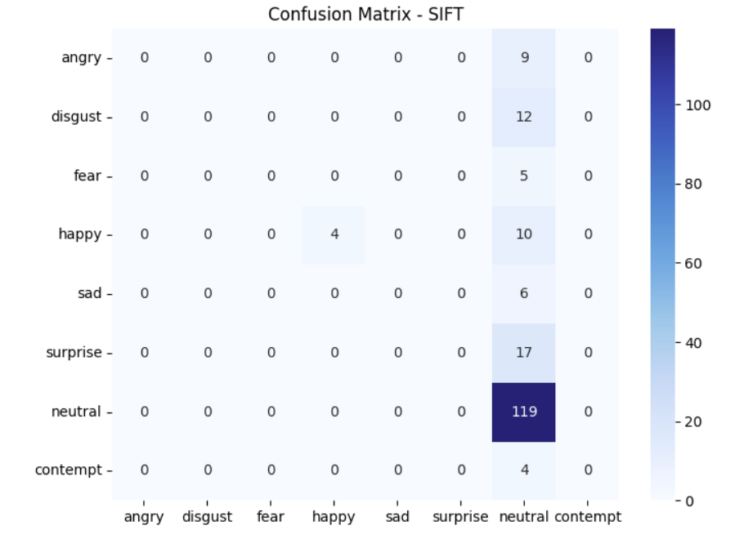
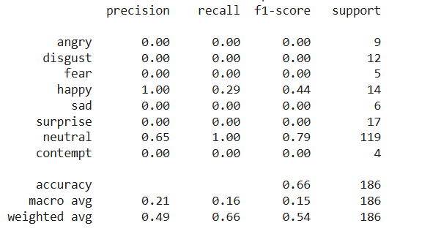

Slide 10
Hybrid Models: HOG-CNN and SIFT-CNN
Extract handcrafted features → reshape → feed into CNN. CNN processes feature maps instead of raw images.
Prevents overfitting on small CK dataset. HOG-CNN performs the best in this project.
Kartik Srivastava (MSDSM, IIM Amritsar) Facial Emotion Recognition using CNN, HO
2025
G-CNN and SIFT-CNN

Slide 11
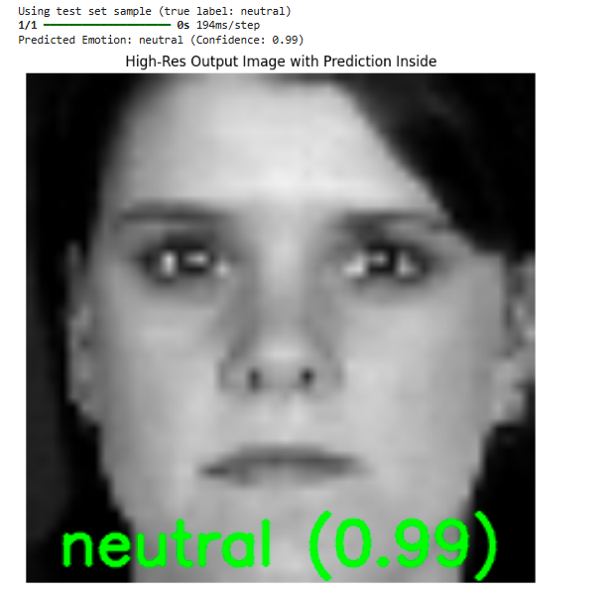
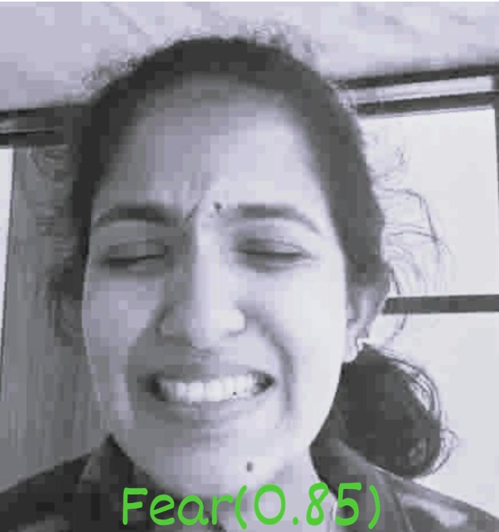

Slide 12
Results Comparison (Based on Project Output)
Model | Dataset | Accuracy | Notes
CNN | FER2013 | 65.01% | Noisy dataset
HOG-CNN | CK-Extended | 70.21% | Best performing model
SIFT-CNN | CK-Extended | 66.24% | Keypoint dependent
Kartik Srivastava (MSDSM, IIM Amritsar) Facial Emotion Recognition using CNN, HO
2025
G-CNN and SIFT-CNN

Slide 13
Observations
CNN performs moderately on FER2013 due to noise. HOG-CNN achieves the highest accuracy in full pipeline.
SIFT-CNN is strong but dependent on detectable keypoints.
Hybrid handcrafted + CNN approach is effective for small datasets.
Kartik Srivastava (MSDSM, IIM Amritsar) Facial Emotion Recognition using CNN, HO
2025
G-CNN and SIFT-CNN

Slide 14
Conclusion
FER2013 benefits from deep CNNs.
CK-Extended benefits from HOG/SIFT + CNN hybrid models. HOG is the most reliable handcrafted feature in this project.
Future work:
Attention-based CNNs Vision Transformers for FER
Fusion of audio + facial expressions
Kartik Srivastava (MSDSM, IIM Amritsar) Facial Emotion Recognition using CNN, HO
2025
G-CNN and SIFT-CNN

Slide 15
Thank You!
Kartik Srivastava (MSDSM, IIM Amritsar) Facial Emotion Recognition using CNN, HO
2025
G-CNN and SIFT-CNN

