Slide 1
RandomForest

Slide 2
Random forest
Random forest, a popular machine learning algorithm developed by Leo Breiman and Adele Cutler, merges the outputs of numerous decision trees to produce a single outcome. I
ts popularity stems from its user-friendliness and versatility, making it suitable for both classification and regression tasks.

Slide 3
Random Forest Applications
Stock price prediction
Medical diagnosis
Medical diagnosis:

Slide 4
Working of Random Forest Algorithm
Ensemble
Ensemble combining multiple models.
Thus a collection of models is used to make predictions rather than an individual model.
Random forest Classifier works on the Bagging principle.

Slide 5
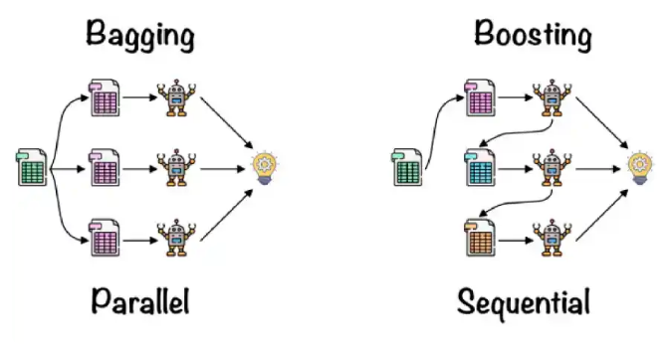
Types of Ensemble

Slide 6
Random Forest-Bagging/ Bootstrap Aggregation
Here are the steps involved in Bagging:
Selection of Subset: Bagging starts by choosing a random sample, or subset, from the entire dataset.
Bootstrap Sampling: Each model from these samples, called Bootstrap Samples, which we take from the original data with replacement. This process is known as row sampling.
Bootstrapping: The step of row sampling with replacement is referred to as bootstrapping.

Slide 7
Random Forest-Bagging/ Bootstrap Aggregation
Independent Model Training: We train each model independently on its corresponding Bootstrap. This training process generates results for each model.
Majority Voting: The final output by combining the results of all models through majority voting. We select the most commonly predicted outcome among the models.
Aggregation: This step by combining all the results and generating the final output based on majority voting, which we call aggregation.

Slide 8
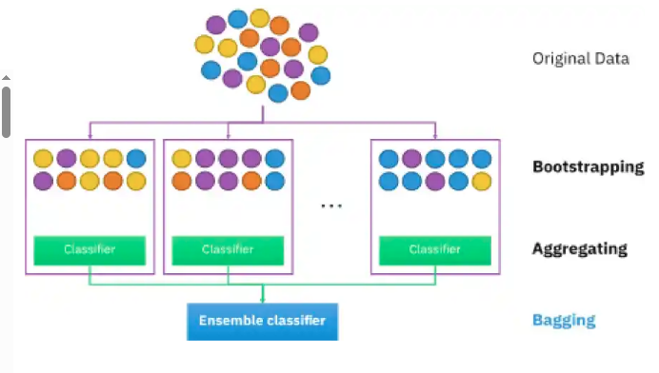
Working of Random Forest Algorithm

Slide 9
Steps Involved in Random Forest Algorithm
Step 1: In this model, we select a subset of data points and a subset of features to construct each decision tree. Simply put, we take n random records and m features from a dataset containing k records.
Step 2: We construct individual decision trees for each sample.
Step 3: Each decision tree will generate an output.
Step 4: We consider the final output based on Majority Voting for classification and Averaging for regression, respectively.

Slide 10
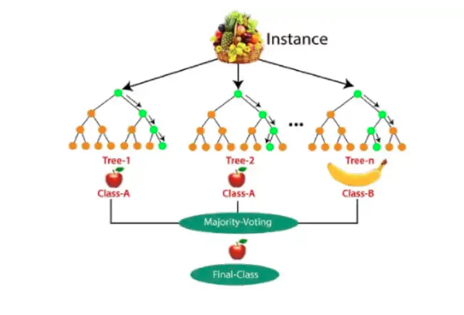

Slide 11
mportant Hyperparameters in Random Forest
Random forests use hyperparameters to enhance model performance and predictive power or to increase the model’s speed.
Increase the Predictive Power
n_estimators: Number of trees the algorithm builds before averaging the predictions.
max_features: Maximum number of features random forest considers splitting a node.
mini_sample_leaf: Determines the minimum number of leaves required to split an internal node.
criterion: How to split the node in each tree? (Entropy/Gini impurity/Log Loss)
max_leaf_nodes: Maximum leaf nodes in each tree
Increase the Speed

Slide 12
n_jobs: it tells the engine how many processors it is allowed to use. If the value is 1, it can use only one processor, but if the value is -1, there is no limit.
random_state: controls randomness of the sample. The model always produces the same results if it has a definite value of random state and receives the same hyperparameters and training data.
oob_score: OOB means out of the bag. It is a random forest cross-validation method. One-third of the sample does not train the data; instead, we use it to evaluate its performance. We call these samples out-of-bag samples.

Slide 13
# Importing the required libraries
import pandas as pd, numpy as np
import matplotlib.pyplot as plt, seaborn as sns
%matplotlib inline

Slide 14
import pandas as pd
import matplotlib.pyplot as plt
import seaborn as sns
df = pd.read_csv('heart_v2.csv')
print(df.head())
sns.countplot(df['heart disease'])
plt.title('Value counts of heart disease patients')
plt.show()

Slide 15
# Putting feature variable to X
X = df.drop('heart disease',axis=1)
# Putting response variable to y
y = df['heart disease']

Slide 16
# now lets split the data into train and test
from sklearn.model_selection import train_test_split
# Splitting the data into train and test
X_train, X_test, y_train, y_test = train_test_split(X, y, train_size=0.7, random_state=42)
X_train.shape, X_test.shape

Slide 17
from sklearn.ensemble import RandomForestClassifier
classifier_rf = RandomForestClassifier(random_state=42, n_jobs=-1, max_depth=5,
n_estimators=100, oob_score=True)
classifier_rf.fit(X_train, y_train)
# checking the oob score
classifier_rf.oob_score_

