Slide 1
Prepared Statement

Slide 2
PreparedStatement interface
The PreparedStatement interface is a subinterface of Statement. It is used to execute parameterized query.
Let's see the example of parameterized query:
String sql="insert into emp values(?,?,?)";

Slide 3
How to get the instance of PreparedStatement?
The prepareStatement() method of Connection interface is used to return the object of PreparedStatement.
Syntax:
public PreparedStatement prepareStatement(String query)throws SQLException{}

Slide 4
Methods
Method | Description
public void setInt(int paramIndex, int value) | sets the integer value to the given parameter index.
public void setString(int paramIndex, String value) | sets the String value to the given parameter index.
public void setFloat(int paramIndex, float value) | sets the float value to the given parameter index.
public void setDouble(int paramIndex, double value) | sets the double value to the given parameter index.
public int executeUpdate() | executes the query. It is used for create, drop, insert, update, delete etc.
public ResultSet executeQuery() | executes the select query. It returns an instance of ResultSet.

Slide 5
Insert Values
PreparedStatement stmt=con.prepareStatement("insert into Emp values(?,?)");
stmt.setInt(1,101);//1 specifies the first parameter in the query
stmt.setString(2,“Priya");
int i=stmt.executeUpdate();
System.out.println(i+" records inserted");
con.close();

Slide 6
Example of PreparedStatement interface that updates the record
PreparedStatement stmt=con.prepareStatement("update emp set name=? where id=?");
stmt.setString(1,"Sonoo");//1 specifies the first parameter in the query i.e. name
stmt.setInt(2,101);
int i=stmt.executeUpdate();
System.out.println(i+" records updated");

Slide 7
Example of PreparedStatement interface that deletes the record
PreparedStatement stmt=con.prepareStatement("delete from emp where id=?");
stmt.setInt(1,101);
int i=stmt.executeUpdate();
System.out.println(i+" records deleted");

Slide 8
Fetch Data
Example of PreparedStatement interface that retrieve the records of a table
PreparedStatement stmt=con.prepareStatement("select * from emp");
ResultSet rs=stmt.executeQuery();
while(rs.next()){
System.out.println(rs.getInt(1)+" "+rs.getString(2));
}

Slide 9
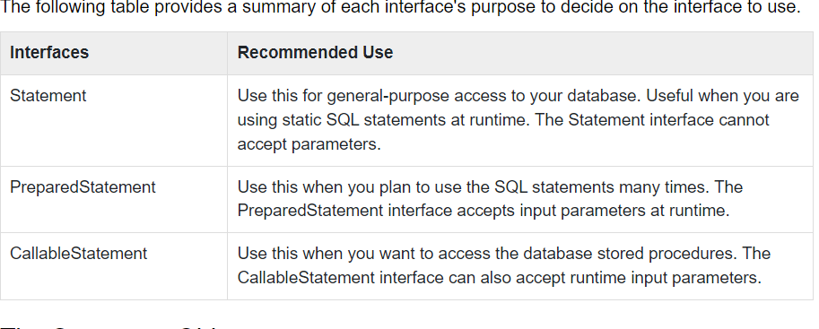
Types of Statements

Slide 10
Callable Statement
CallableStatement cstmt = null;
try
{ String SQL = "{call getEmpName (?, ?)}"; cstmt = conn.prepareCall (SQL);
. }

Slide 11
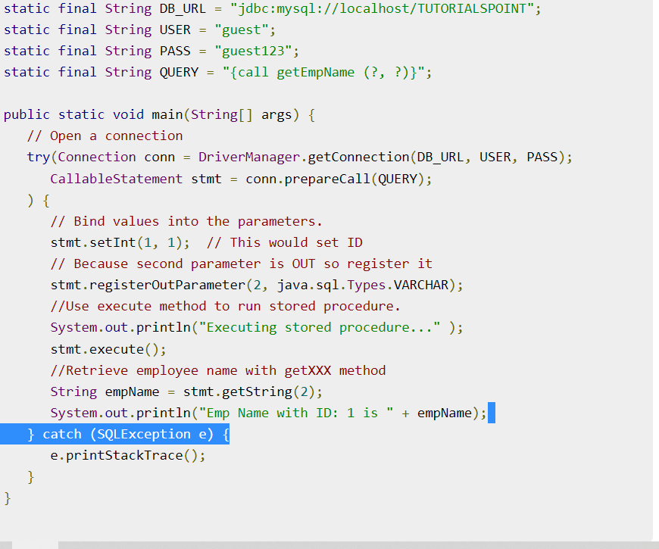

Slide 12
JDBC - Result Sets
The SQL statements that read data from a database query, return the data in a result set.
The SELECT statement is the standard way to select rows from a database and view them in a result set. The java.sql.ResultSet interface represents the result set of a database query.
A ResultSet object maintains a cursor that points to the current row in the result set. The term "result set" refers to the row and column data contained in a ResultSet object.

Slide 13
The methods of the ResultSet interface can be broken down into three categories −
Navigational methods − Used to move the cursor around.
Get methods − Used to view the data in the columns of the current row being pointed by the cursor.
Update methods − Used to update the data in the columns of the current row. The updates can then be updated in the underlying database as well.

Slide 14
The cursor is movable based on the properties of the ResultSet. These properties are designated when the corresponding Statement that generates the ResultSet is created.
JDBC provides the following connection methods to create statements with desired ResultSet −
createStatement(int RSType, int RSConcurrency);
prepareStatement(String SQL, int RSType, int RSConcurrency);
prepareCall(String sql, int RSType, int RSConcurrency);

Slide 15
Statement stmt = conn.createStatement(ResultSet.TYPE_SCROLL_INSENSITIVE , ResultSet.CONCUR_READ_ONLY);

Slide 16
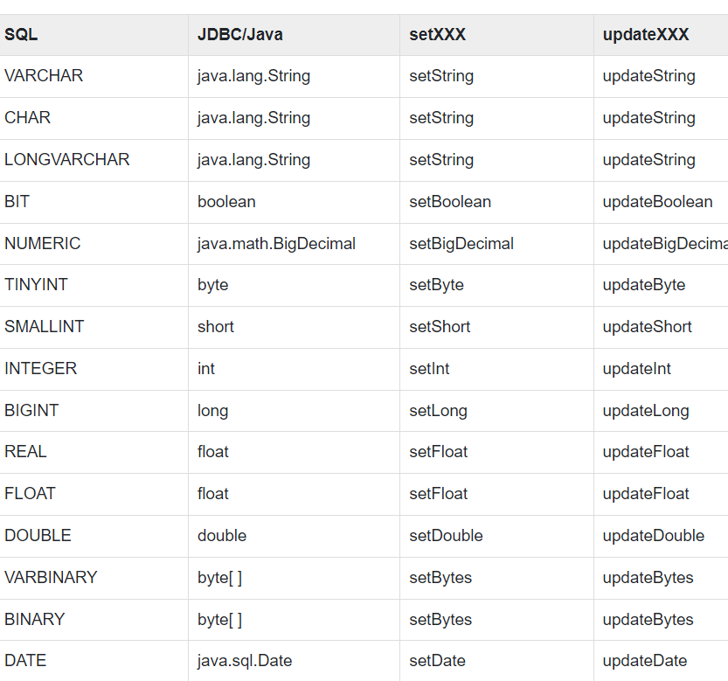
JDBC - Data Types

Slide 17
JDBC - Transactions
If your JDBC Connection is in auto-commit mode, which it is by default, then every SQL statement is committed to the database upon its completion.

Slide 18
For example, if you have a Connection object named conn, code the following to turn off auto-commit −
conn.setAutoCommit(false);

Slide 19
Commit & Rollback
Once you are done with your changes and you want to commit the changes then call commit() method on connection object as follows −
conn.commit( );
Otherwise, to roll back updates to the database made using the Connection named conn, use the following code −
conn.rollback( );

Slide 20
