Slide 1
Server-side Programming:
Java Servlets

Slide 2
What is a Servlet?
Servlet is a technology i.e. used to create web application.
Servlet is an API that provides many interfaces and classes including documentations.
Servlet is an interface that must be implemented for creating any servlet.
Servlet is a class that extends the capabilities of the servers and responds to the incoming requests. It can respond to any type of requests.
Servlet is a web component that is deployed on the server to create dynamic web page.

Slide 3

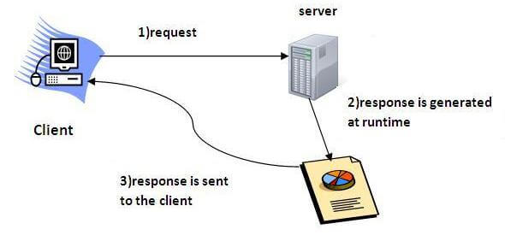

Slide 4
CGI(Commmon Gateway Interface)
CGI technology enables the web server to call an external program and pass HTTP request information to the external program to process the request.
For each request, it starts a new process.

Slide 5
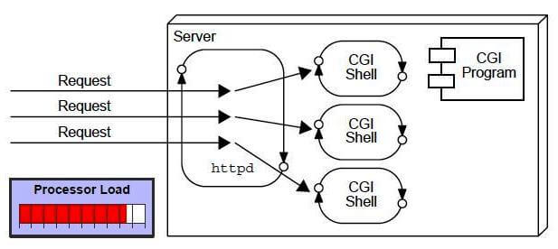

Slide 6
Disadvantages of CGI
There are many problems in CGI technology:
If number of clients increases, it takes more time for sending response.
For each request, it starts a process and Web server is limited to start processes.
It uses platform dependent language e.g. C, C++, perl.

Slide 7
Advantage of Servlet
The web container creates threads for handling the multiple requests to the servlet.
Threads have a lot of benefits over the Processes such as they share a common memory area, lightweight, cost of communication between the threads are low.

Slide 8
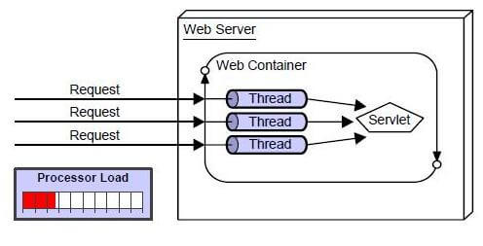

Slide 9
The basic benefits of servlet are as follows:
Better performance: because it creates a thread for each request not process.
Portability: because it uses java language.
Robust: Servlets are managed by JVM so we don't need to worry about memory leak, garbage collection etc.
Secure: because it uses java language

Slide 10
Benefits of servlet
.
Portability
Powerful
Efficiency
Safety
Integration
Extensibility
Inexpensive
Secure
Performance

Slide 11
Java Servlet
Javax.servlet package can be extended for use with any application layer protocol
  http is the most popularly used protocol
  Javax.servlet.http package is extension of the javax.servlet package for http protocol
The Servlet spec allows you to implement separate Java methods implementing each HTTP method in your subclass of HttpServlet.
  Override the doGet() and/or doPost() method to provide normal servlet functionality.
  Override doPut() or doDelete() if you want to implement these methods.
  There's no need to override doOptions() or doTrace().
  The superclass handles the HEAD method all on its own.

Slide 12
Anatomy of a Servlet
init()
destroy()
service()
  doGet()
  doPost()
Notes:
Init() – the init() function is called when the servlet is initialized by the server. This often happens on the first doGet() or doPut() call of the servlet.
Destroy()- this function is called when the servlet is being destroyed by the server, typically when the server process is being stopped.
doGet() – the doGet() function is called when the servlet is called via an HTTP GET.
doPost() – the doPost() function is called when the servlet is called via an HTTP POST.
POSTs are a good way to get input from HTML forms
service() – public function that handles dispatching requests to the protected HTTP-specific service() method;

Slide 13
Servlet API life cycle methods
  init(): called when servlet is instantiated; must return before any other methods will be called
  service(): method called directly by server when an HTTP request is received; default service() method calls doGet() (or related methods covered later)
  destroy(): called when server shuts down

Slide 14
Servlet Container
Create Thread Pool
Thread
Thread
Instantiate servlet
Servlet
Call init ( ) method
Perform Initialization
HTTP Request 1
Call service ( ) method
Allocate request to thread
HTTP Request 2
Call service ( ) method
Allocate request to thread
Perform Service
Shutdown Initiated
Block all further requests Wait for active threads to end
Perform Service
HTTP Response 1
Terminate thread pool
HTTP Response 2
call destroy ( ) method
Perform cleanup
terminate servlet
Servlet destroyed & garbage collected
Container shutdown

Slide 15
Anatomy of a Servlet
HTTPServletRequest object
  Information about an HTTP request
    Headers
    Query String
    Session
    Cookies
HTTPServletResponse object
  Used for formatting an HTTP response
    Headers
    Status codes
    Cookies

Slide 16
Server-side Programming
The combination of
  HTML
  JavaScript
  DOM
  is sometimes referred to as Dynamic HTML (DHTML)
Web pages that include scripting are often called dynamic pages (vs. static)

Slide 17
Server-side Programming
Similarly, web server response can be static or dynamic
  Static: HTML document is retrieved from the file system and returned to the client
  Dynamic: HTML document is generated by a program in response to an HTTP request
Java servlets are one technology for producing dynamic server responses
  Servlet is a class instantiated by the server to produce a dynamic response

Slide 18
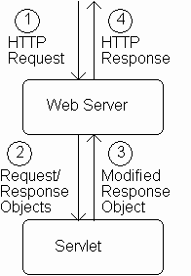
Servlet Overview

Slide 19
Servlet Overview
Reading Data from a Client
When server starts it instantiates servlets
Server receives HTTP request, determines need for dynamic response
Server selects the appropriate servlet to generate the response, creates request/response objects, and passes them to a method on the servlet instance
Servlet adds information to response object via method calls
Server generates HTTP response based on information stored in response object

Slide 20
The browser uses two methods to pass this information to web server. These methods are GET Method and POST Method.
GET Method (doGet())
The GET method sends the encoded user information appended to the page request. The page and the encoded information are separated by the ?(question mark) symbol as follows −
http://www.test.com/hello?key1 = value1&key2 = value2

Slide 21
POST Method
A generally more reliable method of passing information to a backend program is the POST method.
This packages the information in exactly the same way as GET method, but instead of sending it as a text string after a ? (question mark) in the URL it sends it as a separate message.
This message comes to the backend program in the form of the standard input which you can parse and use for your processing.
Servlet handles this type of requests using doPost() method.

Slide 22
Servlets handles form data parsing automatically using the following methods depending on the situation −
getParameter() − You call request.getParameter() method to get the value of a form parameter.
getParameterValues() − Call this method if the parameter appears more than once and returns multiple values, for example checkbox.
getParameterNames() − Call this method if you want a complete list of all parameters in the current request.

Slide 23
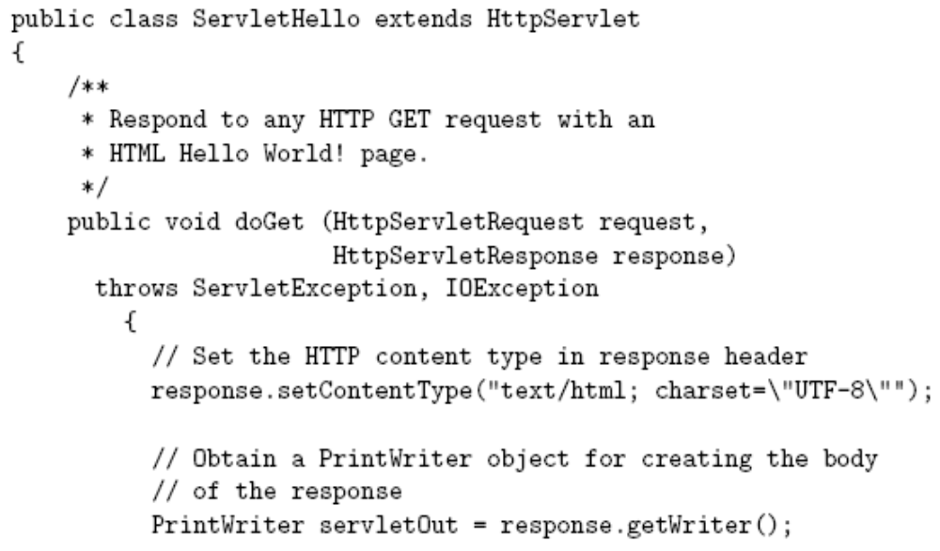
Example

Slide 24
All servlets we will write
are subclasses of
HttpServlet

Slide 25
Server calls doGet() in response to GET request

Slide 26
Interfaces implemented by request/response objects

Slide 27
Production servlet should
catch these exceptions

Slide 28
First two
things done
by typical servlet;
must be in this
order

Slide 29
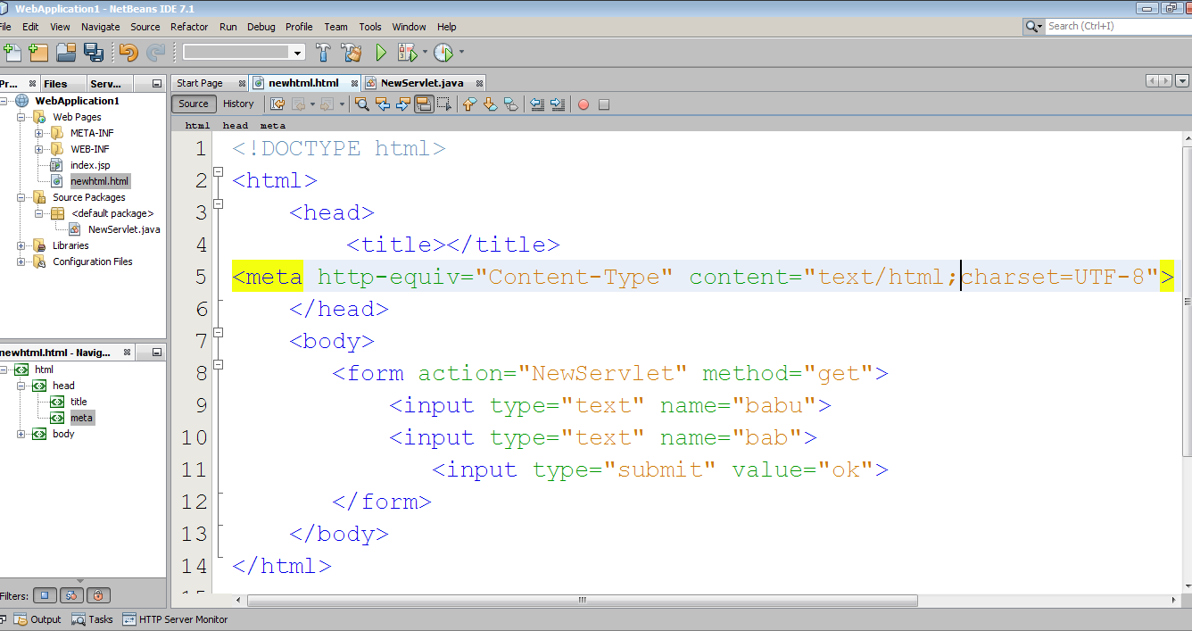

Slide 30
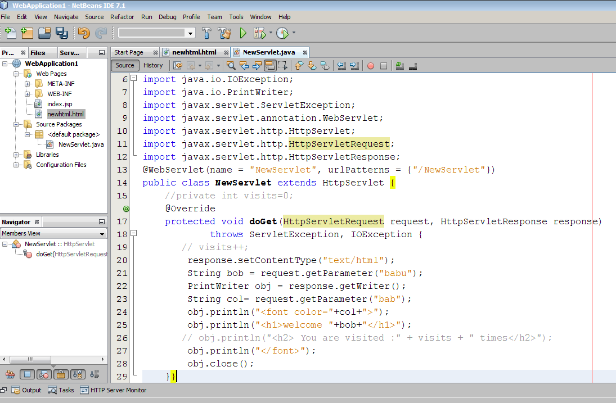
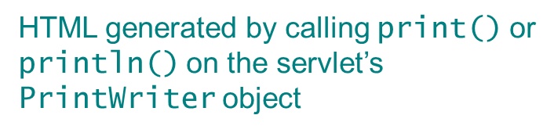
Good practice to explicitly close
the PrintWriter when done

Slide 31
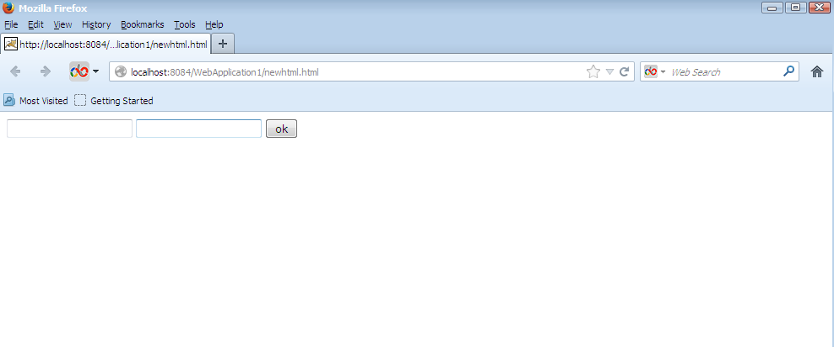

Slide 32
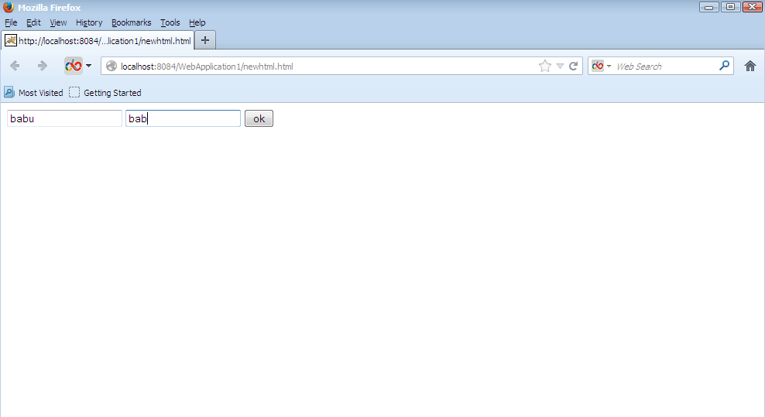

Slide 33
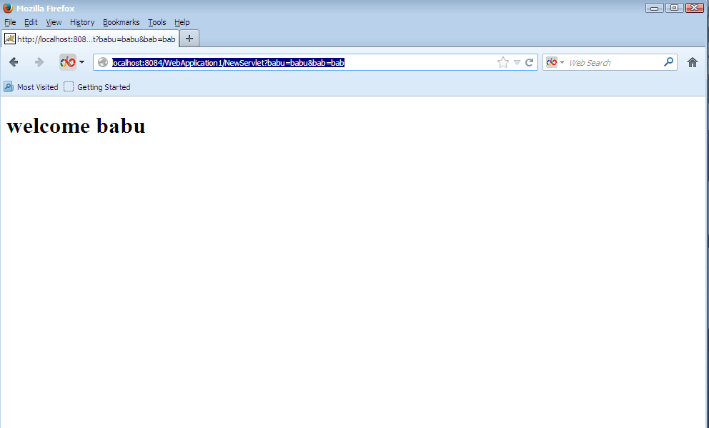

Slide 34
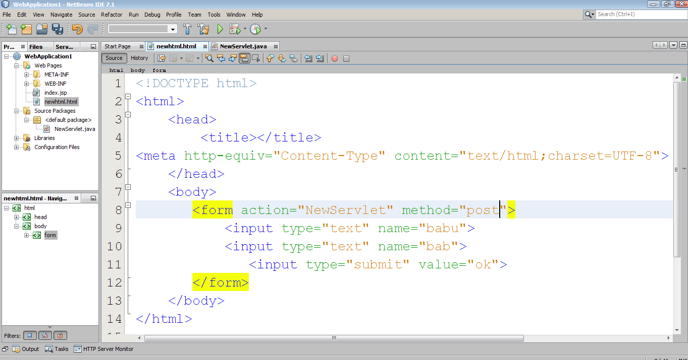

Slide 35
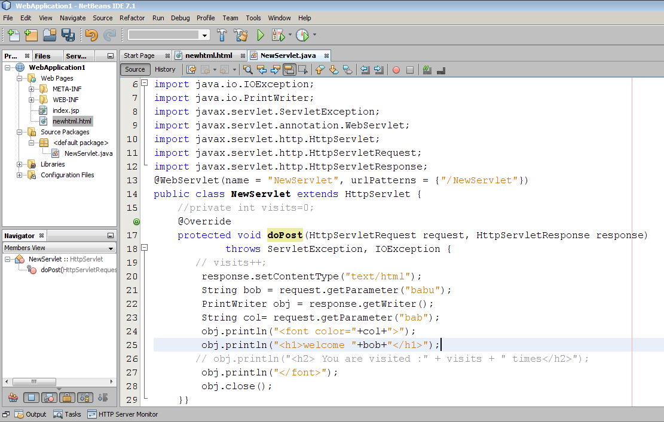

Slide 36
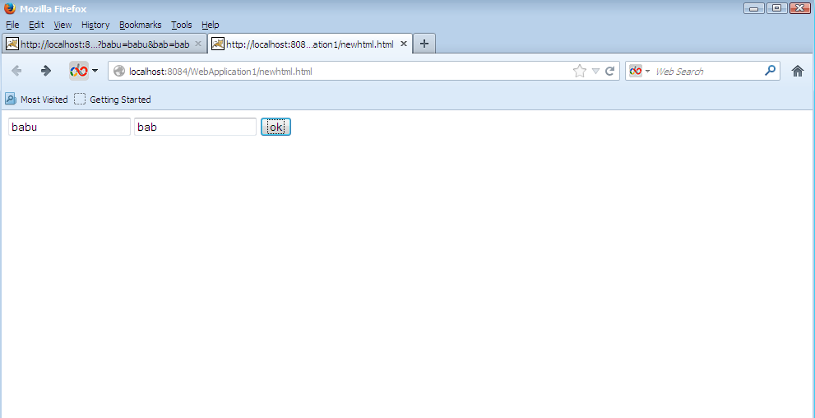

Slide 37
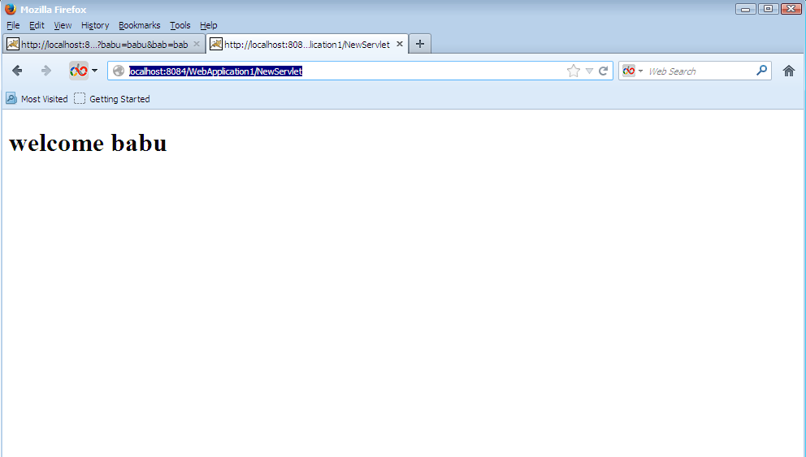

Slide 38
Servlets vs. Java Applications
Servlets do not have a main()
  The main() is in the server
  Entry point to servlet code is via call to a method (doGet() in the example)
Servlet interaction with end user is indirect via request/response object APIs
  Actual HTTP request/response processing is handled by the server
Primary servlet output is typically HTML

Slide 39
Servlet Life Cycle
Servlet API life cycle methods
  init(): called when servlet is instantiated; must return before any other methods will be called
  service(): method called directly by server when an HTTP request is received; default service() method calls doGet() (or related methods covered later)
  destroy(): called when server shuts down

Slide 40
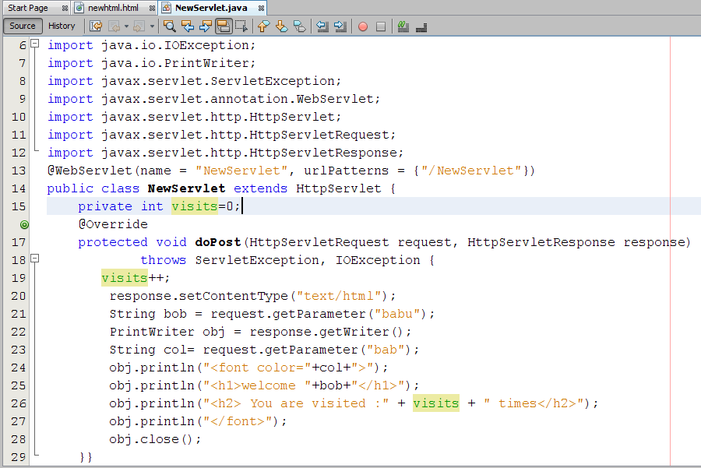

Slide 41
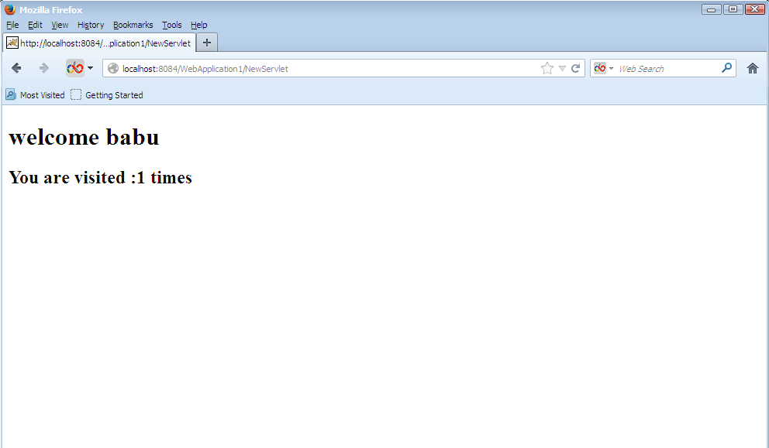

Slide 42
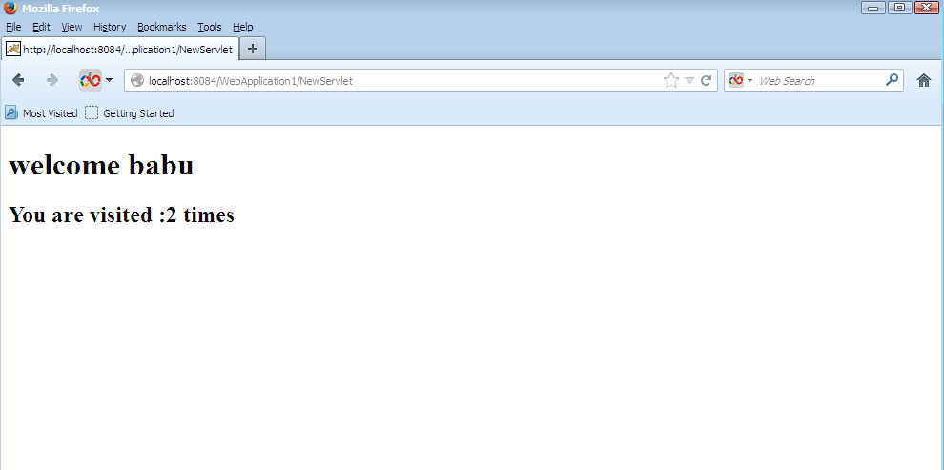

Slide 43
Reading HTTP Request Headers https://www.tutorialspoint.com/servlets/servlets-client-request.htm
When a browser requests for a web page, it sends lot of information to the web server which cannot be read directly because this information travel as a part of header of HTTP request. You can check HTTP Protocol for more information on this.
Following is the important header information which comes from browser side and you would use very frequently in web programming −

Slide 44
Accept
This header specifies the MIME types that the browser or other clients can handle. Values of image/png or image/jpeg are the two most common possibilities.
Accept-Charset
This header specifies the character sets the browser can use to display the information. For example ISO-8859-1.
Accept-Encoding
This header specifies the types of encodings that the browser knows how to handle. Values of gzip or compress are the two most common possibilities.

Slide 45
Accept-Language
This header specifies the client's preferred languages in case the servlet can produce results in more than one language. For example en, en-us, ru, etc
Authorization
This header is used by clients to identify themselves when accessing password-protected Web pages.

Slide 46
Connection
This header indicates whether the client can handle persistent HTTP connections. Persistent connections permit the client or other browser to retrieve multiple files with a single request. A value of Keep-Alive means that persistent connections should be used.
Content-Length
This header is applicable only to POST requests and gives the size of the POST data in bytes.
Cookie
This header returns cookies to servers that previously sent them to the browser.

Slide 47
Host
This header specifies the host and port as given in the original URL.
If-Modified-Since
This header indicates that the client wants the page only if it has been changed after the specified date. The server sends a code, 304 which means Not Modified header if no newer result is available.

Slide 48
If-Unmodified-Since
This header is the reverse of If-Modified-Since; it specifies that the operation should succeed only if the document is older than the specified date.
Referer
This header indicates the URL of the referring Web page. For example, if you are at Web page 1 and click on a link to Web page 2, the URL of Web page 1 is included in the Referrer header when the browser requests Web page 2.
User-Agent
This header identifies the browser or other client making the request and can be used to return different content to different types of browsers.

Slide 49
Methods
Cookie[] getCookies()
Enumeration getAttributeNames()
Enumeration getHeaderNames()
Enumeration getParameterNames()
HttpSession getSession()
HttpSession getSession(boolean create)
Locale getLocale()
Object getAttribute(String name)
ServletInputStream getInputStream()
String getAuthType()
String getCharacterEncoding()
String getContentType()
String getContextPath()
String getHeader(String name)
String getMethod()
String getParameter(String name)

Slide 50
Writing HTTP Response Header
when a Web server responds to an HTTP request, the response typically consists of a status line, some response headers, a blank line, and the document. A typical response looks like this −

Slide 51
1 | Allow This header specifies the request methods (GET, POST, etc.) that the server supports.
2 | Cache-Control This header specifies the circumstances in which the response document can safely be cached. It can have values public, privateor no-cache etc. Public means document is cacheable, Private means document is for a single user and can only be stored in private (non-shared) caches and no cache means document should never be cached.
3 | Connection This header instructs the browser whether to use persistent in HTTP connections or not. A value of close instructs the browser not to use persistent HTTP connections and keepalive means using persistent connections.

Slide 52
4 | Content-Disposition This header lets you request that the browser ask the user to save the response to disk in a file of the given name.
5 | Content-Encoding This header specifies the way in which the page was encoded during transmission.
6 | Content-Language This header signifies the language in which the document is written. For example en, en-us, ru, etc

Slide 53
7 | Content-Length This header indicates the number of bytes in the response. This information is needed only if the browser is using a persistent (keep-alive) HTTP connection.
8 | Content-Type This header gives the MIME (Multipurpose Internet Mail Extension) type of the response document.
9 | Expires This header specifies the time at which the content should be considered out-of-date and thus no longer be cached.
10 | Last-Modified This header indicates when the document was last changed. The client can then cache the document and supply a date by an If-Modified-Since request header in later requests.

Slide 54
11 | Location This header should be included with all responses that have a status code in the 300s. This notifies the browser of the document address. The browser automatically reconnects to this location and retrieves the new document.
12 | Refresh This header specifies how soon the browser should ask for an updated page. You can specify time in number of seconds after which a page would be refreshed.
13 | Retry-After This header can be used in conjunction with a 503 (Service Unavailable) response to tell the client how soon it can repeat its request.
14 | Set-Cookie This header specifies a cookie associated with the page.

Slide 55
Methods to Set HTTP Response Header
There are following methods which can be used to set HTTP response header in your servlet program. These methods are available with HttpServletResponse object.

Slide 56
Sr.No. | Method & Description
1 | String encodeRedirectURL(String url) Encodes the specified URL for use in the sendRedirect method or, if encoding is not needed, returns the URL unchanged.
2 | String encodeURL(String url) Encodes the specified URL by including the session ID in it, or, if encoding is not needed, returns the URL unchanged.
3 | boolean containsHeader(String name) Returns a Boolean indicating whether the named response header has already been set.
4 | boolean isCommitted() Returns a Boolean indicating if the response has been committed.
5 | void addCookie(Cookie cookie) Adds the specified cookie to the response.
6 | void addDateHeader(String name, long date) Adds a response header with the given name and date-value.
7 | void addHeader(String name, String value) Adds a response header with the given name and value.
8 | void addIntHeader(String name, int value) Adds a response header with the given name and integer value.
9 | void flushBuffer() Forces any content in the buffer to be written to the client.
10 | void reset() Clears any data that exists in the buffer as well as the status code and headers.
11 | void resetBuffer() Clears the content of the underlying buffer in the response without clearing headers or status code.
12 | void sendError(int sc) Sends an error response to the client using the specified status code and clearing the buffer.

Slide 57
Sessions
Many interactive Web sites spread user data entry out over several pages:
  Ex: add items to cart, enter shipping information, enter billing information
Problem: how does the server know which users generated which HTTP requests?
  Cannot rely on standard HTTP headers to identify a user

Slide 58
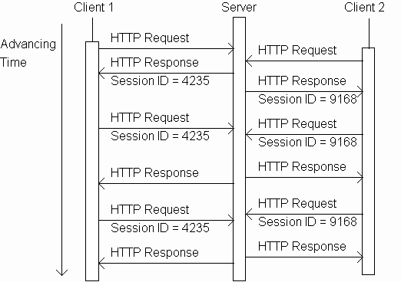
Sessions

Slide 59
Sessions
Server sends back
new unique
session ID when
the request has
none

Slide 60
Sessions
Client that supports
session stores the
ID and sends it
back to the server
in subsequent
requests

Slide 61
Sessions
Server knows
that all of these
requests are
from the same
client. The
set of requests
is known as a
session.

Slide 62
Sessions
And the server
knows that all
of these
requests are
from a different
client.

Slide 63
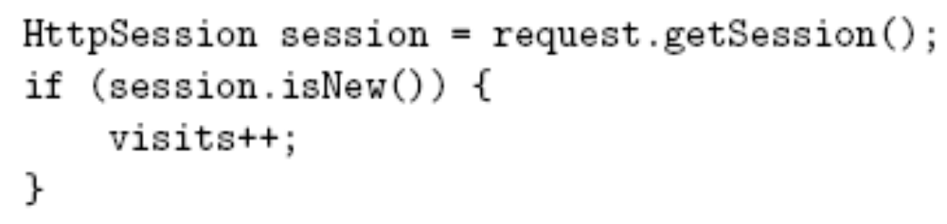
Sessions
Returns HttpSession object associated
with this HTTP request.
Creates new HttpSession object if no
session ID in request or no object with
this ID exists
Otherwise, returns previously created
object

Slide 64
Sessions
Boolean indicating whether returned
object was newly created or already
existed.

Slide 65
Sessions
Incremented once per session

Slide 66
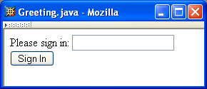
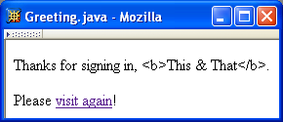
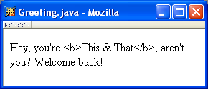
Sessions
Three web
pages produced
by a single servlet

Slide 67
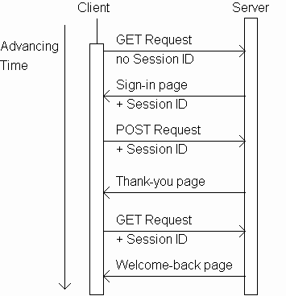
Sessions

Slide 68
Sessions

Slide 69
Sessions

Slide 70
Sessions

Slide 71
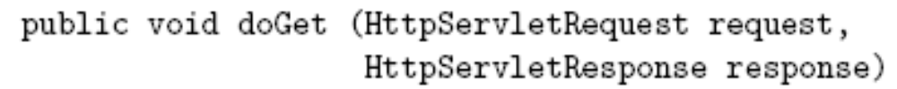
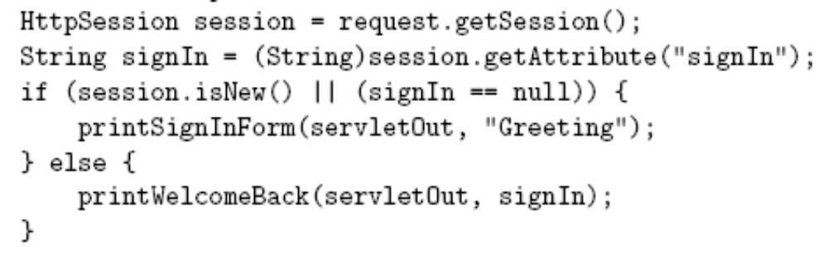
Sessions
,,,

Slide 72
Sessions
,,,
Session attribute is a
name/value pair

Slide 73
Sessions
,,,
Session attribute will
have null value until
a value is assigned

Slide 74
Sessions
,,,
Generate
sign-in form
if session is
new or
signIn
attribute has no value,
weclome-back page
otherwise.

Slide 75
Sessions
Sign-in form
Welcome-back
page

Slide 76
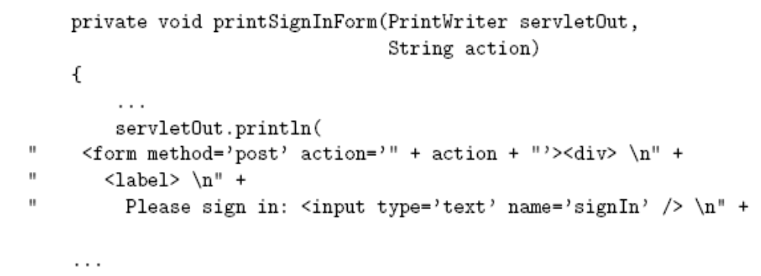
Sessions
Second argument
(“Greeting”) used as
action attribute value
(relative URL)

Slide 77
Sessions
Form will be sent using POST HTTP
method (doPost() method will be called)

Slide 78
Sessions
Text field containing
user name is named
signIn

Slide 79
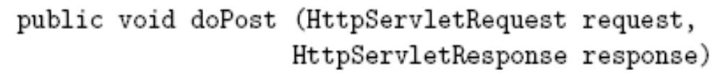
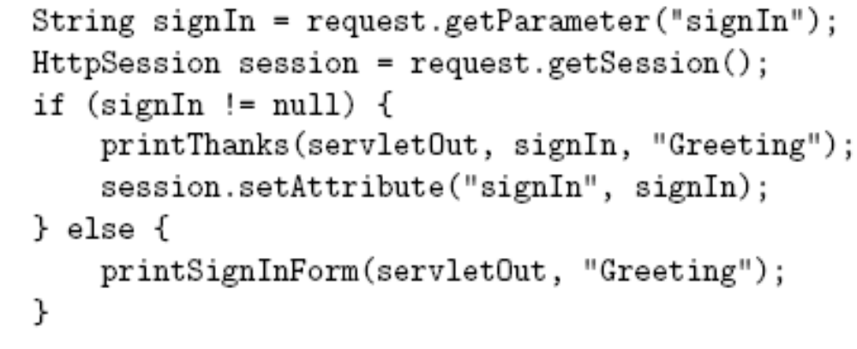
Sessions
…

Slide 80
Sessions
…
Retrieve
signIn
parameter value

Slide 81
Sessions
…
Normal
processing:
signIn
parameter
is present in
HTTP request

Slide 82
Sessions
…
Generate
HTML for
response

Slide 83
Sessions
Thank-you page
Must escape
XML special
characters in
user input

Slide 84
Sessions
…
Assign a
value to the
signIn session
attribute

Slide 85
Sessions
Session attribute methods:
  setAttribute(String name, Object value): creates a session attribute with the given name and value
  Object getAttribute(String name): returns the value of the session attribute named name, or returns null if this session does not have an attribute with this name

Slide 86
Sessions
…
Error
processing
(return user
to sign-in form)

Slide 87
Sessions
By default, each session expires if a server-determined length of time elapses between a session’s HTTP requests
  Server destroys the corresponding session object
Servlet code can:
  Terminate a session by calling invalidate() method on session object
  Set the expiration time-out duration (secs) by calling setMaxInactiveInterval(int)

Slide 88
Cookies
A cookie is a name/value pair in the Set-Cookie header field of an HTTP response
Most (not all) clients will:
  Store each cookie received in its file system
  Send each cookie back to the server that sent it as part of the Cookie header field of subsequent HTTP requests

Slide 89
Cookies
Tomcat sends
session ID as value
of cookie named
JSESSIONID

Slide 90
Cookies
Cookie-enabled
browser returns
session ID as value
of cookie named
JSESSIONID

Slide 91
Cookies
Servlets can set cookies explicitly
  Cookie class used to represent cookies
  request.getCookies() returns an array of Cookie instances representing cookie data in HTTP request
  response.addCookie(Cookie) adds a cookie to the HTTP response

Slide 92
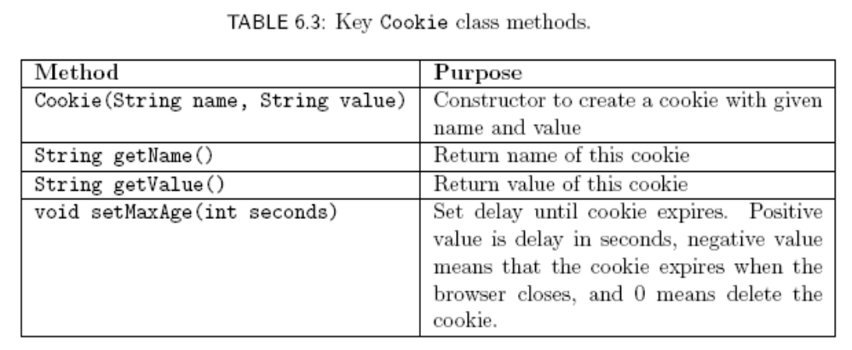
Cookies
Cookies are expired by
client (server can request
expiration date)

Slide 93
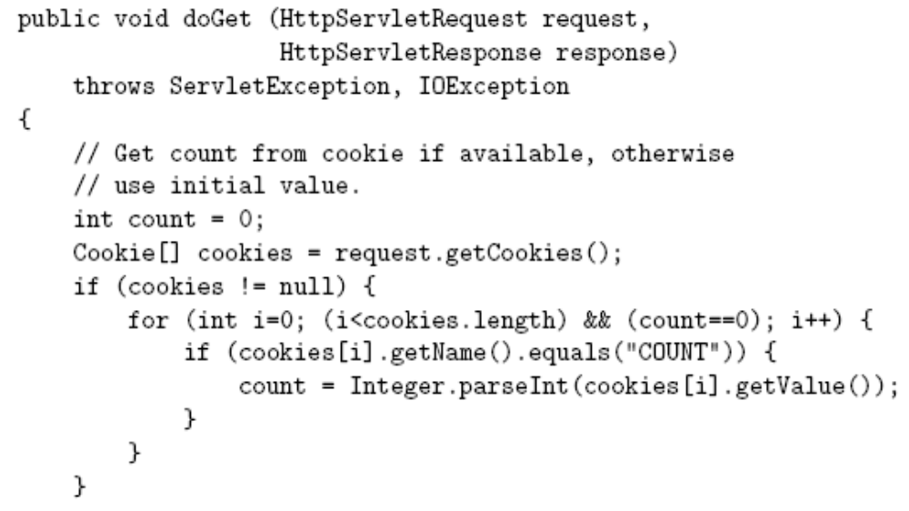
Cookies

Slide 94
Cookies
Return array of cookies
contained in HTTP request

Slide 95
Cookies
Search for
cookie
named
COUNT and
extract value
as an int

Slide 96
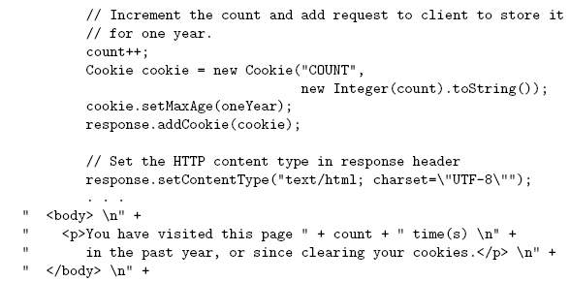
Cookies

Slide 97
Cookies
Send
replacement
cookie value
to client
(overwrites
existing cookie)

Slide 98
Cookies
Should call
addCookie()
before writing
HTML

Slide 99
Cookies
Privacy issues
HTTP request to
intended site
Web site
providing
requested
content
Client
HTTP response:
HTML document
including ad <img>
HTTP request for
ad image
Image
plus Set-Cookie
in response:
third-party cookie
Web site
providing
banner
ads

Slide 100
Cookies
Privacy issues
Second
Web site
providing
requested
content
HTTP request to 2nd
intended site
Web site
providing
requested
content
Client
HTTP response:
HTML document
including ad <img>
HTTP request for
ad image plus Cookie (identifies user)
Image
Web site
providing
banner
ads
Based on
Referer, I know two
Web sites that
this user has
visited

Slide 101
Cookies
Privacy issues
Due to privacy concerns, many users block cookies
  Blocking may be fine-tuned. Ex: Mozilla allows
    Blocking of third-party cookies
    Blocking based on on-line privacy policy
Alternative to cookies for maintaining session: URL rewriting

Slide 102
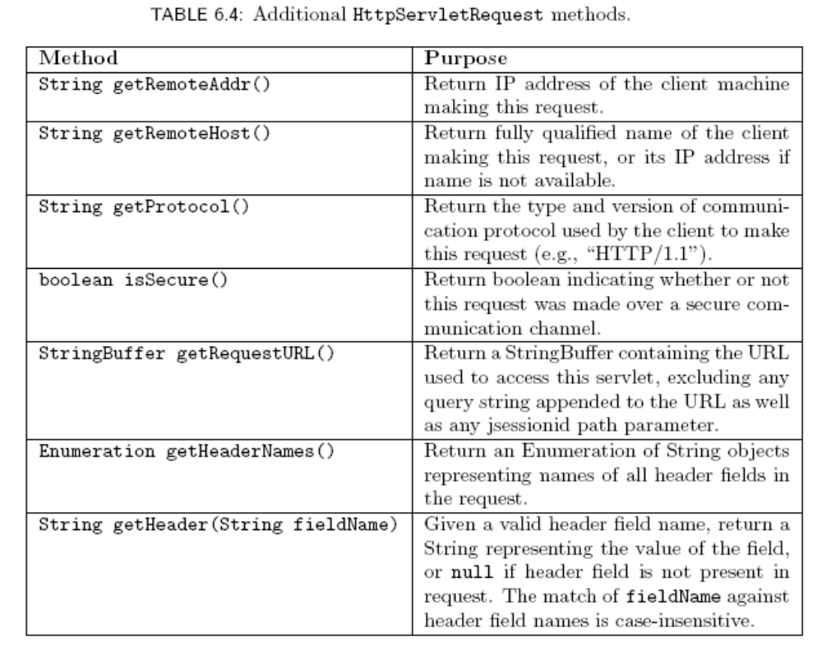
More Servlet Methods

Slide 103
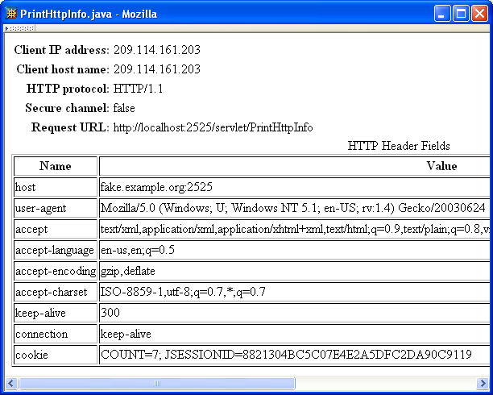
More Servlet Methods

Slide 104
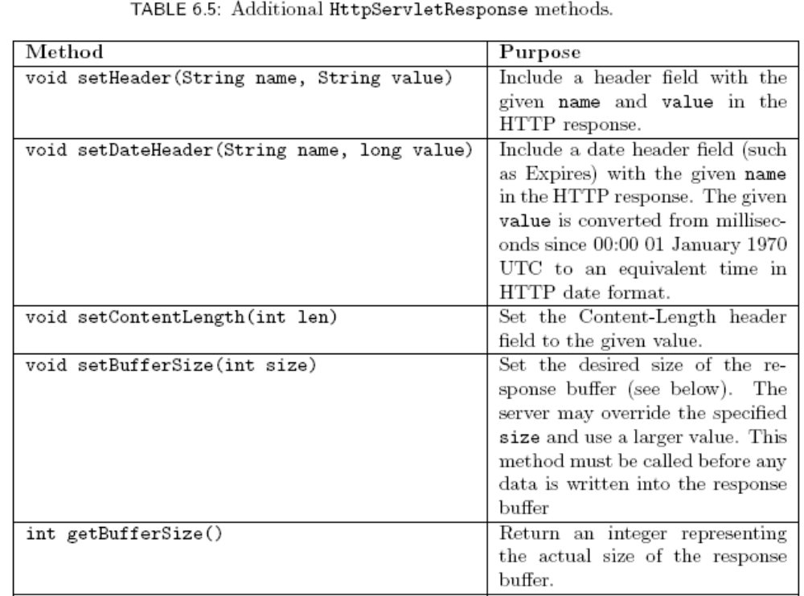
More Servlet Methods

Slide 105
More Servlet Methods
Response buffer
  All data sent to the PrintWriter object is stored in a buffer
  When the buffer is full, it is automatically flushed:
    Contents are sent to the client (preceded by header fields, if this is the first flush)
    Buffer becomes empty
  Note that all header fields must be defined before the first buffer flush

Slide 106
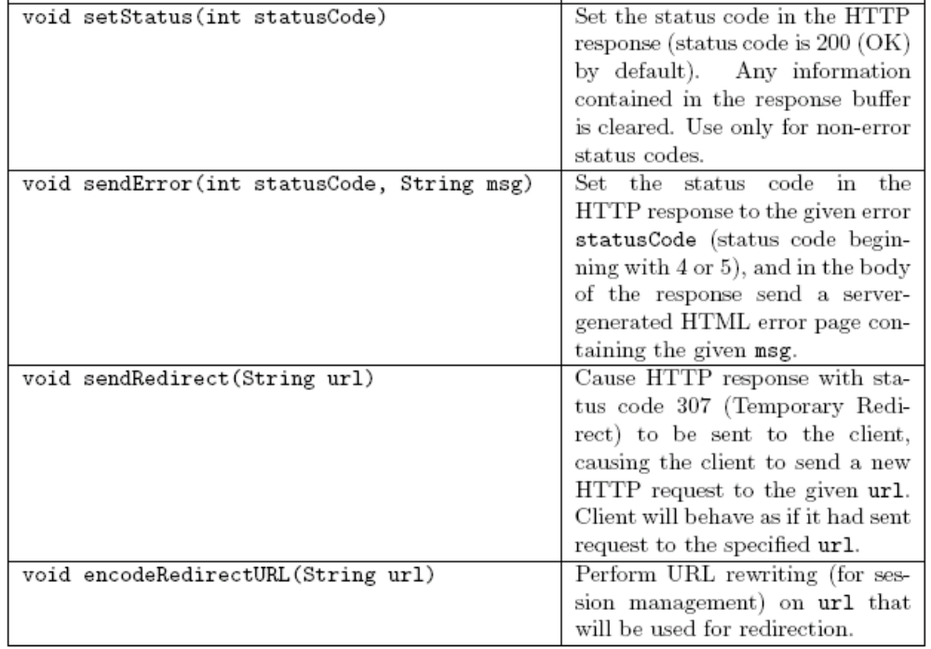
More Servlet Methods

Slide 107
More Servlet Methods
In addition to doGet() and doPost(), servlets have methods corresponding to other HTTP request methods
  doHead(): automatically defined if doGet() is overridden
  doOptions(), doTrace(): useful default methods provided
  doDelete(), doPut(): override to support these methods

Slide 108
Common Gateway Interface
CGI was the earliest standard technology used for dynamic server-side content
CGI basics:
  HTTP request information is stored in environment variables (e.g., QUERY_STRING, REQUEST_METHOD, HTTP_USER_AGENT)
  Program is executed, output is returned in HTTP response

Slide 109
Common Gateway Interface
Advantage:
  Program can be written in any programming language (Perl frequently used)
Disadvantages:
  No standard for concepts such as session
  May be slower (programs normally run in separate processes, not server process)

Slide 110
Java Server Pages

Slide 111
Java Server Pages
Servlets are pure Java programs. They introduce dynamism into web pages by using programmatic content.
JSP technology is an extension/wrapper over the Java servlet technology.
JSP are text based documents.
We will focus only on JSP since it subsumes the servlet technology.
Two major components of JSP:
  Static content: provided by HTML or XML
  Dynamic content: generated by JSP tags and scriplets written in Java language to encapsulate the application logic.

Slide 112
JSP compilation into Servlets
JSP
Initial
request
Web
Browser
Web
Server
J2EE Web
Container
translation
Java
Servlets
Subseq
request

Slide 113
More on JSP syntax and contents
HTML code for user interface lay out
JSP tags: declarations, actions, directives, expressions, scriplets
JSP implicit objects: a request object, response object, session object, config object
Javabeans: for logic that can be taken care of at the JSP level.
We will examine only JSP tags here.

Slide 114
JSP Tags
Declaration: variable declaration
  <%! int age = 56 %>
Directive: ex: import classes
  <%@ page import = “java.util.*” %>
Scriplet: Java code
  <% if password(“xyz”) {
  %>
  <H1> Welcome <\H1>
Expression: regular expression using variables and constants
  <%= param[3]+4 %>
Action: <jsp:usebean name =“cart” class=“com.sun.java.Scart”

Slide 115
Methods
S.No. | Method & Description
1 | out.print(dataType dt) Print a data type value
2 | out.println(dataType dt) Print a data type value then terminate the line with new line character.
3 | out.flush() Flush the stream.

Slide 116
The session Object
The session object is an instance of javax.servlet.http.HttpSession and behaves exactly the same way that session objects behave under Java Servlets.
The session object is used to track client session between client requests.

