Slide 1
23CSS3- FULL STACK DEVELOPMENT-II
Backend development

Slide 2
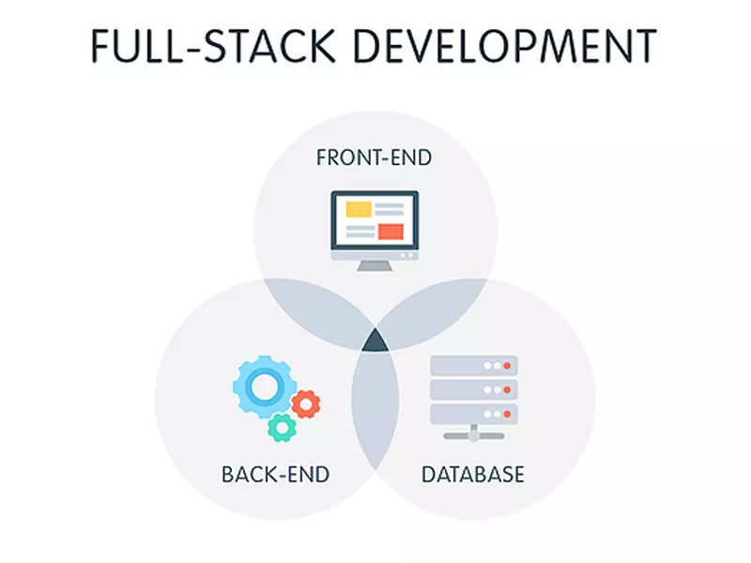

Slide 3
Objective
The objective of this course is to develop dynamic web applications using various advanced Java Technologies.

Slide 4
Pre-requisites
Object Oriented Programming.
Database Management Systems.
Web Application Development- Module-I.

Slide 5
WEB APPLICATION DEVELOPMENT-MODULE-1
HTML- Hyper Text Markup Language
CSS– Cascading Style Sheet
JAVA SCRIPT
Java Query

Slide 6
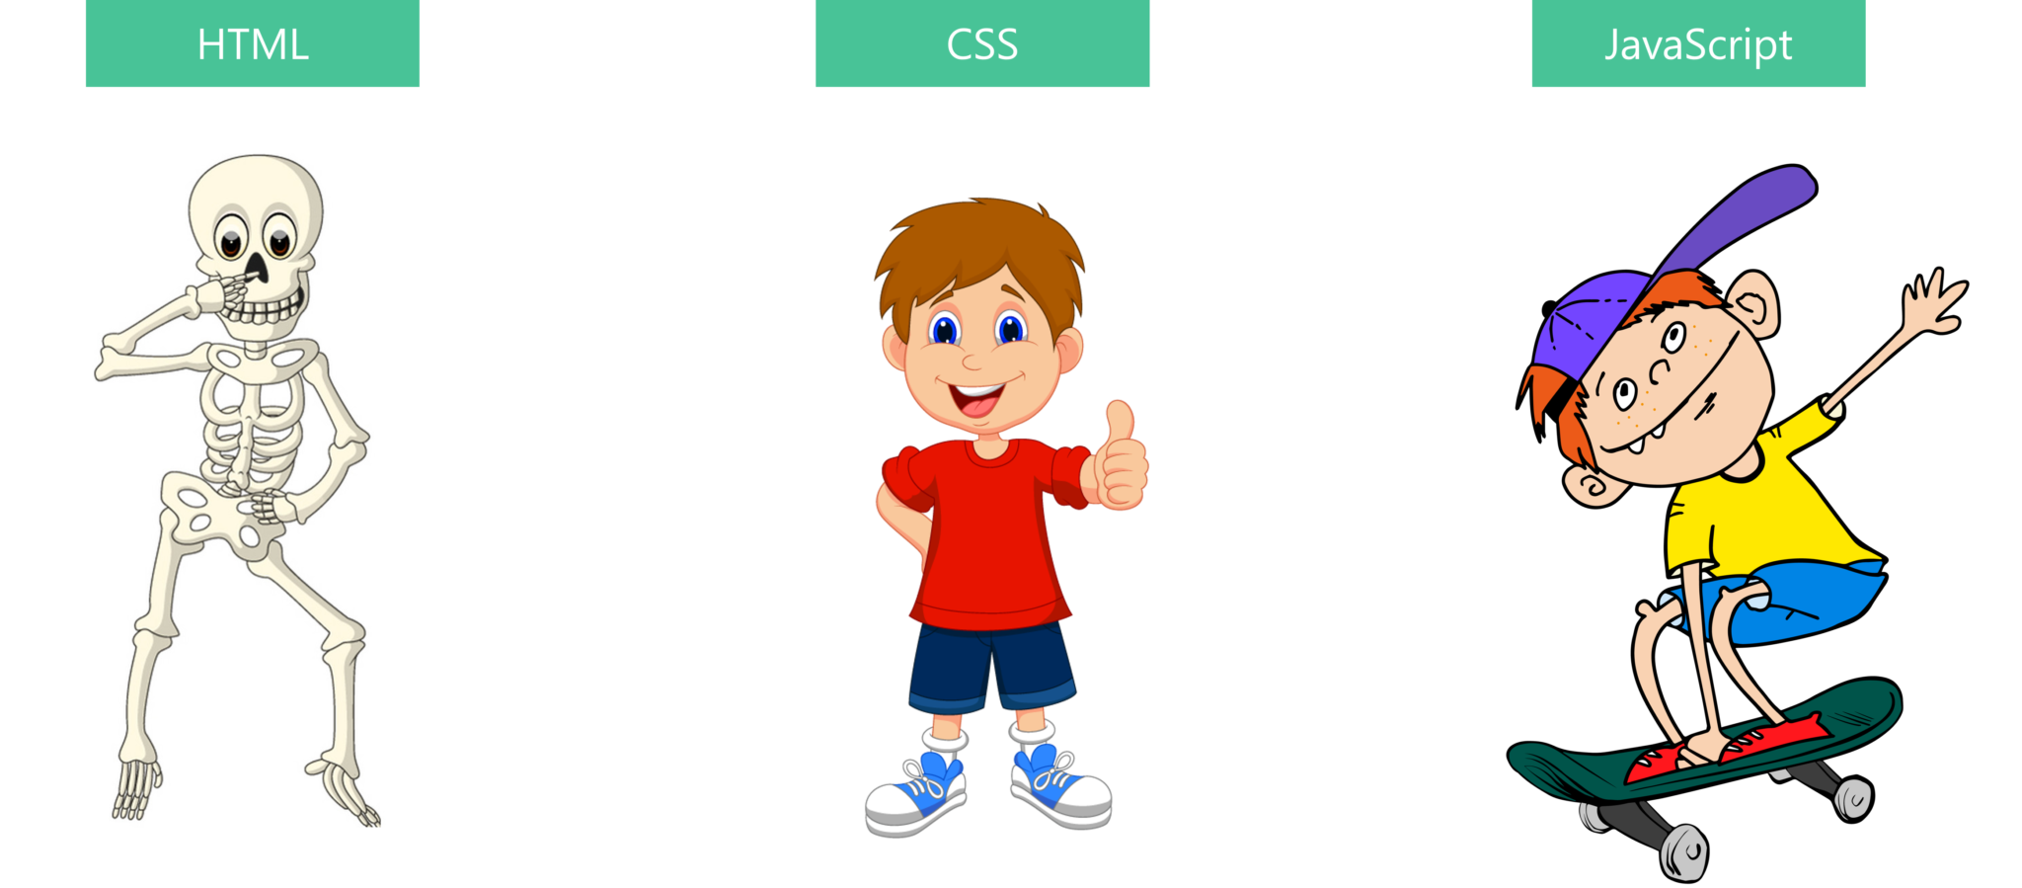
Difference between HTML Vs CSS Vs Java Script

Slide 7
Java Script
It is used to create dynamic web applications, client-side validations.
It is a Client side scripting language.
It is supported by all web browsers.
If we include code using java script it is viewable to every one, so there is no security for the code.
To overcome this, user server side scripting langauges.

Slide 8
23CSS3- FULL STACK DEVELOPMENT-II
JDBC-Java Data Base Connectivity and Java Servlets( Week-1-3)
JSP and MVC Architechture ( Week-4 &5)
Mini Project Using Above
Node.js and Express.js (Weeks 6–8)
MongoDB with Express.js (Weeks 9–10)
React.js and Full Stack Integration (Weeks 11–14)

Slide 9
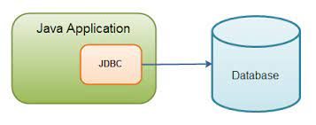
JAVA DATABSE CONNECTIVITY
In java JDBC API is used to establish the connection between Java Application and Data base.
JDBC is used to interact with various type of Database such as Oracle, MS Access, My SQL and SQL Server.
To access JDBC API we need to import java.sql package.

Slide 10
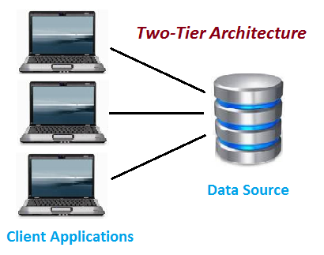
2-tier Architecture

Slide 11
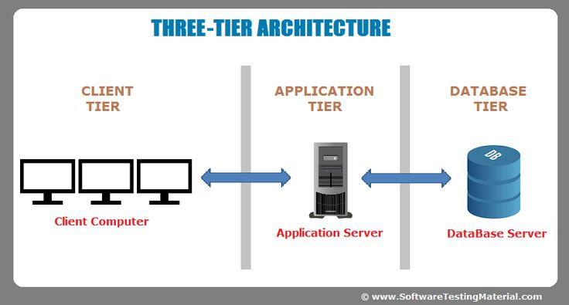
3-Tier Architecture

Slide 12
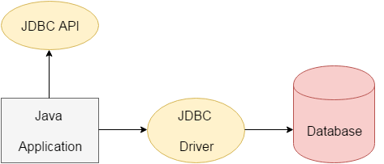
JDBC
JDBC stands for Java Database Connectivity.
JDBC is a Java API to connect and execute the query with the database.
To connect with database, It requires various JDBC Drivers.

Slide 13
JDBC Drivers
JDBC Driver is a software component that enables java application to interact with the database.
There are 4 types of JDBC drivers:
JDBC-ODBC bridge driver
Native-API driver (partially java driver)
Network Protocol driver (fully java driver)
Thin driver (fully java driver)

Slide 14
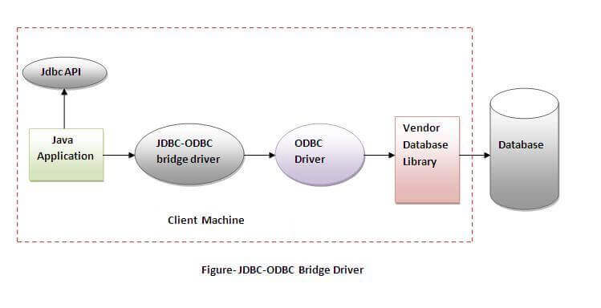
TYPE-1 DRIVER
Type -1 JDBC driver also known as bridge driver it provides a bridge to access the ODBC driver installed on each client.
The JDBC-ODBC bridge driver converts JDBC method calls into the ODBC function calls.
Form version Java 8, The bridge driver is removed.

Slide 15
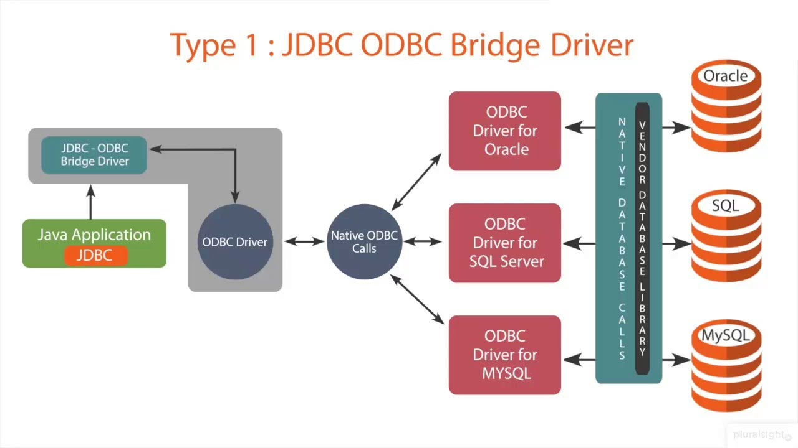

Slide 16
JDBC-ODBC BRIDGE DRIVER
Advantages:
easy to use.
can be easily connected to any database.
Disadvantages:
Performance degraded because JDBC method call is converted into the ODBC function calls.
The ODBC driver needs to be installed on the client machine.

Slide 17
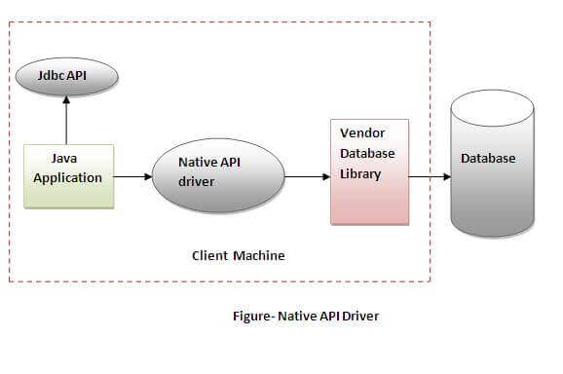
TYPE-II DRIVER
It is written in C++.
The Native API driver uses the client-side libraries of the database.
The driver converts JDBC method calls into native calls of the database API.

Slide 18
Native-API Driver
Advantage:
performance upgraded than JDBC-ODBC bridge driver.
Disadvantage:
The Native driver needs to be installed on the each client machine.
The Vendor client library needs to be installed on client machine.

Slide 19
Type-3 Driver
It is Fully Written in Java, but it does not send SQL calls directly to the database.
Instead, a Type 3 JDBC driver communicates with a separate piece of software that then marshals requests back and forth to the targeted database.

Slide 20
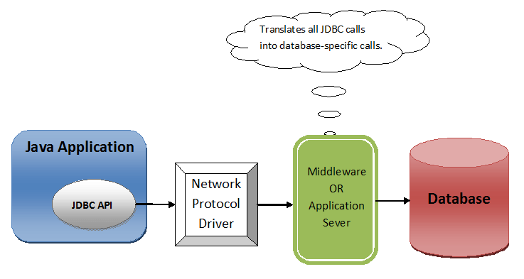
Network Protocol Driver

Slide 21
Type-4 Driver (Thin Driver)
It is Fully Written in Java.
It connects directly to the target database either through the use of Java calls.
This JDBC driver is often referred to as the thin JDBC driver, because it involves no native code and no separate middleware to handle SQL queries.
By using Type-4 driver, we are able to connect any type of data bases like DB2, derby, HSQLDB and MySQL.

Slide 22
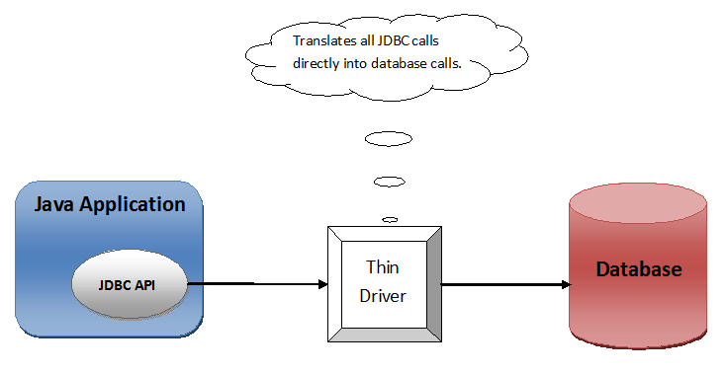
Type-4 Driver

Slide 23
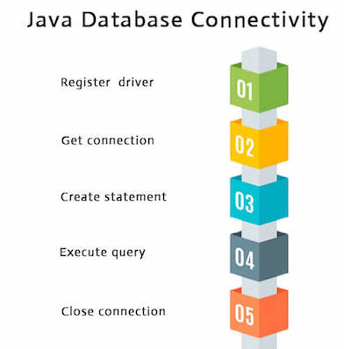
Procedure to establish a Connection
To establish a connection with any data base from client application use the following steps:
Register a Suitable Driver
Establish a Connection with Suitable Database
Create a Statement
Execute the Statement and Process the results
Close the connection.

Slide 24
Register a Suitable Driver or Load a Driver
To load the driver explicitly use a built in method Class.forName()
Every JDBC driver is represented using some class name.
All JDBC drivers are available in ojdbc14.jar file.
Syntax:
Class.forName(“Driver_Name”);
To Load a Oracle Driver
Class.forName(“oracle.jdbc.driver.OracleDriver”);
To Load MySQL Driver
Class.forName(“com.mysql.jdbc.Driver”);

Slide 25
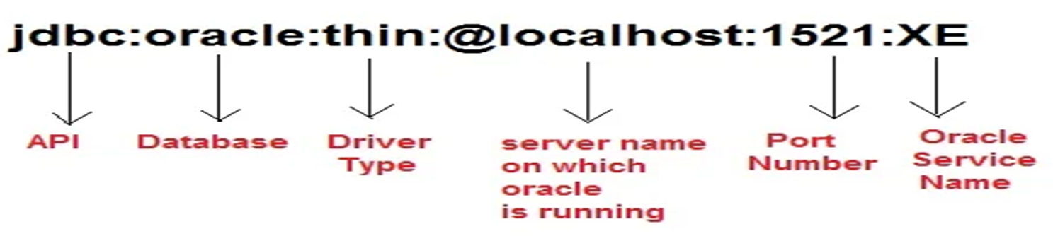
Establish a Connection
We will create a connection using getConnection() method of DriverManager class.
This method has several overloaded methods that can be used based on the requirement.
Basically it require the database name, username and password to establish connection.
getConnection(String url)
getConnection(String url, String username, String password)

Slide 26
Create SQL Statement
In this step we will create statement object using createStatement() method.
It is used to execute the SQL queries and defined in Connection class.
Syntax:
Statement s=con.createStatement();

Slide 27
Execute Query
After creating a SQL statement, we need to execute the statement using the following methods.
The Possible methods in the Statement class are
executeUpdate()
executeQuery()
execute()

Slide 28
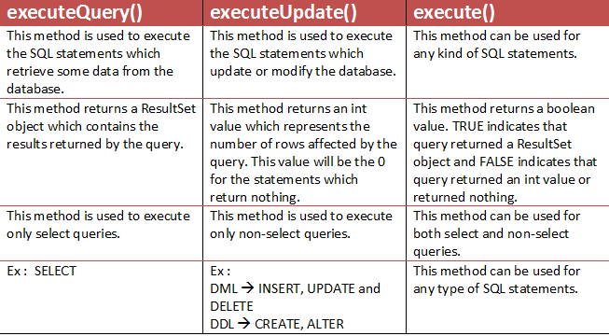

Slide 29
ResultSet
After executing select command , it returns the set of rows and columns.
To store entire table information, use a built in class ResultSet
Syntax:
ResultSet rs=st.executeQuery(“select * from emp”);
By default, ResultSet object can be moved forward only and it is not updatable.

Slide 30
Methods in ResultSet
public boolean next(): It is used to move the cursor to the one row next from the current position.
If the next record is not available it returns False.
public boolean previous(): It is used to move the cursor to the one row previous from the current position.
public boolean first(): is used to move the cursor to the first row in result set object.
public boolean last(): is used to move the cursor to the last row in result set object.
public boolean absolute(int row): is used to move the cursor to the specified row number in the ResultSet object.

Slide 31
Methods in ResultSet
public boolean relative(int row): is used to move the cursor to the relative row number in the ResultSet object, it may be positive or negative.
public int getInt(int columnIndex): is used to return the data of specified column index of the current row as int.
public int getInt(String columnName): is used to return the data of specified column name of the current row as int.
public String getString(int columnIndex): is used to return the data of specified column index of the current row as String.
public String getString(String columnName):is used to return the data of specified column name of the current row as String.

Slide 32
ResultSet rs=st.executeQuery(“select * from student_csm”);
while(rs.next())
{
System.out.println(rs.getString(1));
System.out.println(rs.getString(“name”));
}

Slide 33
Example
ResultSet rs=stmt.executeQuery("select * from emp");
//getting the record of 3rd row
rs.absolute(3);
System.out.println(rs.getString(1)+" "+rs.getString(2));

Slide 34
Close the Connection
This is final step which includes closing all the connection that we opened in our previous steps.
After executing SQL statement you need to close the connection and release the session.
The close() method of Connection interface is used to close the connection.
Example of closing a connection
con.close();

Slide 35
Exercise Programs
Establish a Connection to Oracle Database.
Write a Java Program to create a student table in the oracle database.
Write a Java Program to insert records into student table.
Write a Java Program to retrieve the records from oracle database.

Slide 36
Thank you

