Slide 1


Java
One step Ahead
Anita Seth &
B.L. Juneja
© Oxford University Press 2018. All rights reserved.

Slide 2
Chapter 2
Program Structure in Java
© Oxford University Press 2018. All rights reserved.

Slide 3
Concept of Object Orientation
Three types of programs in Java:
Stand-alone application programs : These programs are made and run on users’ computers.
Applet programs : These programs are meant to run in a web page on the Internet.
Java servlets : These programs run in computers that provide web services. They are also often called servlets.
© Oxford University Press 2018. All rights reserved.

Slide 4
Importing Packages and Classes
Any program in Java may need one or more classes defined in the
Java standard library.
Only one import statement is written in one line.
E.g. of importing the complete packages is as follows:
import java.util.*
© Oxford University Press 2018. All rights reserved.

Slide 5
Writing Simple Java Programs
A class declaration starts with the keyword class, followed by the
identifier or name of the class.
Giving the name of a package at the top is optional.
© Oxford University Press 2018. All rights reserved.

Slide 6
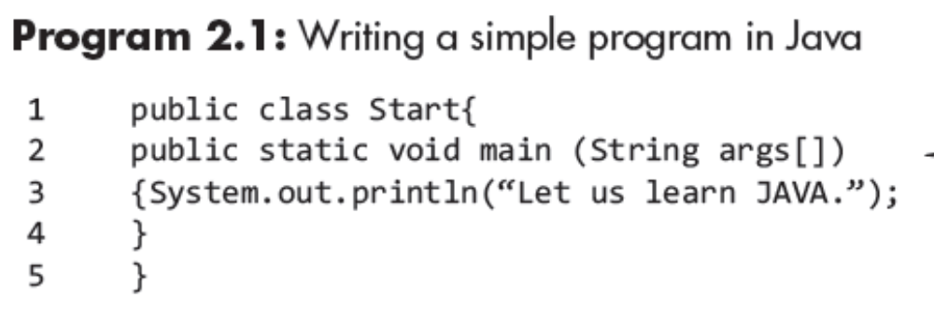
Writing Simple Java Programs
The first word public is the access modifier.
This class is accessible to any outside code.
© Oxford University Press 2018. All rights reserved.

Slide 7
Writing Simple Java Programs
If the modifier public is not used, the class is accessible only to the
classes in its own package.
The second word class is the keyword of Java language.
If the modifier public is not used, the class is accessible only to the
classes in its own package.
The second word class is the keyword of Java language.
The class body starts with the left brace ({) and ends with the right closing
brace (}).
A class body may comprise statements for declaration of variables,
constants, expressions, and methods.
© Oxford University Press 2018. All rights reserved.

Slide 8
Installing and Configuring Java
The class body starts with the left
© Oxford University Press 2018. All rights reserved.

Slide 9
Compiling and Running Java Program
The class body starts with the left
© Oxford University Press 2018. All rights reserved.

Slide 10
Compiling and Running Java Program
For compiling the program, the Java compiler javac is run on the command line as :
javac Start.java
The javac compiler creates a file called Start.class containing the bytecode version of the program.
Java interpretor in JVM executes the instructions contained in this
intermediate Java bytecode version of the program.
For this, the Java interpretator called java is used.
c:>java Start
Java interpretator looks for the main method in the program and starts
executing it.
If it is successfully executed, it would display the following:
Let us learn JAVA.
© Oxford University Press 2018. All rights reserved.

Slide 11
Tokens in Java Programs
Identifiers or names : This is meant for variables, methods, classes, etc.
Keywords : These are special words defined in Java and represent a set of instructions.
Literals : These are values represented by a set of characters, digits, etc.
Separators : These include comma, semicolon, period (.), (), [], etc.
Operators : Operators are mostly represented by symbols such as + , −,*, etc.
© Oxford University Press 2018. All rights reserved.

Slide 12
Identifiers or Names
Rules for framing names:
It may be a single word or a combination of words with no space
between words.
It should not be a keyword of Java.
It should not be Boolean literal, that is, true or false.
It should not be null literal.
It should not start with a digit but it can start with an underscore.
It can comprise one or more unicode characters which are characters as well as digits.
© Oxford University Press 2018. All rights reserved.

Slide 13
Conventions for Writing Names
Names of packages are completely in lower-case letters such as mypackage, java.lang.
Names of classes and interfaces start with an upper-case letter.
Names of methods start with a lower-case character.
Names of variables should start with a lower-case character.
© Oxford University Press 2018. All rights reserved.

Slide 14
Keywords in Java
The keywords represent groups of instructions for the compiler.
These are special tokens that have a predefined meaning and their use is restricted.
keywords cannot be used as names of variables, methods, classes, or packages.
These are written in the lower case.
© Oxford University Press 2018. All rights reserved.

Slide 15
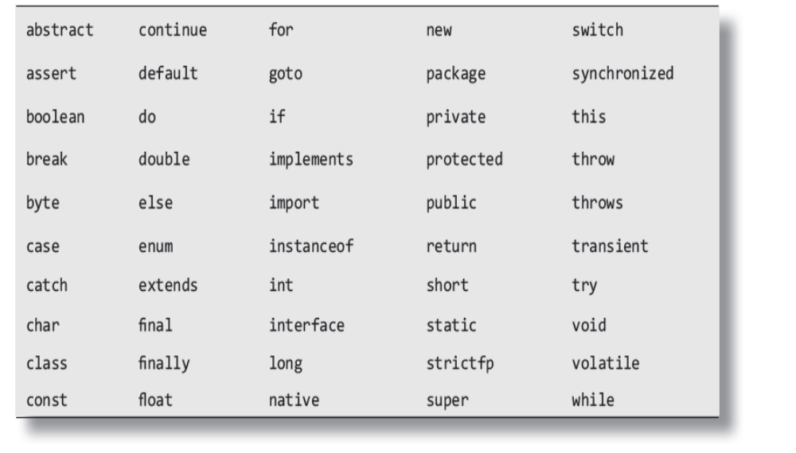
Keywords in Java
© Oxford University Press 2018. All rights reserved.

Slide 16
Literals in Java
A literal represents a value which may be of primitive type, String type, or null type.
The value may be a number (either whole or decimal point number) or a sequence of characters which is called String literal, Boolean type, etc.
A literal is a constant value.
© Oxford University Press 2018. All rights reserved.

Slide 17
Literals in Java
Types of Literals:
1. Integer literals
2. Floating point literal
3. Boolean literal
4. Character literal
5. String literal
6. Null literal
© Oxford University Press 2018. All rights reserved.

Slide 18
Literals in Java
The integral literals
Sequences of digits.
The whole numbers are described by different number systems such as decimal numbers, hexadecimal numbers, octal numbers, and binary numbers.
Each number has a different set of digits.
© Oxford University Press 2018. All rights reserved.

Slide 19
Literals in Java
Decimal Integer Literals
These are sequences of decimal digits which are 0, 1, 2, 3, 4, 5, 6, 7, 8, and 9.
Examples of such literals are 6, 453, 34789, etc.
© Oxford University Press 2018. All rights reserved.

Slide 20
Literals in Java
Hex Integral Literals
These are sequences of hexadecimal digits which are 0, 1, 2, 3, 4, 5, 6, 7, 8, 9, A, B, C, D, E, and F.
The values 10 to 15 are represented by A, B, C, D, E, and F or a, b, c, d, e, and f.
The numbers are preceded by 0x or 0X. Examples are 0x56ab o0X6AF2, etc.
© Oxford University Press 2018. All rights reserved.

Slide 21
Literals in Java
Octal Integer Literals
These are sequences of octal digits which are 0, 1, 2, 3, 4, 5, 6, and 7.
These numbers are preceded by 0. Examples of literals are 07122, 04, 043526.
Binary Literal
These are sequences of binary digits.
Binary numbers have only two digits—0 and 1 and a base 2.
Examples of such literals are 0b0111001, 0b101, 0b1000, etc.
© Oxford University Press 2018. All rights reserved.

Slide 22
Literals in Java
Floating Point Literal
These are floating decimal point numbers or fractional decimal numbers with base 10. Examples are 3.14159, 567.78, etc.
Boolean Literal
These are Boolean values. There are only two values—true or false.
© Oxford University Press 2018. All rights reserved.

Slide 23
Literals in Java
Character Literal
These are the values in characters.
Characters are represented in single quotes such as ‘A’, ‘H’, ‘k’, and so on.
String Literals
These are strings of characters in double quotes. Examples are “Delhi”, “John”, “AA”, etc.
Null Literal
There is only one value of Null Literal, that is, null.
© Oxford University Press 2018. All rights reserved.

Slide 24
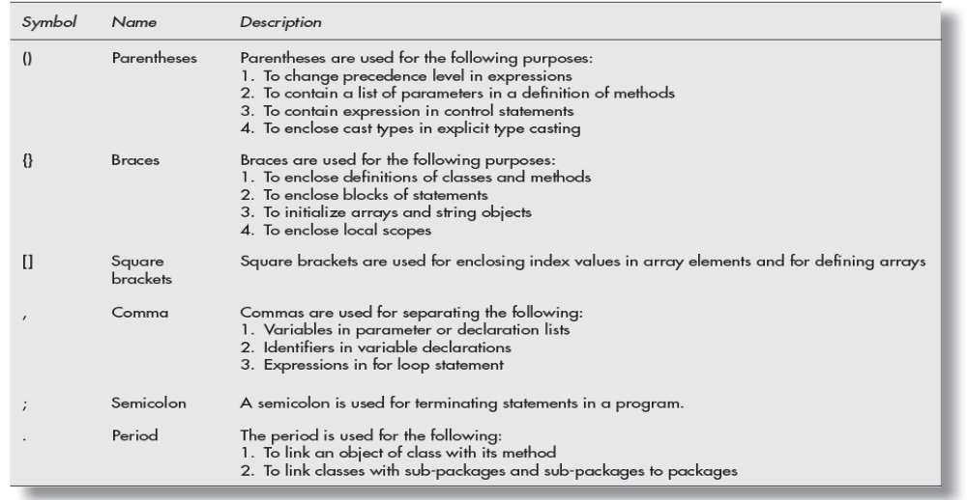
Literals in Java
Separators
© Oxford University Press 2018. All rights reserved.

Slide 25
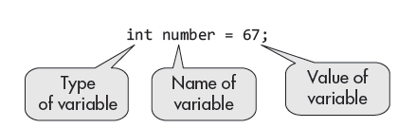
Declaration of Variables
Variables are objects whose values may change in the program.
A variable is declared by first writing its type, followed by its name or identifier.
© Oxford University Press 2018. All rights reserved.

Slide 26
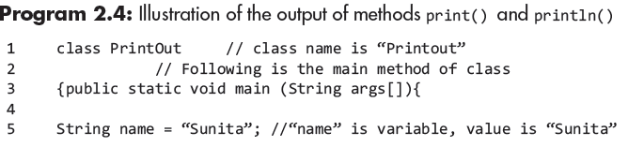
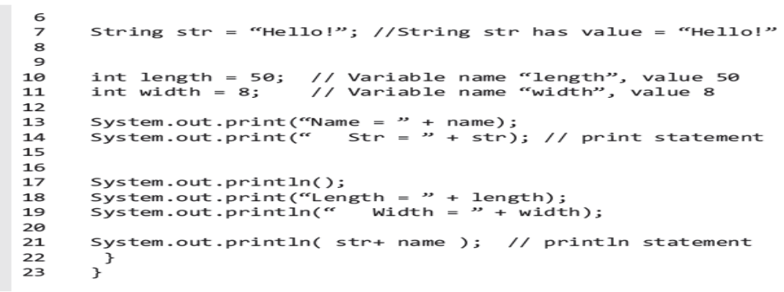
Program Example-1
© Oxford University Press 2018. All rights reserved.

Slide 27
Types of Variables in Class Declaration
Local variables : These are declared inside a method or are argument
to a method.
Instance variables : These variables may be declared anywhere in a
class but outside a method.
Static or class variables : The declaration of these variables is modified
by the keyword static.
- The program keeps only one copy of values of these variables which
are shared by all the objects of a class.
© Oxford University Press 2018. All rights reserved.

Slide 28
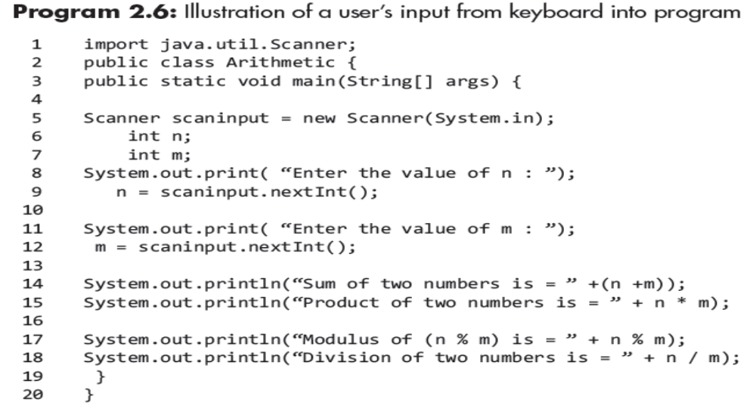
User Input to Programs
© Oxford University Press 2018. All rights reserved.

Slide 29
Escape Sequences
Local variables These are declared inside a
© Oxford University Press 2018. All rights reserved.

Slide 30
Comments
Comments are not a part of the compiled program.
They are added to the source code of the program.
Java supports three types of comments as:
1. Single-line comment
2. Multi-line comment
3. Documentation comment
© Oxford University Press 2018. All rights reserved.

Slide 31
Comments
Single-line comment : It starts after a double slash (//) up to the end of
the line. E.g.
//This is single line comment.
Multi-line comment : comment is enclosed between slash followed by
star at the beginning as (/*) and star followed by slash (*/) at the end.
E.g.
/* This is a multi-line comment. It starts with slash and star and ends
with star followed by slash.*/
© Oxford University Press 2018. All rights reserved.

Slide 32
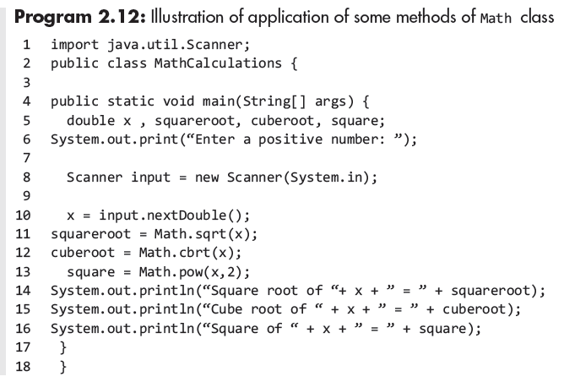
Use of Class Math in Mathematical Calculations
© Oxford University Press 2018. All rights reserved.

Slide 33
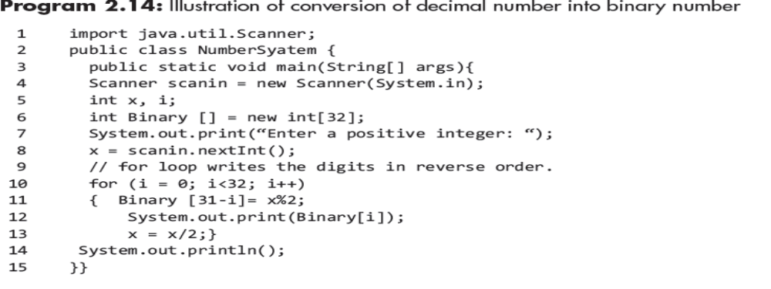
Conversion of Decimal Number into Binary Number
© Oxford University Press 2018. All rights reserved.

Slide 34
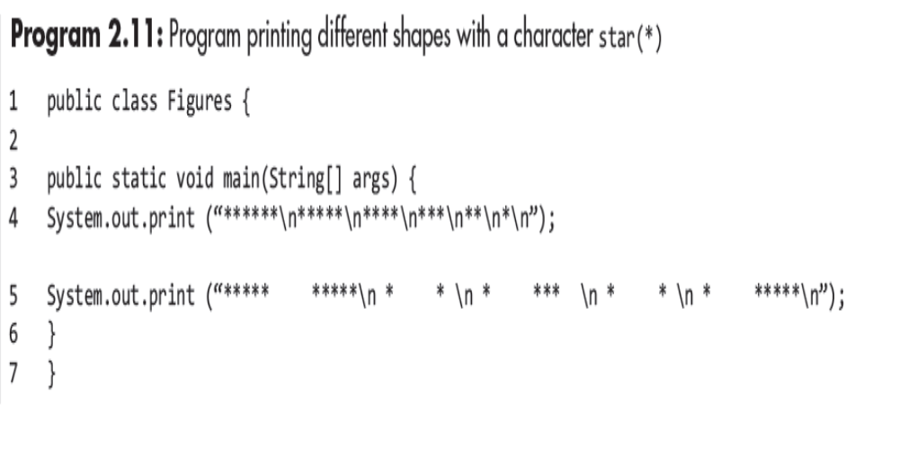
Printing Simple Patterns
© Oxford University Press 2018. All rights reserved.

