Slide 1


Java
One step Ahead
Anita Seth &
B.L. Juneja
© Oxford University Press 2018. All rights reserved.

Slide 2
Chapter 3
Data Types, Variables and
Operators
© Oxford University Press 2018. All rights reserved.

Slide 3
Data Types in Java
Java defines eight primitive (basic) types of data
1. Integral types—byte, short, int, long
2. Floating point types—float, double
3. Character type—char
4. Boolean type—boolean
There is a non-data type called void and no data can be of type void.
This type is used for methods that do not return any value.
© Oxford University Press 2018. All rights reserved.

Slide 4
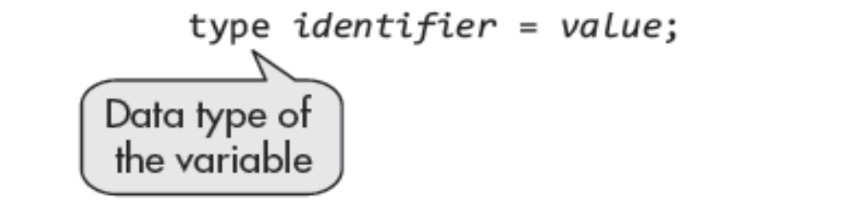
Declaration of Variables
A variable is declared by first declaring its type followed by its
identifier or name.
The name or identifier should not be a keyword of Java language.
It can be of any length and may consist of characters and digits.
© Oxford University Press 2018. All rights reserved.

Slide 5

Non-primitive Types
These are the class and interface types. The name of a class or interface is the name of type. A class object is declared as
© Oxford University Press 2018. All rights reserved.

Slide 6
Data Types
Integers
Integers are whole numbers, that is, they represent numbers that do not have a fractional part.
Examples of such numbers are as follows:
1. Number of passengers in a bus
2. Number of runs made in a cricket match
3. Numbers of events
4. Number of eggs in a basket
In Java, these numbers may be positive or negative.
© Oxford University Press 2018. All rights reserved.

Slide 7
Data Types
The integers can be declared in four types according to the size of
memory allocated:
byte
Short
int
long
More the memory allocated, the higher is the range of values that can
be stored.
© Oxford University Press 2018. All rights reserved.

Slide 8
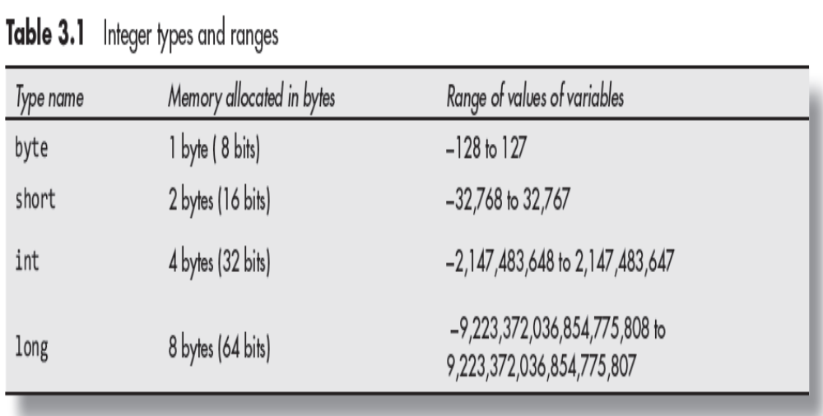
Data Types
Integers
© Oxford University Press 2018. All rights reserved.

Slide 9
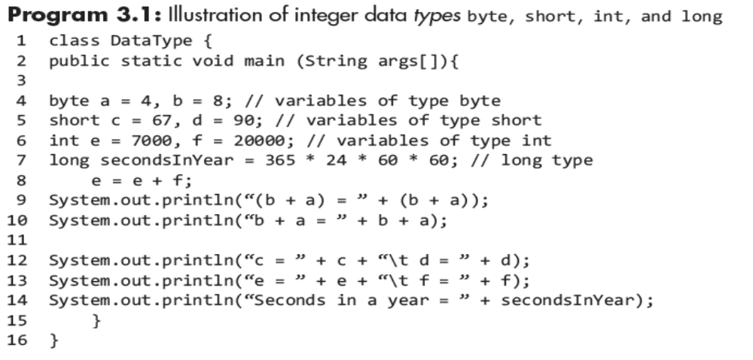
Program Ex-1
Integers
© Oxford University Press 2018. All rights reserved.

Slide 10
Characters
A variable may have value in terms of a character in which the type of variable is char.
These characters represent integer values.
Java supports Unicode for the representation of characters.
Unicode supports all the character sets of all the major languages of the world.
The initial version of Unicode allocated 2 bytes for storing characters.
The range of values for characters in the initial version of Unicode comprised from ‘\u0000’ to ‘\uffff ’ that is from 0 to 65535 both end values inclusive.
© Oxford University Press 2018. All rights reserved.

Slide 11
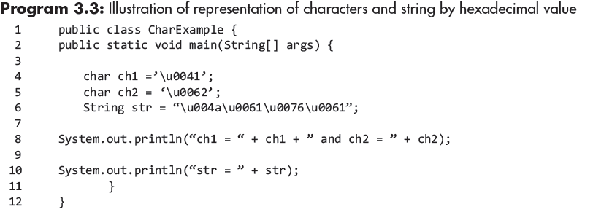
Program Ex-2
© Oxford University Press 2018. All rights reserved.

Slide 12
Floating Point Numbers
The numbers that are not whole numbers, or those that have fractional part, Examples are 3.141, 476.6, and so on.
Java supports two types of such numbers.
Float: This type is used for single-precision decimal floating point
numbers, that is, 7 digits after the decimal point. These numbers
are stored on 4 bytes.
© Oxford University Press 2018. All rights reserved.

Slide 13
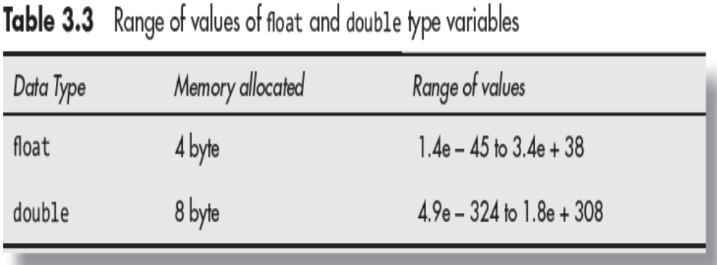
Floating Point Numbers
Double This type is used for double-precision decimal floating point numbers, that is, 15 digits after the decimal point.
© Oxford University Press 2018. All rights reserved.

Slide 14
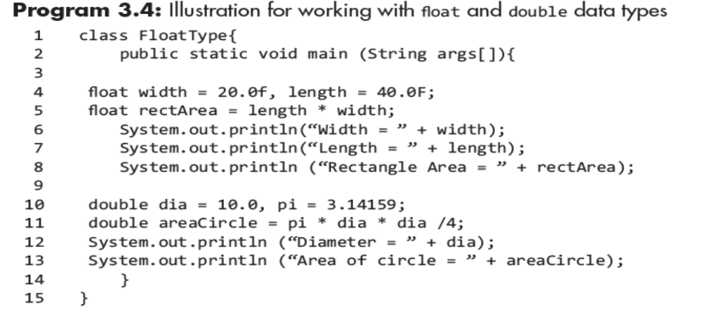
Floating Point Numbers
Program Ex-3
Double This type is used for double-precision decimal floating point numbers, that is, 15 digits after the decimal point.
© Oxford University Press 2018. All rights reserved.

Slide 15
boolean Type Data
For dealing with logical statements, variable of type boolean is supported.
The value of boolean type variable is either true or false.
The boolean type variables are unsigned as similar to char type variables.
The variable may be declared as follows :
boolean a;
a = x > y;
© Oxford University Press 2018. All rights reserved.

Slide 16
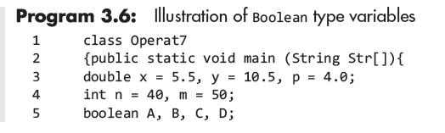
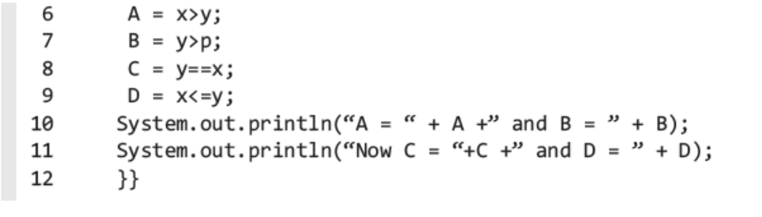
boolean Type Data Program
© Oxford University Press 2018. All rights reserved.

Slide 17
Type Casting
If an expression has more than one type of a variable, the different types have to be changed to conform to a single type.
The conversion of types of data is called type casting or type conversion.
Some type castings are done automatically by a compiler, while others have to be done by the programmer.
Examples :
byte n = 8;
short m = 67 + n;
n is promoted to match type short.
Similarly, in the following code,
int P = m + n;
In
© Oxford University Press 2018. All rights reserved.

Slide 18
Type Casting
The explicit type casting is carried out by the following code:
type variable = (new_type) variable;
It is illustrated by the following code lines:
double D = 6.865;
int A = (int) D;
In such a conversion, there is loss of data, and therefore, the value.
© Oxford University Press 2018. All rights reserved.

Slide 19
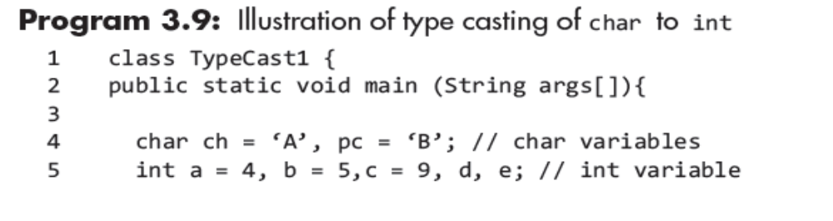
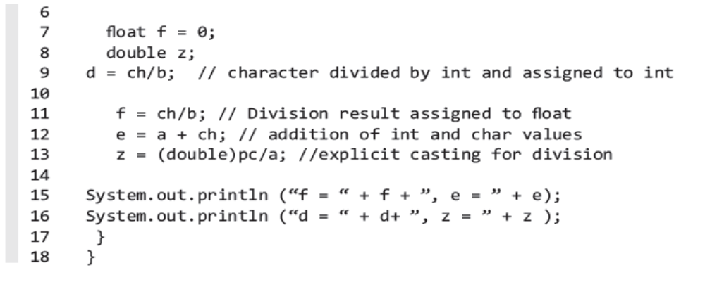
Type Casting- Program EX
© Oxford University Press 2018. All rights reserved.

Slide 20
Literal Constants
Each character is a constant value.
An array of characters or a string also represents a constant value.
The digits in decimal system, octal system, or hexadecimal system
represent constant values.
These are all called literal constants.
The char literals are enclosed in single quotes (‘ ’). The examples ‘A’ and ‘B’.
© Oxford University Press 2018. All rights reserved.

Slide 21
Symbolic Constants
A symbolic constant is a variable whose value does not change throughout the program.
Some of the examples include PI, NORTH, EAST etc.
© Oxford University Press 2018. All rights reserved.

Slide 22
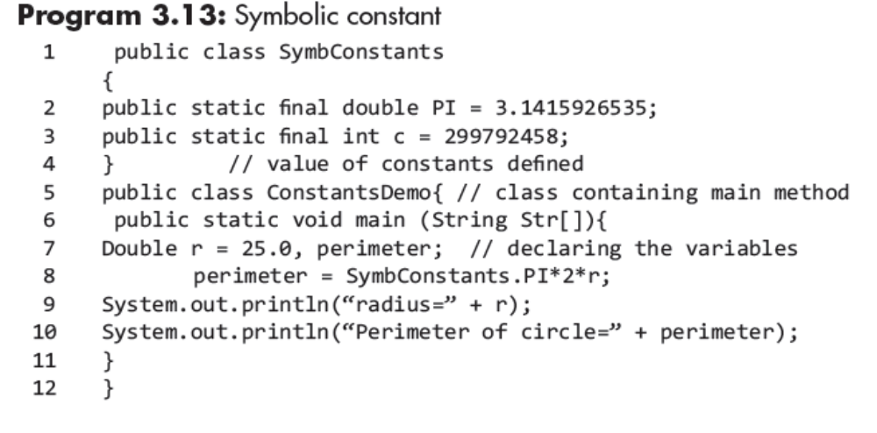
Symbolic Constants-Program EX
A symbolic constant is a variable whose value does not change throughout the
© Oxford University Press 2018. All rights reserved.

Slide 23
Static Variables and Methods
The variables in a class may be modified by modifier static.
The non-static variables declared in a class are instance variables.
Each object of the class keeps a copy of the values of these variables.
The static variables are class variables.
The static variables are accessed through class reference, whereas the instance variables are accessed through class object reference.
© Oxford University Press 2018. All rights reserved.

Slide 24
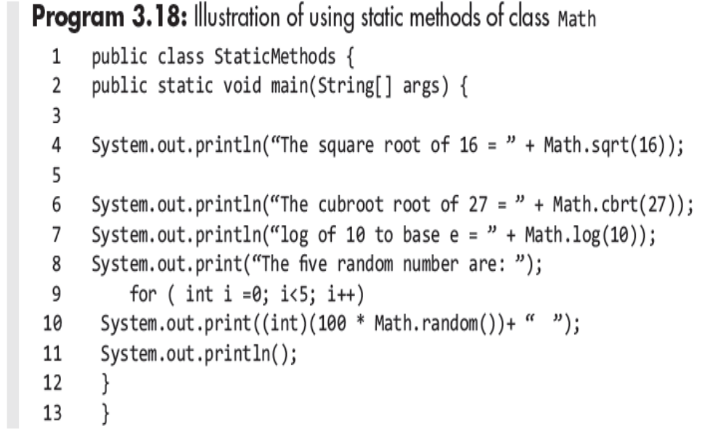
Static Variables and Methods
© Oxford University Press 2018. All rights reserved.

Slide 25
Mathematical Functions
The class Math of the package java.lang. defines several mathematical methods. functions.
java.lang package is imported by default in every Java program, there is no need to place the line import java. lang;
All the methods of class Math are declared static, that is, it can be called even.
© Oxford University Press 2018. All rights reserved.

Slide 26
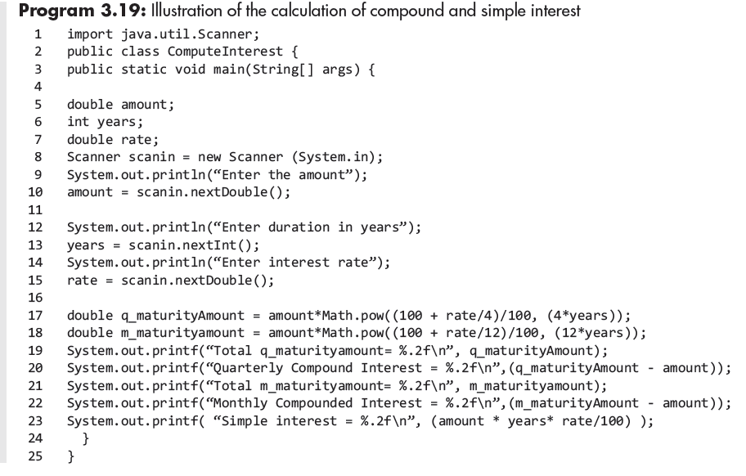
Mathematical Functions
© Oxford University Press 2018. All rights reserved.

Slide 27
Attribute Final
The value of a variable declared final cannot be changed in the program.
It makes the variable a constant.
A few examples of declarations are as:
final double PI = 3.14159;
final int M = 900;
final double X = 7.5643;
© Oxford University Press 2018. All rights reserved.

Slide 28
Introduction to Operators
1. Arithmetic operators
2. Compound assignment operators
3. Increment and decrement operators
4. Relational operators
5. Boolean logical operators
6. Bitwise logical operators
7. Shift operators
8. Special operators
If an operator takes only one operand for its operation, it is called
unary operator.
If it takes two operands, it is called binary operator.
If it takes three operands, it is called ternary operator.
© Oxford University Press 2018. All rights reserved.

Slide 29
Precedence and Associativity of Operators
Rules that determine the order of operations when operators of equal precedence appear within the same expression.
In an expression that has several operators, the precedence level determines the operator’s turn for operation.
In an expression having several operators, the computer first execute the operator with the highest precedence level, and then, it will take the operator which is next (lower) in the precedence level and so on.
BODMAS is one of the easiest ways to remember the order of precedence rule with respect to the basic arithmetic operators.
© Oxford University Press 2018. All rights reserved.

Slide 30
Precedence and Associativity of Operators
According to BODMAS rule, operations in any given expression should precede in the following order :
1. Brackets
2. Order
3. Division
4. Multiplication
5. Addition
6. Subtraction
© Oxford University Press 2018. All rights reserved.

Slide 31
Precedence and Associativity of Operators
If the expression contains several operators with the same precedence level, the expression is evaluated according to its associativity.
For example, in
Z = 6*4%5;
Both the operators * and % have same precedence level.
© Oxford University Press 2018. All rights reserved.

Slide 32
Assignment Operator ( = )
The associativity of assignment operator is from right to left.
On the left of =, we write the name of the variable to which a value is to be assigned, and on its right, we write the value to be assigned.
The name or identifier on the left is also called l-value and the value on the right of = is called r-value.
© Oxford University Press 2018. All rights reserved.

Slide 33
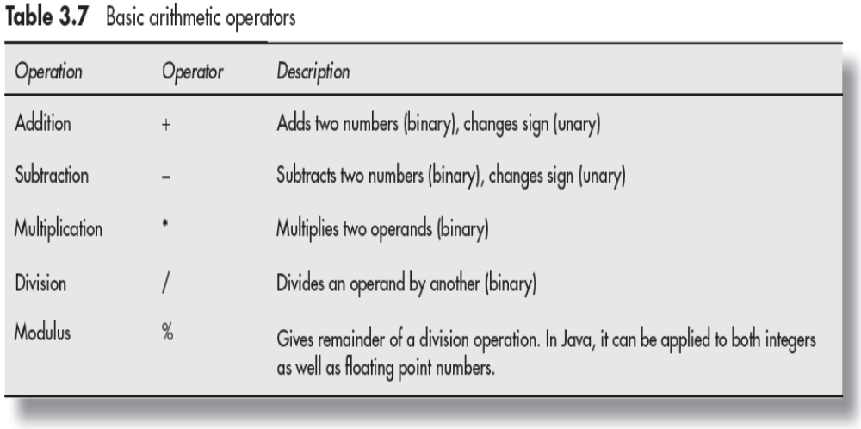
Basic Arithmetic Operators
© Oxford University Press 2018. All rights reserved.

Slide 34
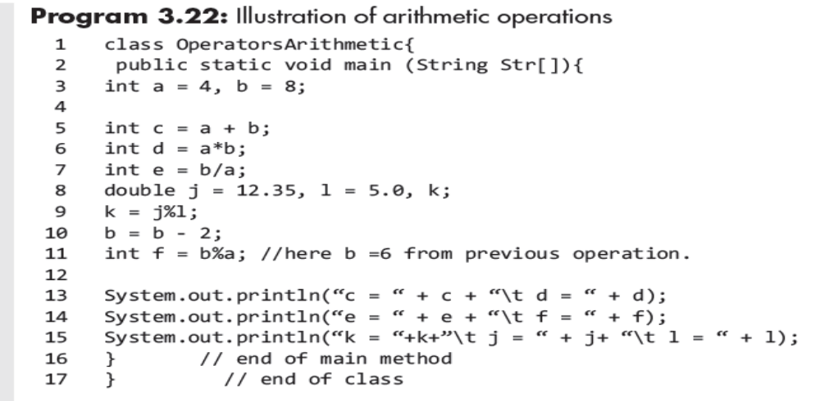
Program Example
© Oxford University Press 2018. All rights reserved.

Slide 35
Combinational Arithmetic Operators
Combinational assignment statements in Java are similar to those used in C or C++.
In a compound assignment operator, the operations by an operator and assignment are combined in a single operator. As for e.g.
int n = 8, m = 10;
n = n + m;
© Oxford University Press 2018. All rights reserved.

Slide 36
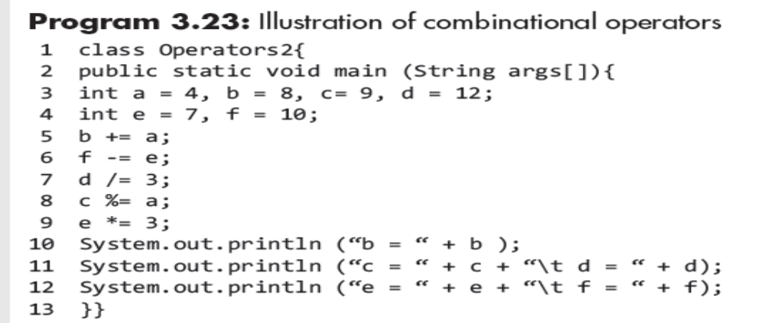
Program Example
© Oxford University Press 2018. All rights reserved.

Slide 37
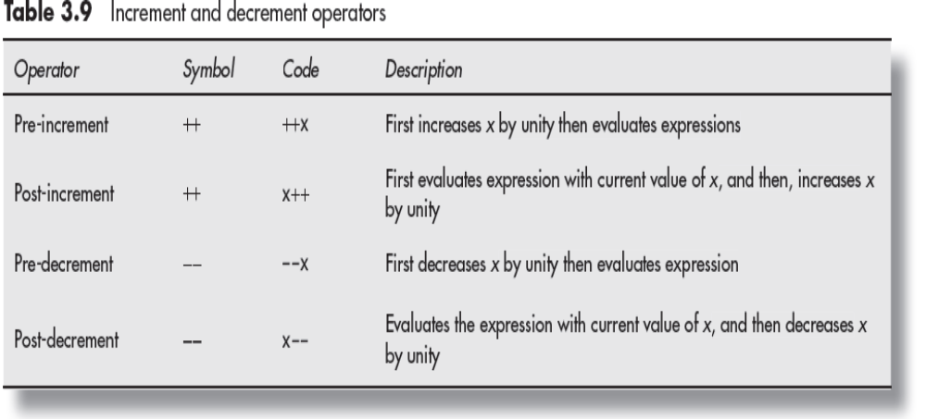
Increment (++) and Decrement (−−) Operators
© Oxford University Press 2018. All rights reserved.

Slide 38
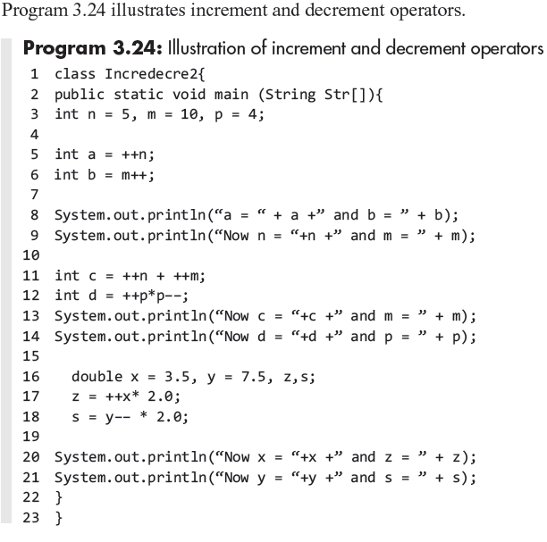
Program Example
© Oxford University Press 2018. All rights reserved.

Slide 39
Ternary Operator
Ternary operator is also called conditional operator.
In Java, there is only one ternary operator described by token (?:).
It takes three operands for its operation.
expression1? expression2 : expression3
If expression1 is true, then expression2 is executed; otherwise,
expression3 is executed.
© Oxford University Press 2018. All rights reserved.

Slide 40
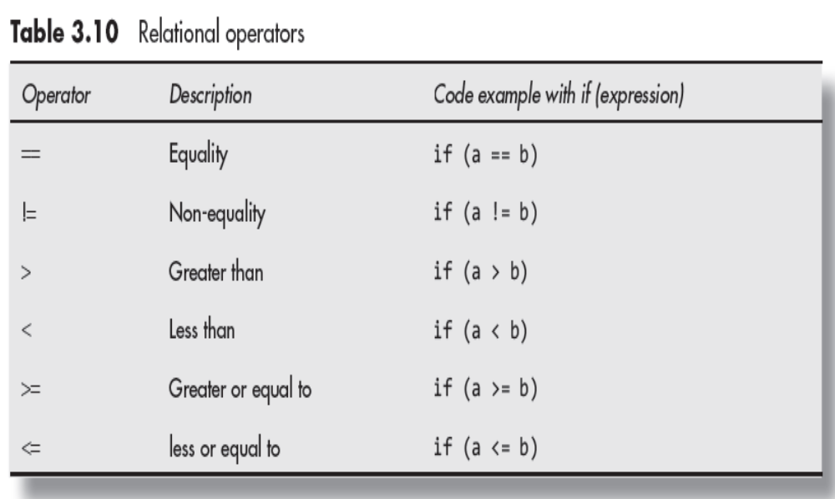
Relational Operator
© Oxford University Press 2018. All rights reserved.

Slide 41
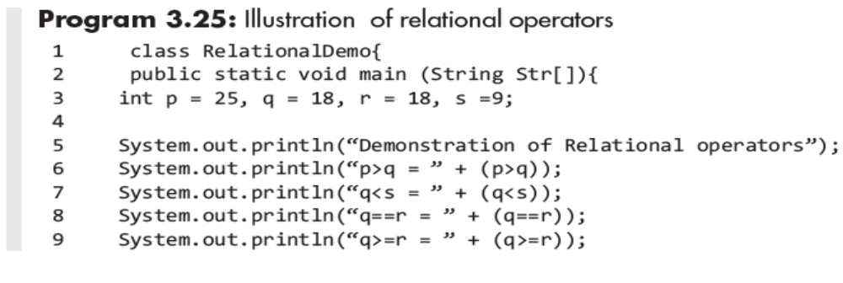
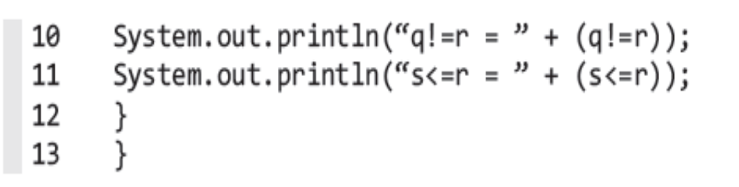
Program Example
© Oxford University Press 2018. All rights reserved.

Slide 42
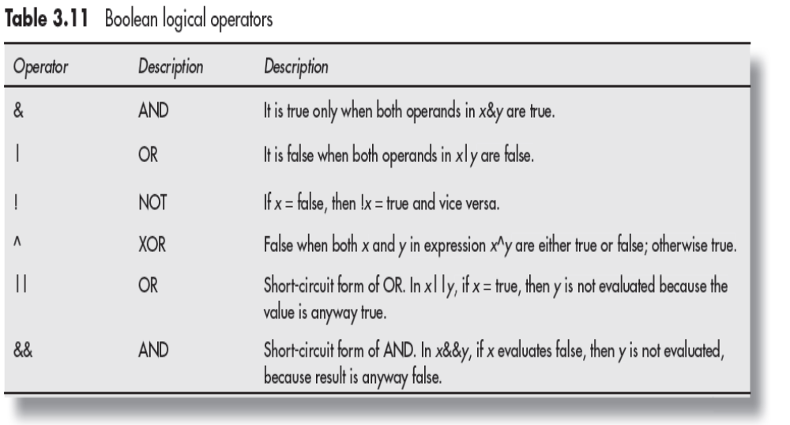
Boolean Logical Operators
© Oxford University Press 2018. All rights reserved.

Slide 43
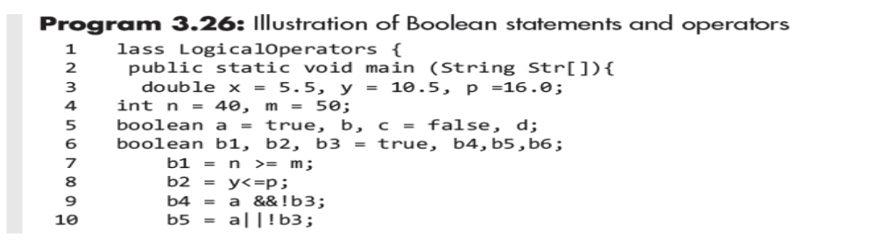
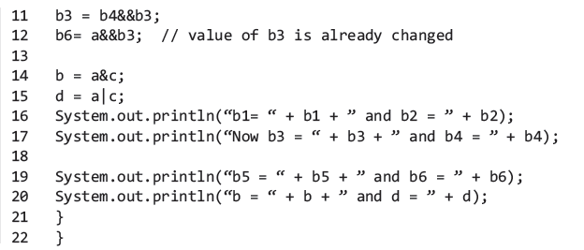
Program Example
© Oxford University Press 2018. All rights reserved.

Slide 44
Short-circuit Logical Operators
These are the secondary versions of Boolean AND and OR operators.
The short-circuit form of OR operator is represented by symbol || and that of AND operator is represented by symbol &&.
© Oxford University Press 2018. All rights reserved.

Slide 45
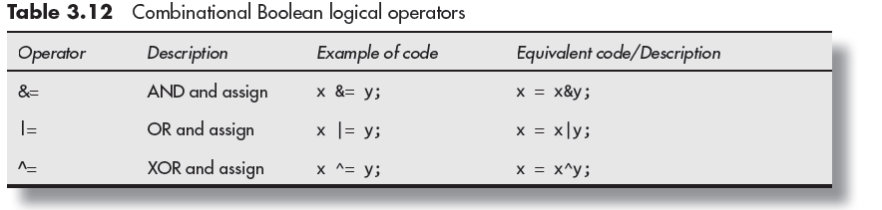
Combinational Boolean Operators
© Oxford University Press 2018. All rights reserved.

Slide 46
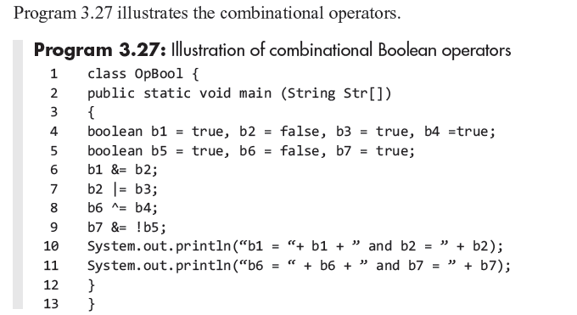
Program Example
© Oxford University Press 2018. All rights reserved.

Slide 47
Bitwise Logical Operators
These operators are applied to individual bits of numbers.
The bitwise operators are OR, AND, XOR, and bitwise
compliment/bitwise NOT operator.
© Oxford University Press 2018. All rights reserved.

Slide 48
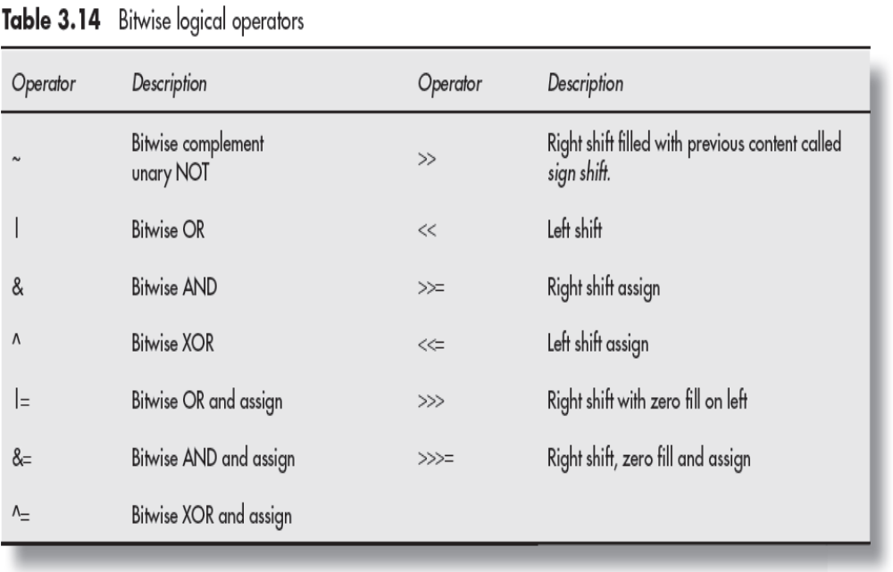
Bitwise Logical Operators
© Oxford University Press 2018. All rights reserved.

Slide 49
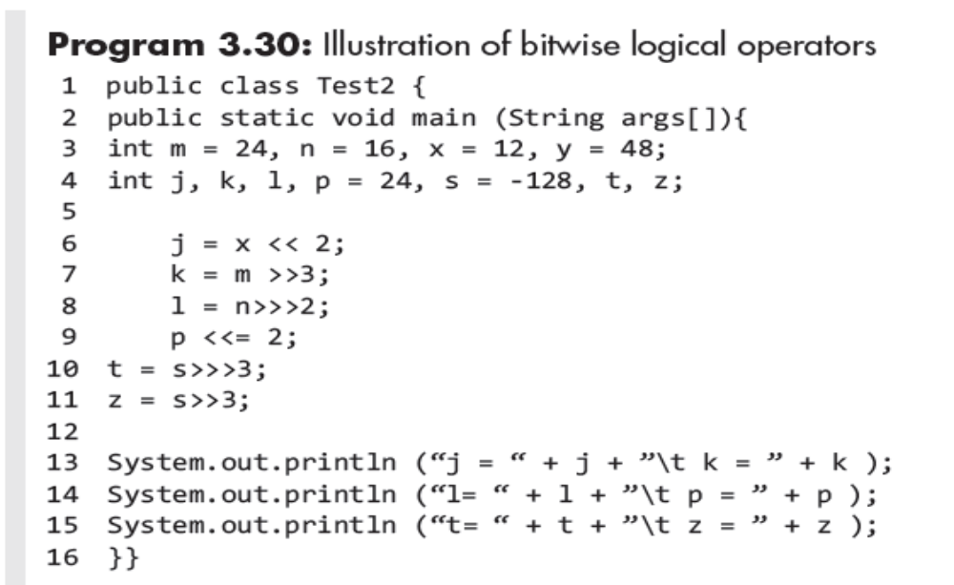
Program Example
© Oxford University Press 2018. All rights reserved.

Slide 50
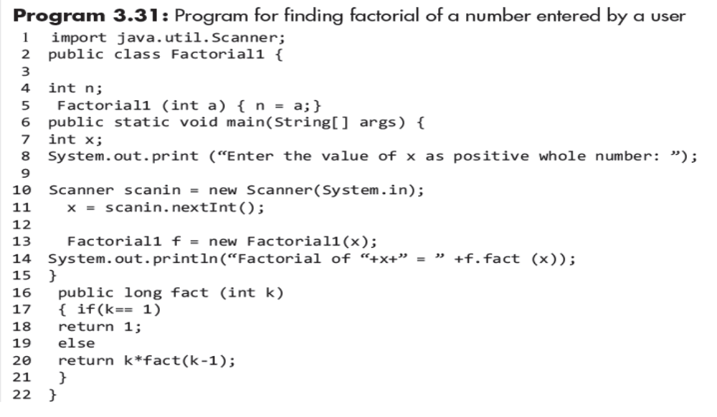
Application Program
© Oxford University Press 2018. All rights reserved.

Slide 51
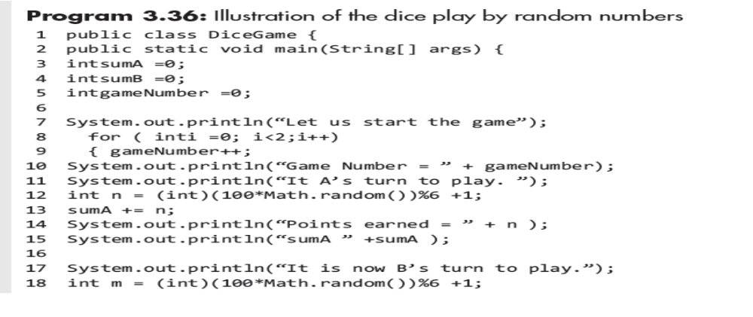
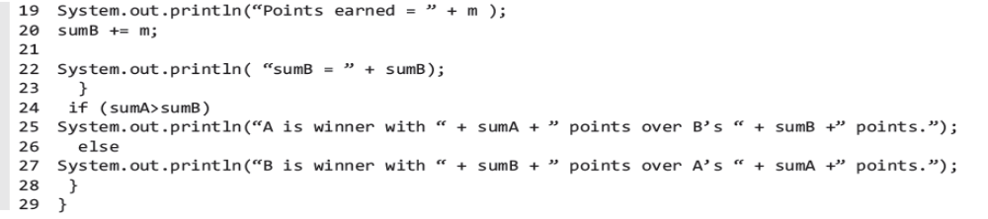
Program Example
© Oxford University Press 2018. All rights reserved.

