Slide 1


Java
One step Ahead
Anita Seth &
B.L. Juneja
© Oxford University Press 2018. All rights reserved.

Slide 2
Chapter 4
Control Statements
© Oxford University Press 2018. All rights reserved.

Slide 3
Control Statements
Selection statements: These statements give an option of choosing different paths of execution of a program depending on the result of a test condition.
The expressions in this group are if, if–else, and switch statement.
Iteration statements: These statements allow repeated evaluation of a statement or a block of statements if the test condition is satisfied.
This group contains statements such as while, do–while, for, and for–
each.
© Oxford University Press 2018. All rights reserved.

Slide 4
Control Statements
Jump statements: These statements make the program control jump to another part of a program in the forward or backward directions with or without a test condition.
The statements in this group are break, break label, continue,
continue label, and return.
© Oxford University Press 2018. All rights reserved.

Slide 5
if Expression
The code for if statement is as follows:
if (conditional expression)
statement;
© Oxford University Press 2018. All rights reserved.

Slide 6
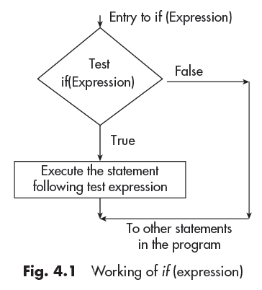
if Expression
© Oxford University Press 2018. All rights reserved.

Slide 7
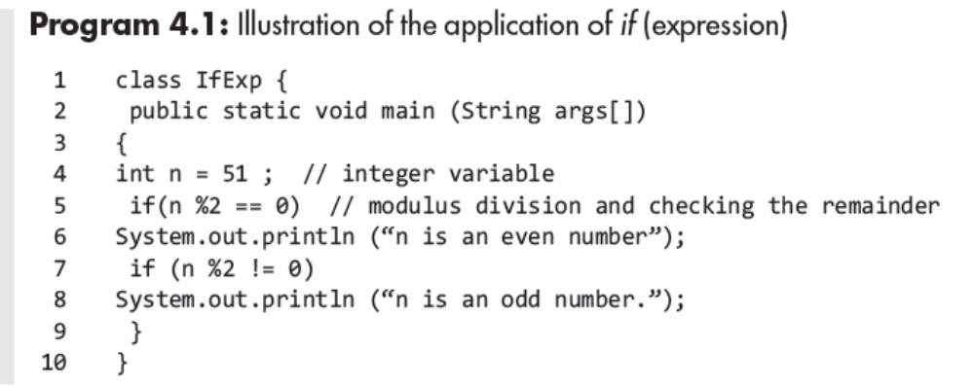
Program Example
© Oxford University Press 2018. All rights reserved.

Slide 8
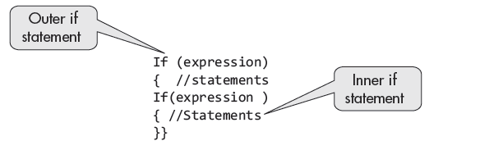
Nested if Expressions
© Oxford University Press 2018. All rights reserved.

Slide 9
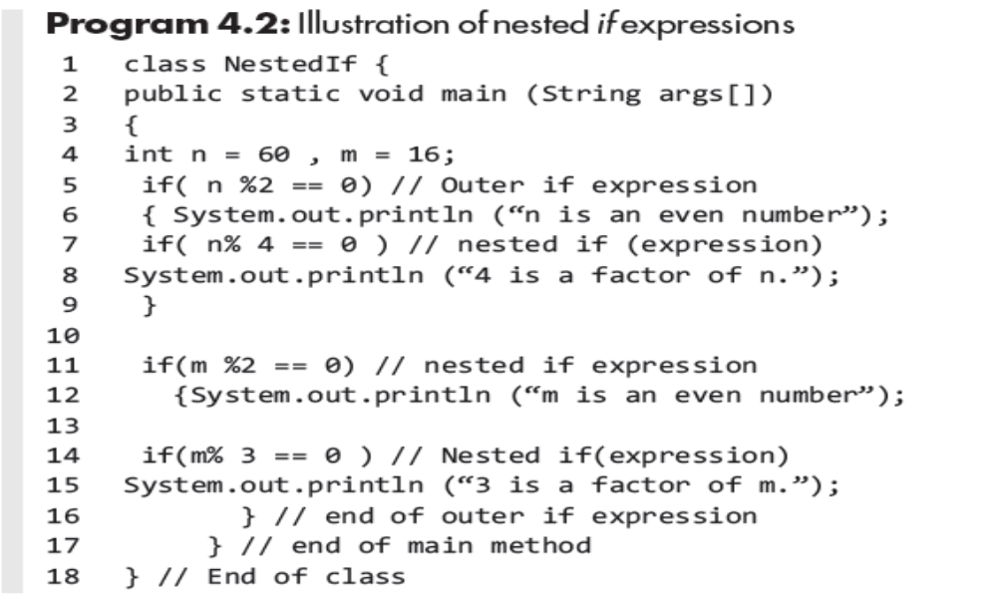
Program Example
© Oxford University Press 2018. All rights reserved.

Slide 10
If-else Expressions
The code for if –else statement is as:
if (expression)
{/* statements */}
else {/* statements */}
© Oxford University Press 2018. All rights reserved.

Slide 11
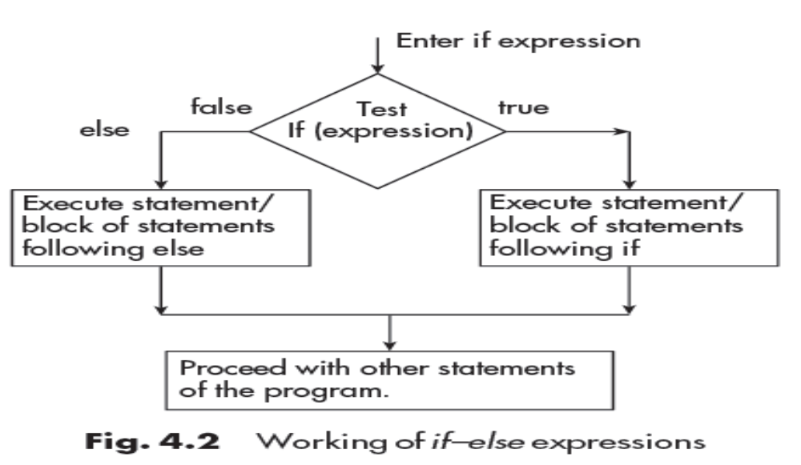
Working of if-else Expressions
© Oxford University Press 2018. All rights reserved.

Slide 12
Program Example
The code for if statement is as follows:
if (conditional expression)
statement;
© Oxford University Press 2018. All rights reserved.

Slide 13
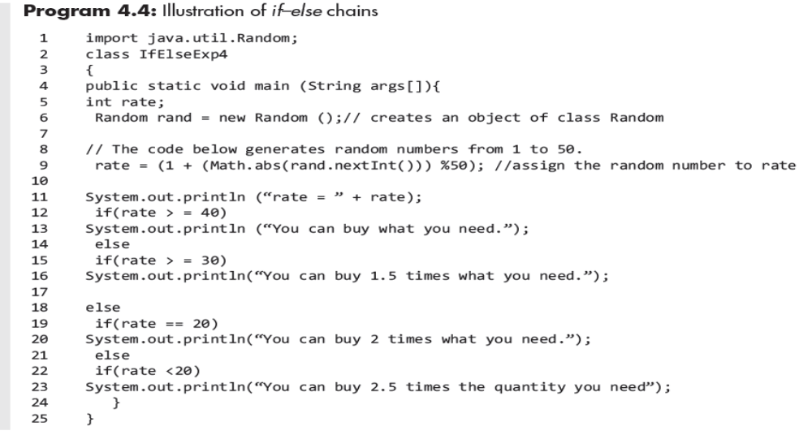
If-else Chains
© Oxford University Press 2018. All rights reserved.

Slide 14
Ternary Operator ?:
Its code is as follows:
Expression1 ?Expression2 :Expression3
The first expression is the test condition.
If it evaluates true, the Expression2 is executed; otherwise Expession3 is executed.
© Oxford University Press 2018. All rights reserved.

Slide 15
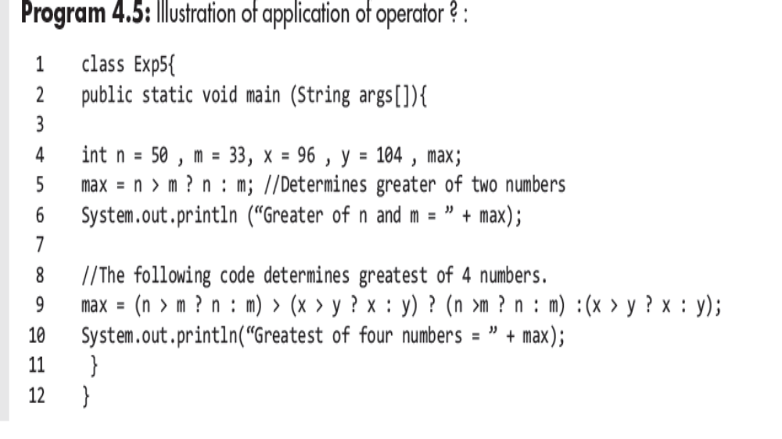
Program Example
© Oxford University Press 2018. All rights reserved.

Slide 16
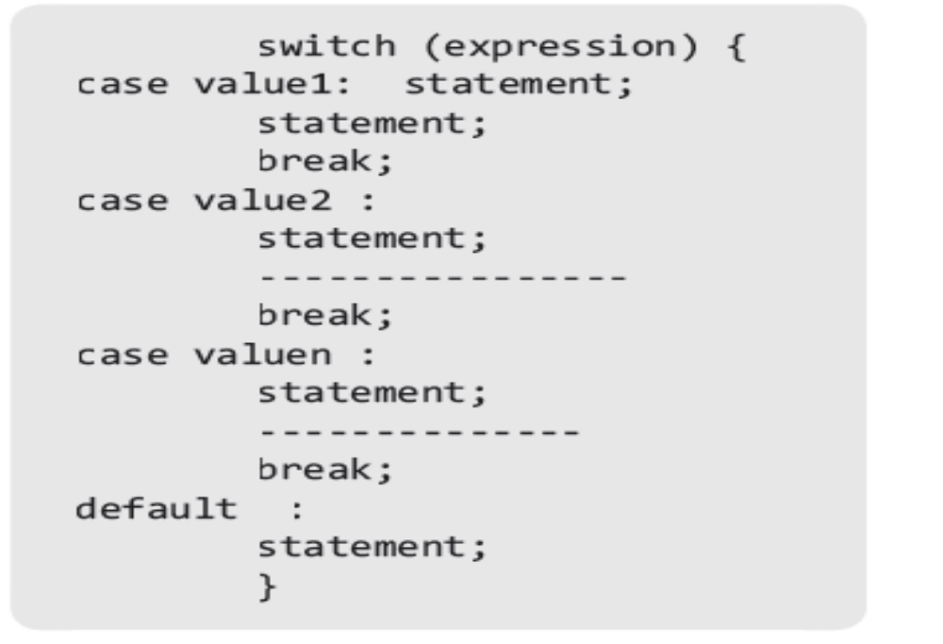
Switch Statement
© Oxford University Press 2018. All rights reserved.

Slide 17
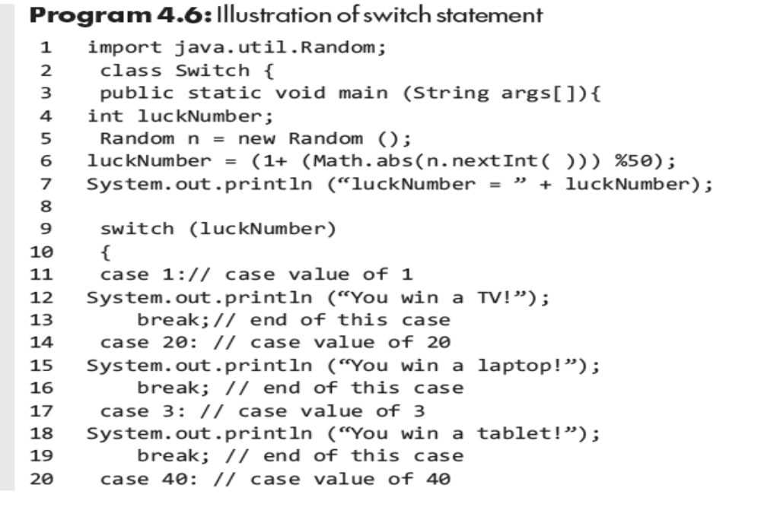
Program Example
© Oxford University Press 2018. All rights reserved.

Slide 18
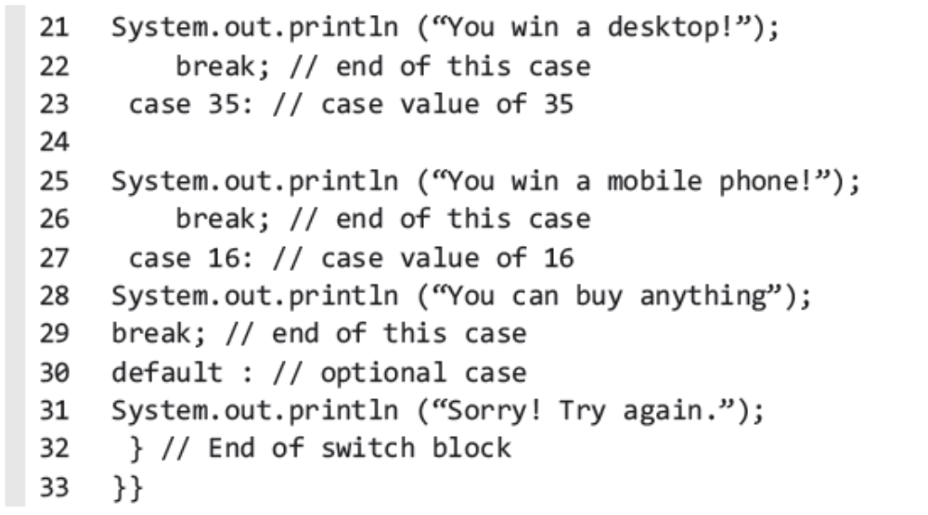
Program Example Cont.
© Oxford University Press 2018. All rights reserved.

Slide 19
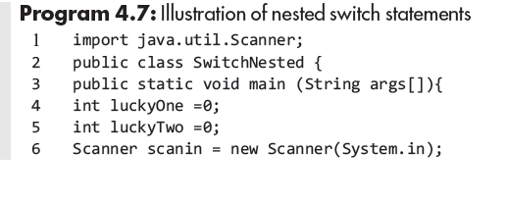
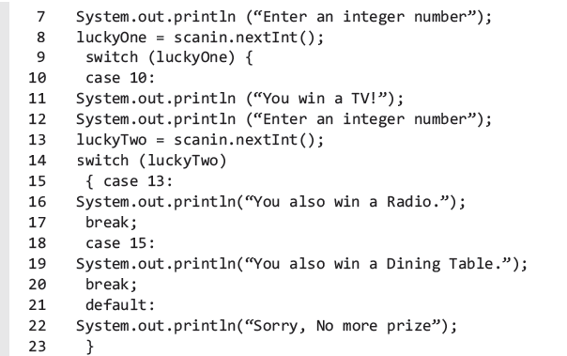
Nested Switch Statement
© Oxford University Press 2018. All rights reserved.

Slide 20
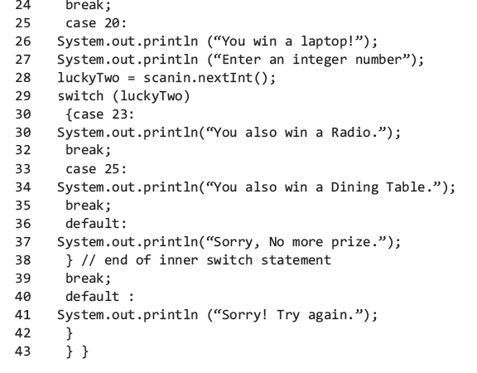
Nested Switch Statement
© Oxford University Press 2018. All rights reserved.

Slide 21
Iteration Switch Statement
Iteration or looping refers to repetitive evaluation of a statement or a block of statements in order to get the final output.
Java has the following constructs for looping:
(i) while (Expression)
(ii) do
--------
while (Expression);
(iii) for ( Expressions)
© Oxford University Press 2018. All rights reserved.

Slide 22
while Expression
The while loop may be coded as:
while (test expression)
statement;
If the while test expression evaluates true, the statement following
the expression is executed.
© Oxford University Press 2018. All rights reserved.

Slide 23
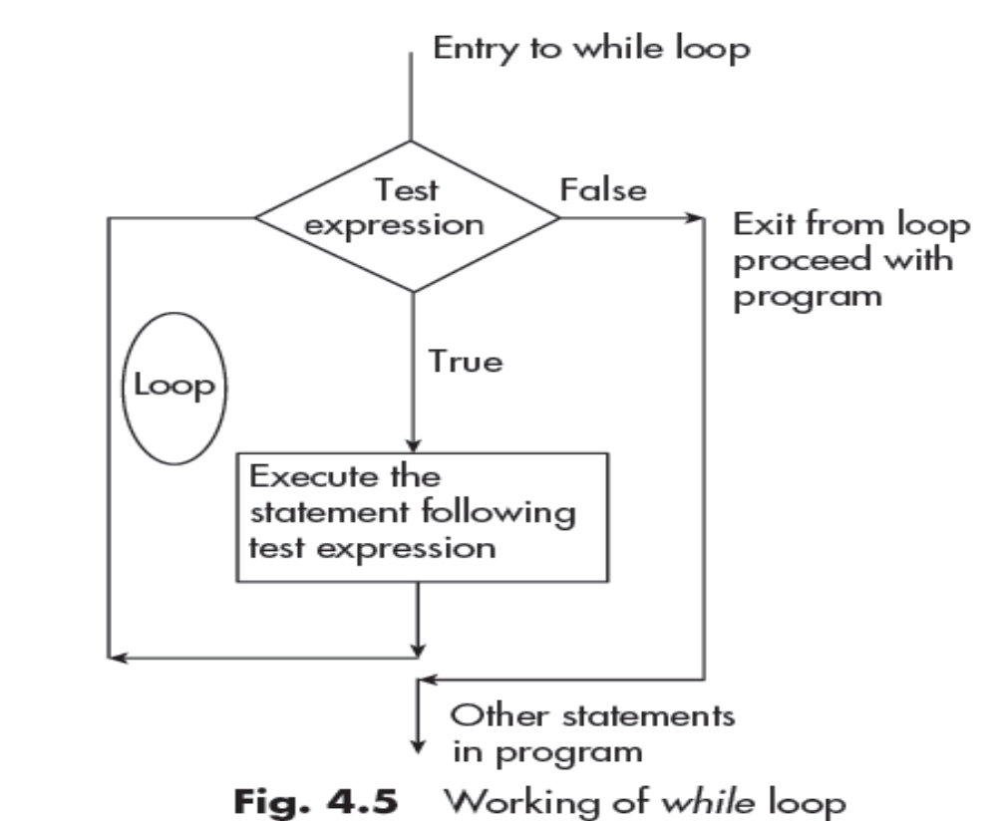
while Expression
© Oxford University Press 2018. All rights reserved.

Slide 24
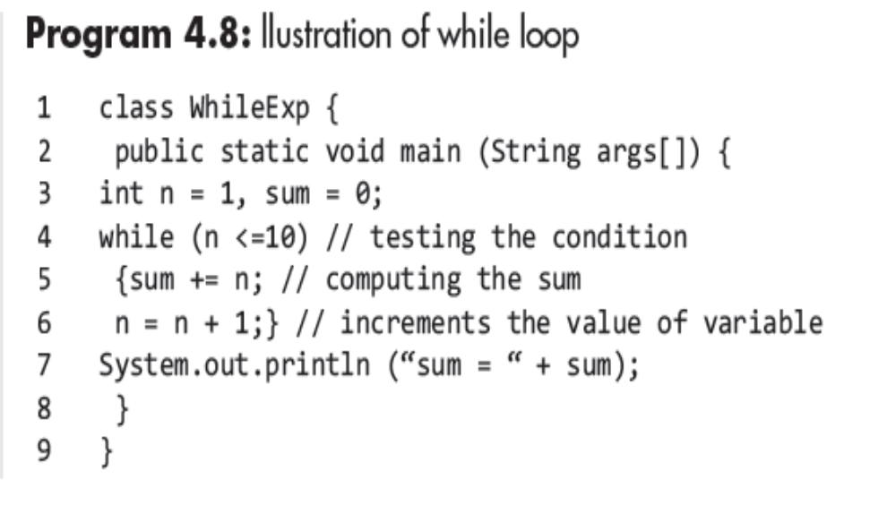
Program Example
© Oxford University Press 2018. All rights reserved.

Slide 25
Endless while Loop
The endless while loop may be coded as:
while (true)
However, it can be stopped by break statement, which is coded as :
break;
© Oxford University Press 2018. All rights reserved.

Slide 26
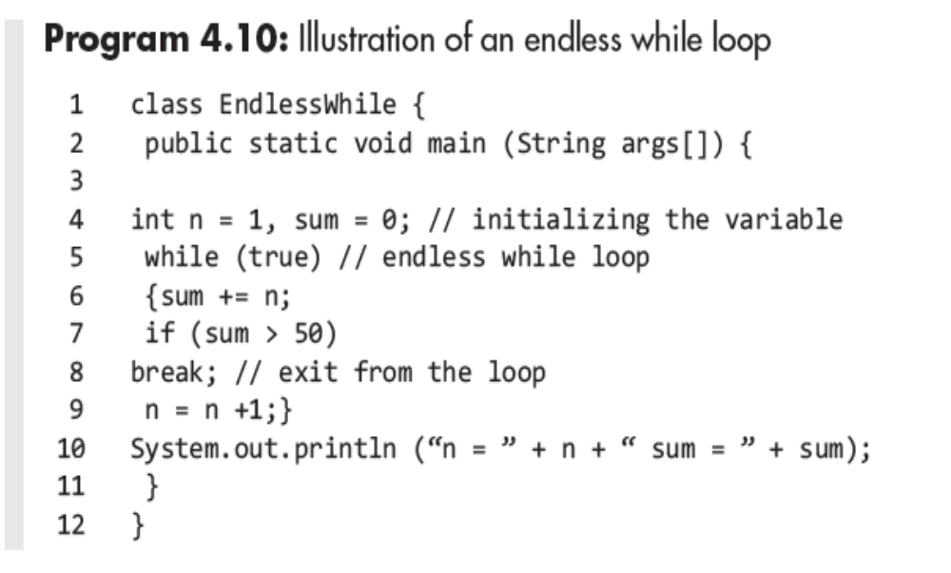
Program Example
© Oxford University Press 2018. All rights reserved.

Slide 27
do while Loop
This loop is similar to while loop except for the fact that the test
expression is placed at the end.
The statement to be executed is placed between do and while
expression.
Code is:
do
Statement;
while (test expression);
© Oxford University Press 2018. All rights reserved.

Slide 28
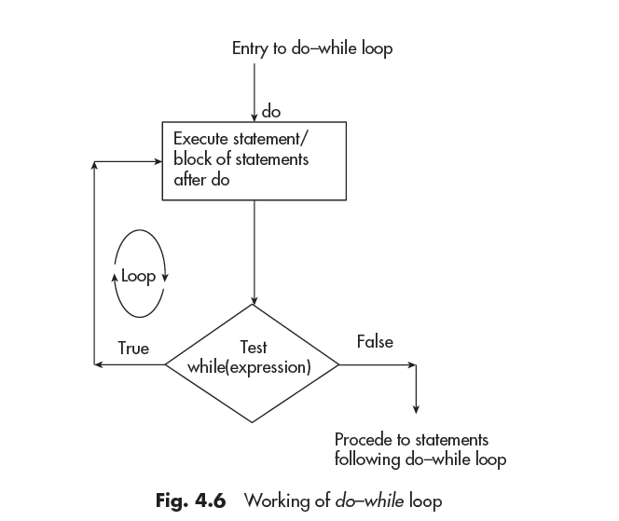
do while Loop
© Oxford University Press 2018. All rights reserved.

Slide 29
Program Example
The code for if statement is as follows:
if (conditional expression)
statement;
© Oxford University Press 2018. All rights reserved.

Slide 30
for Loop
The for loop is the most versatile loop when the start and end points
of the loop are known.
It is an entry controlled loop
for (initialization; test expression; Iteration)
Statement;
© Oxford University Press 2018. All rights reserved.

Slide 31
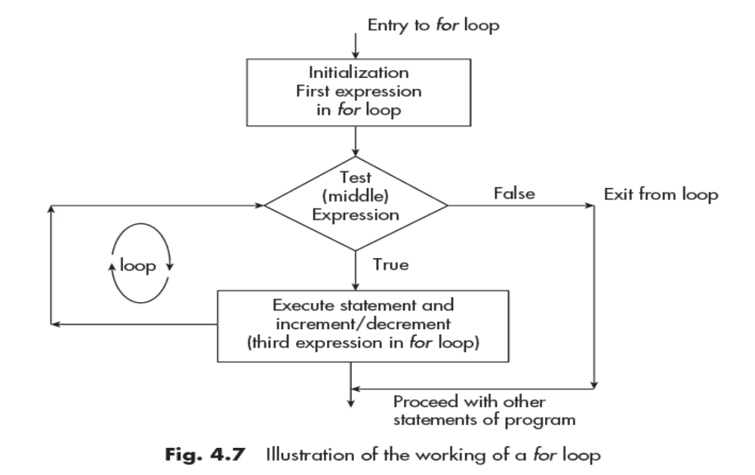
for Loop
© Oxford University Press 2018. All rights reserved.

Slide 32
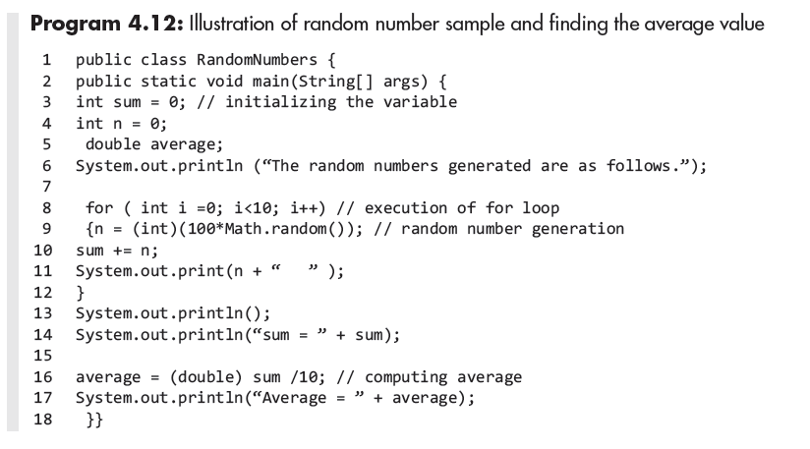
Program Example
© Oxford University Press 2018. All rights reserved.

Slide 33
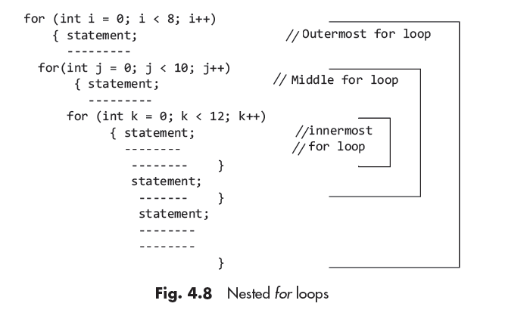
Nested for Loop
© Oxford University Press 2018. All rights reserved.

Slide 34
For-Each for Loop
The for–each loop is also called enhanced for loop.
It was introduced in Java 5 to simplify the iteration through arrays
and collections. The general form of the loop is
for(Object obj:Collection_name){Body of loop}
A
© Oxford University Press 2018. All rights reserved.

Slide 35
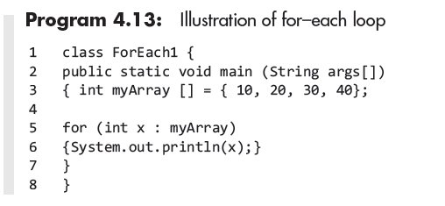
Program Example
© Oxford University Press 2018. All rights reserved.

Slide 36
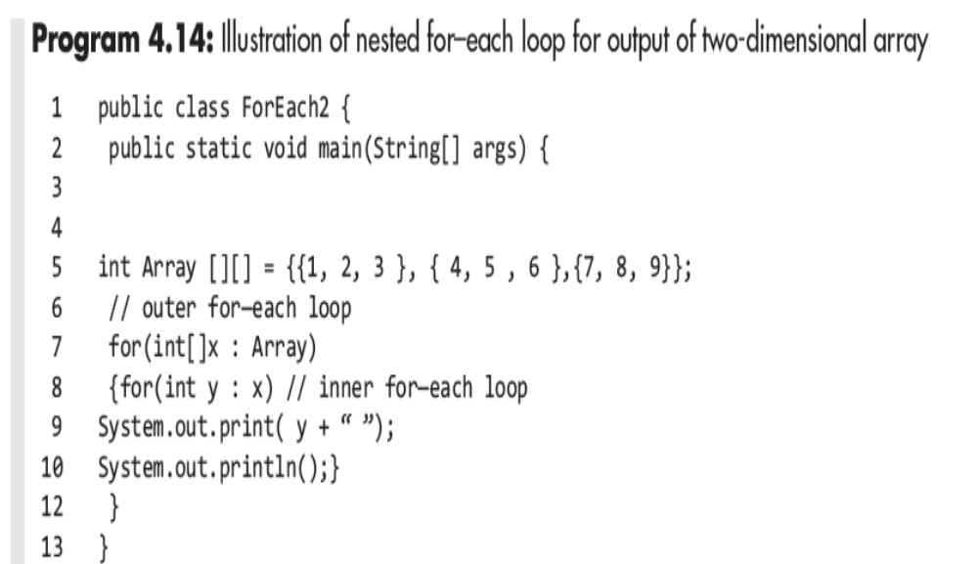
Nested for-each for Loop
© Oxford University Press 2018. All rights reserved.

Slide 37
Advantages and Limitations of for–each Loop
Advantages:
1. Less clutter in code, especially when iterators are used.
2. Less chances of errors.
3. Improves overall readability of program.
© Oxford University Press 2018. All rights reserved.

Slide 38
Advantages and Limitations of for–each Loop
Limitations:
1. It is designed to iterate in forward direction only.
2. In iteration, it takes a single step at a time.
3. It cannot simultaneously traverse multiple arrays or collections.
© Oxford University Press 2018. All rights reserved.

Slide 39
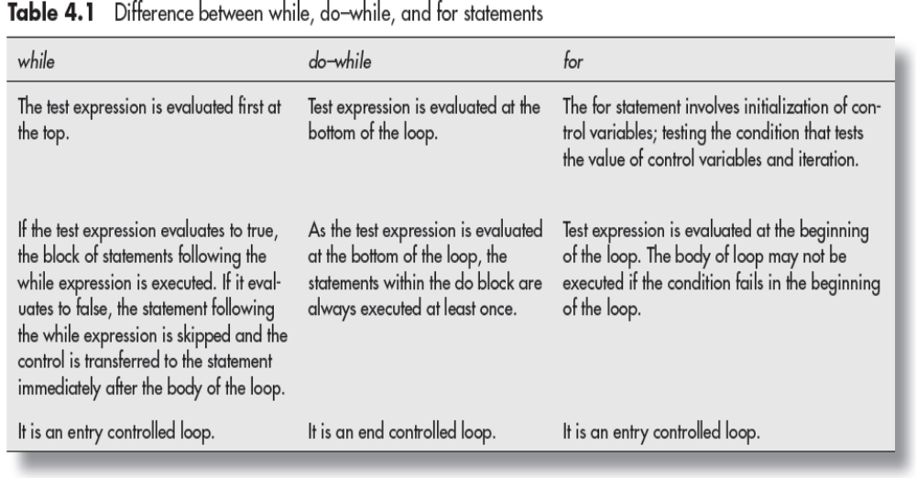
Comparison between while, do-while, for loop
© Oxford University Press 2018. All rights reserved.

Slide 40
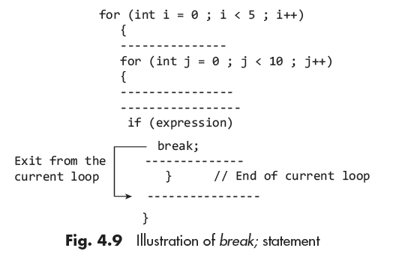
Break Statement
This is used for exiting from a loop and control goes to the end of the current loop.
© Oxford University Press 2018. All rights reserved.

Slide 41
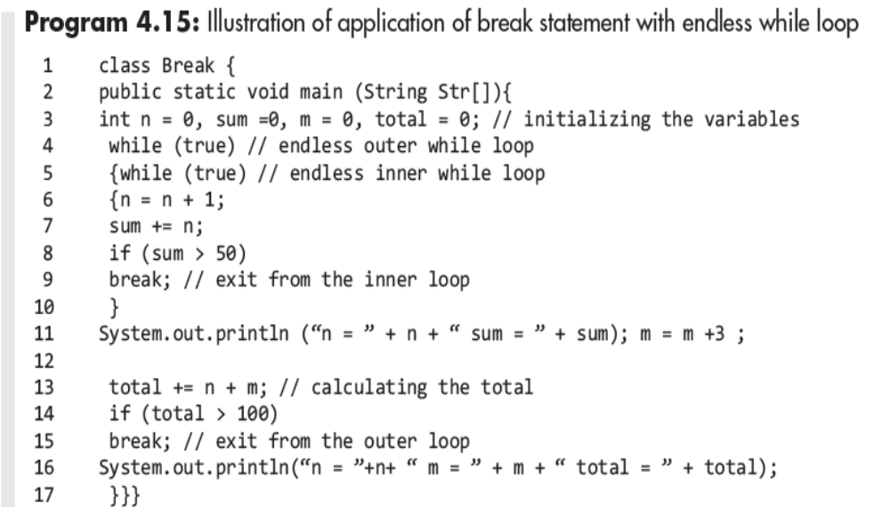
Program Example
© Oxford University Press 2018. All rights reserved.

Slide 42
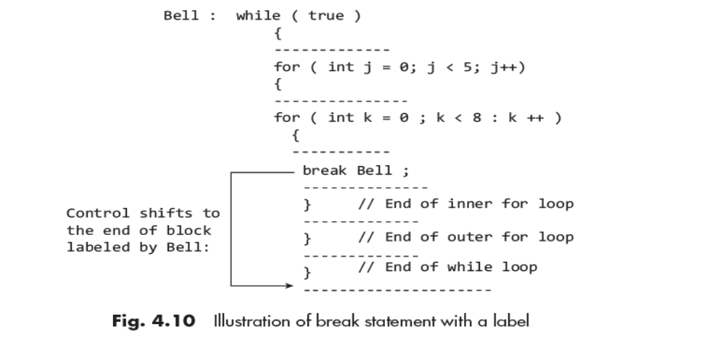
Break Statement with Labels
Break with a label statement is similar to goto statement in C++, but the implementation is different.
© Oxford University Press 2018. All rights reserved.

Slide 43
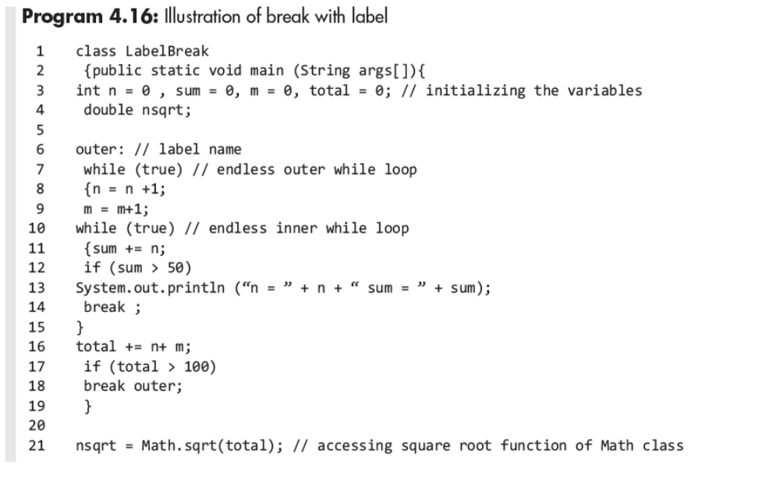
Program Example
© Oxford University Press 2018. All rights reserved.

Slide 44
Continue Statement
The statement continue is used to shift the control to the test expression and would skip the processing of the remaining statements.
© Oxford University Press 2018. All rights reserved.

Slide 45
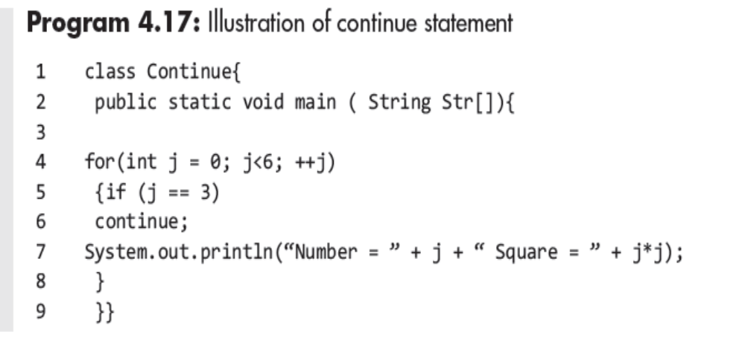
Program Example
© Oxford University Press 2018. All rights reserved.

Slide 46
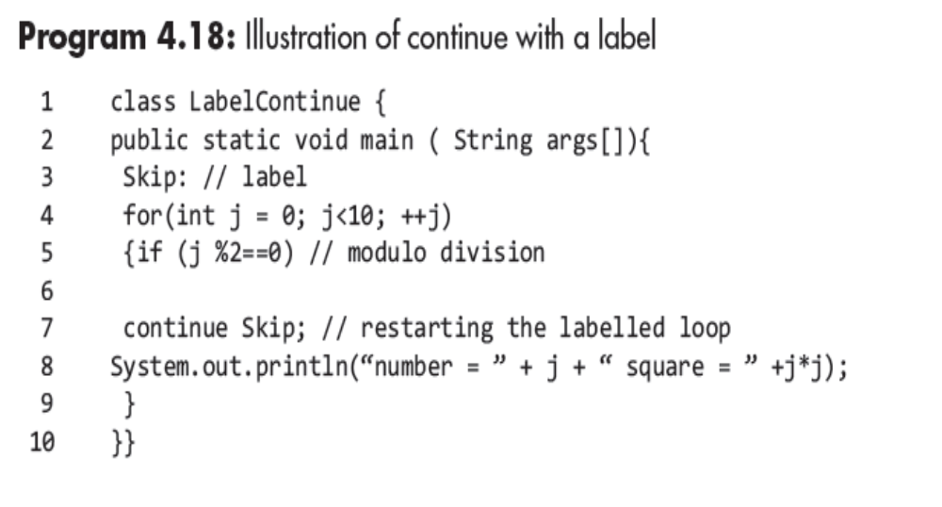
Continue Statement with Labels
© Oxford University Press 2018. All rights reserved.

Slide 47
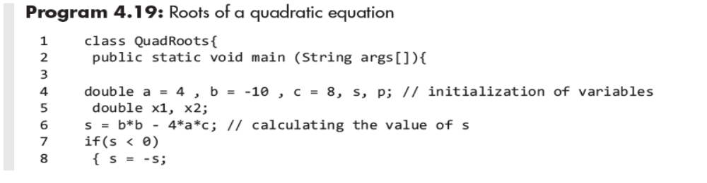
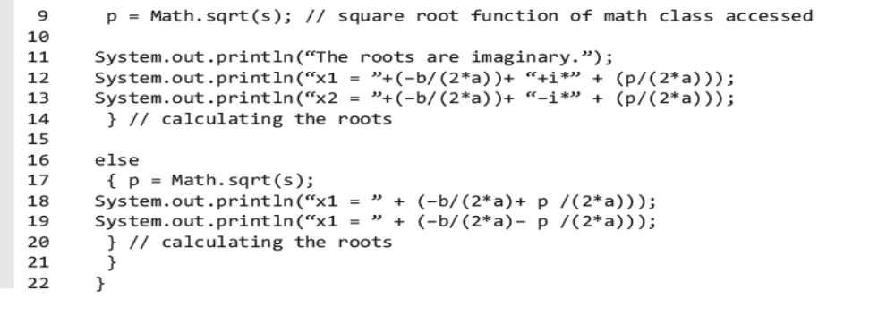
Application Program
© Oxford University Press 2018. All rights reserved.

Slide 48
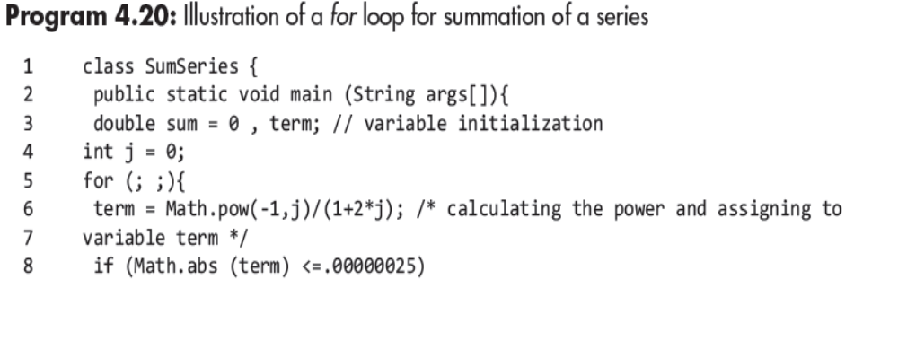
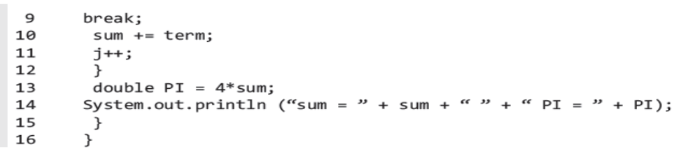
Application Program
© Oxford University Press 2018. All rights reserved.

