Slide 1
Machine Learning Metrics Examples
Mathematical Examples for
Classification & Regression

Slide 2
Classification Example Dataset
Confusion Matrix Example
TP = 50
FN = 10
FP = 5
TN = 35
Total = 100 Samples

Slide 3
Accuracy Example
Accuracy = (TP + TN) / (TP + TN + FP + FN)
= (50 + 35) / 100
= 85 / 100
= 0.85 = 85%

Slide 4
Precision Example
Precision = TP / (TP + FP)
= 50 / (50 + 5)
= 50 / 55
= 0.909 ≈ 90.9%

Slide 5
Recall Example
Recall = TP / (TP + FN)
= 50 / (50 + 10)
= 50 / 60
= 0.833 ≈ 83.3%

Slide 6
F1 Score Example
F1 = 2 * (Precision * Recall) / (Precision + Recall)
= 2 * (0.909 * 0.833) / (0.909 + 0.833)
= 0.87 ≈ 87%

Slide 7
Regression Dataset Example
Actual Vs Predicted Values
Actual: 10, 15, 20, 25
Predicted: 12, 14, 18, 30

Slide 8
MAE Example
Errors = -2, 1, 2, -5
MAE = (|−2| + |1| + |2| + |−5|) / 4
= (2+1+2+5) / 4
= 10 / 4
= 2.5

Slide 9
MSE Example
MSE = [(-2)^2 + (1)^2 + (2)^2 + (-5)^2] / 4
= (4 + 1 + 4 + 25) / 4
= 34 / 4
= 8.5

Slide 10
RMSE Example
RMSE = √8.5
= 2.91

Slide 11
R-Squared Example
Mean = 17.5
SS_res = 34
SS_tot = 125
R² = 1 − (34 / 125)
= 0.728 = 72.8%

Slide 12
Actual values (y):
10, 15, 20, 25
Predicted values (ŷ):
12, 14, 18, 30
Number of observations = 4

Slide 13
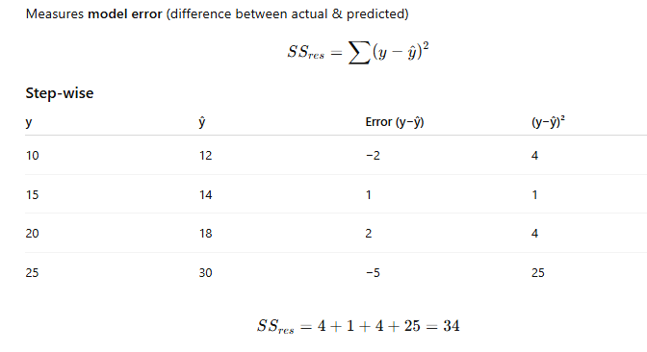
SS₍res₎ — Residual Sum of Squares

Slide 14
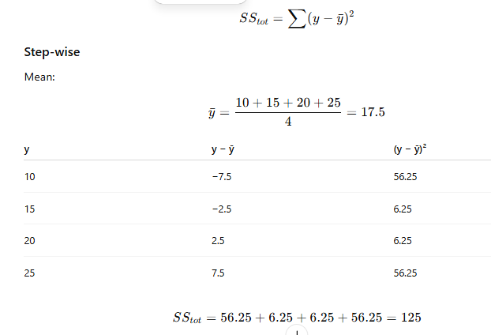
SS₍tot₎ — Total Sum of Squares
Measures total variation in actual data from the mean.

Slide 15
Final Summary
Classification: Accuracy, Precision, Recall, F1
Regression: MAE, MSE, RMSE, R²
Use appropriate metric based on use case

