Slide 1
UNIT–III
Classification: Basic Concepts, General Approach to solving a classification problem,
Decision Tree Induction: Attribute Selection Measures, Tree Pruning, Scalability and Decision Tree Induction, Visual Mining for Decision Tree Induction,
Bayesian Classification Methods: Bayes Theorem, Naïve Bayes Classification, Rule-Based Classification, Model Evaluation and Selection..

Slide 2
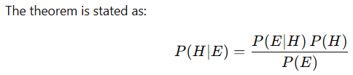
Bayes’ Theorem is a fundamental result in probability theory that describes how to update the probability of a hypothesis when given new evidence.
It provides a way to compute the posterior probability P(H∣E) of a hypothesis H, given observed evidence E, using prior knowledge.
where:
P(H∣E): Posterior probability – probability of hypothesis H given the evidence E.
P(H): Prior probability – initial probability of H before seeing the evidence.
P(E∣H): Likelihood – probability of observing evidence E given that H is true.
P(E): Marginal probability (or evidence) – total probability of observing E under all possible hypotheses.
Note: Bayes’ Theorem tells us how to revise our belief about an event or hypothesis after considering new data or evidence.

Slide 3
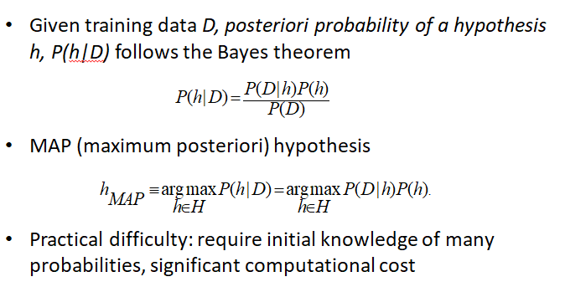
Naïve Bayes Classifier :
The naive Bayesian classifier, or simple Bayesian classifier, works as follows:

Slide 4
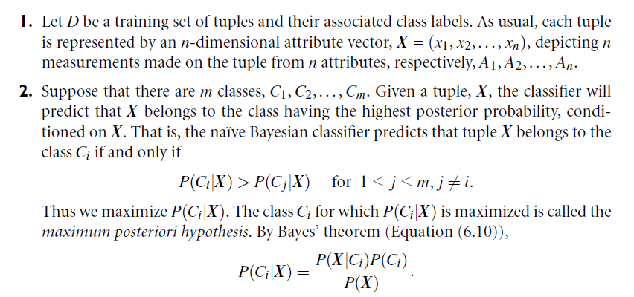

Slide 5

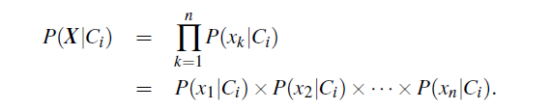

Slide 6
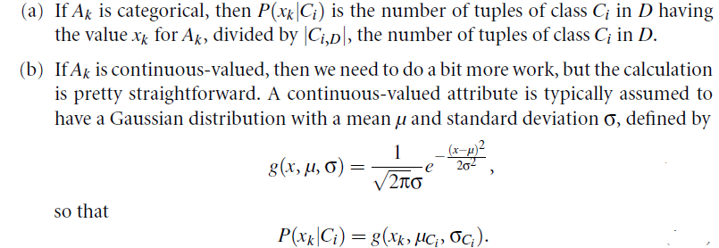

Slide 7
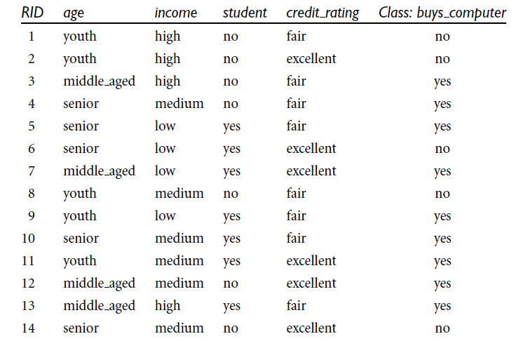

Slide 8
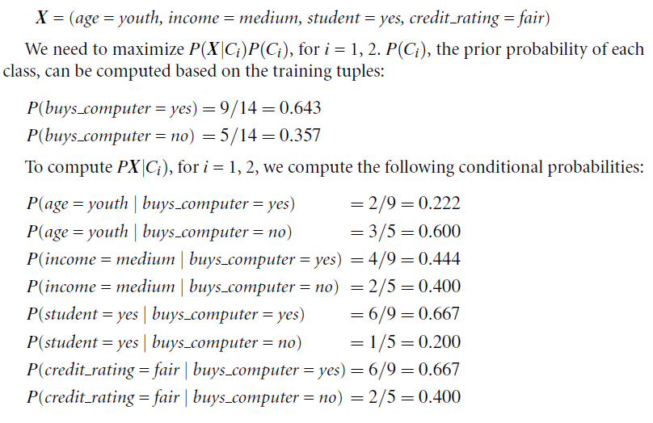

Slide 9
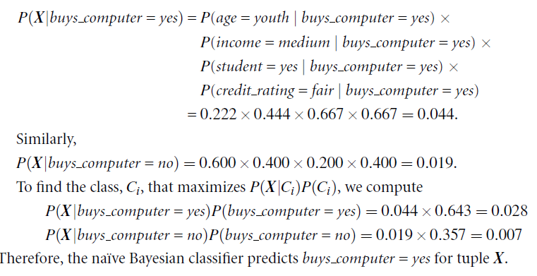

Slide 10
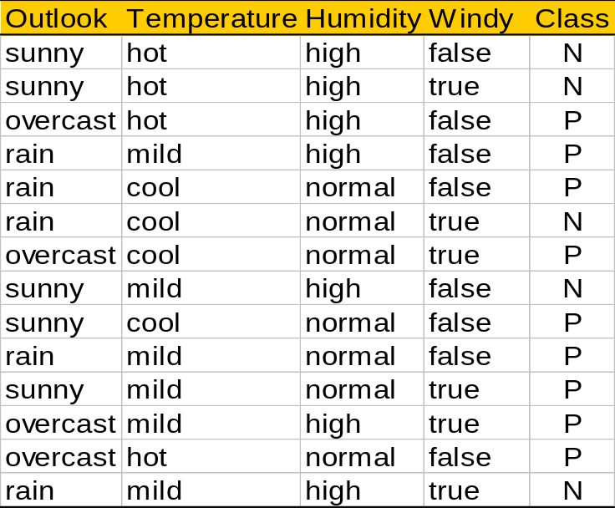
Play-tennis example: estimating P(x_{i}|C)
outlook
P(sunny|p) = 2/9 | P(sunny|n) = 3/5
P(overcast|p) = 4/9 | P(overcast|n) = 0
P(rain|p) = 3/9 | P(rain|n) = 2/5
temperature
P(hot|p) = 2/9 | P(hot|n) = 2/5
P(mild|p) = 4/9 | P(mild|n) = 2/5
P(cool|p) = 3/9 | P(cool|n) = 1/5
humidity
P(high|p) = 3/9 | P(high|n) = 4/5
P(normal|p) = 6/9 | P(normal|n) = 2/5
windy
P(true|p) = 3/9 | P(true|n) = 3/5
P(false|p) = 6/9 | P(false|n) = 2/5
P(p) = 9/14
P(n) = 5/14

Slide 11
Play-tennis example: classifying X
An unseen sample X = <rain, hot, high, false>
P(X|p)·P(p) =
P(rain|p)·P(hot|p)·P(high|p)·P(false|p)·P(p) = 3/9·2/9·3/9·6/9·9/14 = 0.010582
P(X|n)·P(n) =
P(rain|n)·P(hot|n)·P(high|n)·P(false|n)·P(n) = 2/5·2/5·4/5·2/5·5/14 = 0.018286
Sample X is classified in class n (don’t play)

