Slide 1
UNIT–III
Classification: Basic Concepts, General Approach to solving a classification problem,
Decision Tree Induction: Attribute Selection Measures, Tree Pruning, Scalability and Decision Tree Induction, Visual Mining for Decision Tree Induction,
Bayesian Classification Methods: Bayes Theorem, Naïve Bayes Classification, Rule-Based Classification, Model Evaluation and Selection.

Slide 2
BASIC CONCPETS
What Is Classification?
➔ A bank loans officer needs analysis of his/her data to learn which loan applicants are “safe” and which are “risky” for the bank.
➔ A marketing manager at All Electronics needs data analysis to help guess whether a customer with a given profile will buy a new computer.
➔ A medical researcher wants to analyze breast cancer data to predict which one of three specific treatments a patient should receive.
In each of these examples, the data analysis task is classification, where a model or classifier is constructed to predict class (categorical) labels, such as “safe” or “risky” for the loan application data; “yes” or “no” for the marketing data; or “treatment A,” “treatment B,” or “treatment C” for the medical data. These categories can be represented by discrete values, where the ordering among values has no meaning

Slide 3
Suppose that the marketing manager wants to predict how much a given customer will spend during a sale at All Electronics. This data analysis task is an example of numeric prediction, where the model constructed predicts a continuous-valued function, or ordered value, as opposed to a class label. This model is a predictor. Regression analysis is a statistical methodology that is most often used for numeric prediction

Slide 4
Introduction:
Classification is a form of data analysis that extracts models describing important data classes. Such models called classifiers, predict categorical class labels.
For example, we can build a classification model to categorize bank loan applications as either safe or risky. Such analysis can help provide us with a better understanding of the data at large.

Slide 5
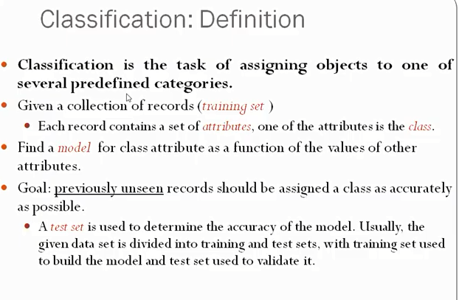

Slide 6
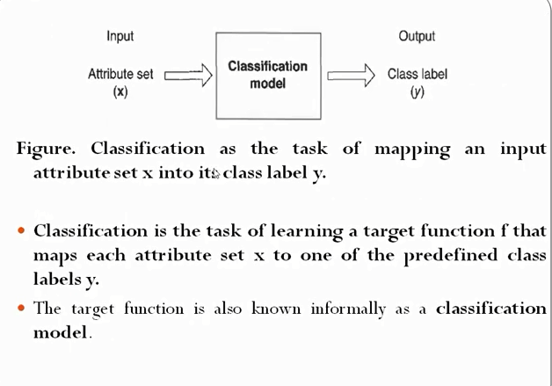

Slide 7
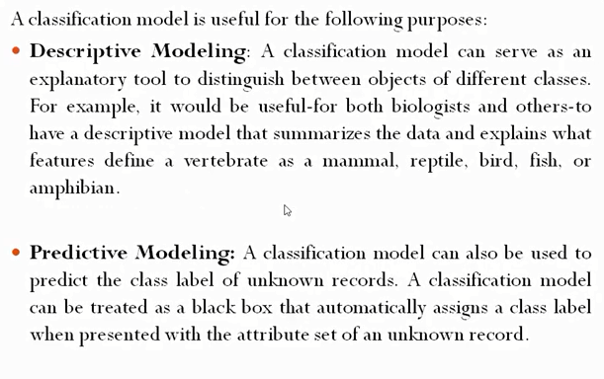

Slide 8
Animal | Has fur | Lays eggs | Lives in water | Class
Dog | Yes | No | No | Mammal
Snake | No | Yes | No | Reptile
Fish | No | Yes | Yes | Fish
Eagle | No | Yes | No | Bird
X=(fur = Yes, eggs = No, water = No)

Slide 9
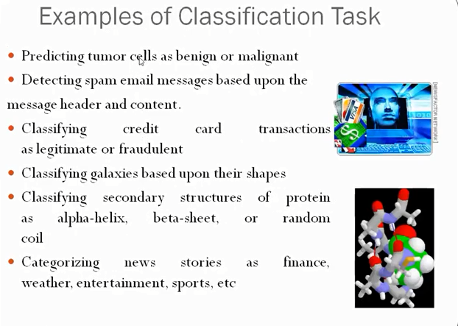

Slide 10
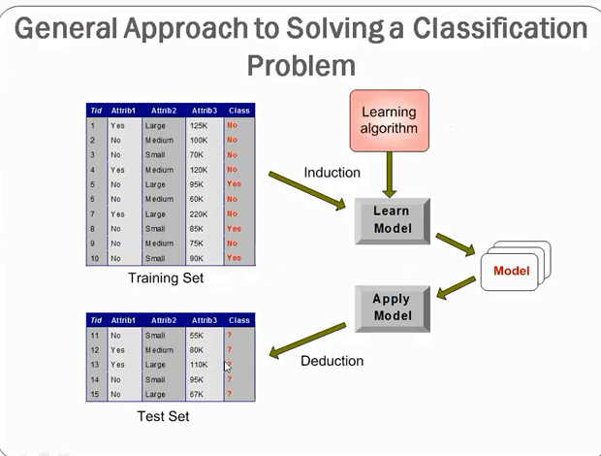

Slide 11
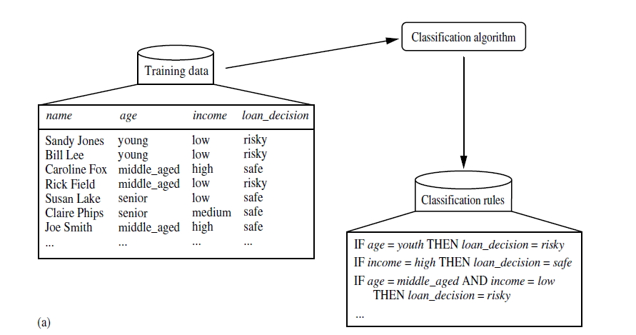

Slide 12
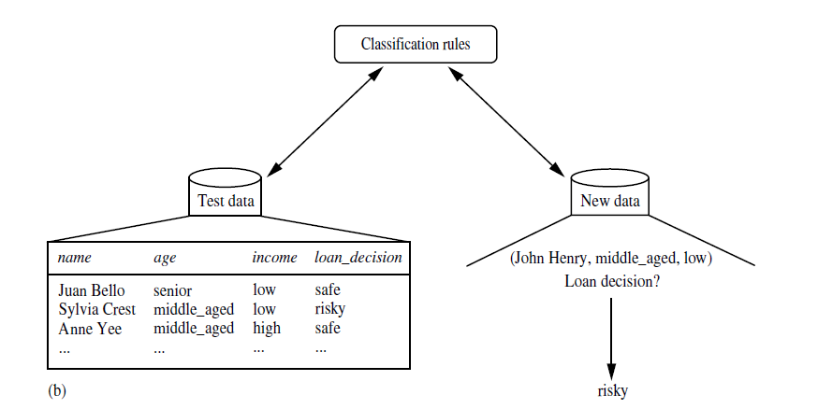

Slide 13
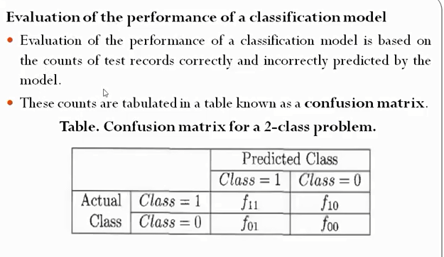

Slide 14
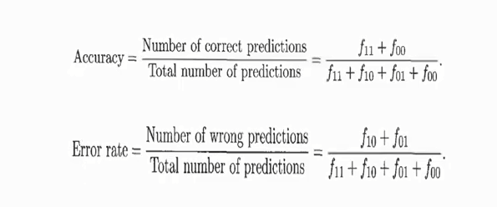

Slide 15
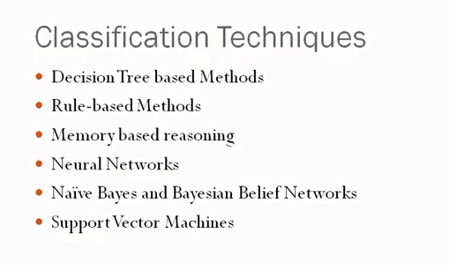

Slide 16
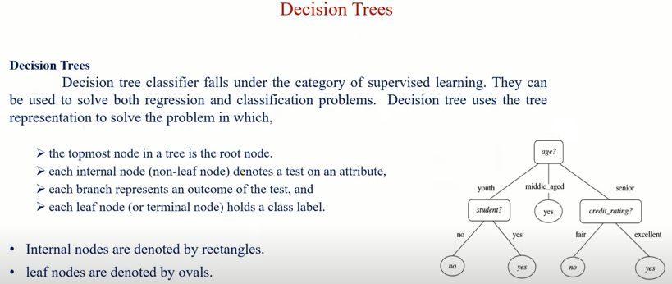

Slide 17
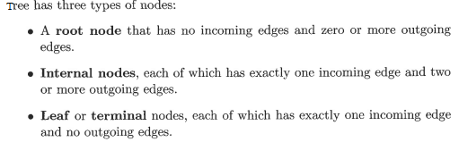
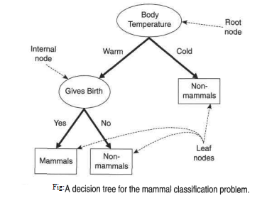


Slide 18
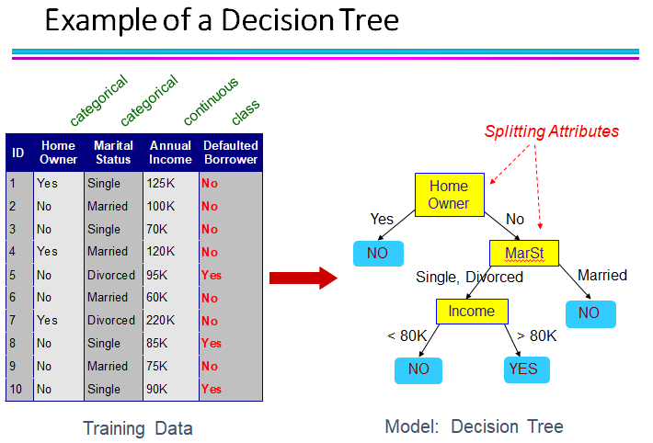

Slide 19
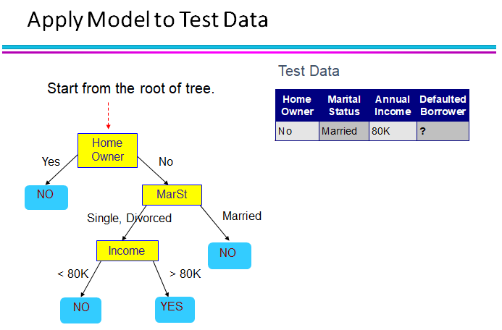

Slide 20
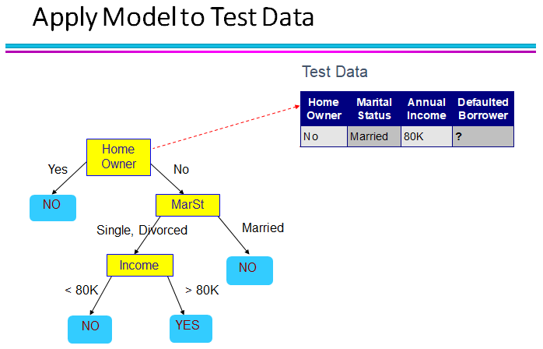

Slide 21
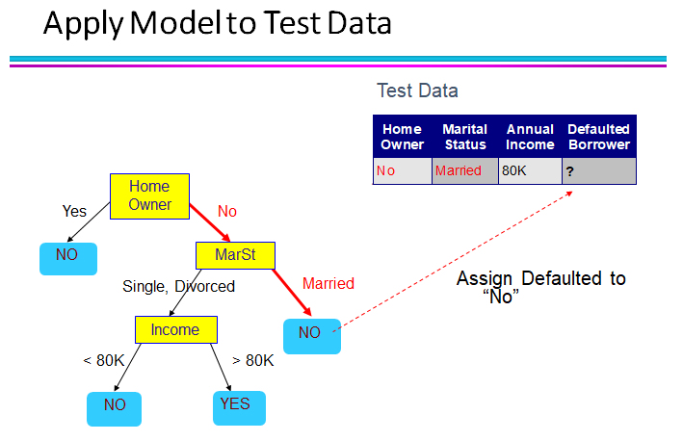

Slide 22
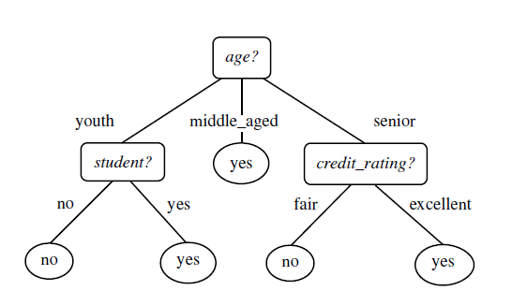
Decision Tree - Buys Computer:
A decision tree for the concept buys computer, indicating whether an AllElectronics customer is likely to purchase a computer. Each internal (non-leaf) node represents a test on an attribute. Each leaf node represents a class (either buys computer yes or buys computer no).

Slide 23
Why are decision tree classifiers so popular?
No domain knowledge is required
No complicated parameter settings
They can handle multidimensional data
Easy for humans to understand
Learning is simple and fast

Slide 24
Decision Tree Induction:
ID3(Iterative Dichotomiser), C4.5, and CART adopt a greedy (i.e., nonbacktracking) approach in which decision trees are constructed in a top-down recursive divide-and-conquer manner. Most algorithms for decision tree induction also follow a top-down approach, which starts with a training set of tuples and their associated class labels. The training set is recursively partitioned into smaller subsets as the tree is being built.
The algorithm is called with three parameters:
-- D as a data partition, it is the complete set of training tuples and their associated class labels.
--Attribute list is a list of attributes describing the tuples. and
--Attribute selection method, specifies a heuristic procedure for selecting the attribute that “best” discriminates the given tuples according to class.
This procedure employs an attribute selection measure such as information gain or the Gini index.
The tree starts as a single node, N, representing the training tuples in D (step 1)

Slide 25
Algorithm: Generate decision tree.
Generate a decision tree from the training tuples of data partition, D.
Input:
Data partition, D, which is a set of training tuples and their associated class labels;
Attribute list, the set of candidate attributes;
Attribute selection method, a procedure to determine the splitting criterion that “best” partitions the data tuples into individual classes. This criterion consists of a splitting attribute and, possibly, either a split-point or splitting subset.
Output: A decision tree.

Slide 26
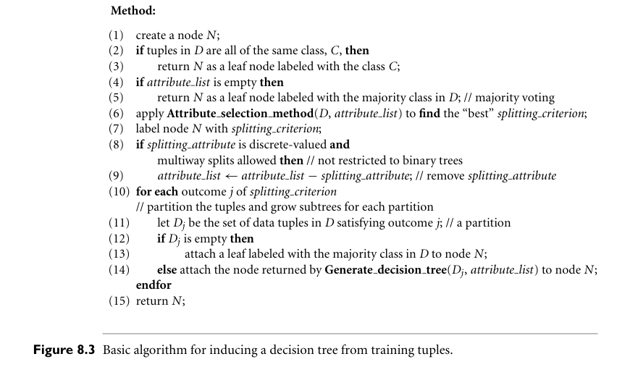

Slide 27
The tree starts as a single node, N, representing the training tuples in D (step 1)
If the tuples in D are all of the same class, then node N becomes a leaf and is labeled with that class (steps 2 and 3). Note that steps 4 and 5 are terminating conditions.
Otherwise, the algorithm calls Attribute selection method to determine the splitting criterion. The splitting criterion tells us which attribute to test at node N by determining the “best” way to separate or partition the tuples in D into individual classes (step 6).
The splitting criterion is determined so that, ideally, the resulting partitions at each branch are as “pure” as possible. A partition is pure if all the tuples in it belong to the same class.
The node N is labeled with the splitting criterion, which serves as a test at the node (step 7). A branch is grown from node N for each of the outcomes of the splitting criterion.
The tuples in D are partitioned accordingly (steps 10 to 11). There are three possible scenarios, as illustrated in Figure 8.4. Let A be the splitting attribute. A has v distinct values {a₁, a₂, , a_{v}} based on the training data.

Slide 28
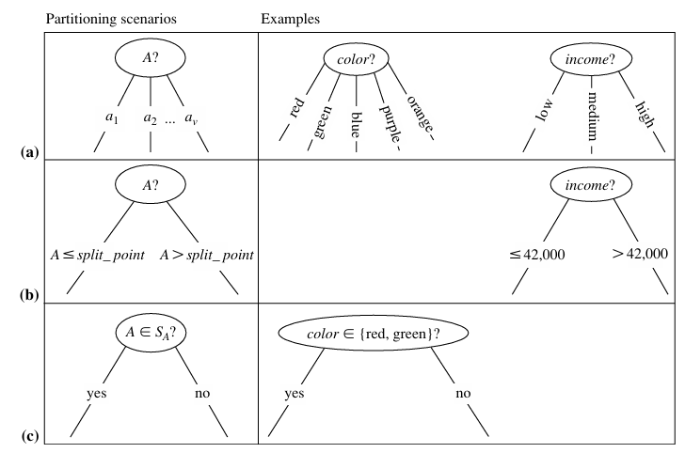
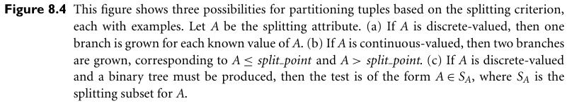

Slide 29
The algorithm uses the same process recursively to form a decision tree for the tuples at each resulting partition, Dj, of D (step 14).
The recursive partitioning stops only when any one of the following terminating conditions is true:
All the tuples in partition D (represented at node N) belong to the same class (steps 2 and 3).
There are no remaining attributes on which the tuples may be further partitioned (step 4). In this case, majority voting is employed (step 5).
There are no tuples for a given branch, that is, a partition Dj is empty (step 12). In this case, a leaf is created with the majority class in D (step 13).
The resulting decision tree is returned (step 15).

Slide 30
The computational complexity of the algorithm given training set D is O(n×|D|× log(|D|)), where n is the number of attributes describing the tuples in D and |D| is the number of training tuples in D. This means that the computational cost of growing a tree grows at most n×|D|×log(|D|) with |D| tuples.

Slide 31
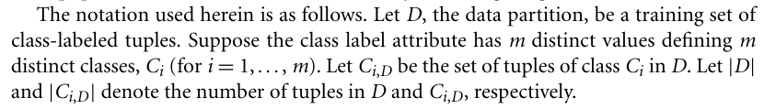
Attribute Selection Measures: An attribute selection measure is a heuristic for selecting the splitting criterion that “best” separates a given data partition, D, of class-labeled training tuples into individual classes. If we were to split D into smaller partitions according to the outcomes of the splitting criterion, ideally each partition would be pure.
Attribute selection measures are also known as splitting rules because they determine how the tuples at a given node are to be split.
There are three popular attribute selection measures—information gain, gain ratio, and Gini index.

Slide 32
Information Gain (IG)
Information Gain measures how much knowing a particular feature reduces the uncertainty about the target variable. It is commonly used in Decision Trees to decide which feature should be used for splitting the data

Slide 33
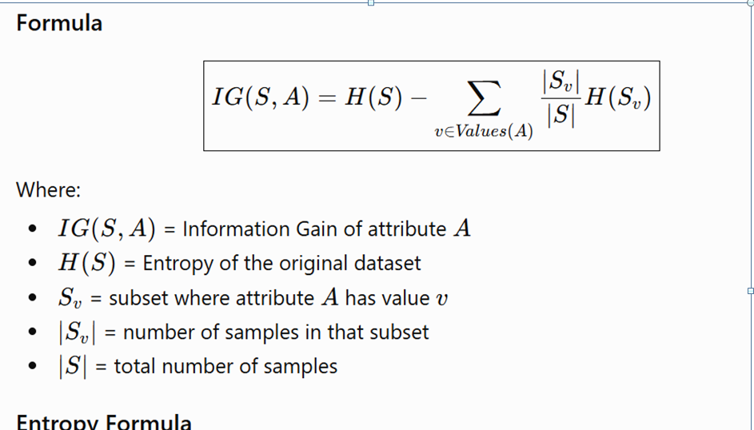

Slide 34
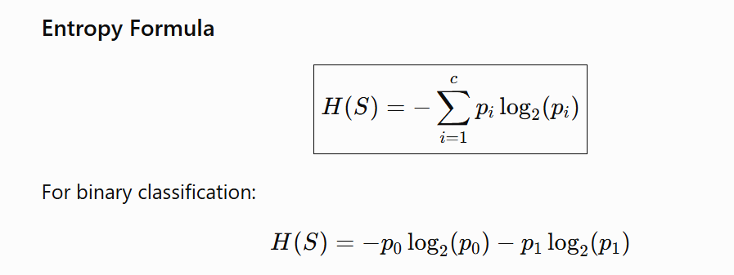

Slide 35
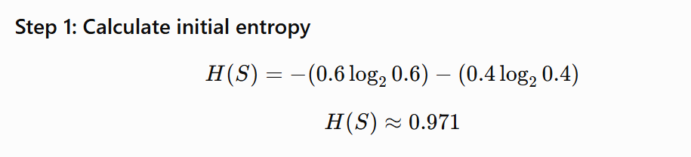

Simple Example
Suppose we have 10 students and want to predict whether they will Pass or Fail.
 |  | Pass | Fail | Total
 | Entire dataset | 6 | 4 | 10

Slide 36
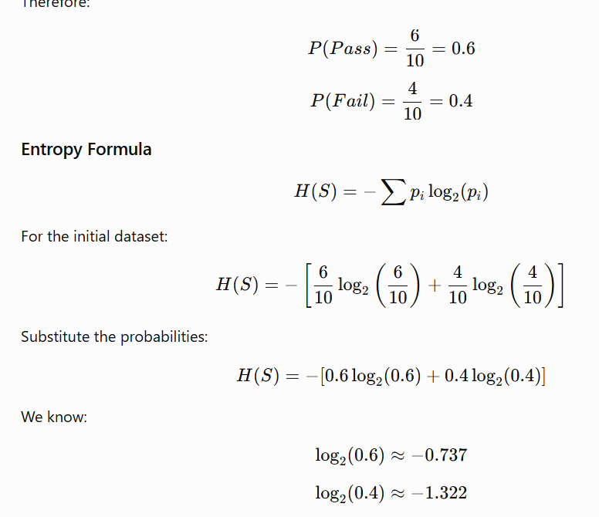
Sure. The initial dataset entropy can be calculated exactly the same way.
Initial Dataset
Suppose the complete dataset contains:
Pass = 6
Fail = 4
Total = 10
​

Slide 37
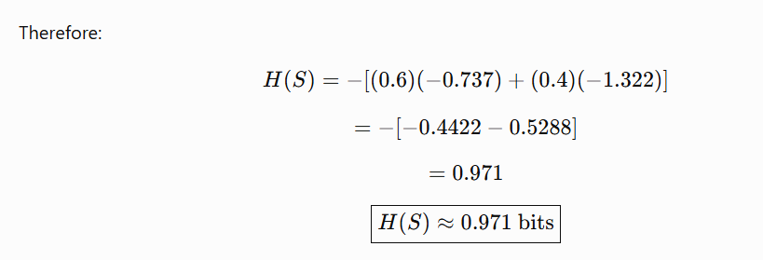

Slide 38
Now consider a feature "Study Hours", divided into:
High
Low
Study Hours | Pass | Fail | Total
High | 5 | 1 | 6
Low | 1 | 3 | 4

Slide 39
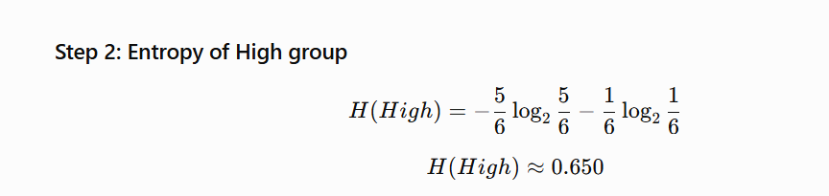
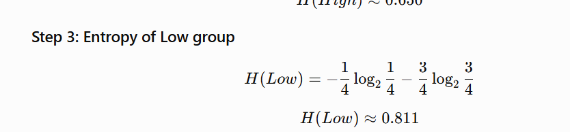

Slide 40
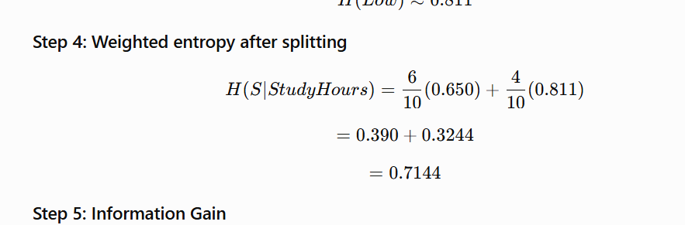

Slide 41
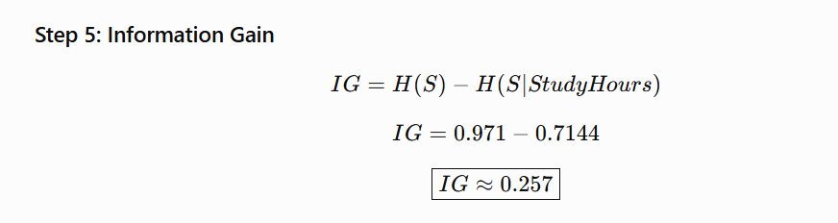
The Information Gain of Study Hours = 0.257 bits.
This means splitting the students based on Study Hours reduces the uncertainty about Pass/Fail by approximately 0.257 bits.

Slide 42
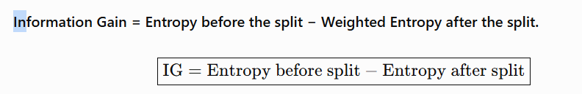

Slide 44
Information Gain – ID3 Decision Tree
ID3 uses Information Gain as its attribute selection measure.
The basic idea:
• Calculate the entropy of the original dataset.
• Calculate the weighted entropy after splitting on an attribute.
• Information Gain is the reduction in entropy.

Slide 45
1. Information / Entropy of Dataset D
Info(D) = − Σ pᵢ log₂(pᵢ)
where pᵢ is the probability that a tuple in D belongs to class Cᵢ.
For a class: pᵢ = |Cᵢ,D| / |D|

Slide 46
Example: Initial Dataset Entropy
Dataset D:
• Pass = 6
• Fail = 4
• Total = 10
P(Pass) = 6/10 = 0.6
P(Fail) = 4/10 = 0.4
Info(D) = −[0.6 log₂(0.6) + 0.4 log₂(0.4)]
Info(D) ≈ 0.971 bits

Slide 47
2. Expected Information After Splitting
Info_A(D) = Σ (|Dⱼ| / |D|) × Info(Dⱼ)
For Study Hours:
High: 6 students → Entropy = 0.650
Low: 4 students → Entropy = 0.811
Info_StudyHours(D) = (6/10)(0.650) + (4/10)(0.811)
= 0.7144

Slide 48
Entropy of the Low Study-Hours Group
Low group:
• Pass = 1
• Fail = 3
• Total = 4
P(Pass) = 1/4 = 0.25
P(Fail) = 3/4 = 0.75
Info(Low) = −[0.25 log₂(0.25) + 0.75 log₂(0.75)]
Info(Low) ≈ 0.811 bits

Slide 49
3. Information Gain
Gain(A) = Info(D) − Info_A(D)
Gain(Study Hours) = 0.971 − 0.7144
Gain(Study Hours) = 0.2566 ≈ 0.257
Interpretation: Study Hours reduces the uncertainty in classifying Pass/Fail by approximately 0.257 bits.

Slide 50
ID3 Calculation – Summary
Step 1: Calculate initial entropy
Info(D) = 0.971
Step 2: Calculate entropy of each subset
Info(High) = 0.650
Info(Low) = 0.811
Step 3: Calculate weighted entropy
Info_A(D) = 0.7144
Step 4: Calculate Information Gain
Gain(A) = 0.971 − 0.7144 = 0.257

Slide 51
Key Point
Info(D) → Entropy BEFORE the split
Info_A(D) → Weighted entropy AFTER the split
Gain(A) → Reduction in entropy
Therefore:
Gain(A) = Info(D) − Info_A(D)
In ID3, the attribute with the HIGHEST Information Gain is selected for splitting.

Slide 52
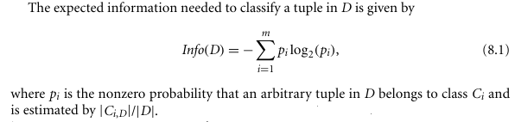
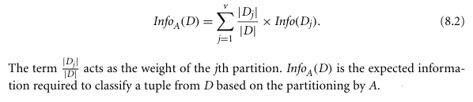
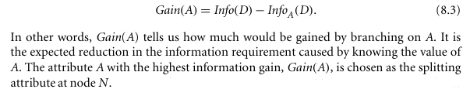
Information Gain: Info(D)/ Entropy of D
ID3 uses information gain as its attribute selection measure.

Slide 53
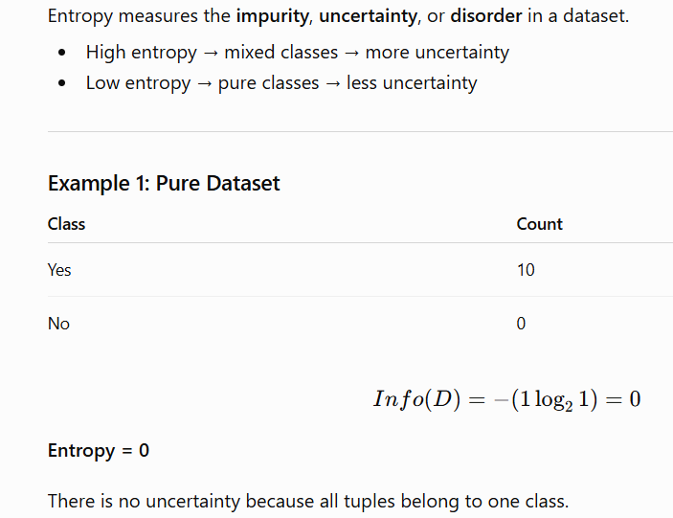
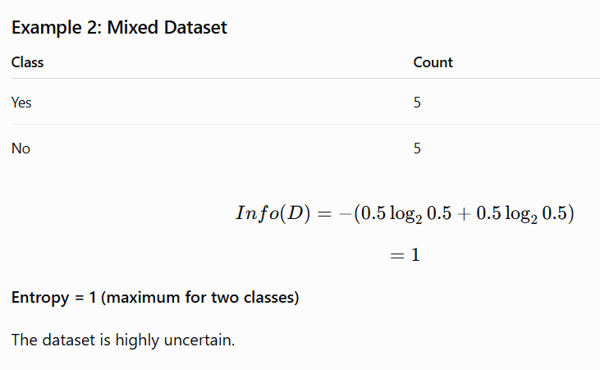
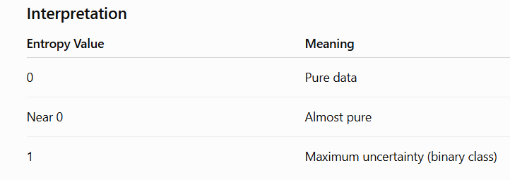

Slide 54
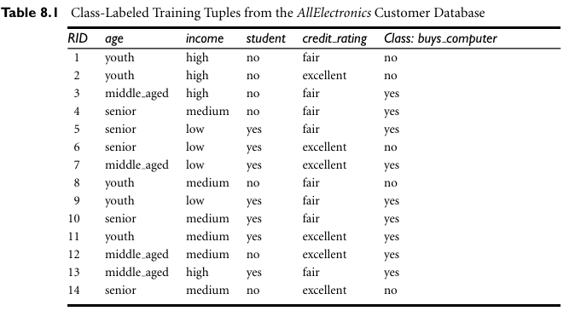

Slide 55

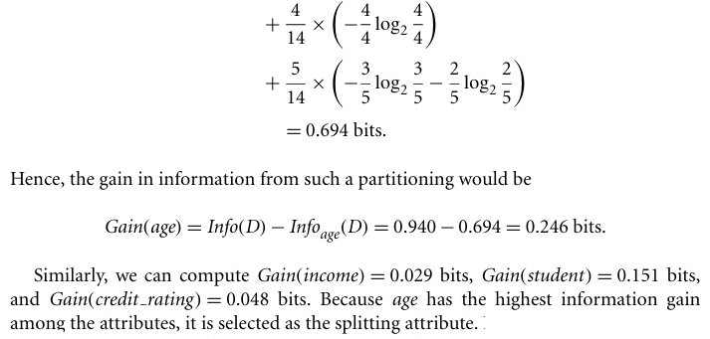

Slide 56
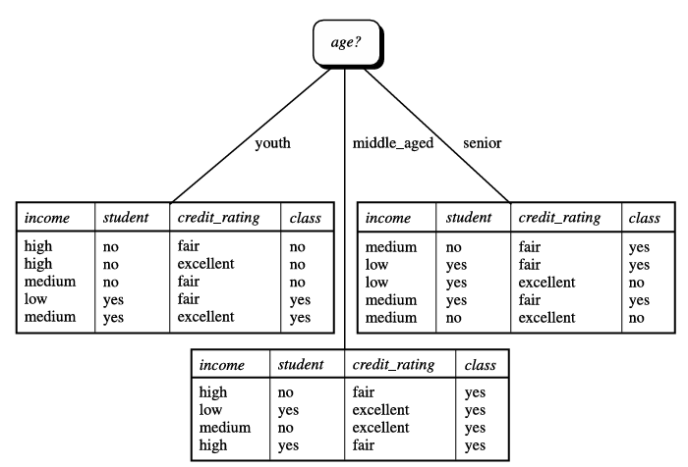

Slide 57
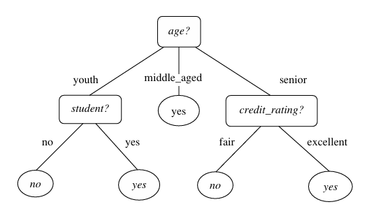

Slide 58
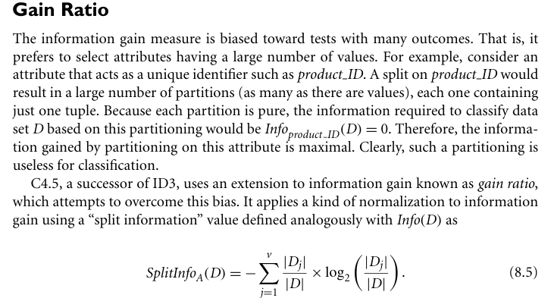

Slide 59

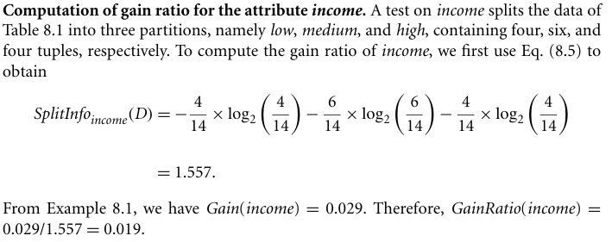

Slide 60
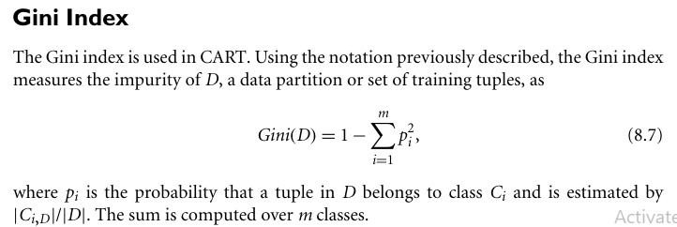

Slide 61
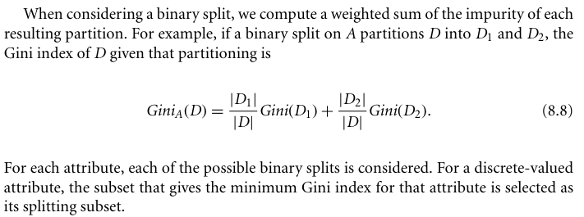

Slide 62
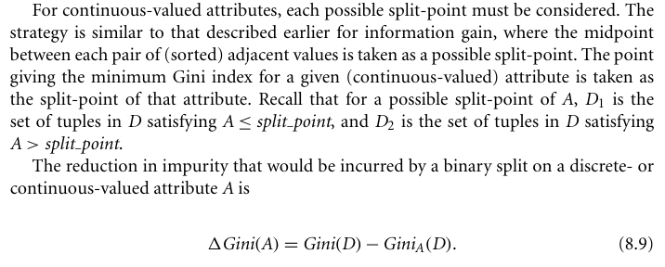
The attribute that maximizes the reduction in impurity (or, equivalently, has the minimum Gini index) is selected as the splitting attribute. This attribute and either its splitting subset (for a discrete-valued splitting attribute) or split-point (for a continuous-valued splitting attribute)together form the splitting criterion.

Slide 63
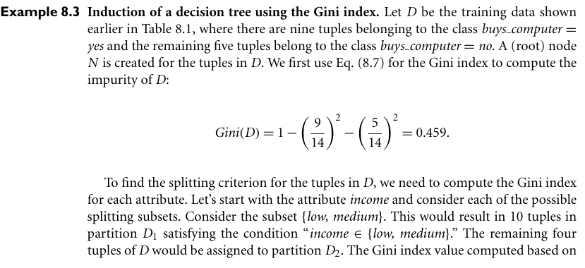

Slide 64

Information gain from above table:
The class label attribute, buys computer, has two distinct values(namely, yes, no); therefore, there are two distinct classes(i.e.,m=2). Let class C₁ correspond to yes and classC₂ correspond to no. There are nine tuples of class yes and five tuples of class no. A(root) node N is created for the tuples in D. To find the splitting criterion for these tuples, we must compute the information gain of each attribute.
Next, we need to compute the expected information requirement for each attribute.
Let’s start with the attribute age:
We need to look at the distribution of yes and no tuples for each category of age.
For the age category “youth”: 2-yes tuples and 3-no tuples.
For the category “middle aged,” : 4-yes tuples and 0-no tuples.
For the category “senior,” : 3-yes tuples and 2-no tuples.

Slide 65
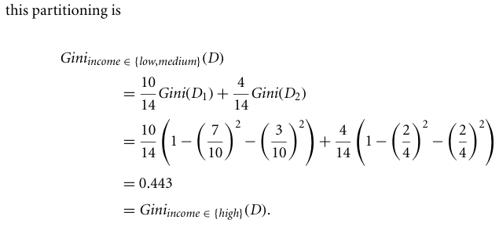
Similarly, the Gini index values for splits on the remaining subsets are 0.458 (for the sub sets low, high and medium) and 0.450 (for the subsets medium, high and low). Therefore, the best binary split for attribute income is on low, medium (or high) because it minimizes the Gini index. Evaluating age, we obtain {youth, senior} (or {middle aged}) as the best split for age with a Gini index of 0.357; the attributes student and credit rating are both binary, with Gini index values of 0.367 and 0.429, respectively.

Slide 66
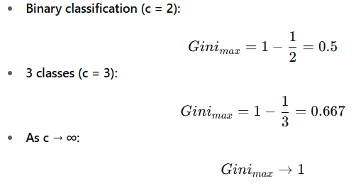

The attribute age and splitting subset youth, senior therefore give the minimum Gini index overall, with a reduction in impurity of:
0.459 - 0.357 = 0.102.
The binary split “age belongs to {youth, senior?}” results in the maximum reduction in impurity of the tuples in D and is returned as the splitting criterion. Node N is labeled with the criterion, two branches are grown from it, and the tuples are partitioned accordingly.

Slide 67

Computing Gini Index of a Single Node:
P(C1) = 0/6 = 0 P(C2) = 6/6 = 1
Gini = 1 – P(C1)² – P(C2)² = 1 – 0 – 1 = 0
P(C1) = 1/6 P(C2) = 5/6
Gini = 1 – (1/6)² – (5/6)² = 0.278
P(C1) = 2/6 P(C2) = 4/6
Gini = 1 – (2/6)² – (4/6)² = 0.444
P(C1) = 3/6 P(C2) = 3/6
Gini = 1 – (3/6)² – (3/6)² = 0.50

Slide 68
Information Gain (IG): Used in ID3 algorithm.
Works with multiway splits
Not inherently binary. However, it can be adapted to binary splits if the algorithm enforces it (like C4.5 or CART can).
Gain Ratio (GR): Used in C4.5 algorithm.
Works with multiway splits naturally.
Not inherently binary, though it can be constrained to binary splits if the implementation requires.
Gini Index: Used in CART (Classification and Regression Trees).
By design, CART uses binary splits only (i.e., every node splits into exactly 2 branches).
So, when Gini index is used, the splitting is always binary.
Note:
Information Gain and Gain Ratio → Can handle multiway splits (not strictly binary).
Gini Index → Is binary by design (used in CART).

Slide 69
Tree Pruning:
When a decision tree is built, many of the branches will reflect anomalies in the training data due to noise or outliers. Tree pruning methods address this problem of overfitting the data.
An unpruned tree and a pruned version of it are shown in Figure 8.6. Pruned trees tend to be smaller and less complex and, thus, easier to comprehend.
There are two common approaches to tree pruning: prepruning and postpruning.
In the prepruning approach, a tree is “pruned” by halting its construction early. Upon halting, the node becomes a leaf. The leaf may hold the most frequent class among the subset tuples or the probability distribution of those tuples.

Slide 70
When constructing a tree, measures such as statistical significance, information gain, Gini index, and so on, can be used to assess the goodness of a split. If partitioning the tuples at a node would result in a split that falls below a prespecified threshold, then further partitioning of the given subset is halted.
The second and more common approach is postpruning, which removes subtrees from a “fully grown” tree. A subtree at a given node is pruned by removing its branches and replacing it with a leaf. The leaf is labeled with the most frequent class among the subtree being replaced.
Ex: “A3?” in the unpruned tree of Figure 8.6.
Suppose that the most common class within this subtree is “class B.” In the pruned version of the tree, the subtree in question is pruned by replacing it with the leaf “class B.”

Slide 71


Slide 72
The cost complexity pruning algorithm used in CART is an example of the postpruning approach. This approach considers the cost complexity of a tree to be a function of the number of leaves in the tree and the error rate of the tree. It starts from the bottom of the tree. For each internal node, N, it computes the cost complexity of the subtree at N, and the cost complexity of the subtree at N if it were to be pruned (i.e., replaced by a leaf node). The two values are compared. If pruning the subtree at node N would result in a smaller cost complexity, then the subtree is pruned. Otherwise, it is kept.

Slide 73
C4.5 uses a method called pessimistic pruning, which is similar to the cost complexity method in that it also uses error rate estimates to make decisions regarding subtree pruning. Pessimistic pruning, however, does not require the use of a prune set. Instead, it uses the training set to estimate error rates. Recall that an estimate of accuracy or error based on the training set is overly optimistic and, therefore, strongly biased. The pessimistic pruning method therefore adjusts the error rates obtained from the training set by adding a penalty, so as to counter the bias incurred.
Rather than pruning trees based on estimated error rates, we can prune trees based on the number of bits required to encode them. The “best” pruned tree is the one that minimizes the number of encoding bits. This method adopts the MDL principle.
Alternatively, prepruning and postpruning may be interleaved for a combined approach. Postpruning requires more computation than prepruning, yet generally leads to a more reliable tree. No single pruning method has been found to be superior over all others.

Slide 74
Although pruned trees tend to be more compact than their unpruned counterparts, they may still be rather large and complex. Decision trees can suffer from repetition and replication (Figure 8.7), making them overwhelming to interpret. Repetition occurs when an attribute is repeatedly tested along a given branch of the tree (e.g., “age < 60?,” followed by “age < 45?,” and so on). In replication, duplicate subtrees exist within the tree. These situations can impede the accuracy and comprehensibility of a decision tree. The use of multivariate splits (splits based on a combination of attributes) can prevent these problems.
Another approach is to use a different form of knowledge representation, such as rules, instead of decision trees, which shows how a rule-based classifier can be constructed by extracting IF-THEN rules from a decision tree.

Slide 75


Figure 8.7 An example of: (a) subtree repetition, where an attribute is repeatedly tested along a given branch of the tree (e.g., age) and (b) subtree replication, where duplicate subtrees exist within a tree (e.g., the subtree headed by the node “credit rating?”).

Slide 76
Scalability and Decision Tree Induction:
“What if D, the disk-resident training set of class-labeled tuples, does not fit in memory? In other words, how scalable is decision tree induction?” The efficiency of existing decision tree algorithms, such as ID3, C4.5, and CART, has been well established for relatively small datasets. Efficiency becomes an issue of concern when these algorithms are applied to the mining of very large real-world databases. The pioneering decision tree algorithms that we have discussed so far have the restriction that the training tuples should reside in memory.
In data mining applications, very large training sets of millions of tuples are common. Most often, the training data will not fit in memory! Therefore, decision tree construction becomes inefficient due to swapping of the training tuples in and out of main and cache memories.

Slide 77
Several scalable decision tree induction methods have been introduced in recent studies. RainForest, for example, adapts to the amount of main memory available and applies to any decision tree induction algorithm. The method maintains an AVC-set (where “AVC” stands for “Attribute-Value, Class label”) for each attribute, at each tree node, describing the training tuples at the node. The AVC-set of an attribute A at node N gives the class label counts for each value of A for the tuples at N. Figure 8.8 shows AVC sets for the tuple data of Table 8.1. The set of all AVC-sets at a node N is the AVC-group of N. The size of an AVC-set for attribute A at node N depends only on the number of distinct values of A and the number of classes in the set of tuples at N. Typically, this size should fit in memory, even for real-world data.
BOAT (Bootstrapped Optimistic Algorithm for Tree construction) is a decision tree algorithm that takes a completely different approach to scalability—it is not based on the use of any special data structures. Instead, it uses a statistical technique known as “bootstrapping” (Section 8.5.4) to create several smaller samples (or subsets) of the given training data, each of which fits in memory.

Slide 78

Each subset is used to construct a tree, resulting in several trees. The trees are examined and used to construct a new tree, T¹, that turns out to be “very close” to the tree that would have been generated if all the original training data had fit in memory.
Figure 8.8 The use of data structures to hold aggregate information regarding the training data (e.g., these AVC-sets describing Table 8.1’s data) are one approach to improving the scalability of decision tree induction.

Slide 79
BOAT can use any attribute selection measure that selects binary splits and that is based on the notion of purity of partitions such as the Gini index. BOAT uses a lower bound on the attribute selection measure to detect if this “very good” tree, T¹, is different from the “real” tree, T, that would have been generated using all of the data. It refines T¹ to arrive at T.
BOAT usually requires only two scans of D. This is quite an improvement, even in comparison to traditional decision tree algorithms (e.g., the basic algorithm in Figure 8.3), which require one scan per tree level! BOAT was found to be two to three times faster than RainForest, while constructing exactly the same tree. An additional advantage of BOAT is that it can be used for incremental updates. That is, BOAT can take new insertions and deletions for the training data and update the decision tree to reflect these changes, without having to reconstruct the tree from scratch.

Slide 80
Visual Mining for Decision Tree Induction:
“Are there any interactive approaches to decision tree induction that allow us to visual ize the data and the tree as it is being constructed?
Perception-based classification (PBC) is an interactive approach based on multidimensional visualization techniques and allows the user to incorporate background knowledge about the data when building a decision tree. By visually interacting with the data, the user is also likely to develop a deeper understanding of the data. The resulting trees tend to be smaller than those built using traditional decision tree induction methods and so are easier to interpret, while achieving about the same accuracy.
“How can the data be visualized to support interactive decision tree construction?” PBC uses a pixel-oriented approach to view multidimensional data with its class label information. The circle segments approach is adapted, which maps d-dimensional data objects to a circle that is partitioned into d segments, each representing one attribute.

Slide 81
The PBC system displays a split screen, consisting of a Data Interaction window and a Knowledge Interaction window (Figure 8.9). The Data Interaction window displays the circle segments of the data under examination, while the Knowledge Interaction window displays the decision tree constructed so far. Initially, the complete training set is visualized in the Data Interaction window, while the Knowledge Interaction window displays an empty decision tree.
A tree is interactively constructed as follows. The user visualizes the multidimensional data in the Data Interaction window and selects a splitting attribute and one or more split-points. The current decision tree in the Knowledge Interaction window is expanded. The user selects a node of the decision tree. The user may either assign a class label to the node (which makes the node a leaf) or request the visualization of the train ing data corresponding to the node. This leads to a new visualization of every attribute except the ones used for splitting criteria on the same path from the root. The interactive process continues until a class has been assigned to each leaf of the decision tree.

Slide 82

Figure 8.9 A screenshot of PBC, a system for interactive decision tree construction. Multidimensional training data are viewed as circle segments in the Data Interaction window (left). The Know ledge Interaction window (right) displays the current decision tree. Source: From Ankerst, Elsen, Ester, and Kriegel [AEEK99].

