Slide 1
UNIT–III
Classification: Basic Concepts, General Approach to solving a classification problem,
Decision Tree Induction: Attribute Selection Measures, Tree Pruning, Scalability and Decision Tree Induction, Visual Mining for Decision Tree Induction,
Bayesian Classification Methods: Bayes Theorem, Naïve Bayes Classification, Rule-Based Classification, Model Evaluation and Selection.

Slide 2
Rule-Based Classification
Here, we look at rule-based classifiers, where the learned model is represented
as a set of IF-THEN rules. We first examine how such rules are used for classification. We then study ways in which they can be generated, either from a decision
tree or directly from the training data using a sequential covering algorithm.
Using IF-THEN Rules for Classification
Rules are a good way of representing information or bits of knowledge. A rule-based classifier uses a set of IF-THEN rules for classification. An IF-THEN rule is an expression of the form:
IF condition THEN conclusion.
An example is rule R1,
R1: IF age =youth AND student =yes THEN buys computer =yes.
The “IF” part (or left side) of a rule is known as the rule antecedent or precondition. The “THEN” part (or right side) is the rule consequent. In the rule antecedent, the condition consists of one or more attribute tests (e.g., age=youth and student =yes) that are logically ANDed.

Slide 3
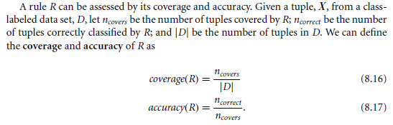
R1 can also be written as:
If the condition in a rule antecedent holds true for a given tuple, we say that the rule antecedent is satisfied and that the rule covers the tuple.
That is, a rule’s coverage is the percentage of tuples that are covered by the rule. For a rule’s accuracy, gives what percentage of them the rule can correctly classify.

Slide 4
Ex: Rule accuracy and coverage. Let’s take data in Table 8.1. (AllElectronics customer database). Consider rule R1, which covers 2 of the 14 tuples. It can correctly classify both tuples. Therefore:
coverage(R1)= 2/14 = 14.28% and accuracy(R1)=2/2=100%.
Suppose we have
X= (age = youth, income = medium, student = yes, credit rating = fair).
We would like to classify X according to buys computer= X satisfies R1, which triggers the rule. If R1 is the only rule satisfied, then the rule fires by returning the class prediction for X.
If more than one rule is triggered, we need a conflict resolution strategy to figure out which rule gets to fire and assign its class prediction to X. Possible strategies are:
size ordering and rule ordering

Slide 5
The size ordering scheme assigns the highest priority to the triggering rule that has the “toughest” requirements, where toughness is measured by the rule antecedent size. That is, the triggering rule with the most attribute tests is fired.
With rule-based ordering, the rules are organized into one long priority list, according to some measure of rule quality, such as accuracy, coverage, or size, or based on advice from domain experts. When rule ordering is used, the rule set is known as a decision list. With rule ordering, the triggering rule that appears earliest in the list has the highest priority, and so it gets to fire its class prediction. Any other rule that satisfies X is ignored.
Rule Extraction from a Decision Tree:
To extract rules from a decision tree, one rule is created for each path from the root to a leaf node. Each splitting criterion along a given path is logically ANDed to form the rule antecedent (“IF” part). The leaf node holds the class prediction, forming the rule class prediction, forming the rule consequent (“THEN” part).

Slide 6
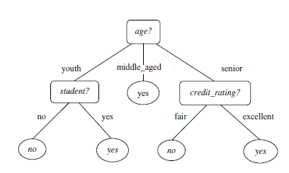
Extracting classification rules from a decision tree:
R1: IF age = youth AND student = no THEN buys computer = no
R2: IF age = youth AND student = yes THEN buys computer = yes
R3: IF age = middle aged THEN buys computer = yes
R4: IF age = senior AND credit rating = excellent THEN buys computer = yes
R5: IF age = senior AND credit rating = fair THEN buys computer = no

Slide 7
Rule Induction Using a Sequential Covering Algorithm:
The general strategy is as follows. Rules are learned one a time. Each time a rule is learned, the tuples covered by the rule are removed, and the process repeats on the remaining tuples. This sequential learning of rules is in contrast to decision tree induction. Because the path to each leaf in a decision tree corresponds to a rule, we can consider decision tree induction as learning a set of rules simultaneously.
“How are rules learned?”
Rules are grown in a general-to-specific manner and process is as follows:
We start off with an empty rule and then gradually keep appending attribute tests to it. We append by adding the attribute test as a logical conjunct to the existing condition of the rule antecedent. Suppose our training set, D, consists of loan application data. Attributes regarding each applicant include their age, income, education level, residence, credit rating, and the term of the loan. The classifying attribute is loan decision, which indicates whether a loan is accepted or rejected. To learn a rule for the class “accept,” we start off with the most general rule possible, that is, the condition of the rule antecedent is empty. The rule is
IF THEN loan decision = accept.

Slide 8
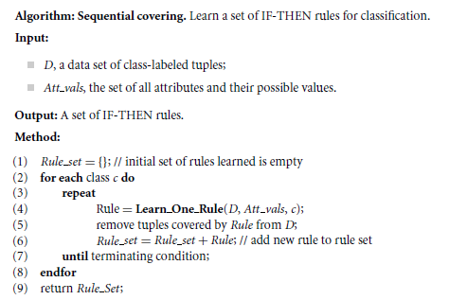

Slide 9
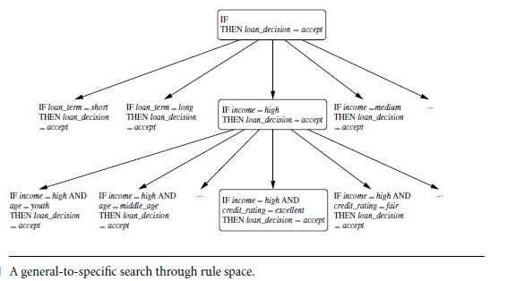

Slide 10
Suppose Learn One Rule finds that the attribute test income = high best improves the accuracy of our current (empty) rule. We append it to the condition, so that the current rule becomes
IF income = high THEN loan decision = accept.
Each time we add an attribute test to a rule, the resulting rule should cover relatively more of the “accept” tuples. During the next iteration, we again consider the possible attribute tests and end up selecting credit rating D excellent. Our current rule grows to become
IF income = high AND credit rating = excellent THEN loan decision = accept.
The process repeats, where at each step we continue to greedily grow rules until the resulting rule meets an acceptable quality level.

Slide 11
Rule Quality Measures:
Learn One Rule needs a measure of rule quality. Every time it considers an attribute test, it must check to see if appending such a test to the current rule’s condition will result in an improved rule.
Ex: Choosing between two rules based on accuracy. Consider the two rules as illustrated in Figure 8.12. Both are for the class loan decision = accept. We use “a” to represent the tuples of class “accept” and “r” for the tuples of class “reject.” Rule R1 correctly classifies 38 of the 40 tuples it covers. Rule R2 covers only two tuples, which it correctly classifies. Their respective accuracies are 95% and 100%. Thus, R2 has greater accuracy than R1, but it is not the better rule because of its small coverage.
Suppose we are learning rules for the class c. Our current rule is R: IF condition THEN class = c. We want to see if logically ANDing a given attribute test to condition would result in a better rule. We call the new condition, condition¹, where R¹: IF condition¹ THEN class = c is our potential new rule. In other words, we want to see if R¹ is any better than R.

Slide 12
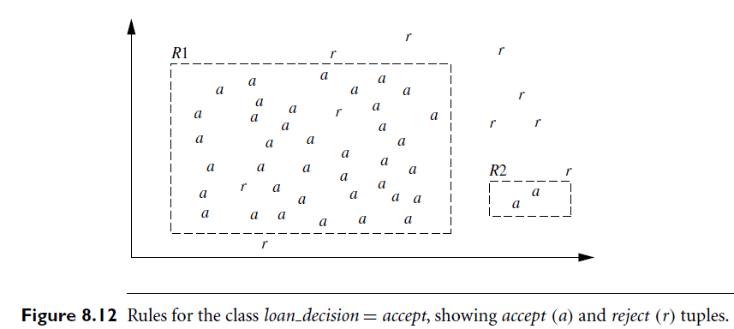

Slide 13

Another measure is based on information gain and was proposed in FOIL (First Order Inductive Learner), a sequential covering algorithm that learns first-order login rules. In machine learning, the tuples of the class for which we are learning rules are called positive tuples, while the remaining tuples are negative. Let pos (neg) be the number of positive (negative) tuples covered by R. Let pos¹ (neg¹) be the number of positive (negative) tuples covered by R¹. FOIL assesses the information gained by extending condition¹ as:
It favors rules that have high accuracy and cover many positive tuples.
We can also use a statistical test of significance to determine if the apparent effect of a rule is not attributed to chance but instead indicates a genuine correlation between attribute values and classes. The test compares the observed distribution among classes of tuples covered by a rule with the expected distribution that would result if the rule made predictions at random. We want to assess whether any observed differences between these two distributions may be attributed to chance. We can use the likelihood ratio statistic:

Slide 14

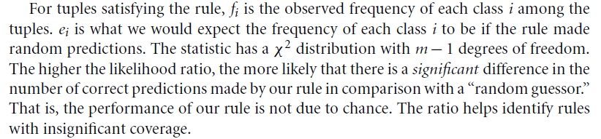
where m is the number of classes.

Slide 15
Model Evaluation and Selection
Suppose you used data from previous sales to build a classifier to predict customer purchasing behavior. You would like an estimate of how accurately the classifier can predict the purchasing behavior of future customers.
Metrics for Evaluating Classifier Performance:
Here, we present measures for assessing how good or how “accurate” your classifier is at predicting the class label of tuples. We will consider the case of where the class tuples are more or less evenly distributed, as well as the case where classes are unbalanced. The classifier evaluation measures are summarized as follows. They include accuracy (also known as recognition rate), sensitivity (or recall), specificity, precision, F1, and F.
Positive tuples (P) - tuples of the main class of interest and
Negative tuples (N) - all other tuples.
Given two classes, for example, the positive tuples may be buys computer yes while the negative tuples are buys computer no. Suppose we use our classifier on a test set of labeled tuples. P is the number of positive tuples and N is the number of negative tuples.

Slide 16
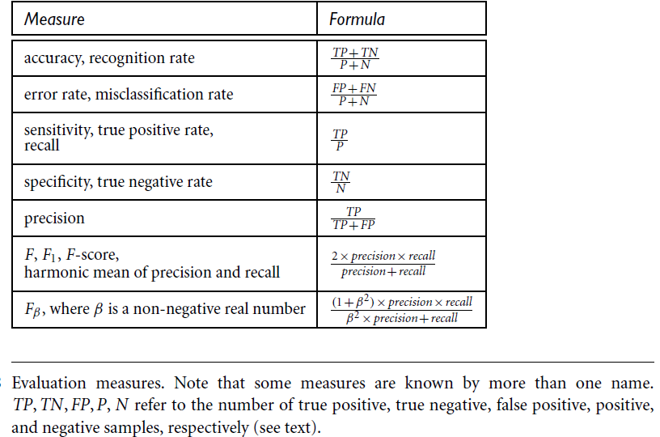

Slide 17
True positives (TP): These refer to the positive tuples that were correctly labeled by the classifier. Let TP be the number of true positives.
True negatives (TN): These are the negative tuples that were correctly labeled by the classifier. Let TN be the number of true negatives.
False positives (FP): These are the negative tuples that were incorrectly labeled as positive (e.g., tuples of class buys computer no for which the classifier predicted buys computer yes). Let FP be the number of false positives.
False negatives (FN): These are the positive tuples that were mislabeled as negative (e.g., tuples of class buys computer yes for which the classifier predicted buys computer no). Let FN be the number of false negatives.
These terms are summarized in the confusion matrix as follows:

Slide 18
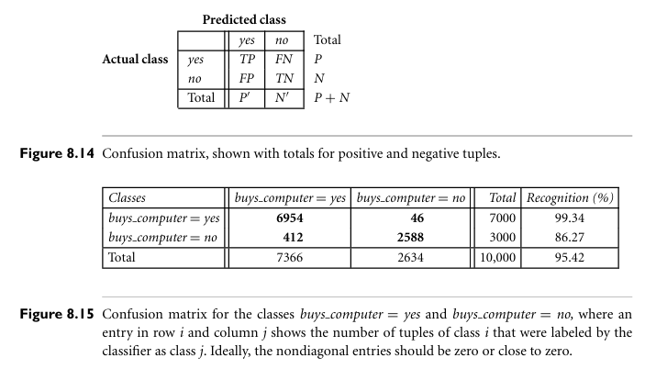

Slide 19
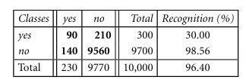

EX: Following Fig. shows a confusion matrix for medical data where the class values are yes and no for a class label attribute, cancer.
Precision= 90/230 = 39.13 % and
Recall = 90/300 = 30.00 %

Slide 20
In addition to accuracy-based measures, classifiers can also be compared with respect to the following additional aspects:
Speed: This refers to the computational costs involved in generating and using the given classifier.
Robustness: This is the ability of the classifier to make correct predictions given noisy data or data with missing values. Robustness is typically assessed with a series of synthetic data sets representing increasing degrees of noise and missing values.
Scalability: This refers to the ability to construct the classifier efficiently given large amounts of data. Scalability is typically assessed with a series of data sets of increasing size.
Interpretability: This refers to the level of understanding and insight that is provided by the classifier or predictor.

Slide 21
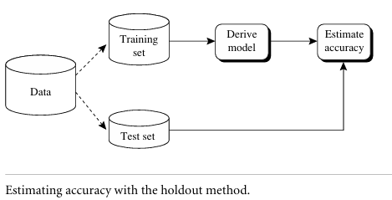
Holdout Method and Random Subsampling:
In this method, the given data are randomly partitioned into two independent sets, a training set and a test set. Typically, two-thirds of the data are allocated to the training set, and the remaining one-third is allocated to the test set. The training set is used to derive the model. The model’s accuracy is then estimated with the test set as following fig. The estimate is pessimistic because only a portion of the initial data is used to derive the model.
Random subsampling is a variation of the holdout method in which the holdout method is repeated k times. The overall accuracy estimate is taken as the average of the accuracies obtained from each iteration.

Slide 22
Cross-Validation:
In k-fold cross-validation, the initial data are randomly partitioned into k mutually exclusive subsets or “folds,” D1, D2, , Dk, each of approximately equal size. Training and testing is performed k times. In iteration i, partition Di is reserved as the test set, and the remaining partitions are collectively used to train the model. That is, in the first iteration, subsets D2, , Dk collectively serve as the training set to obtain a first model, which is tested on D1; the second iteration is trained on subsets D1, D3, , Dk and tested on D2; and so on.
Unlike the holdout and random subsampling methods, here each sample is used the same number of times for training and once for testing. For classification, the accuracy estimate is the overall number of correct classifications from the k iterations, divided by the total number of tuples in the initial data.
Leave-one-out is a special case of k-fold cross-validation where k is set to the number of initial tuples. That is, only one sample is “left out” at a time for the test set.
In stratified cross-validation, the folds are stratified so that the class distribution of the tuples in each fold is approximately the same as that in the initial data.

Slide 23
Bootstrap Unlike the accuracy estimation methods just mentioned, the bootstrap method samples the given training tuples uniformly with replacement. That is, each time a tuple is selected, it is equally likely to be selected again and re-added to the training set.
There are several bootstrap methods. A commonly used one is the .632 bootstrap, which works as follows:
Suppose we are given a data set of d tuples. The data set is sampled d times, with replacement, resulting in a bootstrap sample or training set of d samples. It is very likely that some of the original data tuples will occur more than once in this sample. The data tuples that did not make it into the training set end up forming the test set. Suppose we were to try this out several times. As it turns out, on average, 63.2% of the original data tuples will end up in the bootstrap sample, and the remaining 36.8% will form the test set (hence, the name, .632 bootstrap).

Slide 24


“Where does the figure, 63.2%, come from?” Each tuple has a probability of 1/d of being selected, so the probability of not being chosen is (1-1/d). We have to select d times, so the probability that a tuple will not be chosen during this whole time is (1-1/d)^{d}. If d is large, the probability approaches e⁻¹ = 0.368⁷ Thus, 36.8% of tuples will not be selected for training and thereby end up in the test set, and the remaining 63.2% will form the training set.
We can repeat the sampling procedure k times, where in each iteration, we use the current test set to obtain an accuracy estimate of the model obtained from the current bootstrap sample. The overall accuracy of the model, M, is then estimated as:

Slide 25
Model Selection Using Statistical Tests of Significance:
Suppose that we have generated two classification models, M1 and M2, from our data. We have performed 10-fold cross-validation to obtain a mean error rate for each. How can we determine which model is best? It may seem intuitive to select the model with the lowest error rate.
There can be considerable variance between error rates within any given 10-fold cross-validation experiment. Although the mean error rates obtained for M1 and M2 may appear different, that difference may not be statistically significant. To determine if there is any “real” difference in the mean error rates of two models, we need to employ a test of statistical significance.

Slide 26
What do we need to perform the statistical test? Suppose that for each model, we did 10-fold cross-validation, say, 10 times, each time using a different 10-fold data partitioning. Each partitioning is independently drawn. We can average the 10 error rates obtained each for M1 andM2,respectively, to obtain the mean error rate for each model.
For a given model, the individual error rates calculated in the cross-validations may be considered as different, independent samples from a probability distribution. In general, they follow a t-distribution with k-1 degrees of freedom where, here, k=10. This allows us to do hypothesis testing where the significance test used is the t-test, or Student’s t-test. Our hypothesis is that the two models are the same, or in other words, that the difference in mean error rate between the two is zero. If we can reject this hypothesis (referred to as the null hypothesis), then we can conclude that the difference between the two models is statistically significant, in which case we can select the model with the lower error rate.

Slide 27
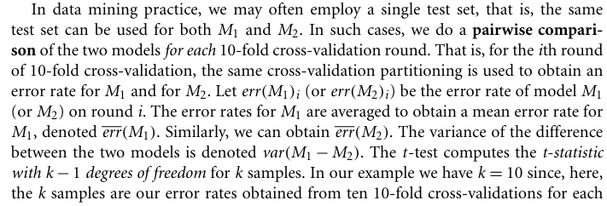
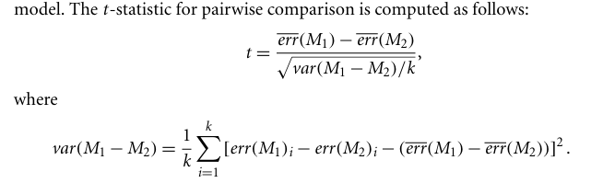

Slide 28
The t-distribution table (also called Student’s t-table) gives critical values of the t statistic for different degrees of freedom (df) and significance levels (α). These are used in t-tests for hypothesis testing. Here’s a compact version of the standard t-distribution table: (t-Distribution Critical Values (two-tailed test)
How to Read the Table
df = degrees of freedom (n – 1 for one-sample, n₁+n₂–2 for two-sample tests).
Columns = significance levels (α).
  Example: for df = 10, α = 0.05 (two-tailed), critical t = 2.228.
If your calculated |t| > table value → Reject Null Hypothesis (H₀).

Slide 29
df | 0.10 (90%) | 0.05 (95%) | 0.025 (97.5%) | 0.01 (99%) | 0.005 (99.5%)
1 | 6.314 | 12.706 | 25.452 | 63.657 | 127.321
2 | 2.920 | 4.303 | 6.205 | 9.925 | 14.089
3 | 2.353 | 3.182 | 4.177 | 5.841 | 7.453
4 | 2.132 | 2.776 | 3.495 | 4.604 | 5.598
5 | 2.015 | 2.571 | 3.163 | 4.032 | 4.773
6 | 1.943 | 2.447 | 2.969 | 3.707 | 4.317
7 | 1.895 | 2.365 | 2.841 | 3.499 | 4.029
8 | 1.860 | 2.306 | 2.752 | 3.355 | 3.833
9 | 1.833 | 2.262 | 2.685 | 3.250 | 3.690
10 | 1.812 | 2.228 | 2.634 | 3.169 | 3.581
12 | 1.782 | 2.179 | 2.518 | 3.055 | 3.373
15 | 1.753 | 2.131 | 2.447 | 2.947 | 3.289
20 | 1.725 | 2.086 | 2.390 | 2.845 | 3.153
25 | 1.708 | 2.060 | 2.360 | 2.787 | 3.078
30 | 1.697 | 2.042 | 2.340 | 2.750 | 3.030
40 | 1.684 | 2.021 | 2.303 | 2.704 | 2.971
60 | 1.671 | 2.000 | 2.290 | 2.660 | 2.940
∞ | 1.645 | 1.960 | 2.326 | 2.576 | 2.807

Slide 30
To determine whether M1 and M2 are significantly different, we compute t and select a significance level, sig. In practice, a significance level of 5% or 1% is typically used. We then consult a table for the t-distribution, available in standard textbooks on statistics. This table is usually shown arranged by degrees of freedom as rows and significance levels as columns. Suppose we want to ascertain whether the difference between M1 and M2 is significantly different for 95% of the population, that is, sig 5% or 0.05. We need to find the t-distribution value corresponding to k-1 degrees of freedom (or 9 degrees of freedom for our example) from the table. However, because the t-distribution is symmetric, typically only the upper percentage points of the distribution are shown. Therefore, we look up the table value for z=sig/2, which in this case is 0.025, where z is also referred to as a confidence limit. If t > z or t < z, then our value of t lies in the rejection region, within the distribution’s tails. This means that we can reject the null hypothesis that the means of M1 and M2 are the same and conclude that there is a statistically significant difference between the two models. Otherwise, if we cannot reject the null hypothesis, we conclude that any difference between M1 and M2 can be attributed to chance.

Slide 31

If two test sets are available instead of a single test set, then a nonpaired version of the t-test is used, where the variance between the means of the two models is estimated as:
and k1 and k2 are the number of cross-validation samples (in our case, 10-fold cross validation rounds) used for M1 and M2, respectively. This is also known as the two sample t-test. When consulting the table of t-distribution, the number of degrees of freedom used is taken as the minimum number of degrees of the two models.

