Slide 1
APRIORI
ALGORITHM
Steps, support, confidence & a clear example
DATA MINING • ASSOCIATION RULES

Slide 3
1. What is the Apriori Algorithm?
• A data-mining algorithm used to discover items that frequently occur together.
• Commonly used for market-basket analysis in supermarkets and online shopping.
• Example: customers who buy bread may also buy milk.
• Main outputs: frequent itemsets and association rules.
2
APRIORI ALGORITHM • DATA MINING

Slide 4
1. What is the Apriori Algorithm?
• Apriori Algorithm is a data mining technique used to identify items that frequently appear together in large datasets. It helps discover relationships and association rules between items, making it widely used in market basket analysis.
2
APRIORI ALGORITHM • DATA MINING

Slide 5
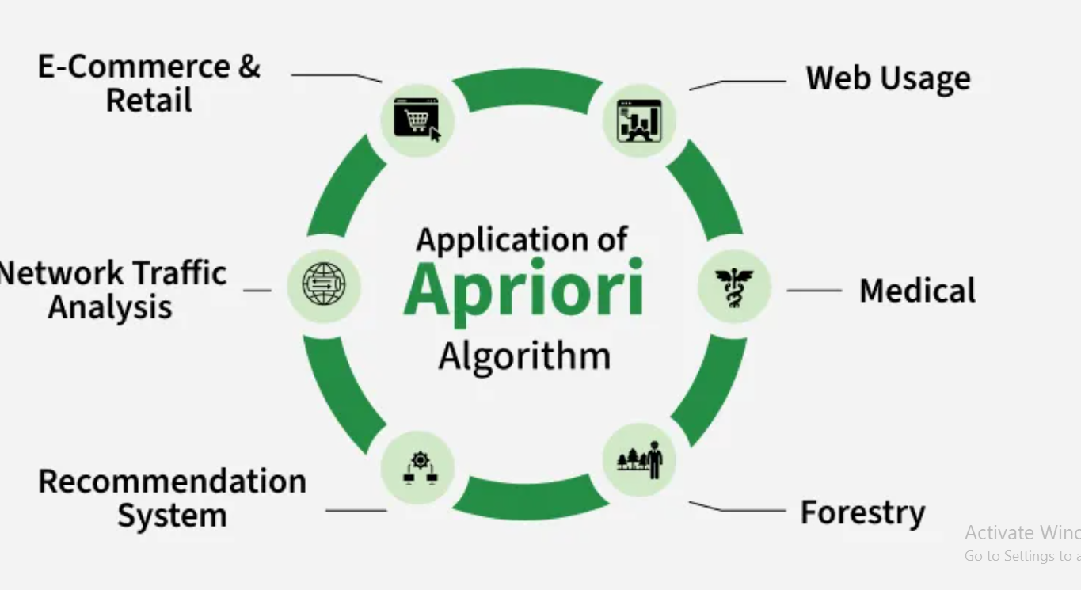

Slide 6
1 Working
• 1. Identifying Frequent Item-Sets
The Apriori algorithm starts by looking through all the data to count how many times each single item appears. These single items are called 1-Item-Sets.
Next it uses a rule called minimum support this is a number that tells us how often an item or group of items needs to appear to be important. If an item appears often enough meaning its count is above this minimum support it is called a frequent Item-Set.
2
APRIORI ALGORITHM • DATA MINING

Slide 7
• 2. Creating Possible Item Group
After finding the single items that appear often enough (frequent 1-item groups) the algorithm combines them to create pairs of items (2-item groups). Then it checks which pairs are frequent by seeing if they appear enough times in the data.
This process keeps going step by step making groups of 3 items, then 4 items and so on. The algorithm stops when it can’t find any bigger groups that happen often enough.
2
APRIORI ALGORITHM • DATA MINING

Slide 8
• 3. Removing Infrequent Item Groups
.
The Apriori algorithm uses a helpful rule to save time. This rule says, if a group of items does not appear often enough then any larger group that includes these items will also not appear often.
Because of this, the algorithm does not check those larger groups. This way it avoids wasting time looking at groups that won’t be important making the whole process faster.
2
APRIORI ALGORITHM • DATA MINING

Slide 9
• 4. Generating Association Rules
.
4. Generating Association Rules
The algorithm makes rules to show how items are related.
It checks these rules using support, confidence and lift to find the strongest ones.
2
APRIORI ALGORITHM • DATA MINING

Slide 10
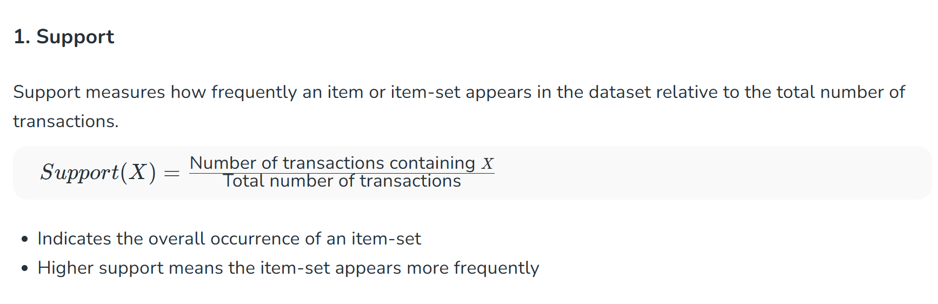

Slide 11
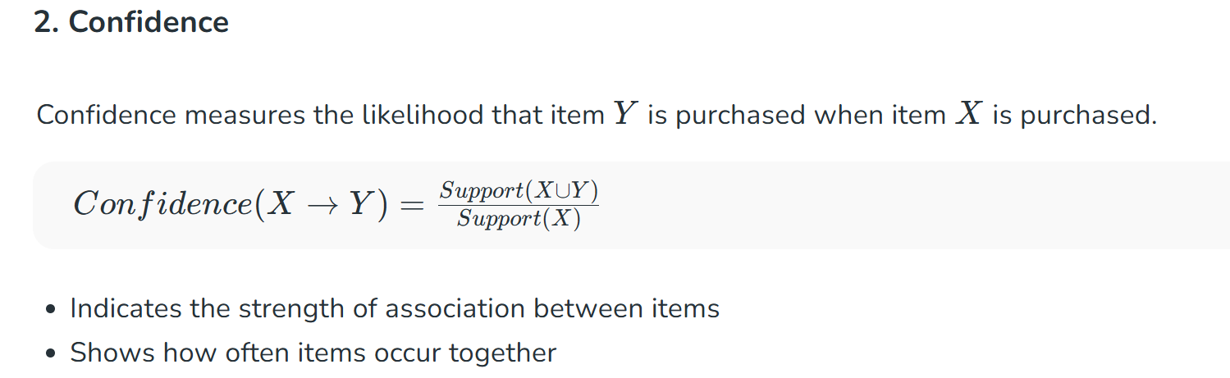

Slide 12
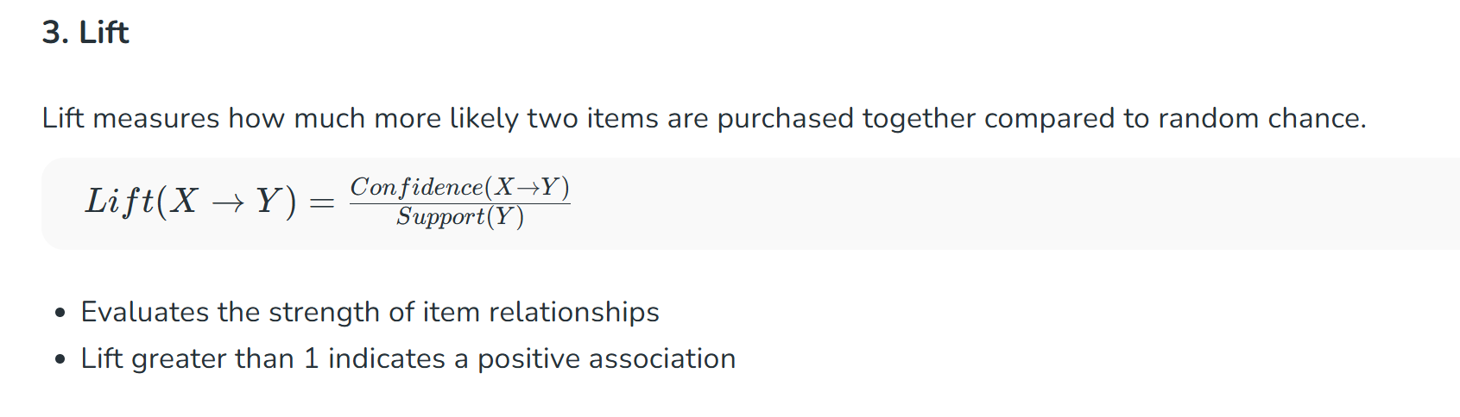

Slide 13
2. Important Terms & Formulas
SUPPORT
Example settings
Support(A) = Transactions containing A ÷ Total transactions
• Total transactions = 5
• Minimum support = 60% (at least 3 transactions)
• Minimum confidence = 70%
CONFIDENCE
Confidence(A → B) = Support(A ∪ B) ÷ Support(A)
3
APRIORI ALGORITHM • DATA MINING

Slide 14
3. Example: Supermarket Transactions
Transaction | Items purchased
T1 | Bread, Milk
T2 | Bread, Diaper, Beer
T3 | Milk, Diaper, Beer
T4 | Bread, Milk, Diaper, Beer
T5 | Bread, Milk, Diaper
Minimum support = 60% | Minimum confidence = 70%
4
APRIORI ALGORITHM • DATA MINING

Slide 15
4. Step 1 — Find Frequent 1-Itemsets (L1)
Item | Count | Support | Frequent?
Bread | 4 | 4/5 = 80% | Yes
Milk | 4 | 4/5 = 80% | Yes
Diaper | 4 | 4/5 = 80% | Yes
Beer | 3 | 3/5 = 60% | Yes
All four items meet the 60% minimum support threshold.
5
APRIORI ALGORITHM • DATA MINING

Slide 16
5. Step 2 — Find Frequent 2-Itemsets (L2)
Pair | Count | Support | Decision
Bread, Milk | 3 | 60% | Keep
Bread, Diaper | 3 | 60% | Keep
Bread, Beer | 2 | 40% | Remove
Milk, Diaper | 3 | 60% | Keep
Milk, Beer | 2 | 40% | Remove
Diaper, Beer | 3 | 60% | Keep
6
APRIORI ALGORITHM • DATA MINING

Slide 17
6. Step 3 — Check 3-Itemsets (C3)
• Candidate {Bread, Milk, Diaper} occurs in T4 and T5: support = 2/5 = 40%.
• Candidate {Milk, Diaper, Beer} occurs in T3 and T4: support = 2/5 = 40%.
• No 3-itemset reaches the required 60% support.
• Therefore, L3 is empty and the algorithm stops.
7
APRIORI ALGORITHM • DATA MINING

Slide 18
7. Step 4 — Generate Association Rules
Example rule: Bread → Milk
Confidence = Support(Bread, Milk) ÷ Support(Bread)
= 3/4 × 100 = 75%
75% ≥ minimum confidence 70% → ACCEPT the rule
Interpretation: 75% of transactions containing Bread also contain Milk.
8
APRIORI ALGORITHM • DATA MINING

Slide 19
8. Accepted Association Rules
Rule | Confidence
Bread → Milk | 75%
Milk → Bread | 75%
Bread → Diaper | 75%
Diaper → Bread | 75%
Milk → Diaper | 75%
Diaper → Milk | 75%
Diaper → Beer | 75%
Beer → Diaper | 100%
9
APRIORI ALGORITHM • DATA MINING

Slide 20
9. Algorithm Flow & Key Property
1
Count individual items
2
Remove items below minimum support
3
Generate pairs, then larger itemsets
4
Count support and prune infrequent sets
5
Repeat until no frequent sets remain
6
Generate rules using minimum confidence
Apriori property: every subset of a frequent itemset must also be frequent.
10
APRIORI ALGORITHM • DATA MINING

Slide 21
10. Applications & Conclusion
Applications
Remember
• Supermarket product recommendations
• Online shopping basket analysis
• Cross-selling and product placement
• Discovering patterns in transaction data
• Support measures frequency.
• Confidence measures rule reliability.
• C1/C2/C3 = candidate sets; L1/L2/L3 = frequent sets.
• Stop when no larger frequent itemsets can be found.
11
APRIORI ALGORITHM • DATA MINING

Slide 22
10. Applications & Conclusion
Applications
Remember
• Supermarket product recommendations
• Online shopping basket analysis
• Cross-selling and product placement
• Discovering patterns in transaction data
• Support measures frequency.
• Confidence measures rule reliability.
• C1/C2/C3 = candidate sets; L1/L2/L3 = frequent sets.
• Stop when no larger frequent itemsets can be found.
11
APRIORI ALGORITHM • DATA MINING

Slide 23
Frequent Pattern Growth Algorithm
The FP-Growth (Frequent Pattern Growth) algorithm efficiently mines frequent itemsets from large transactional datasets. Unlike the Apriori algorithm which suffers from high computational cost due to candidate generation and multiple database scans. FP-Growth avoids these inefficiencies by compressing the data into an FP-Tree (Frequent Pattern Tree) and extracts patterns directly from it.

