Slide 1
UNIT–IV
Association Analysis: Problem Definition, Frequent Itemset Generation,
Rule Generation: Confident Based Pruning, Rule Generation in Apriori Algorithm, Compact Representation of frequent item sets, FP-Growth Algorithm.

Slide 2
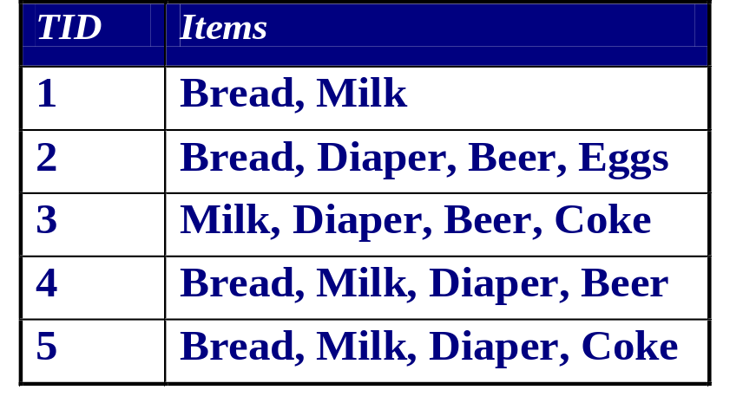
Association Analysis: Basic Concepts and Algorithms
Association Rule Mining Given a set of transactions, find rules that will predict the occurrence of an item based on the occurrences of other items in the transaction
Market-Basket transactions
Example of Association Rules:
{Diaper} → {Beer},
{Milk, Bread} → {Eggs, Coke},
{Beer, Bread} → {Milk},

Slide 3
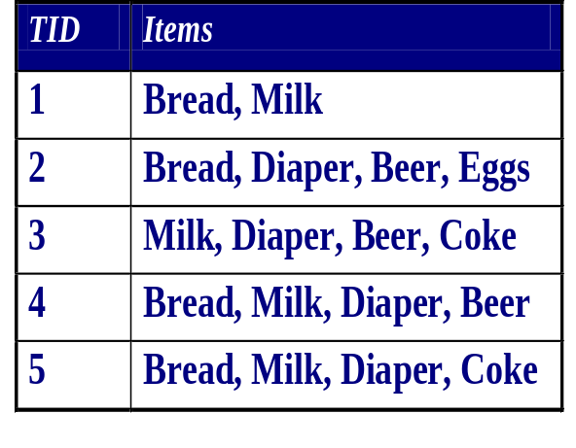
Definition: Frequent Itemset
Itemset
  A collection of one or more items
    Example:{Milk,Bread, Diaper}
  k-itemset
    An itemset that contains k items
Support count (σ)
  Frequency of occurrence of an itemset
  E.g. σ({Milk, Bread,Diaper}) = 2
Support
  Fraction of transactions that contain an itemset
  E.g. s({Milk, Bread, Diaper}) = 2/5
Frequent Itemset
  An itemset whose support is greater than or equal to a minsup threshold

Slide 4
Support Count of Itemset
Support = ─────────────────────────
Total number of Transactions
Confidence:
Confidence is the probability that Itemset B exists when given
Itemset A exists in transaction.
Support Count (A ∪ B)
Confidence = ───────────────────────
Support Count (A)

Slide 5
Example
Suppose there are 10 transactions and:
{Milk, Bread} appears in 6 transactions
Minimum support = 50%
Then:
Support(Milk,Bread)=6/10=60%
60% ≥ 50%
Therefore, {Milk, Bread} is a Frequent Itemset.

Slide 6
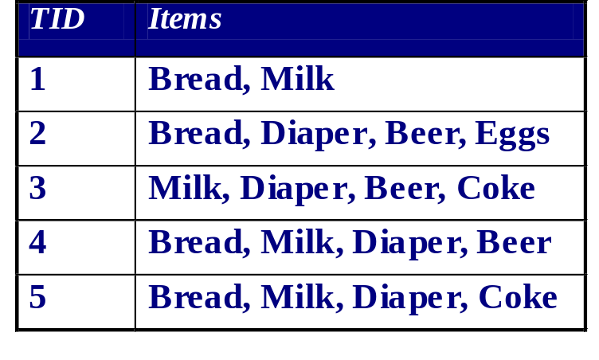

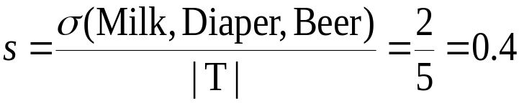
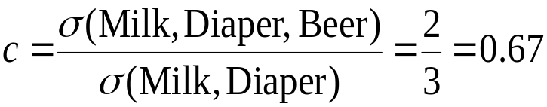
Definition: Association Rule
Association Rule
  An implication expression of the form X → Y, where X and Y are itemsets
  Example:
  {Milk, Diaper} → {Beer}
Rule Evaluation Metrics
  Support (s)
    Fraction of transactions that contain both X and Y
  Confidence (c)
    Measures how often items in Y appear in transactions that
    contain X
Example:

Slide 7
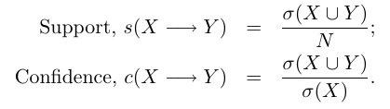
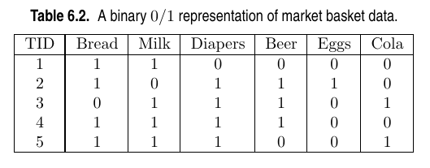
The strength of an association rule can be measured in terms of its support and confidence. Support determines how often a rule is applicable to a given data set, while confidence determines how frequently items in Y appear in transactions that contain X. The formal definitions of these metrics are:
Binary Representation:

Slide 8

Association Rule Mining Task
Given a set of transactions T, the goal of association rule mining is to find all rules having
  support ≥ minsup threshold and confidence ≥ minconf threshold
Brute-force approach:
A brute-force approach for mining association rules is to compute the support and confidence for every possible rule. This approach is prohibitively expensive because there are exponentially many rules that can be extracted from a data set. More specifically, the total number of possible rules extracted from a data set that contains d items is:
Even for the small data set shown in our Table (Previous), this approach requires us to compute the support and confidence for 3⁶−2⁷+1 = 602 rules.

Slide 9
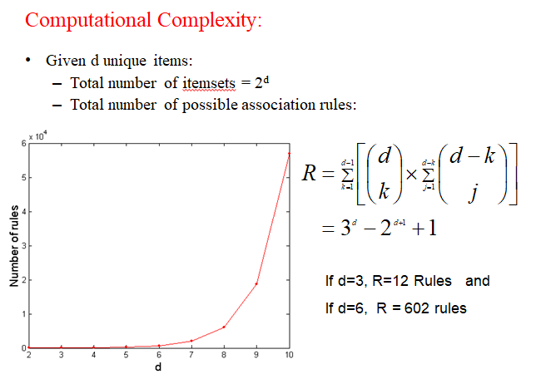

Slide 10
  More than 80% of the rules are discarded after applying minsup = 20% and minconf = 50%, thus making most of the computations become wasted. To avoid performing needless computations, it would be useful to prune the rules early without having to compute their support and confidence values.
  Therefore, a common strategy adopted by many association rule mining algorithms is to decompose the problem into two major subtasks:
  Frequent Itemset Generation, whose objective is to find all the item sets that satisfy the minsup threshold. These itemsets are called frequent itemsets.
  Rule Generation, whose objective is to extract all the high-confidence rules from the frequent itemsets found in the previous step. These rules are called strong rules.
  Note: The computational requirements for frequent itemset generation are generally more expensive than those of rule generation.

Slide 11
1000 students
↓
Apply first filter
↓
Students who satisfy support
↓
Frequent itemsets
↓
Apply second filter
↓
Students/rules who satisfy confidence
↓
Strong association rules

Slide 12
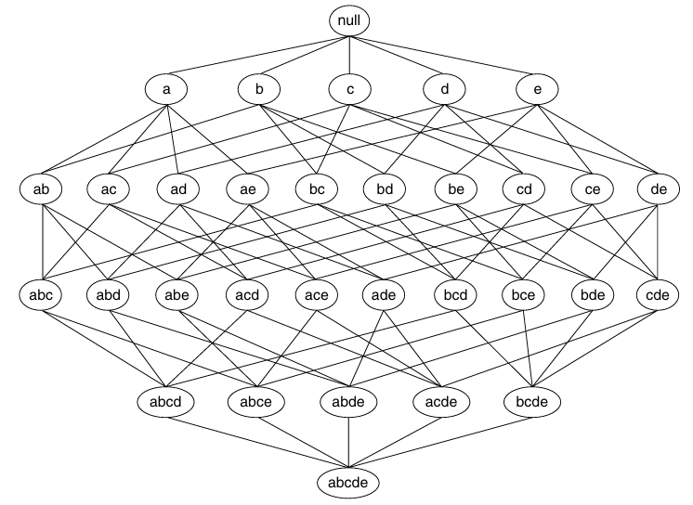
An itemset lattice: Given d items, there are 2^{d} possible candidate itemsets

Slide 13
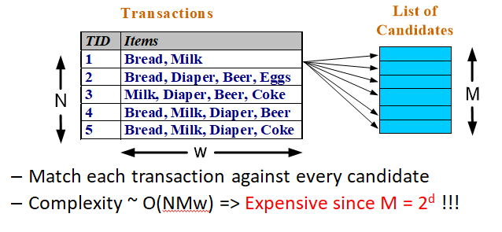
Frequent Itemset Generation:
Brute-force approach:
  Each itemset in the lattice is a candidate frequent itemset
  Count the support of each candidate by scanning the database

Slide 14
Frequent Itemset Generation Strategies:
Reduce the number of candidates (M)
  Complete search: M=2^{d}
  Use pruning techniques to reduce M
Reduce the number of transactions (N)
  Reduce size of N as the size of itemset increases
  Used by DHP(Direct Hashing and Pruning) and vertical-based mining algorithms
Reduce the number of comparisons (NM)
  Use efficient data structures to store the candidates or transactions
  No need to match every candidate against every transaction

Slide 15
For 1st one
For example:
{Milk, Bread} → ❌ Infrequent
Then don't generate:
{Milk, Bread, Butter}
{Milk, Bread, Eggs}
{Milk, Bread, Coke}
For 2nd one
1-itemset
↓
Consider many/all relevant transactions
N = 5
↓
2-itemset
↓
Fewer relevant transactions
N may decrease
↓
3-itemset
↓
Even fewer relevant transactions
N may decrease further

Slide 16
For example:
Brute force:
T1 → C1, C2, C3, C4, C5, ... C10000
T2 → C1, C2, C3, C4, C5, ... C10000...
Instead, an efficient structure may allow:
T1 → only relevant candidates
T2 → only relevant candidates...
Therefore, the number of comparisons decreases.

Slide 17
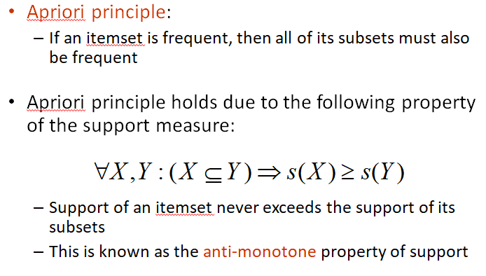
Reducing Number of Candidates:

Slide 18
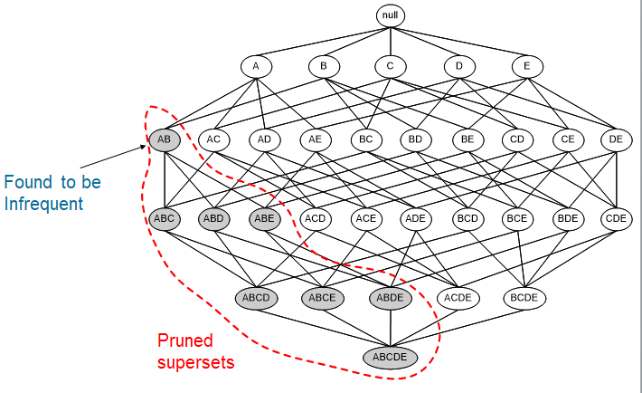
Illustrating Apriori Principle:

Slide 19
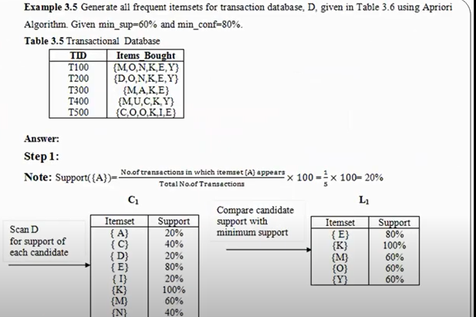

Slide 20
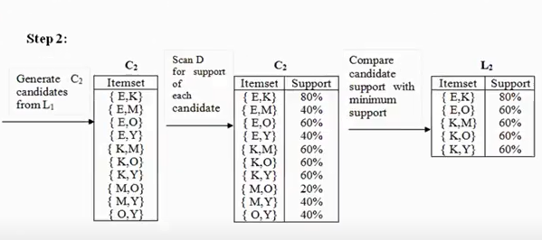

Slide 21
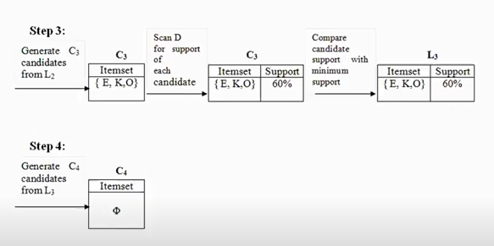

Slide 22
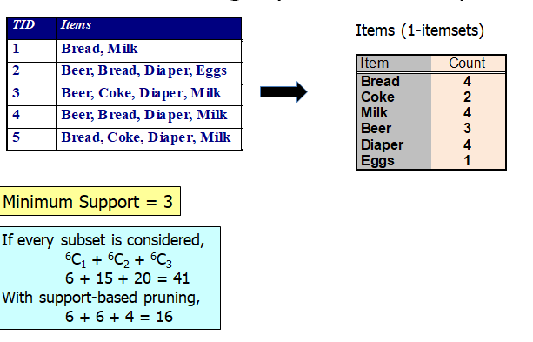
Illustrating Apriori Principle:

Slide 23
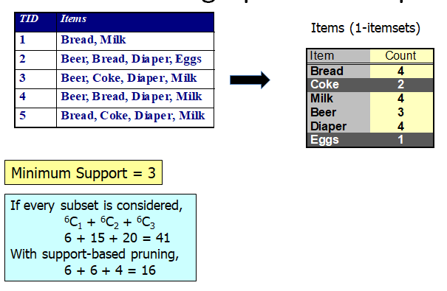

Slide 24
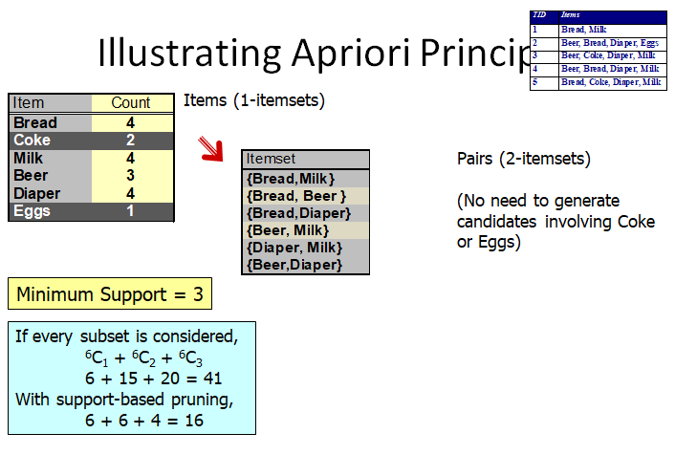

Slide 25
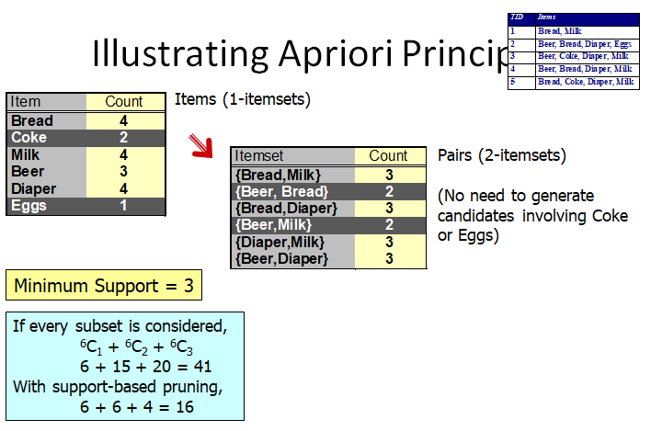

Slide 26
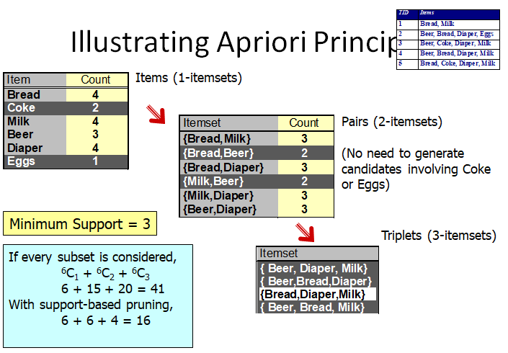

Slide 27
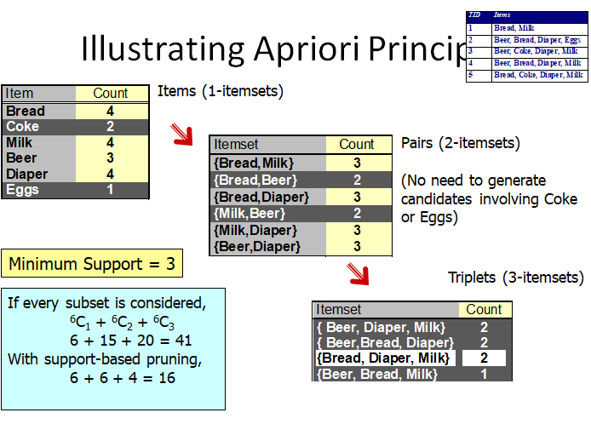

Slide 28
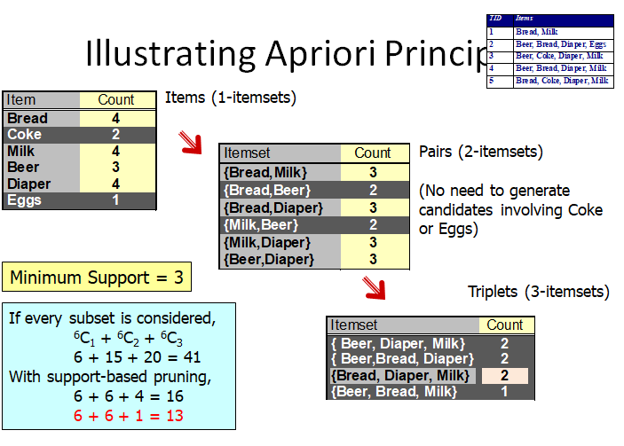

Slide 29
Mining Association Rules:
Two-step approach:
  Frequent Item set Generation
    Generate all item sets whose support ≥ min sup
  Rule Generation
    Generate high confidence rules from each frequent item set, where each rule is a binary partitioning of a frequent item set

Slide 30
Apriori Algorithm
  F_{k}: frequent k-itemsets
  L_{k}: candidate k-itemsets
Algorithm
  Let k=1
  Generate F₁ = {frequent 1-itemsets}
  Repeat until F_{k} is empty
    Candidate Generation: Generate L_{k+1} from F_{k}
    Candidate Pruning: Prune candidate itemsets in L_{k+1} containing subsets of length k that are infrequent
    Support Counting: Count the support of each candidate in L_{k+1} by scanning the DB
    Candidate Elimination: Eliminate candidates in L_{k+1} that are infrequent, leaving only those that are frequent => F_{k+1}

Slide 31
Support counting:
Support counting is the process of determining the frequency of occurrence for every candidate item set that survives the candidate pruning step of the Apriori-gen function.
How many transactions contain each candidate?
Support count = Number of transactions containing the itemset
One approach for doing this is to compare each transaction against every candidate item set and to update the support counts of candidates contained in the transaction.
An alternative approach is to enumerate the item sets contained in each transaction and use them to update the support counts of their respective candidate item sets.

Slide 32
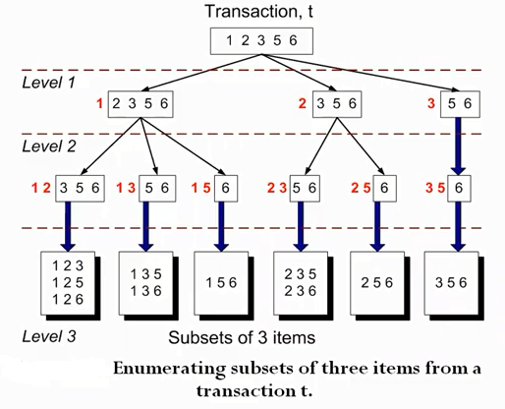
Example:

Slide 33
Support Counting Using a Hash Tree:
In the Apriori, algorithm, candidate item sets are partitioned into different buckets and stored in a hash tree.
During support counting, item sets contained in each transaction are also hashed into their appropriate buckets.
Instead of comparing each item set in the transaction with every candidate item set, it is matched only against candidate item sets that belong to the same bucket

Slide 34
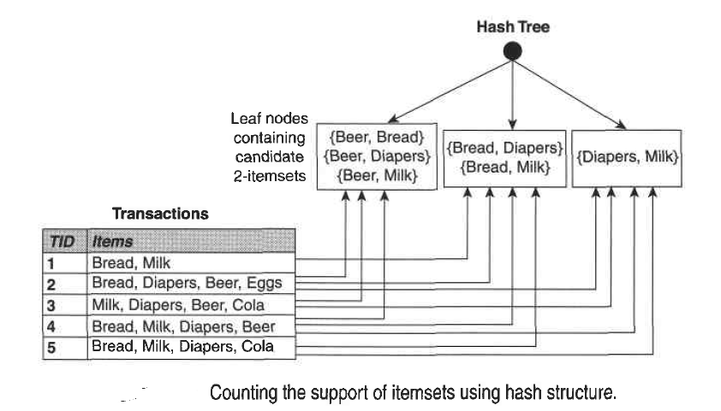

Slide 35
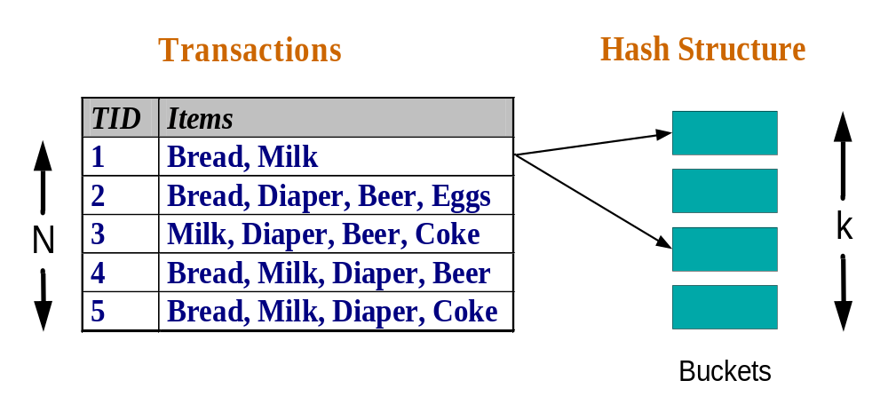
Support Counting of Candidate Item sets
To reduce number of comparisons, store the candidate item sets in a hash structure
  Instead of matching each transaction against every candidate, match it against candidates contained in the hashed buckets.

Slide 36
Support Counting Using a Hash Tree
Hash tree structure. Each internal node of the tree uses the following hash function, h(p) : p mod 3, to determine which branch of the current node
All candidate item sets are stored at the leaf nodes of the hash tree.
Consider a transaction, f : {1,2,3,5,6}.
To update the support counts of the candidate item sets, the hash tree must be traversed in such a way that all the leaf nodes containing candidate 3-itemsets belonging to f must be visited at least once.
Hash function
36,9
1,4,7
2,5,8

Slide 37
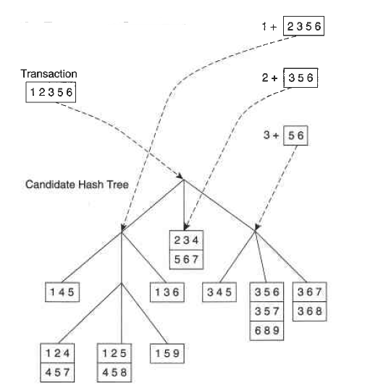

Slide 38
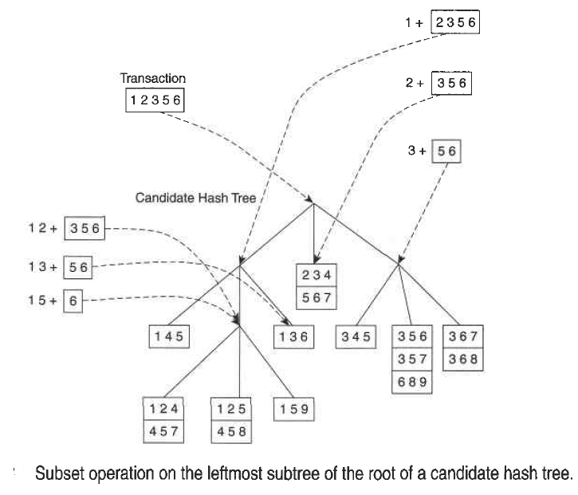

Slide 39
Rule Generation:
Each frequent k-item set Y can produce up to 2^{k} - 2 association rules
An association rule can be extracted by partitioning the item set Y into two non-empty subsets ,X and Y -X, such that
X →Y-X satisfies the confidence threshold.

Slide 40
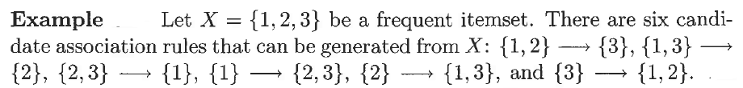
Each of their support is identical to the support for X, the rules must satisfy the support threshold.
Computing the confidence of an association rule does not require additional scans of the transaction data set.

Slide 41
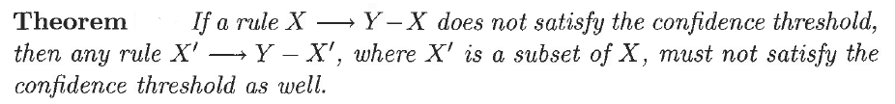
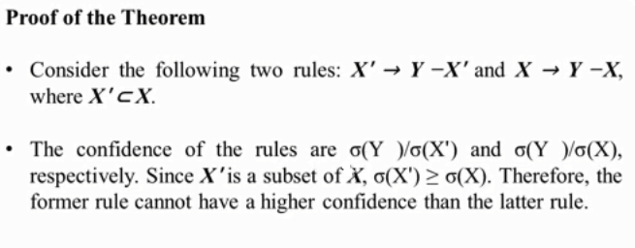
Confidence-Based Pruning:
To compare rules generated from the same frequent item set Y, the following theorem holds for the confidence measure.

Slide 42

Rule Generation in Apriori Algorithm
The Apriori algorithm uses a level-wise approach for generating association rules, where each level corresponds to the number of items that belong to the rule consequent.
Initially, all the high-confidence rules that have only one item in the rule consequent are extracted.
A lattice structure for the association rules generated from the frequent item set {a,b,c,d}. If any node in the lattice has low confidence entire sub graph spanned by the node can be pruned immediately.

Slide 43
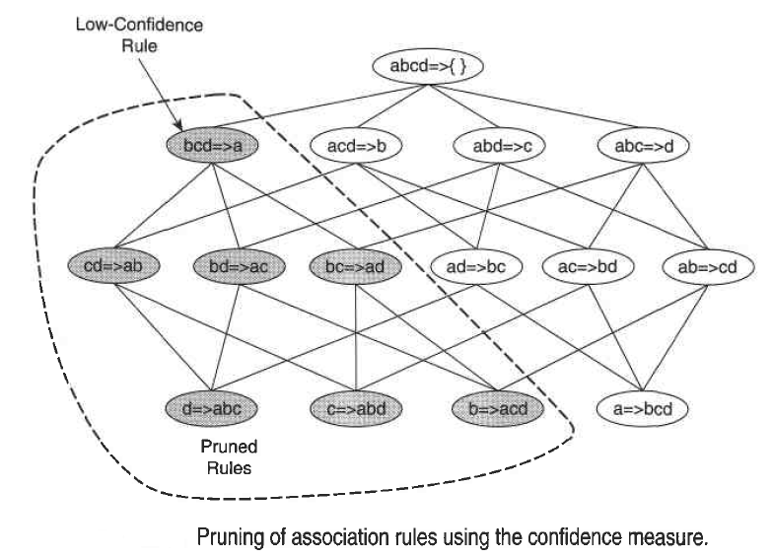

Slide 44
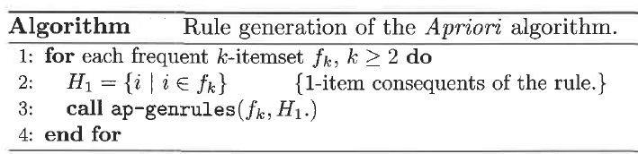
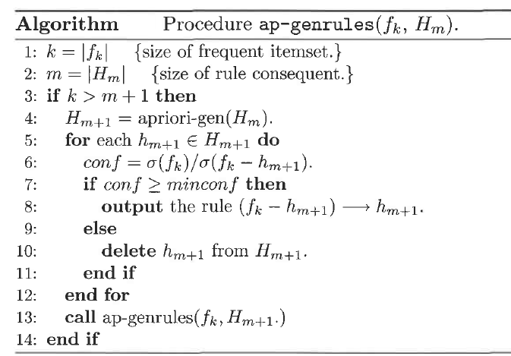

Slide 45
Frequent itemset
↓
Generate H1(1-item consequents)
↓
Calculate confidence
↓
Keep high-confidence rules
↓
Generate H2(2-item consequents)
↓
Calculate confidence
↓
Prune low-confidence candidates
↓
Generate H3(3-item consequents)
↓
Calculate confidence
↓
Continue until no larger consequent can be generated

Slide 46
Limitations of Apriori Algorithm:
It may need to generate a huge number of candidate sets. For example, if there are 10⁴ frequent 1-itemsets, the Apriori algorithm will need to generate more than 10⁷ candidate 2-itemsets.
The Algorithm incurs considerable I/O overhead since It may need to repeatedly scan the database and check a large set of candidates by pattern matching.

Slide 47
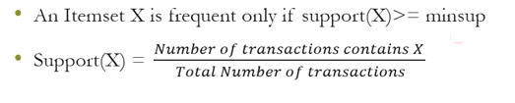
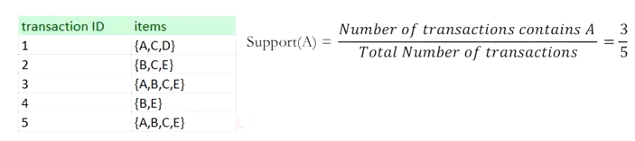
Frequent Item Sets

Slide 48
In real-world datasets (like supermarket transactions), the number of frequent itemsets can be huge — even millions.
Storing and processing them all individually becomes inefficient.
Hence, compact representations are introduced.
Note: They summarize the frequent itemsets without losing important information.
Compact Representation:
Instead of storing every frequent itemset, we store only a subset of them from which all other frequent itemsets can be derived. These subsets include:
Maximal Frequent Itemsets (MFI)
Closed Frequent Itemsets (CFI)

Slide 49
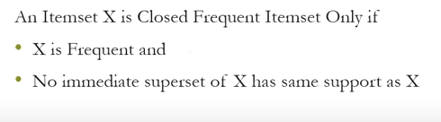
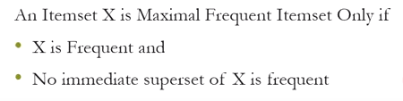
Closed Frequent Itemsets(CFI)
Maximal Frequent Itemsets(MFI)

Slide 50
Maximal Frequent Itemsets (MFI):
A maximal frequent itemset is a frequent itemset that is not a subset of any other frequent itemset.
In other words, it is “frequent,” but if you add any more items to it, it becomes infrequent.
Example:
Frequent Itemsets: {A}, {B}, {C}, {A,B}, {A,C}, {A,B,C}
If {A,B,C} is frequent, it’s Maximal, because:
We can’t add more items to make it larger and still be frequent.
MFI = {A,B,C}
All its subsets are also frequent, but we don’t need to store them separately.

Slide 51
Closed Frequent Itemsets (CFI):
A closed frequent itemset is a frequent itemset for which no proper superset has the same support count.
That means — if a superset has the same frequency, then we can drop the smaller set.
Example:
Here (A,B} and {A,B,C} have the same support
So {A,B} is not closed because it’s superset {A,B,C} has the same frequency
There fore: Closed itemset = {A,B,C}
Itemset | Support Count
{A, B} | 3
{A, B, C} | 3

Slide 52
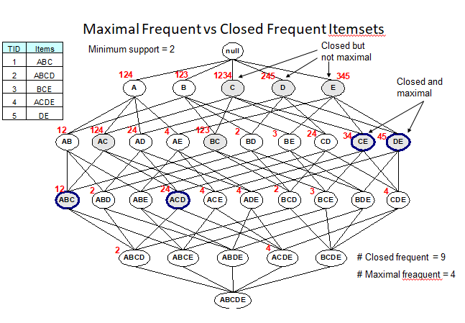

Slide 53
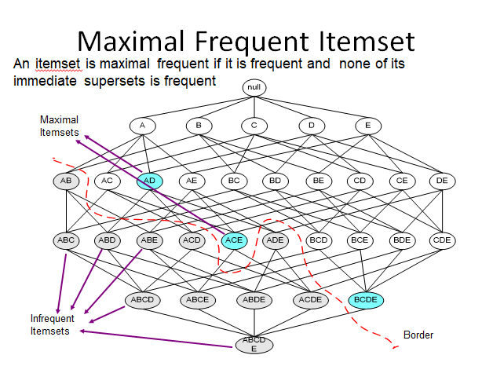

Slide 54
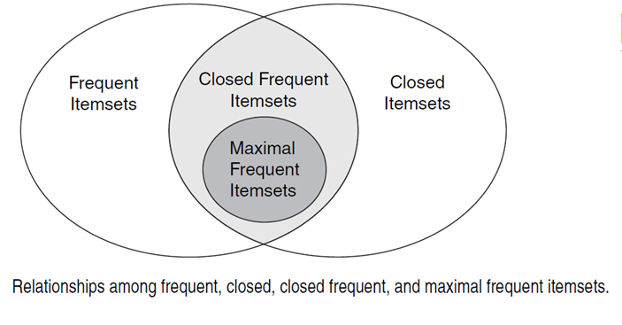

Slide 55
Apriori Algorithm Disadvantages
Apriori needs a generation of candidate item sets. These item sets may be large in number if the item set in the database is huge.
Apriori needs multiple scans of the database to check the support of each item set generated and this leads to high costs.

Slide 56
Frequent Pattern Growth Algorithm(FP-Growth Algorithm):
A frequent pattern is generated without the need for candidate generation. FP growth algorithm represents the database in the form of a tree called a frequent pattern tree or FP tree.
FP Tree:
Frequent Pattern Tree is a tree-like structure that is made with the initial item sets of the database.
The purpose of the FP tree is to mine the most frequent pattern.
Each node of the FP tree represents an item of the item set.
The root node represents null while the lower nodes represent the item sets.

Slide 57
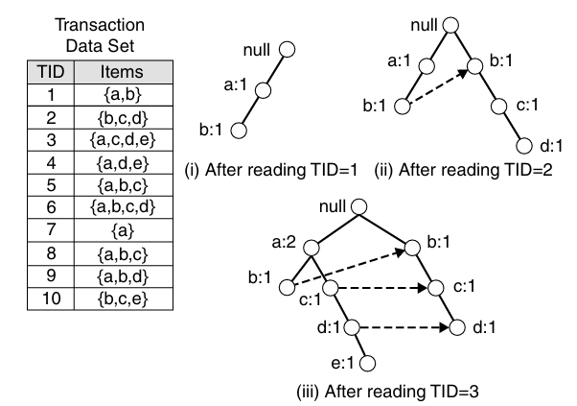
FP-Tree Representation:
An FP-tree is a compressed representation of the input data. It is constructed by reading the data set one transaction at a time and mapping each transaction onto a path in the FP-tree.

Slide 58
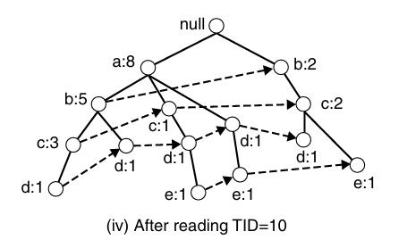

Slide 59
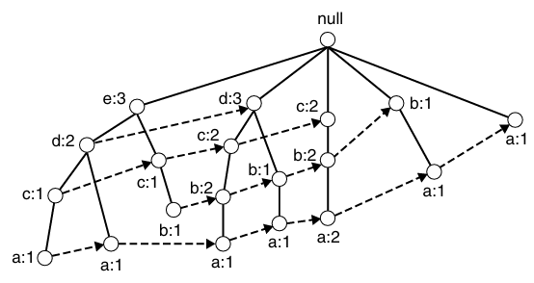
The size of an FP-tree also depends on how the items are ordered. If the ordering scheme in the preceding example is reversed, the resulting FP-tree is shown as follows:
An FP-tree also contains a list of pointers connecting between nodes that have the same items. These pointers, represented as dashed lines in above Figures, help to facilitate the rapid access of individual items in the tree.

Slide 60
Frequent Itemset Generation in FP-Growth Algorithm:
FP-growth is an algorithm that generates frequent itemsets from an FP-tree by exploring the tree in a bottom-up fashion. Given the example tree shown in previous(First) Figure, the algorithm looks for frequent itemsets ending in e first, followed by d, c, b, and finally, a. This bottom-up strategy for finding frequent item sets ending with a particular item is equivalent to the suffix-based approach.
Since every transaction is mapped onto a path in the FP-tree, we can derive the frequent itemsets ending with a particular item, say, e, by examining only the paths containing node e. These paths can be accessed rapidly using the pointers associated with node e. The extracted paths are shown in following Figure.

Slide 61
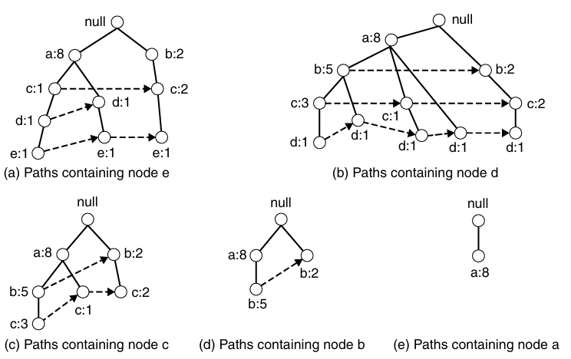

Slide 62
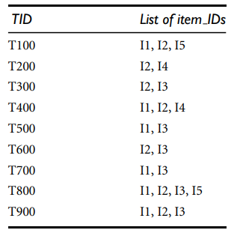
Example of FP-Growth Algorithm:

Slide 63
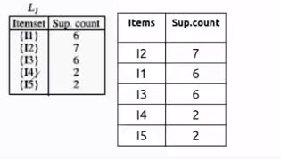

Slide 64

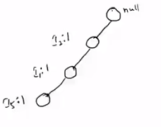
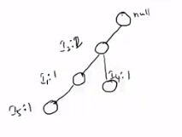

Slide 65
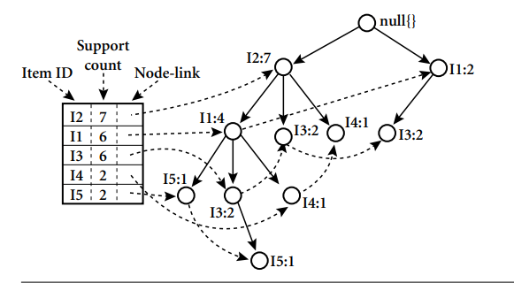

Slide 66
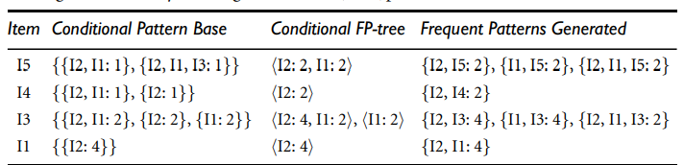

Slide 67


Slide 68


Slide 69



Slide 70


Slide 71



Slide 72


Slide 73


Slide 74


Slide 75


Slide 76
Advantages -FP Growth Algorithm:
This algorithm needs to scan the database only twice.
The pairing of items is not done in this algorithm and this makes it faster.
The database is stored in a compact version in memory.
It is efficient and scalable for mining both long and short frequent patterns.

