Slide 1
DATA WAREHOUSING
&
DATA MINING

Slide 2
UNIT–I
Data Warehousing and Online Analytical Processing: Basic concepts, Data Warehouse Modelling: Data Cube and OLAP, Data Warehouse Design and Usage, Data Warehouse Implementation, Cloud Data Warehouse.
Data Mining and Patten Mining, Technologies, Applications, Major issues.
Data Objects &Attribute Types, Basic Statistical Descriptions of Data, Data Visualization, Measuring Data Similarity and Dissimilarity.

Slide 3
Data Warehousing and Online Analytical Processing(OLAP):
Data warehouses generalize and consolidate data in multidimensional space. The construction of data warehouses involves data cleaning, data integration, and data transformation, and can be viewed as an important preprocessing step for data mining.
Moreover, data warehouses provide online analytical processing (OLAP) tools for the interactive analysis of multidimensional data of varied granularities, which facilitates effective data generalization and data mining.

Slide 4
Data Warehouse: Basic Concepts
What is data warehouse?
Defined in many different ways, but not rigorously.
A decision support database that is maintained separately from the organization’s operational database
Support information processing by providing a solid platform of consolidated, historical data for analysis.
“A data warehouse is a subject-oriented, integrated, time-variant, and nonvolatile collection of data in support of management’s decision-making process.”—W. H. Inmon
Data warehousing:
The process of constructing and using data warehouses

Slide 5
Data Warehouse—Subject-Oriented
Organized around major subjects, such as customer, product, sales & suppliers.
Focusing on the modeling and analysis of data for decision makers, not on daily operations or transaction processing
Provide a simple and concise view around particular subject issues by excluding data that are not useful in the decision support process
Data Warehouse— Integrated
Constructed by integrating multiple, heterogeneous data sources
relational databases, flat files, on-line transaction records
Data cleaning and data integration techniques are applied.
Ensure consistency in naming conventions, encoding structures, attribute measures, etc. among different data sources
E.g., Hotel price: currency, tax, breakfast covered, etc.
When data is moved to the warehouse, it is converted.

Slide 6
Data Warehouse—Time Variant
The time horizon for the data warehouse is significantly longer than that of operational systems
Operational database: current value data
Data warehouse data: provide information from a historical perspective (e.g., past 5-10 years)
Every key structure in the data warehouse
Contains an element of time, explicitly or implicitly
But the key of operational data may or may not contain “time element”

Slide 7
Operational Database Order ID | Customer ID | Product ID
1001 | C01 | P101
Example Data Warehouse Product ID | Month | Sales
P101 | Jan 2026 | 500
P101 | Feb 2026 | 650
➡️ Here, Month is the time element.

Slide 8
Data Warehouse— Nonvolatile
A physically separate store of data transformed from the operational environment
Operational update of data does not occur in the data warehouse environment
Does not require transaction processing, recovery, and concurrency control mechanisms
Requires only two operations in data accessing:
initial loading of data and access of data

Slide 9
Differences between Operational Database Systems and Data Warehouses:
The major task of online operational database systems is to perform online transaction and query processing. These systems are called online transaction processing (OLTP) systems. They cover most of the day-to-day operations of an organization such as purchasing, inventory, manufacturing, banking, payroll, registration, and accounting. Data warehouse systems, on the other hand, serve users or knowledge workers in the role of data analysis and decision making. Such systems can organize and present data in various formats in order to accommodate the diverse needs of different users. These systems are known as online analytical processing (OLAP) systems.
The major distinguishing features of OLTP and OLAP are summarized as follows:
Users and system orientation: An OLTP system is customer-oriented and is used for transaction and query processing by clerks, clients, and information technology professionals. An OLAP system is market-oriented and is used for data analysis by knowledge workers, including managers, executives, and analysts.

Slide 10
Data contents: An OLTP system manages current data that, typically, are too detailed to be easily used for decision making. An OLAP system manages large amounts of historic data, provides facilities for summarization and aggregation, and stores and manages information at different levels of granularity.
Database design: An OLTP system usually adopts an entity-relationship (ER) data model and an application-oriented database design. An OLAP system typically adopts either a star or a snowflake model and a subject-oriented database design.
View: An OLTP system focuses mainly on the current data within an enterprise or department, without referring to historic data or data in different organizations. In contrast, an OLAP system often spans multiple versions of a database schema, due to the evolutionary process of an organization.
Access patterns: The access patterns of an OLTP system consist mainly of short, atomic transactions. Such a system requires concurrency control and recovery mechanisms. However, accesses to OLAP systems are mostly read-only operations(because most data warehouses store historic rather than up-to-date information), although many could be complex queries.

Slide 11
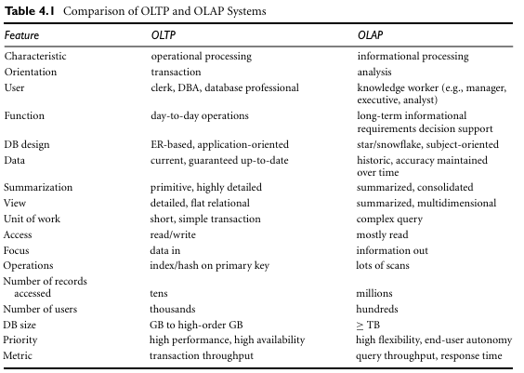

Slide 12
Why Separate Data Warehouse?
High performance for both systems
DBMS— tuned for OLTP: access methods, indexing, concurrency control, recovery
Warehouse—tuned for OLAP: complex OLAP queries, multidimensional view, consolidation
Different functions and different data:
missing data: Decision support requires historical data which operational DBs do not typically maintain
data consolidation: DS requires consolidation (aggregation, summarization) of data from heterogeneous sources
data quality: different sources typically use inconsistent data representations, codes and formats which have to be reconciled
Note: There are more and more systems which perform OLAP analysis directly on relational databases.

Slide 13
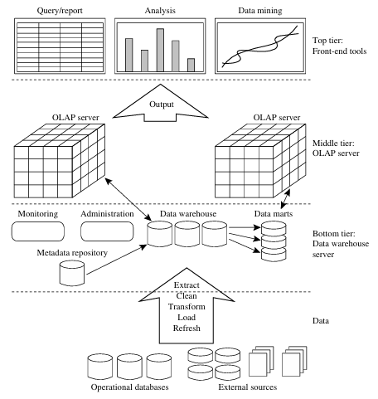
Data Warehousing: A Multitiered Architecture
Data warehouses often adopt a three-tier architecture is as follows:

Slide 14
The bottom tier is a warehouse database server that is almost always a relational database system. Back-end tools and utilities are used to feed data into the bottom tier from operational databases or other external sources (e.g., customer profile information provided by external consultants). These tools and utilities perform data extraction, cleaning, and transformation, as well as load and refresh functions to update the data warehouse.
The middle tier is an OLAP server that is typically implemented using either relational OLAP(ROLAP) model (i.e. an extended relational DBMS that maps operations on multidimensional data to standard relational operations); or (2) a multi dimensional OLAP (MOLAP) model (i.e., a special-purpose server that directly implements multidimensional data and operations).
The top tier is a front-end client layer, which contains query and reporting tools, analysis tools, and/or data mining tools (e.g., trend analysis, prediction, and so on).

Slide 15
Data Warehouse Models:
From the architecture point of view, there are three data warehouse models: the enterprise warehouse, the data mart, and the virtual warehouse.
Enterprise warehouse: An enterprise warehouse collects all of the information about subjects spanning the entire organization. It provides corporate-wide data integration, usually from one or more operational systems or external information providers, and is cross-functional in scope. It typically contains detailed data as well as summarized data.
Data mart: A data mart contains a subset of corporate-wide data that is of value to a specific group of users. The scope is confined to specific selected subjects. For example, a marketing data mart may confine its subjects to customer, item, and sales. The data contained in data marts tend to be summarized. Depending on the source of data, data marts can be categorized as independent or dependent. Independent data marts are sourced from data captured from one or more operational systems or external information providers, or from data generated locally within a particular department or geographic area. Dependent data marts are sourced directly from enterprise data warehouses.
Virtual warehouse: A virtual warehouse is a set of views over operational databases. For efficient query processing, only some of the possible summary views may be materialized. A virtual warehouse is easy to build but requires excess capacity on operational database servers.

Slide 16
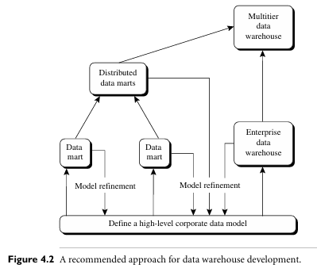
A recommended method for the development of data warehouse systems is to implement the warehouse in an incremental and evolutionary manner, as shown in Figure 4.2. First, a high-level corporate data model is defined within a reasonably short period (such as one or two months) that provides a corporate-wide, consistent, integrated view of data among different subjects and potential usages. This high-level model, although it will need to be refined in the further development of enterprise data warehouses and departmental data marts, will greatly reduce future integration problems.

Slide 17
Second, independent data marts can be implemented in parallel with the enterprise. warehouse based on the same corporate data model set noted before. Third, distributed data marts can be constructed to integrate different data marts via hub servers. Finally, a multitier data warehouse is constructed where the enterprise warehouse is the sole custodian of all warehouse data, which is then distributed to the various dependent data marts.
Extraction, Transformation, and Loading:
Data warehouse systems use back-end tools and utilities to populate and refresh their data (Figure 4.1). These tools and utilities include the following functions:
Data extraction: which typically gathers data from multiple, heterogeneous, and external sources.
Data cleaning: which detects errors in the data and rectifies them when possible.
Data transformation: which converts data from legacy or host format to warehouse format.

Slide 18
Load: which sorts, summarizes, consolidates, computes views, checks integrity, and builds indices and partitions.
Refresh: which propagates the updates from the data sources to the warehouse.
Besides cleaning, loading, refreshing, and metadata definition tools, data warehouse systems usually provide a good set of data warehouse management tools.
Metadata Repository:
Metadata are data about data. When used in a data warehouse, metadata are the data that define warehouse objects. Figure 4.1 showed a metadata repository within the bottom tier of the data warehousing architecture.
A metadata repository should contain the following:
Data warehouse structure: which includes the warehouse schema, view, dimensions, hierarchies, and derived data definitions, as well as data mart locations and contents.
Operational metadata: which include data lineage (history of migrated data and the sequence of transformations applied to it), currency of data (active, archived, or purged), and monitoring information (warehouse usage statistics, error reports, and audit trails).

Slide 19
The algorithms used for summarization: which include measure and dimension definition algorithms, data on granularity, partitions, subject areas, aggregation, summarization, and predefined queries and reports.
Mapping from the operational environment to the data warehouse: which includes source databases and their contents, gateway descriptions, data partitions, data extraction, cleaning, transformation rules and defaults, data refresh and purging rules, and security (user authorization and access control).
Data related to system performance: which include indices and profiles that improve data access and retrieval performance, in addition to rules for the timing and scheduling of refresh, update, and replication cycles.
Business metadata: which include business terms and definitions, data ownership information, and charging policies.

Slide 20
Data Warehouse Modelling
Data Cube and OLAP Data warehouses and OLAP tools are based on a multidimensional data model. This model views data in the form of a data cube.
Data Cube: A Multi dimensional Data Model
A data cube allows data to be modeled and viewed in multiple dimensions. It is defined by dimensions and facts.
In general terms, dimensions are the entities with respect to which an organization wants to keep records. For example, All Electronics may create a sales data warehouse in order to keep records of the store’s sales with respect to the dimensions time, item, branch, and location. These dimensions allow the store to keep track of things like monthly sales of items and the branches and locations at which the items were sold.
Each dimension may have a table associated with it, called a dimension table, which further describes the dimension.
A multidimensional data model is typically organized around a central theme, such as sales. This theme is represented by a fact table. Facts are numeric measures (quantities by which we want to analyze relationships between dimensions).
Ex: Facts for a sales data warehouse include dollars sold (sales amount in dollars), units sold (number of units sold).

Slide 21
Data Warehouse Modelling
A data cube (or OLAP cube) is a multi-dimensional data structure used in business intelligence and data warehousing for rapid, interactive analysis. It organizes metrics (facts) along different categories (dimensions)—like time, product, and location—allowing users to effortlessly aggregate, slice, and view data from multiple perspectives.
Grouping of data in a multidimensional matrix is called data cubes. In

Slide 22
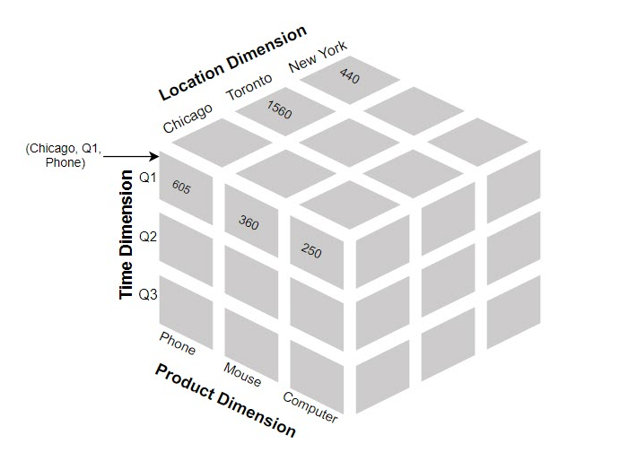

Slide 23
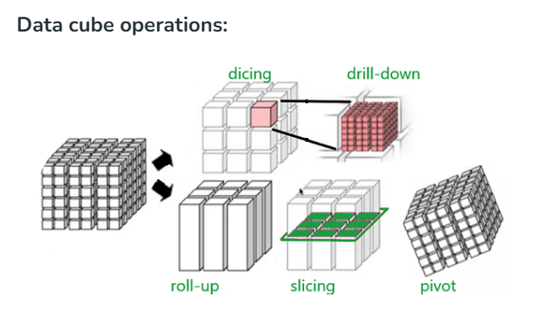

Slide 24
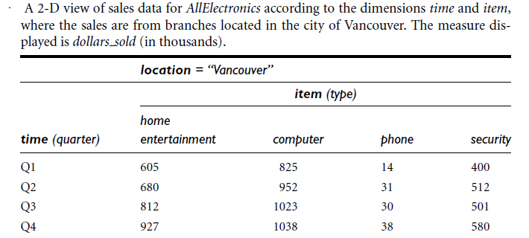
For example, a dimension table for item may contain the attributes item name, brand, and type. Dimension tables can be specified by users or experts, or automatically generated and adjusted based on data distributions.
In data warehousing literature, an n-D base cube is called a base cuboid. The top most 0-D cuboid, which holds the highest-level of summarization, is called the apex cuboid. The lattice of cuboids forms a data cube

Slide 25
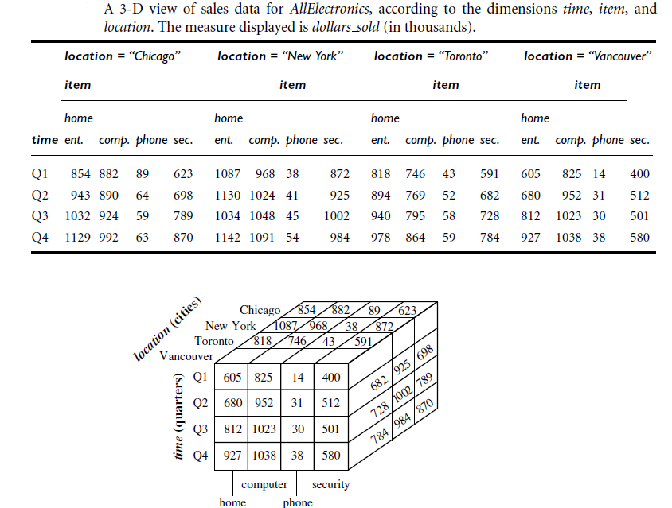

Slide 26
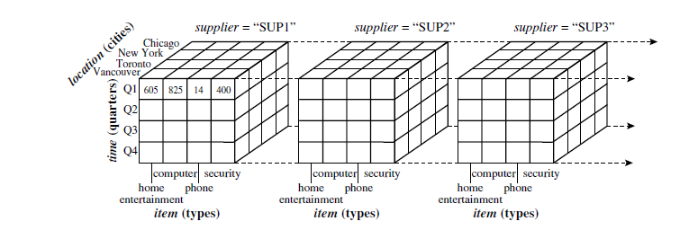

Slide 27
Cube: A Lattice of Cuboids
all
0-D(apex) cuboid
time
item
location
supplier
1-D cuboids
time,location
item,location
location,supplier
2-D cuboids
time,supplier
item,supplier
time,location,supplier
3-D cuboids
time,item,supplier
item,location,supplier
4-D(base) cuboid

Slide 28
Conceptual Modeling of Data Warehouses
Modeling data warehouses: dimensions & measures
Star schema: A fact table in the middle connected to a set of dimension tables
Snowflake schema: A refinement of star schema where some dimensional hierarchy is normalized into a set of smaller dimension tables, forming a shape similar to snowflake
Fact constellations: Multiple fact tables share dimension tables, viewed as a collection of stars, therefore called galaxy schema or fact constellation

Slide 29
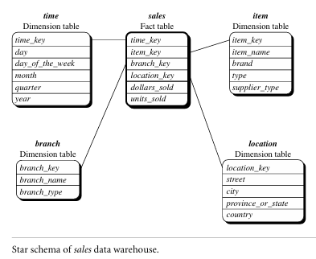

Slide 30
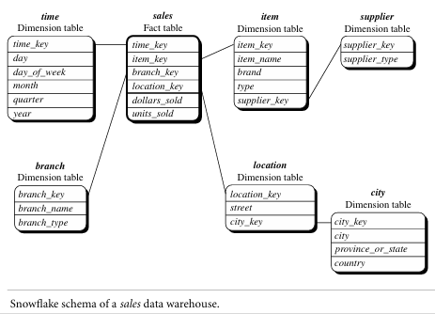

Slide 31
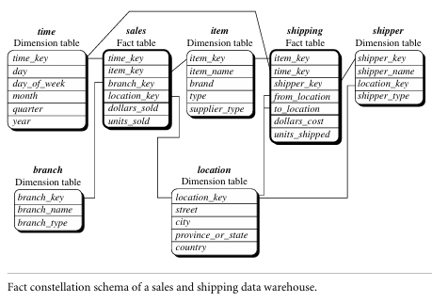

Slide 32
Cube Definition Syntax in DMQL
Cube Definition (Fact Table)
define cube <cube_name> [<dimension_list>]: <measure_list>
Dimension Definition (Dimension Table)
define dimension <dimension_name> as (<attribute_or_subdimension_list>)
Special Case (Shared Dimension Tables)
First time as “cube definition”
define dimension <dimension_name> as <dimension_name_first_time> in cube <cube_name_first_time>

Slide 33
Defining Star Schema in DMQL
define cube sales_star [time, item, branch, location]:
dollars_sold = sum(sales_in_dollars), avg_sales = avg(sales_in_dollars), units_sold = count(*)
define dimension time as (time_key, day, day_of_week, month, quarter, year)
define dimension item as (item_key, item_name, brand, type, supplier_type)
define dimension branch as (branch_key, branch_name, branch_type)
define dimension location as (location_key, street, city, province_or_state, country)

Slide 34
Defining Snowflake Schema in DMQL
define cube sales_snowflake [time, item, branch, location]:
dollars_sold = sum(sales_in_dollars), avg_sales = avg(sales_in_dollars), units_sold = count(*)
define dimension time as (time_key, day, day_of_week, month, quarter, year)
define dimension item as (item_key, item_name, brand, type, supplier(supplier_key, supplier_type))
define dimension branch as (branch_key, branch_name, branch_type)
define dimension location as (location_key, street, city(city_key, province_or_state, country))

Slide 35
Defining Fact Constellation in DMQL
define cube sales [time, item, branch, location]:
dollars_sold = sum(sales_in_dollars), avg_sales = avg(sales_in_dollars), units_sold = count(*)
define dimension time as (time_key, day, day_of_week, month, quarter, year)
define dimension item as (item_key, item_name, brand, type, supplier_type)
define dimension branch as (branch_key, branch_name, branch_type)
define dimension location as (location_key, street, city, province_or_state, country)
define cube shipping [time, item, shipper, from_location, to_location]:
dollar_cost = sum(cost_in_dollars), unit_shipped = count(*)
define dimension time as time in cube sales
define dimension item as item in cube sales
define dimension shipper as (shipper_key, shipper_name, location as location in cube sales, shipper_type)
define dimension from_location as location in cube sales
define dimension to_location as location in cube sales

Slide 36
Dimensions: The Role of Concept Hierarchies
A concept hierarchy defines a sequence of mappings from a set of low-level concepts to higher-level (or) more general concepts. Consider a concept hierarchy for the dimension location. City values for location include Vancouver, Toronto, New York, and Chicago. Each city, however, can be mapped to the province or state to which it belongs.
For example, Vancouver can be mapped to British Columbia, and Chicago to Illinois. The provinces and states can in turn be mapped to the country (e.g., Canada or the United States) to which they belong. These mappings form a concept hierarchy for the dimension location, mapping a set of low-level concepts(i.e., cities) to higher-level, more general concepts (i.e., countries). This concept hierarchy is illustrated in Figure 4.9.
Many concept hierarchies are implicit within the database schema. For example, suppose that the dimension location is described by the attributes number, street, city, province or state, zip code, and country. These attributes are related by a total order, forming a concept hierarchy such as “street < city < province or state < country.” This hierarchy is shown in Figure 4.10.

Slide 37
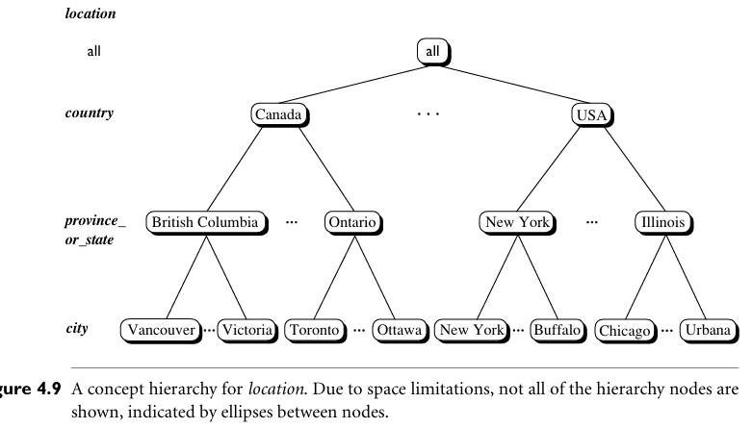

Slide 38
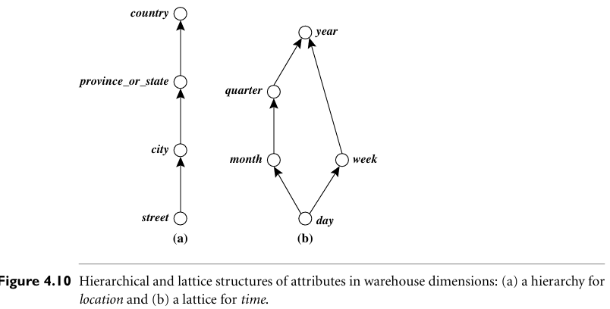

Slide 39
Measures of Data Cube: Three Categories
Distributive: if the result derived by applying the function to n aggregate values is the same as that derived by applying the function on all the data without partitioning
E.g., count(), sum(), min(), max()
Algebraic: if it can be computed by an algebraic function with M arguments (where M is a bounded integer), each of which is obtained by applying a distributive aggregate function
E.g., avg(), min_N(), standard_deviation()
Holistic: if there is no constant bound on the storage size needed to describe a subaggregate.
E.g., median(), mode(), rank()

Slide 40
Typical OLAP Operations
Roll up (drill-up): summarize data
by climbing up hierarchy or by dimension reduction
Drill down (roll down): reverse of roll-up
from higher level summary to lower level summary or detailed data, or introducing new dimensions
Slice and dice: project and select
Pivot (rotate):
reorient the cube, visualization, 3D to series of 2D planes
Other operations
drill across: involving (across) more than one fact table
drill through: through the bottom level of the cube to its back-end relational tables (using SQL)

Slide 41
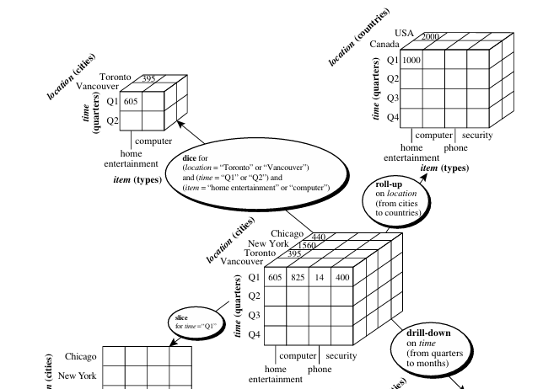

Slide 42
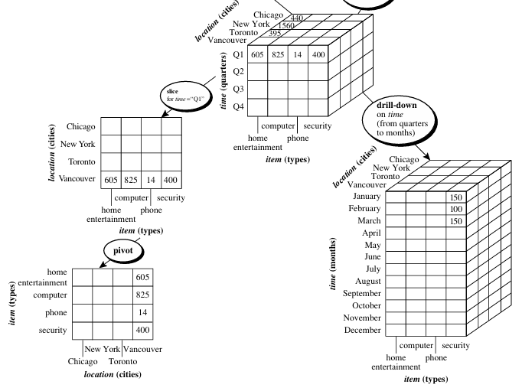

Slide 43
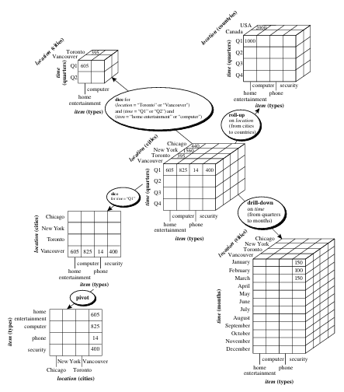

Slide 44
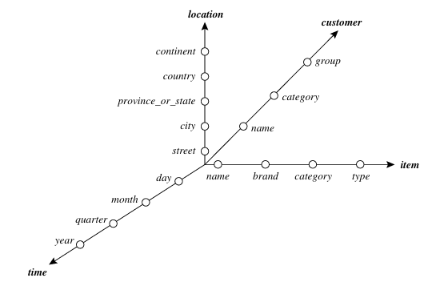
A Starnet Query Model for Querying Multidimensional Databases:
The querying of multidimensional databases can be based on a starnet model, which consists of radial lines emanating from a central point, where each line represents a concept hierarchy for a dimension.
Ex: Starnet
A starnet query model for the AllElectronics data warehouse is shown in Figure 4.13. This starnet consists of four radial lines, representing concept hierarchies for the dimensions location, customer, item, and time, respectively. Each line consists of footprints representing abstraction levels of the dimension.

Slide 45
Data Warehouse Design and Usage
What goes into a data warehouse design?
How are data warehouses used?
How do data warehousing and OLAP relate to data mining?
A Business Analysis Framework for Data Warehouse Design:
To design an effective data warehouse we need to understand and analyze business needs and construct a business analysis framework. The construction of a large and complex information system can be viewed as the construction of a large and complex building, for which the owner, architect, and builder have different views. These views are combined to form a complex framework that represents the top-down, business-driven, or owner’s perspective, as well as the bottom-up, builder-driven, or implementer's view of the information system.
Four different views regarding a data warehouse design must be considered:
The top-down view allows the selection of the relevant information necessary for the data warehouse. This information matches current and future business needs.

Slide 46
The data source view exposes the information being captured, stored, and managed by operational systems. This information may be documented at various levels of detail and accuracy, from individual data source tables to integrated data source tables.
The data warehouse view includes fact tables and dimension tables. It represents the information that is stored inside the data warehouse, including precalculated totals and counts, as well as information regarding the source, date, and time of origin, added to provide historical context.
Finally, the business query view is the data perspective in the data warehouse from the end-user’s viewpoint.
Building and using a data warehouse is a complex task because it requires business skills, technology skills, and program management skills.

Slide 47
Data Warehouse Design Process
A data warehouse can be built using a top-down approach, a bottom-up approach, or a combination of both.
The top-down approach starts with overall design and planning. It is useful in cases where the technology is mature and well known, and where the business problems that must be solved are clear and well understood.
The bottom up approach starts with experiments and prototypes. This is useful in the early stage of business modeling and technology development.
In the combined approach, an organization can exploit the planned and strategic nature of the top-down approach while retaining the rapid implementation and opportunistic application of the bottom-up approach.
From software engineering point of view:
Waterfall: structured and systematic analysis at each step before proceeding to the next
Spiral: rapid generation of increasingly functional systems, short turn around time, quick turn around

Slide 48
The warehouse design process consists of the following steps:
Choose a business process to model (e.g., orders, invoices, shipments, inventory, account administration, sales, or the general ledger)
Choose the business process grain, which is the fundamental, atomic level of data to be represented in the fact table for this process (e.g., individual transactions, individual daily snapshots, and so on).
Choose the dimensions that will apply to each fact table record. Typical dimensions are time, item, customer, supplier, warehouse, transaction type, and status.
Choose the measures that will populate each fact table record. Typical measures are numeric additive quantities like dollars sold and units sold.

Slide 49
Data Warehouse Usage for Information Processing
Data warehouses and data marts are used in a wide range of applications. Business executives use the data in data warehouses and data marts to perform data analysis and make strategic decisions.
There are three kinds of data warehouse applications: information processing, analytical processing, and data mining. Information processing supports querying, basic statistical analysis, and reporting using crosstabs, tables, charts, or graphs.
Analytical processing supports basic OLAP operations, including slice-and-dice, drill-down, roll-up, and pivoting. It generally operates on historic data in both summarized and detailed forms.
Data mining supports knowledge discovery by finding hidden patterns and associations, constructing analytical models, performing classification and prediction, and presenting the mining results using visualization tools.

Slide 50
From Online Analytical Processing to Multidimensional Data Mining:
The data mining field has conducted substantial research regarding mining on various data types, including relational data, data from data warehouses, transaction data, time-series data, spatial data, text data, and flat files.
Multidimensional data mining integrates OLAP with data mining to uncover knowledge in multidimensional databases. Among the many different paradigms and architectures of data mining systems, multidimensional data mining is particularly important for the following reasons:
High quality of data in data warehouses
Available information processing infrastructure surrounding data warehouses
OLAP-based exploration of multidimensional data
Online selection of data mining functions

Slide 51
Data Warehouse Implementation
Data warehouses contain huge volumes of data. OLAP servers demand that decision support queries be answered in the order of seconds. Therefore, it is crucial for data warehouse systems to support highly efficient cube computation techniques, access methods, and query processing techniques.
Efficient Data Cube Computation: An Overview
Multidimensional data analysis is the efficient computation of aggregations across many sets of dimensions. In SQL terms, these aggregations are referred to as group-by’s. Each group-by can be represented by a cuboid, where the set of group-by’s forms a lattice of cuboids defining a data cube. The issues relating to the efficient computation of data cubes are:
The compute cube Operator and the Curse of Dimensionality:
The compute cube operator computes aggregates over all subsets of the dimensions specified in the operation. This can require excessive storage space, especially for large numbers of dimensions.

Slide 52
Example: A data cube is a lattice of cuboids. Suppose that you want to create a data cube for AllElectronics sales that contains the following: city, item, year, and sales in dollars. You want to be able to analyze the data, with queries such as the following:
“Compute the sum of sales, grouping by city and item.”
“Compute the sum of sales, grouping by city.”
“Compute the sum of sales, grouping by item.”
Taking the three attributes, city, item, and year, as the dimensions for the data cube, and sales in dollars as the measure, the total number of cuboids, or group by’s, that can be computed for this data cube is 2³ = 8.
The possible group-by’s are the following: {(city, item, year), (city, item), (city, year), (item, year), (city), (item), (year), ()} where () means that the group-by is empty. These group-by’s form a lattice of cuboids for the data cube, as shown in Figure.

Slide 53
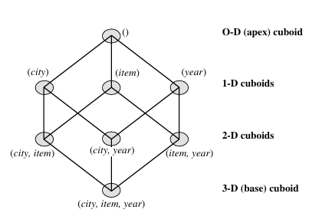

Slide 54
The base cuboid contains all three dimensions, city, item, and year. It can return the total sales for any combination of the three dimensions. Note: The apex cuboid, or 0-D cuboid, refers to the case where the group-by is empty. It contains the total sum of all sales.
The base cuboid is the least generalized (most specific) of the cuboids. The apex cuboid is the most generalized (least specific) of the cuboids, and is often denoted as all.
If we start at the apex cuboid and explore downward in the lattice, this is equivalent to drilling down within the data cube. If we start at the base cuboid and explore upward, this is akin to rolling up.
The SQL syntax, the data cube in Example could be defined as: define cube sales cube [city, item, year]: sum(sales in dollars)
For a cube with n dimensions, there are a total of 2^{n} cuboids, including the base cuboid. A statement such as compute cube sales cube would explicitly instruct the system to compute the sales aggregate cuboids for all eight subsets of the set {city, item, year} including the empty subset.

Slide 55

It is good idea to compute in advance all or at least some of the cuboids in a data cube. Precomputation leads to fast response time and avoids some redundant computation.
A major challenge related to this precomputation is, required storage space may explode if all the cuboids in a data cube are precomputed, especially when the cube has many dimensions. The storage requirements are even more excessive when many of the dimensions have associated concept hierarchies, each with multiple levels. This problem is referred to as the curse of dimensionality.
For an n-dimensional data cube, the total number of cuboids that can be generated is:
where L_{i} is the number of levels associated with dimension i. One is added to L_{i} to include the virtual top level, all.
From this we realize that it is unrealistic to precompute and materialize all of the cuboids that can possibly be generated for a data cube. If there are many cuboids, and these cuboids are large in size, a more reasonable option is partial materialization.

Slide 56
Partial Materialization: Selected Computation of Cuboids
There are three choices for data cube materialization given a base cuboid:
No materialization: Do not precompute any of the “nonbase” cuboids. This leads to computing expensive multidimensional aggregates on-the-fly, which can be extremely slow.
Full materialization: Precompute all of the cuboids. The resulting lattice of computed cuboids is referred to as the full cube. This choice typically requires huge amounts of memory space in order to store all of the precomputed cuboids.
Partial materialization: Selectively compute a proper subset of the whole set of possible cuboids. Alternatively, we may compute a subset of the cube, which contains only those cells that satisfy some user-specified criterion, such as where the tuple count of each cell is above some threshold. We will use the term subcube to refer to the latter case, where only some of the cells may be precomputed for various cuboids. Partial materialization represents an interesting trade-off between storage space and response time.

Slide 57
The partial materialization of cuboids or subcubes should consider three factors:
Identify the subset of cuboids or subcubes to materialize;
Exploit the materialized cuboids or subcubes during query processing; and
Efficiently update the materialized cuboids or subcubes during load and refresh.
The selection of the subset of cuboids or subcubes to materialize should take into account the queries in the workload, their frequencies, and their accessing costs. The selection must also consider the broad context of physical database design such as the generation and selection of indices. A popular approach is to materialize the cuboids set on which other frequently referenced cuboids are based.
Another common strategy is to materialize a shell cube. This involves precomputing the cuboids for only a small number of dimensions (e.g., three to five) of a data cube.

Slide 58
Once the selected cuboids have been materialized, it is important to take advantage of them during query processing. This involves several issues, such as how to determine the relevant cuboid(s) from among the candidate materialized cuboids, how to use available index structures on the materialized cuboids, and how to transform the OLAP operations onto the selected cuboid(s).
Finally, during load and refresh, the materialized cuboids should be updated efficiently. Parallelism and incremental update techniques for this operation should be explored.
Indexing OLAP Data: Bitmap Index and Join Index
The bitmap indexing method is popular in OLAP products because it allows quick searching in data cubes. The bitmap index is an alternative representation of the record ID (RID) list. In the bitmap index for a given attribute, there is a distinct bit vector, Bv, for each value v in the attribute’s domain. If a given attribute’s domain consists of n values, then n bits are needed for each entry in the bitmap index

Slide 59
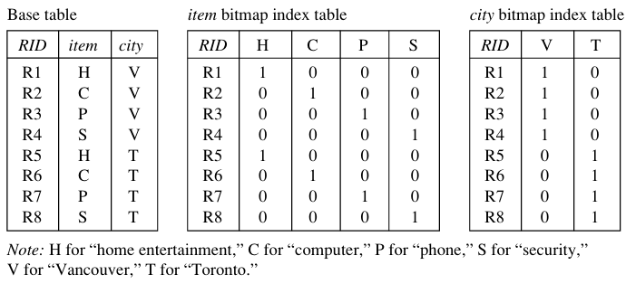
If the attribute has the value v for a given row in the data table, then the bit representing that value is set to 1 in the corresponding row of the bitmap index. All other bits for that row are set to 0.
Ex: Bitmap indexing. In the AllElectronics data warehouse, suppose the dimension item at the top level has four values: “home entertainment,” “computer,” “phone,” and “security.” Each value (e.g., “computer”) is represented by a bit vector in the item bitmap index table. Suppose that the cube is stored as a relation table with 100,000 rows. Because the domain of item consists of four values, the bitmap index table requires four bit vectors (or lists), each with 100,000 bits.
Fig: Indexing OLAP data using bitmap indices

Slide 60
The join indexing method gained popularity from its use in relational database query processing. Traditional indexing maps the value in a given column to a list of rows having that value. In contrast, join indexing registers the joinable rows of two relations from a relational database. For example, if two relations R.RID, A and S.B, SID join on the attributes A and B, then the join index record contains the pair .RID, SID, where RID and SID are record identifiers from the R and S relations, respectively. Hence, the join index records can identify joinable tuples without performing costly join operations.
Join indexing. In Example 3.4, we defined a star schema for AllElectronics of the form “sales star [time, item, branch, location]: dollars sold sum (sales in dollars).” An example of a join index relationship between the sales fact table and the location and item dimension tables is shown in Figure 4.16.

Slide 61
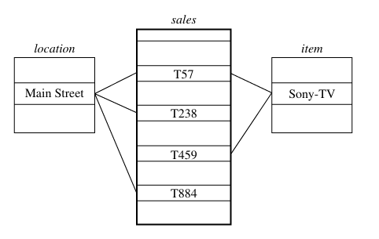
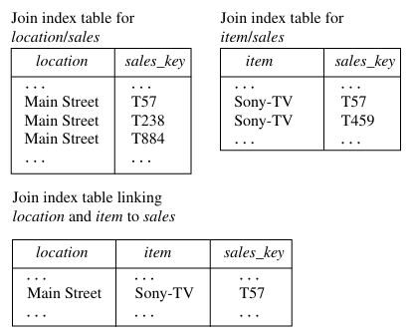

Slide 62
Efficient Processing of OLAP Queries
The purpose of materializing cuboids and constructing OLAP index structures is to speed up query processing in data cubes. Given materialized views, query processing should proceed as follows:
1. Determine which operations should be performed on the available cuboids
2. Determine to which materialized cuboid(s) the relevant operations should be applied
Ex: OLAP query processing. Suppose that we define a data cube for AllElectronics of the form “sales cube [time, item, location]: sum(sales in dollars).” The dimension hierarchies used are “day < month < quarter < year” for time; “item name < brand < type” for item; and “street < city < province or state < country” for location.
Suppose that the query to be processed is on brand, province or state, with the selection constant “year = 2010.” Also, suppose that there are four materialized cuboids available, as follows:
cuboid 1: {year, item name, city}
cuboid 2: {year, brand, country}
cuboid 3: {year, brand, province or state}
cuboid 4: {item name, province or state}, where year = 2010

Slide 63
“Which of these four cuboids should be selected to process the query?” Finer-granularity data cannot be generated from coarser-granularity data. Therefore, cuboid 2 cannot be used because country is a more general concept than province or state. Cuboids 1, 3, and 4 can be used to process the query because:
they have the same set or a superset of the dimensions in the query,
the selection clause in the query can imply the selection in the cuboid, and
the abstraction levels for the item and location dimensions in these cuboids are at a finer level than brand and province or state, respectively.
OLAP Server Architectures: ROLAP versus MOLAP versus HOLAP
Logically, OLAP servers present business users with multidimensional data from data warehouses or data marts, without concerns regarding how or where the data are stored. However, the physical architecture and implementation of OLAP servers must consider data storage issues. Implementations of a warehouse server for OLAP processing include the following:

Slide 64
Relational OLAP (ROLAP)servers: These are the intermediate servers that stand in between a relational back-end server and client front-end tools. They use a relational or extended-relational DBMS to store and manage warehouse data, and OLAP middleware to support missing pieces. ROLAP servers include optimization for each DBMS back end, implementation of aggregation navigation logic, and additional tools and services. ROLAP technology tends to have greater scalability than MOLAP technology.
Multidimensional OLAP(MOLAP)servers: These servers support multidimensional data views through array-based multidimensional storage engines. They map multi dimensional views directly to data cube array structures. The advantage of using a data cube is that it allows fast indexing to precomputed summarized data.
Hybrid OLAP(HOLAP)servers: The hybrid OLAP approach combines ROLAP and MOLAP technology, benefiting from the greater scalability of ROLAP and the faster computation of MOLAP. For example, a HOLAP server may allow large volumes of detailed data to be stored in a relational database, while aggregations are kept in a separate MOLAP store. The Microsoft SQL Server 2000 supports a hybrid OLAP server.

Slide 65
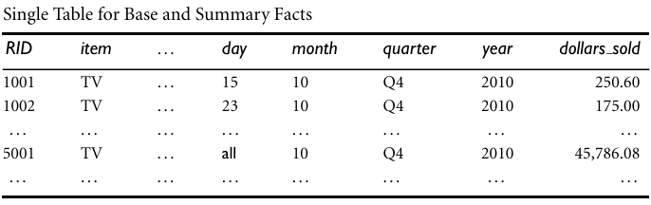
Specialized SQL servers: To meet the growing demand of OLAP processing in relational databases, some database system vendors implement specialized SQL servers that provide advanced query language and query processing support for SQL queries over star and snow flake schemas in a read-only environment.
Ex: A ROLAP data store. Following Table shows a summary fact table that contains both base fact data and aggregated data.

