Slide 1
Python

Slide 2
Pandas
Pandas is a powerful open-source Python library used for data manipulation, analysis, and preprocessing.
It provides easy-to-use data structures and functions to work with structured data such as tables, spreadsheets, CSV files, and databases.
Pandas is a Python library that helps users read, clean, organize, analyze, and manipulate datasets efficiently.

Slide 3
Pandas
Pandas is an open-source Python library used for data manipulation, analysis, and cleaning. It provides powerful data structures such as Series and DataFrame that make handling large datasets easier.
Pandas (stands for Python Data Analysis) is an open-source software library designed for data manipulation and analysis.
Built on top of NumPy, efficiently manages large datasets, offering tools for data cleaning, transformation and analysis.
Seamlessly integrates with other Python libraries like NumPy, Matplotlib and scikit-learn.
Revolves around two primary Data structures: Series (1D) and DataFrame (2D)

Slide 4
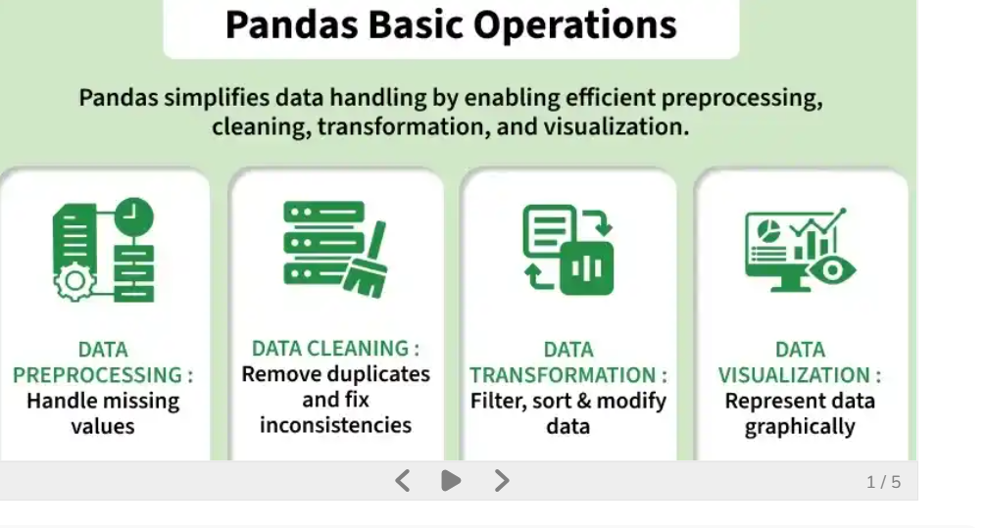
Pandas-Operations

Slide 5
Pandas-Why is Pandas Used?
Read data from CSV, Excel, JSON, SQL, etc.
Clean missing or duplicate data.
Filter and sort data.
Merge and join datasets.
Perform statistical analysis.
Group and summarize data.
Prepare data for machine learning.

Slide 6
Read files using Pandas
read_csv() Syntax in Pandas- read_csv() is a Pandas function used to read data from a CSV (Comma Separated Values) file and store it in a DataFrame.
import pandas as pd
df = pd.read_csv(filepath_or_buffer)

Slide 7
Syntax
df = pd.read_csv(
filepath_or_buffer,
sep=',',
header='infer',
names=None,
index_col=None,
usecols=None,
skiprows=None,
nrows=None
)

Slide 8
Read CSV File
import pandas as pd
df = pd.read_csv("students.csv")
print(df)

Slide 9
Example 2: Read Specific Columns
df = pd.read_csv("students.csv", usecols=['Name', 'Marks'])

Slide 10
Example 3: Change Delimiter
df = pd.read_csv("students.csv", sep=';')

Slide 11
Example 4: Read First 5 Rows Only
df = pd.read_csv("students.csv", nrows=5)

Slide 12
Used in Data Cleaning
df = pd.read_csv(
"students.csv",
na_values=['NA', 'Null'],
skiprows=1
)

Slide 13
header
import pandas as pd df = pd.read_csv("students.csv“ header=“infer”) print(df)
Output:First row is considered as header
Header=“None”
No header in CSV then default header is 0 1 2 index

Slide 14
1. Check if the dataset contains missing values
import pandas as pd
df = pd.read_csv("students.csv")
print(df.isnull())
Or
print(df.isna())

Slide 15
2. Count missing values in each column
print(df.isnull().sum())

Slide 16
3. Count total missing values in the dataset
print(df.isnull().sum().sum())

Slide 17
4. Display only the rows containing missing values
print(df[df.isnull().any(axis=1)])

Slide 18
5. Check if any missing values exist
print(df.isnull().values.any())

Slide 19
Function | Purpose
df.isnull() or df.isna() | Show missing values (True/False)
df.isnull().sum() | Count missing values in each column
df.isnull().sum().sum() | Count total missing values
df[df.isnull().any(axis=1)] | Show rows with missing values
df.isnull().values.any() | Check whether any missing values exist

Slide 20
Student.csv
Student_ID Name Age Gender Marks City
10 101 Asha 20.0 Female 85.0 Hyderabad
1 102 Ravi 21.0 Male 78.0 Vijayawada
2103 Priya NaN Female 92.0 Guntur
3 104 Kiran 22.0 Male NaN Visakhapatnam
4 105 Divya 20.0 Female 88.0 NaN
5 106 Rahul 23.0 Male 76.0 Vijayawada
6 107 Sneha NaN Female 95.0 Hyderabad
7 108 Arjun 21.0 Male 81.0 NaN
8 109 Meena 22.0 Female NaN Guntur
9 110 Vikram 20.0 Male 90.0 Visakhapatnam

Slide 21
isnull()
isna()
notnull()
dropna()
fillna()
Mean, median, and mode imputation
Forward fill (ffill) Backward fill (bfill)

Slide 22
Check the Missing Values
df.isnull().sum()

Slide 23
Method 2: Remove Columns with Missing Values
df2 = df.dropna(axis=1)
print(df2)
Axis =0 operate on column wise
Axis=1 operate on row wise

Slide 24
Method 3: Replace Missing Values with a Constant
Replace with 0
df.fillna(0, inplace=True)
inplace=True means make the changes directly to the original DataFrame. The operation modifies the existing DataFrame, so you don't need to assign the result to a new variable.

Slide 25
Method 4: Replace Missing Numeric Values with Mean
df["Marks"] = df["Marks"].fillna(df["Marks"].mean())

Slide 26
Method 5: Replace Missing Numeric Values with Median
df["Age"] = df["Age"].fillna(df["Age"].median())

Slide 27
Method 6: Replace Missing Values with Mode
df["City"] = df["City"].fillna(df["City"].mode()[0])

Slide 28
Method 7: Forward Fill
Copies the previous value into the missing position.
df.fillna(method="ffill", inplace=True)

Slide 29
Method 8: Backward Fill
df.fillna(method="bfill", inplace=True)

Slide 30
import pandas as pd
# Read CSV file
df = pd.read_csv("student.csv")
# Display dataset
print(df)
# Display missing values
print(df.isnull())
# Count missing values
print(df.isnull().sum())
# Fill missing Age with median
df["Age"] = df["Age"].fillna(df["Age"].median())
# Fill missing Marks with mean
df["Marks"] = df["Marks"].fillna(df["Marks"].mean())
# Fill missing City with mode
df["City"] = df["City"].fillna(df["City"].mode()[0])
# Display updated dataset
print(df)

Slide 31
In Python, the from ... import syntax is used to import specific functions, classes, variables, or modules from a module.
from module_name import item_name

Slide 33
from math import sqrt
print(sqrt(25))

Slide 34
from math import sqrt, factorial
print(sqrt(16))
print(factorial(5))

Slide 35
from math import *
print(sqrt(49))
print(pi)

