Slide 1
UNIT–I
Data Warehousing and Online Analytical Processing: Basic concepts, Data Warehouse Modelling: Data Cube and OLAP, Data Warehouse Design and Usage, Data Warehouse Implementation, Cloud Data Warehouse.
Data Mining and Patten Mining, Technologies, Applications, Major issues.
Data Objects & Attribute Types, Basic Statistical Descriptions of Data, Data Visualization, Measuring Data Similarity and Dissimilarity.

Slide 2
Measuring Data Similarity and Dissimilarity:
In data mining applications, such as clustering, outlier analysis, and nearest-neighbor classification, we need ways to assess how alike or unalike objects are in comparison to one another.
For example, a store may want to search for clusters of customer objects, resulting in groups of customers with similar characteristics (e.g., similar income, area of residence, and age). Such information can then be used for marketing.
A cluster is a collection of data objects such that the objects within a cluster are similar to one another and dissimilar to the objects in other clusters.

Slide 3
A similarity measure for two objects, I and j, will typically return the value 0 if the objects are unalike. The higher the similarity value, the greater the similarity between objects.
Note: Typically, a value of 1 indicates complete similarity, that is, the objects are identical.
A dissimilarity measure works the opposite way. It returns a value of 0 if the objects are the same.

Slide 4
Data Matrix versus Dissimilarity Matrix:
Suppose that we have n objects (e.g., persons, items, or courses) described by p attributes (also called measurements or features, such as age, height, weight, or gender).
The objects are x₁= (x₁₁,x₁₂, ,x_{1p}), x₂= (x₂₁,x₂₂, ,x_{2p}),and soon, where x_{ij} is the value for object xi of the j^{th} attribute.
Here after refer to object x_{i} as object i. The objects may be tuples in a relational database, and are also referred to as data samples or feature vectors.

Slide 5
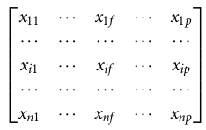
Data matrix (or object-by-attribute structure): This structure stores the n data objects in the form of a relational table, or n-by-p matrix:
Each row corresponds to an object.
Dissimilarity matrix (or object-by-object structure): This structure stores a collection of proximities that are available for all pairs of n objects. It is often represented by an n-by-n table:

Slide 6
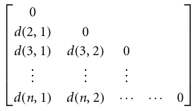
where d(i, j) is the measured dissimilarity or “difference” between objects i and j. In general, d(i, j) is a non-negative number that is close to 0 when objects i and j are highly similar or “near” each other, and becomes larger when more they differ.
Measures of similarity can often be expressed as a function of measures of dissimilarity. For example, for nominal data:
sim(i, j)=1- d(i,j),
where sim(i, j) is the similarity between objects i and j.

Slide 7
A data matrix is made up of two entities namely rows (for objects) and columns (for attributes). Therefore, the data matrix is often called a two-mode matrix. The dissimilarity matrix contains one kind of entity (dissimilarities) and so is called a one-mode matrix.
Proximity Measures for Nominal Attributes:
A nominal attribute can take on two or more states. For example, map color is a nominal attribute that may have, say, five states: red, yellow, green, pink, and blue.
Let the number of states of a nominal attribute be M. The states can be denoted by letters, symbols, or a set of integers, such as 1, 2, , M.

Slide 8

The dissimilarity between two objects i and j can be computed based on the ratio of mismatches:
Where m is the number of matches and p is the total number of attributes describing the objects.
Note: Weights can be assigned to increase the effect of m.
Ex: Dissimilarity between nominal attributes. Suppose that we have the sample data of Table 2.2

Slide 9
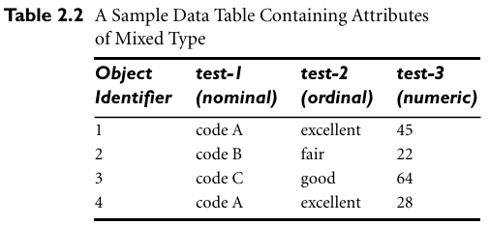
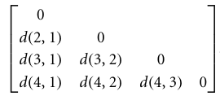
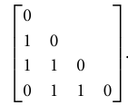
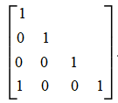
(a) (b) ©
Since here we have one nominal attribute, test-1, we set
P = 1 so that d(i,j) evaluates to 0 if objects I and j match, and 1 if the objects differ. Thus, we get (b)
From this, we see that all objects are dissimilar except objects 1 and 4 (i.e.,d(4,1)= 0).

Slide 10

Nominal attributes can be encoded using asymmetric binary attributes by creating a new binary attribute for each of the M states. For an object with a given state value, the binary attribute representing that state is set to 1, while the remaining binary attributes are set to 0.
Ex: To encode the nominal attribute map color, a binary attribute can be created for each of the five colors previously listed. For an object having the color yellow, the yellow attribute is set to 1, while the remaining four attributes are set to 0.

Slide 11
Proximity Measures for Binary Attributes:
Dissimilarity and similarity measures for objects described by either symmetric or asymmetric binary attributes. The binary attribute has only one of two states: 0 and 1, where 0 means that the attribute is absent, and 1 means that it is present.
Given the attribute smoker describing a patient: 1 indicates that the patient smokes, while 0 indicates that the patient does not.
Approach for computing a dissimilarity matrix from the given binary data:
If all binary attributes are thought of as having the same weight, we have the 2X2 contingency table of Table 2.3:
where q is the number of attributes that equal 1 for both objects i and j,
r is the number of attributes that equal 1 for object i but equal 0 for object j, s is the number of attributes that equal 0 for object i but equal 1 for object j, and t is the number of attributes that equal 0 for both objects i and j.
The total number of attributes is p,
where p = q+r+s+t.

Slide 12
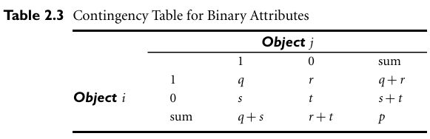


Dissimilarity that is based on symmetric binary attributes is called symmetric binary dissimilarity. If objects i and j are described by symmetric binary attributes, then the dissimilarity between i and j is:
For asymmetric binary attributes, the two states are not equally important, such as the positive(1) and negative(0) outcomes of a disease test. Given two asymmetric binary attributes, the agreement of two 1s(a positive match) is then considered more significant than that of two 0s(a negative match). There fore, such binary attributes are often considered “monary” (having one state). The dissimilarity based on these attributes is called asymmetric binary dissimilarity, where the number of negative matches, t, is considered unimportant and is thus ignored the computation as above:

Slide 13

Complementarily, we can measure the difference between two binary attributes based on the notion of similarity instead of dissimilarity.
The coefficient sim(i,j) is called the Jaccard coefficient.
Ex: Dissimilarity between binary attributes. Suppose that a patient record table(Table2.4) contains the attributes name, gender, fever, cough, test-1, test-2, test-3, and test-4, where name is an object identifier, gender is a symmetric attribute, and the remaining attributes are asymmetric binary.
For asymmetric attribute values, let the values Y(yes) and P(positive) be set to 1, and the value N (no or negative)be set to 0. Suppose that the distance be tween objects is computed based only on the asymmetric attributes. According to Eq. (2.14), the distance between each pair of the three patients—Jack, Mary, and Jim—is

Slide 14
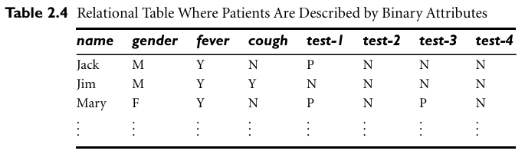

Slide 15
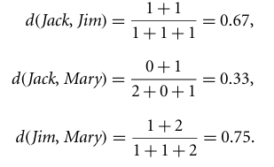
These measurements suggest that Jim and Mary are unlikely to have a similar disease because they have the highest dissimilarity value among the three pairs. From the three patients: Jack and Mary are the most likely to have a similar disease.

Slide 16


Dissimilarity of Numeric Data: Minkowski Distance
Different measures that are commonly used for computing the dissimilarity of objects described by numeric attributes. These measures include the Euclidean, Manhattan, and Minkowski distances.
Euclidean distance:
Let i=(x_{i1}, x_{i2}, , x_{ip}) and j=(x_{j1}, x_{j2}, , x_{jp}) be two objects described by p numeric attributes. The Euclidean distance between objects i and j is defined as:
Manhattan (or city block) distance:

Slide 17
Euclidean Distance:

Slide 18
Euclidean Distance:
Distance Matrix

Slide 19
Both the Euclidean and the Manhattan distance satisfy the following mathematical properties:
Non-negativity: d(i, j)>=0: Distance is a non-negative number.
Identity of indiscernibles: d(i, i)=0: The distance of an object to itself is 0.
Symmetry: d(i,j)=d(j,i): Distance is a symmetric function.
Triangle inequality: d(i,j)<=d(i,k)+d(k,j): Going directly from object i to object j in space is no more than making a detour over any other object k.
Ex: Euclidean distance and Manhattan distance.
Let x₁=(1,2) and x2=(3,5) represent two objects as shown in Figure: 2.23. The Euclidean distance is: 3.61 and Manhattan distance is: 5.

Slide 20
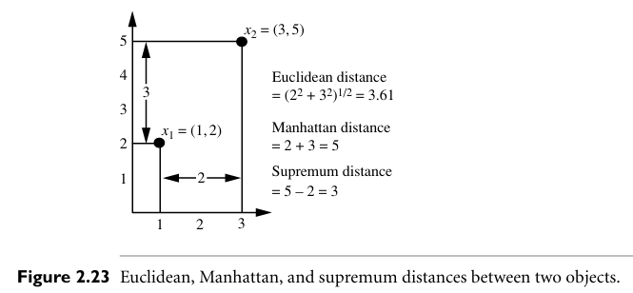

Slide 21

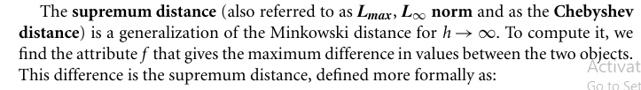
Minkowski distance is a generalization of the Euclidean and Manhattan distances. It is defined as:
Where h is a real number such that h>=1. Such a distance is also called L_{p} norm.
Note: Manhattan distance when h=1(i.e.,L₁norm) and Euclidean distance when h=2 (i.e.,L₂ norm).

Slide 22
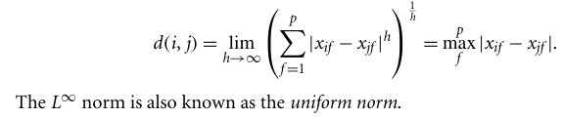
Ex: Supremum distance. Let’s use the same two objects, x1=(1, 2) and x2=(3, 5), as in Figure 2.23. The second attribute gives the greatest difference between values for the objects, which is 5-2=3. This is the supremum distance between both objects.

Slide 23
Minkowski Distance: Examples
r = 1. City block (Manhattan, taxicab, L₁ norm) distance.
A common example of this for binary vectors is the Hamming distance, which is just the number of bits that are different between two binary vectors
r = 2. Euclidean distance
r → ∞. “supremum” (L_{max} norm, L∞ norm) distance.
This is the maximum difference between any component of the vectors

Slide 24
Minkowski Distance: Examples

Slide 25
Minkowski Distance:
Distance Matrix

Slide 26
Proximity Measures for Ordinal Attributes:
The values of an ordinal attribute have a meaningful order or ranking about them, yet the magnitude between successive values is unknown. An example includes the sequence small, medium, large for a size attribute.
“How are ordinal attributes handled?” The treatment of ordinal attributes is quite similar to that of numeric attributes when computing dissimilarity between objects. Suppose that f is an attribute from a set of ordinal attributes describing n objects. The dissimilarity computation with respect to f involves the following steps
The value of f for the i_{th} object is x_{if} , and f has M_{f} ordered states, representing the ranking 1, ,M_{f} . Replace each x_{if} by its corresponding rank, r_{if} 1, , M_{f} .

Slide 27

Since each ordinal attribute can have a different number of states, it is often necessary to map the range of each attribute onto [0.0, 1.0] so that each attribute has equal weight. We perform such data normalization by replacing the rank r_{if} of the i_{th} object in the f th attribute by:
Dissimilarity can then be computed using any of the distance measures described in Section 2.4.4 for numeric attributes, using z_{if} to represent the f value for the ith object.
Example: Dissimilarity between ordinal attributes:
Suppose that we have the sample data shown earlier in Table:2.2, except that this time only the object-identifier and the continuous ordinal attribute, test-2, are available. There are three states for test-2: fair, good, and excellent, that is, Mf=3. For step1, if we replace each value for test-2 by its rank, the four objects are assigned the ranks 3,1,2, and 3, respectively. Step2 normalizes the ranking by mapping rank 1 to 0.0, rank 2 to 0.5, and rank 3 to 1.0. For step3, we can use, say, the Euclidean distance (Eq.2.16), which results in the following dissimilarity matrix:

Slide 28
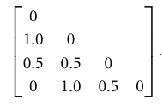
Therefore, objects 1 and 2 are the most dissimilar, as are objects 2 and 4 (i.e., d(2,1)=1.0andd(4,2)=1.0). This makes intuitive sense since objects 1 and 4 are both excellent. Object 2 is fair, which is at the opposite end of the range of valuesfortest-2. Similarity values for ordinal attributes can be interpreted from dissimilarity as sim (i,j)=1- d(i,j).

Slide 29
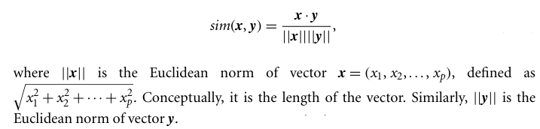
Cosine Similarity:
It is a measure of similarity that can be used to compare documents or, say, give a ranking of documents with respect to a given vector of query words. Let x and y be two vectors for comparison. Using the cosine measure as a similarity function, we have:
The measure computes the cosine of the angle between vectors x and y. A cosine value of 0 means that the two vectors are at 90 degrees to each other (orthogonal) and have no match. The closer the cosine value to 1, the smaller the angle and the greater the match between vectors.

Slide 30
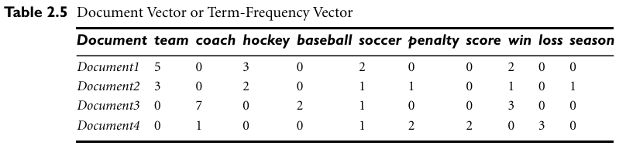

Slide 31
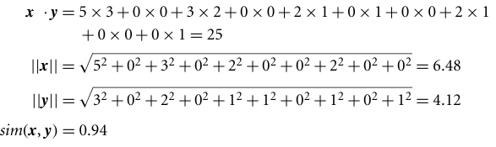
Ex: Cosine similarity between two term-frequency vectors. Suppose that x and y are the first two term-frequency vectors in Table 2.5. That is, x=(5,0,3,0,2,0,0,2,0,0) and y=(3,0,2,0,1,1,0,1,0,1). Compute the cosine similarity between the two vectors?

Slide 32
Example-2:
d₁ = 3 2 0 5 0 0 0 2 0 0
d₂ = 1 0 0 0 0 0 0 1 0 2
<d₁, d2> = 3*1 + 2*0 + 0*0 + 5*0 + 0*0 + 0*0 + 0*0 + 2*1 + 0*0 + 0*2 = 5
| d₁ || = (3*3+2*2+0*0+5*5+0*0+0*0+0*0+2*2+0*0+0*0)^{0.5} = (42) ^{0.5} = 6.481
|| d₂ || = (1*1+0*0+0*0+0*0+0*0+0*0+0*0+1*1+0*0+2*2) ^{0.5} = (6) ^{0.5} = 2.449
cos(d₁, d₂ ) = 0.3150

Slide 33
Example-3:
Doc1: A Student from LBRCE NTR Dist Mylavaram.
Doc2: A Faculty from LBRCE Krishna Dist Vijayawada
Unique words across both documents :
{A,Student,from,LBRCE,NTR,Dist,Mylavaram,Faculty,Krishna,Vijayawada}
So size = 10.
d₁ = 1 1 1 1 1 1 1 0 0 0
d₂ = 1 0 1 1 0 1 0 1 1 1
<d₁, d2> = 4
| d₁ || = (7) ^{0.5} = 2.6458
|| d₂ || = (7) ^{0.5} = 2.6458
cos(d₁, d₂ ) = 4/7 = 0.5714

