Slide 1
Bayes' Theorem- Naive Bayesian

Slide 2
Naive Bayesian Classification
supervised machine learning and data mining algorithm used to predict the category or class of a data point using probability. It is built directly on Bayes' Theorem but introduces a simplifying ("naive") assumption that all features in a dataset are completely independent of one another given the class label.

Slide 3
The Naive Bayes Classifier is a simple probabilistic classifier and it has very few number of parameters which are used to build the ML models that can predict at a faster speed than other classification algorithms.
It is a probabilistic classifier because it assumes that one feature in the model is independent of existence of another feature. In other words, each feature contributes to the predictions with no relation between each other.

Slide 4
Applications
Naive Bayes Algorithm is used in
spam filtration,
Sentimental analysis,
classifying articles and many more.

Slide 5
Assumption of Naive Bayes
The fundamental Naive Bayes assumption is that each feature makes an:
Feature independence: This means that when we are trying to classify something, we assume that each feature (or piece of information) in the data does not affect any other feature.
Continuous features are normally distributed: If a feature is continuous, then it is assumed to be normally distributed within each class.
Discrete features have multinomial distributions: If a feature is discrete, then it is assumed to have a multinomial distribution within each class.
Features are equally important: All features are assumed to contribute equally to the prediction of the class label.
No missing data: The data should not contain any missing values.

Slide 6
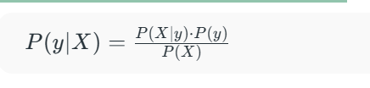
Bayes’ Theorem
Bayes’ Theorem provides a principled way to reverse conditional probabilities. It is defined as:

Slide 7
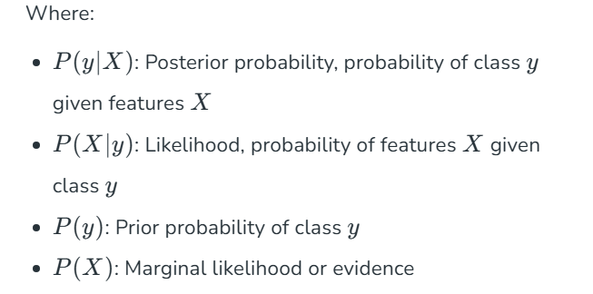

Slide 8
Bayes' Theorem
Bayes' Theorem is a mathematical formula used to determine the conditional probability of an event based on prior knowledge and new evidence.
It adjusts probabilities when new information comes in and helps make better decisions in uncertain situations.

Slide 9
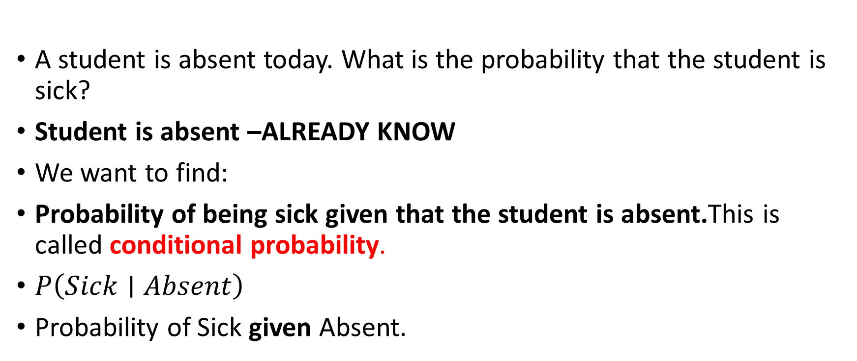
Why Do We Need Bayes' Theorem?
A student is absent today. What is the probability that the student is sick?
Student is absent –ALREADY KNOW
We want to find:
Probability of being sick given that the student is absent.This is called conditional probability.
$P\left(Sick∣Absent\right)$
Probability of Sick given Absent.

Slide 10
We start with what we already know, then we get new information, and that new information changes our probability.
Example: Rain and Dark Clouds
Suppose you are going to college in the morning.
Before looking outside, based on the weather forecast, you believe:
There is a 30% chance of rain today.
This is your prior knowledge:
P(Rain)=0.30

Slide 11
Bayes Theorem and Conditional Probability
Bayes' theorem (also known as the Bayes Rule or Bayes Law) is used to determine the conditional probability of event A when event B has already occurred.

Slide 12
10 Days of Weather-A=Rain B=Dark Clouds
Day | Rain (A) | Dark Clouds (B)
1 | Yes | Yes
2 | Yes | Yes
3 | Yes | No
4 | No | Yes
5 | No | Yes
6 | No | No
7 | Yes | Yes
8 | No | No
9 | No | Yes
10 | No | No

Slide 13

1. Finding P(A)
Count how many days had Rain.
Rain occurred on:
Day 1, 2, 3, 7 = 4 days
Total days = 10
Probability of rain = 40%

Slide 14
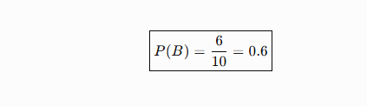

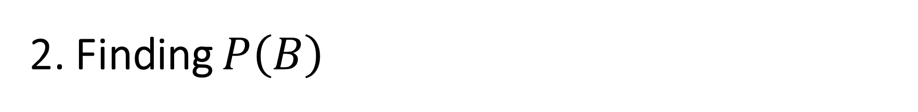
2. Finding $P\left(B\right)$
Now count how many days had Dark Clouds.
Dark clouds occurred on:
Day 1, 2, 4, 5, 7, 9 = 6 days
Therefore:

Slide 15

3. Finding P(A∩B)
A∩B=Rain AND Dark Clouds
Look for days where both are Yes:
Day 1, Day 2, Day 7 = 3 days
Probability of both rain and dark clouds = 30%

Slide 16
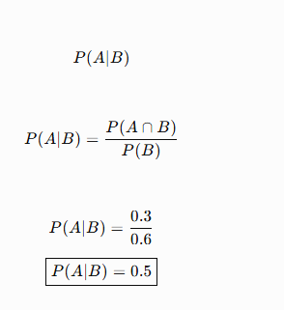
calculate conditional probability
What is the probability of rain when we know that there are dark clouds?
If we know that there are dark clouds, the probability of rain is 50%.

Slide 17
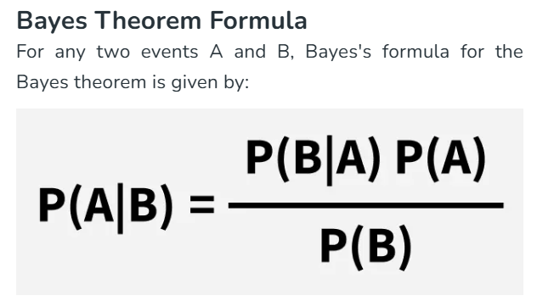
Bayes' Theorem

