Slide 2
A branch of Computer Science named Artificial Intelligence pursues creating the computers or machines as intelligent as human beings.

Slide 3
Basic Concept of Artificial Intelligence (AI)
According to the father of Artificial Intelligence, John McCarthy, it is “The science and engineering of making intelligent machines, especially intelligent computer programs”.

Slide 4
The Necessity of Learning AI
AI can learn through data
AI can teach itself
AI can respond in real time
AI achieves accuracy
AI can organize data to get most out of it

Slide 5
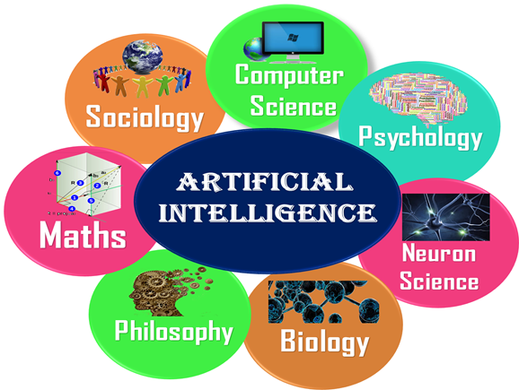

Slide 6
Application of AI
Gaming
Expert Systems
Vision Systems
Speech Recognition
Handwriting Recognition
Intelligent Robots

Slide 7
What is machine learning?
Machine learning is a branch of artificial intelligence (AI) and computer science which focuses on the use of data and algorithms to imitate the way that humans learn, gradually improving its accuracy.

Slide 9
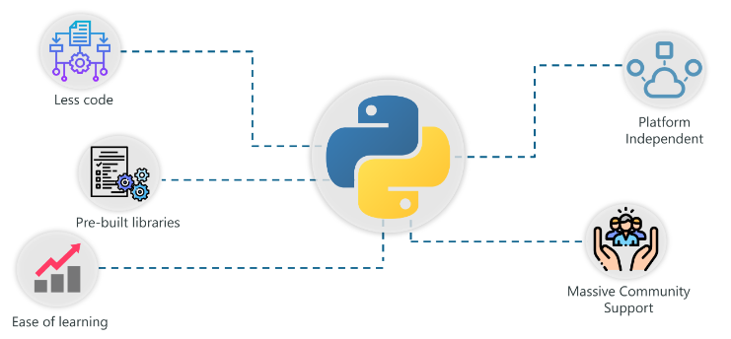
Python With AI

Slide 10
Tensorflow: Developed by Google, this library is popularly used in writing Machine Learning algorithms and performing heavy computations that involve Neural Networks.
Scikit-Learn: Scikit-learn is a Python library associated with NumPy and SciPy. It is considered as one of the best libraries for working with complex data.
NumPy: Numpy is a python library specifically used for computing scientific/mathematical data.
Theano: Theano is a functional library that effectively calculates and computes mathematical expressions involving multi-dimensional arrays.
Keras: This library simplifies the implementation of neural networks. It also has the best functionalities for computing models, evaluating data-sets, visualizing graphs, and much more.
NLTK: NLTK or Natural Language ToolKit is an open source Python library specifically built for Natural Language Processing, text analysis, and text mining.

Slide 11
Pandas
Why Use Pandas?
Pandas allows us to analyze big data and make conclusions based on statistical theories.
Pandas can clean messy data sets, and make them readable and relevant.
Relevant data is very important in data science.

Slide 12
What Can Pandas Do?
Pandas gives you answers about the data. Like:
Is there a correlation between two or more columns?
What is average value?
Max value?
Min value?

Slide 13
Creation of Data Frame
import pandas mydataset = { 'cars': ["BMW", "Volvo", "Ford"], 'passings': [3, 7, 2] } myvar = pandas.DataFrame(mydataset) print(myvar)

Slide 14
What is a Series?
A Pandas Series is like a column in a table.
It is a one-dimensional array holding data of any type.

Slide 15
Create a simple Pandas Series from a list:
import pandas as pd a = [1, 7, 2] myvar = pd.Series(a) print(myvar)
Print(myvar[0])

Slide 16
Add Index
import pandas as pd
a = [1, 7, 2]
myvar = pd.Series(a, index = ["x", "y", "z"])
print(myvar)

Slide 17
Return Value Based on Index
import pandas as pd
a = [1, 7, 2]
myvar = pd.Series(a, index = ["x", "y", "z"])
print(myvar)
print(myvar["y"])

Slide 18
What is a DataFrame?
A Pandas DataFrame is a 2 dimensional data structure, like a 2 dimensional array, or a table with rows and columns.

Slide 19
import pandas as pd data = { "calories": [420, 380, 390], "duration": [50, 40, 45] } #load data into a DataFrame object: df = pd.DataFrame(data) print(df)

Slide 20
Locate Row
As you can see from the result above, the DataFrame is like a table with rows and columns.
Pandas use the loc attribute to return one or more specified row(s)

Slide 21
import pandas as pd
data = {
"calories": [420, 380, 390],
"duration": [50, 40, 45]
}
#load data into a DataFrame object:
df = pd.DataFrame(data)
print(df)
print(df.loc[1])

Slide 22
Return row 0 and 1:
#use a list of indexes: print(df.loc[[0, 1]])

Slide 23
Pandas Read CSV
Read CSV Files
A simple way to store big data sets is to use CSV files (comma separated files).
CSV files contains plain text and is a well know format that can be read by everyone including Pandas.
In our examples we will be using a CSV file called 'data.csv'.

Slide 24
import pandas as pd df = pd.read_csv('data.csv')

Slide 25
import pandas as pd df = pd.read_csv('data.csv') print(df.to_string())

Slide 26
import pandas as pd df = pd.read_csv('data.csv') print(df)

