Slide 2
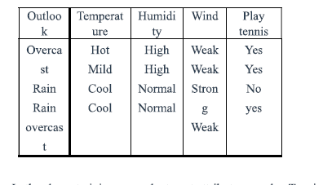
Find-S Algorithm
Outlook | Temperature | Humidity | PlayTennis

Slide 3

Initialize most specific Hypothesis

Slide 4
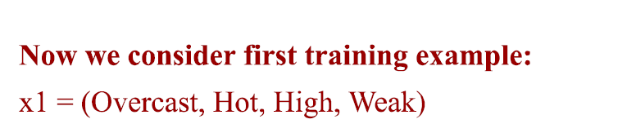
First Positive Training Sample

Slide 5
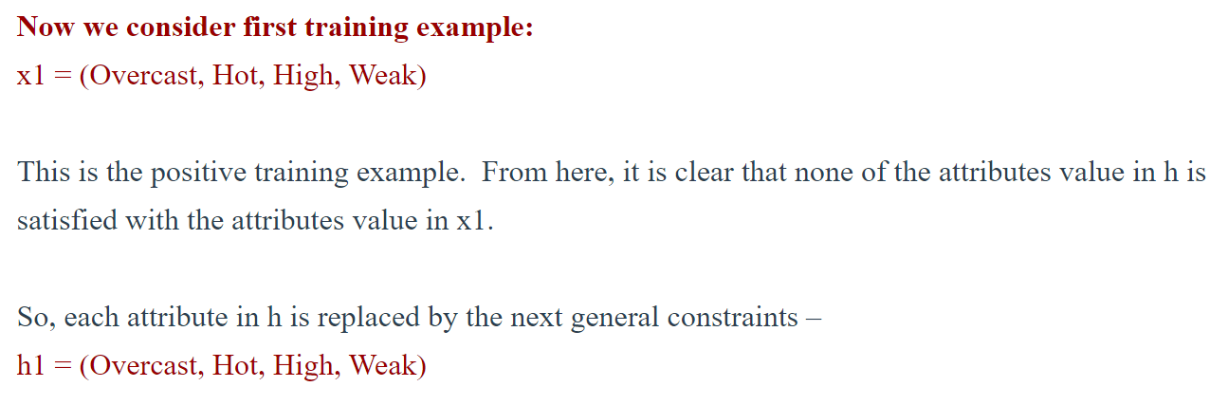
Generate hypothesis h1-

Slide 6
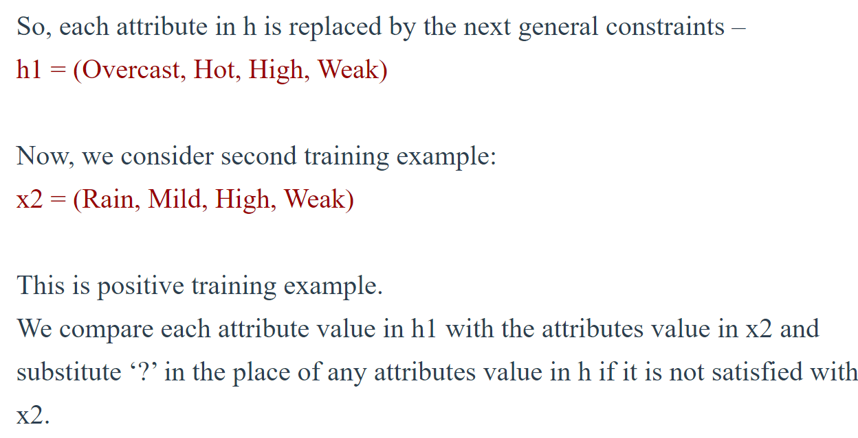
Consider Second Positive Training set then compare with h1 and replace non-matched values with ?

Slide 7
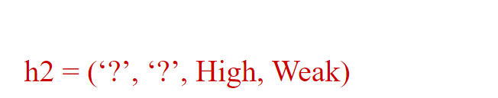
H2-Hypothesis

Slide 8
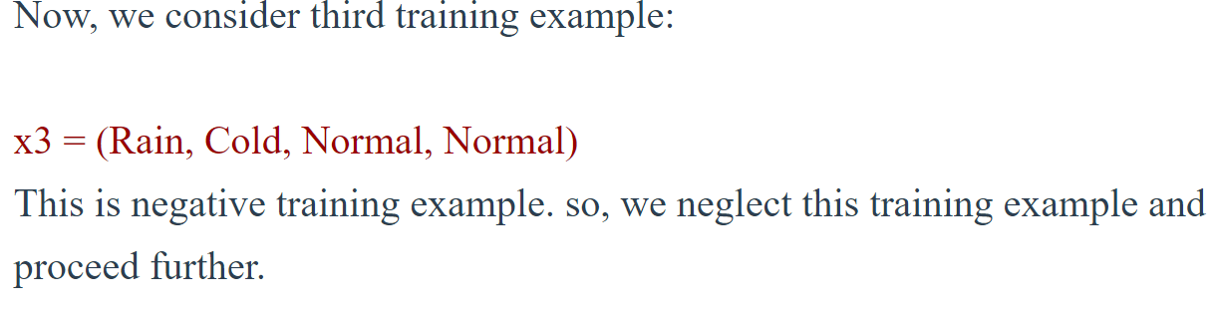
X3-training set is negative Sample- so Neglect

Slide 9
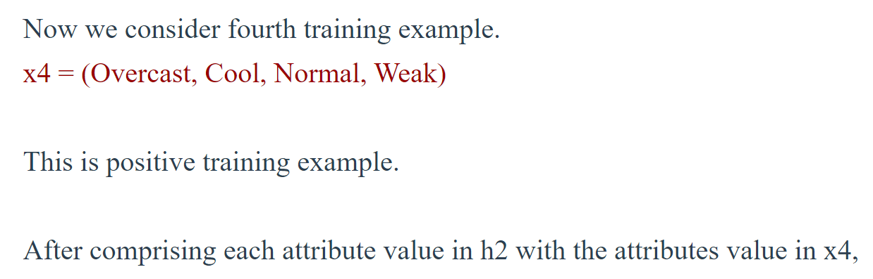

Compare x4 with h2 and generate h3 by replacing ? With unmatched values

Slide 10
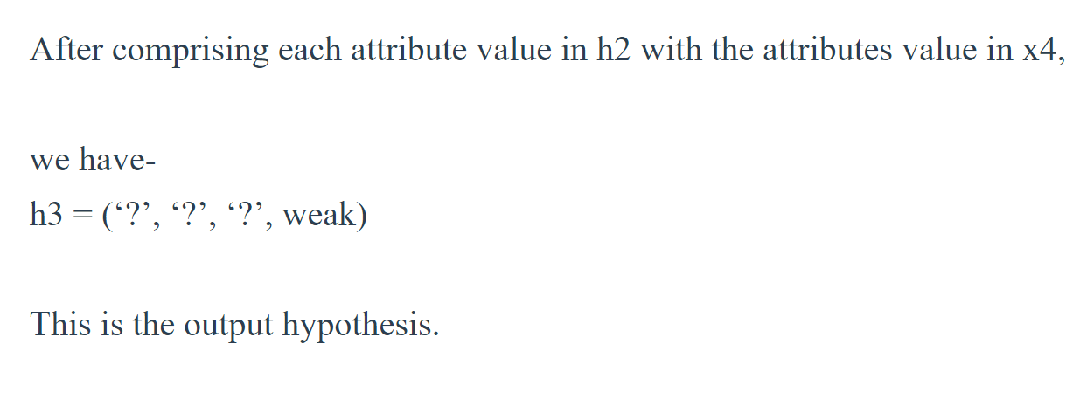

Slide 11
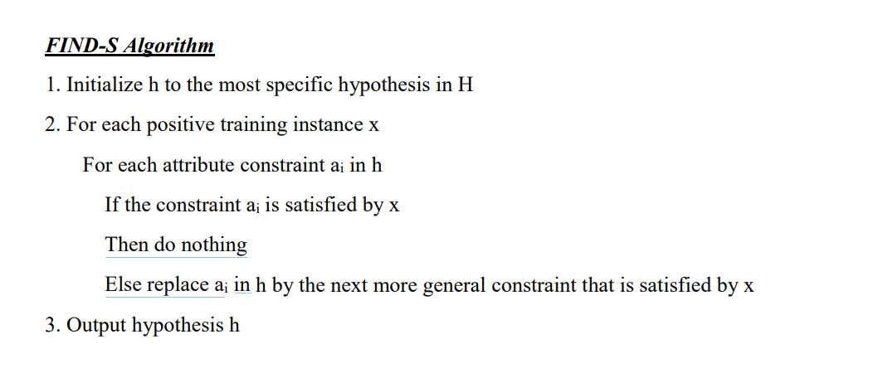

Slide 12
Find-S algorithm
Start with the most specific hypothesis. h = {ϕ, ϕ, ϕ, ϕ, ϕ, ϕ}
Take the next example and if it is negative, then no changes occur to the hypothesis.
If the example is positive and we find that our initial hypothesis is too specific then we update our current hypothesis to a general condition.
Keep repeating the above steps till all the training examples are complete.
After we have completed all the training examples we will have the final hypothesis when can use to classify the new examples.

Slide 13
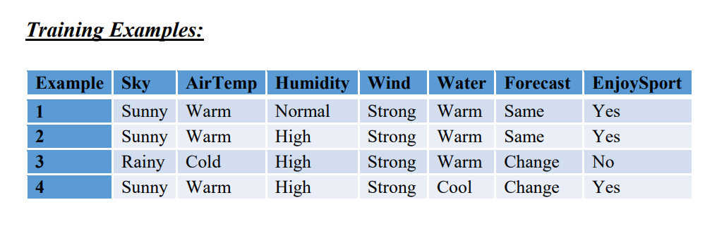

Slide 14
