Slide 1
Unit-4

Slide 2
Well-Proposed Learning Algorithm
A computer program is said to learn from experience E with respect to some class of tasks T and performance measure P, if its performance at tasks in T, as measured by P, improves with experience E.

Slide 3
Well-Proposed Learning Algorithm
A computer program is said to learn from experience E in context to some task T and some performance measure P, if its performance on T, as was measured by P, upgrades with experience E.

Slide 4
Well Defined Learning Algorithm: Three features:
The class of tasks,
the measure of performance to be improved, and
the source of experience.

Slide 5
Scientific Application of Machine Learning
Machine Learning
CSE 574, Spring 2004
Learning to classify new astronomical structures
Very large databases to learn general regularities implicit in the data
Classify celestial objects from image data
Decision tree algorithms are now used by NASA to classify all objects in sky survey which consists of 3 terabytes of image data

Slide 6
A Robot Driving Learning Problem
Machine Learning
CSE 574, Spring 2004
Task T: driving on public, 4-lane highway using vision sensors
Performance measure P: average distance traveled before an error (as judged by human overseer)
Training experience E: a sequence of images and steering commands recorded while observing a human driver

Slide 7
A Handwriting Recognition Learning Problem
Machine Learning
CSE 574, Spring 2004
Task T: recognizing and classifying handwritten words within images
Performance measure P: percent of words correctly classified
Training experience E: a database of handwritten words with given classifications

Slide 8
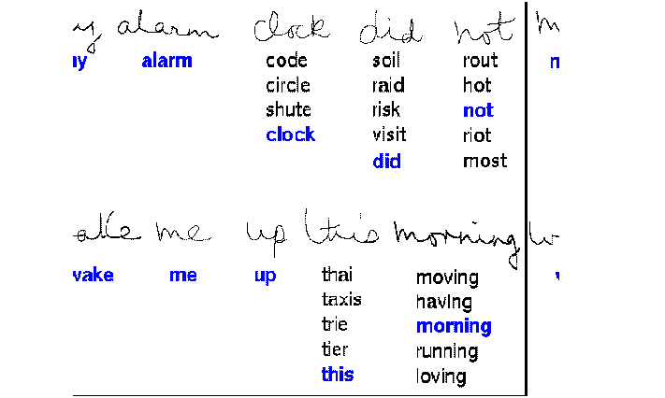
Handwriting Recognition Learning
Machine Learning
CSE 574, Spring 2004

Slide 9
Text Categorization Problem
Machine Learning
CSE 574, Spring 2004
Task T: assign a document to its content category
Performance measure P: Precision and Recall
Training experience E: Example pre- classified documents

Slide 10
To better filter emails as spam or not
Task – Classifying emails as spam or not
Performance Measure – The fraction of emails accurately classified as spam or not spam
Experience – Observing you label emails as spam or not spam

Slide 11
2. A checkers learning problem
Task – Playing checkers game
Performance Measure – percent of games won against opposer
Experience – playing implementation games against itself

Slide 12
Fruit Prediction Problem
Task – forecasting different fruits for recognition
Performance Measure – able to predict maximum variety of fruits
Experience – training machine with the largest datasets of fruits images

Slide 13
Automatic Translation of documents
Task – translating one type of language used in a document to other language
Performance Measure – able to convert one language to other efficiently
Experience – training machine with a large dataset of different types of languages

Slide 14
Learning to recognize spoken words
All of the most successful speech recognition systems employ machine learning in some form. For example, the SPHINX system (e.g., Lee 1989) learns speaker-specific strategies for recognizing the primitive sounds (phonemes) and words from the observed speech signal.
Neural network learning methods (e.g., Waibel et al. 1989) and methods for learning hidden Markov models (e.g., Lee 1989) are effective for automatically customizing to,individual speakers, vocabularies, microphone characteristics, background noise, etc. Similar techniques have potential applications in many signal-interpretation problems.

Slide 15
Learning to drive an autonomous vehicle.
Machine learning methods have been used to train computer-controlled vehicles to steer correctly when driving on a variety of road types. For example, the ALVINN system (Pomerleau 1989) has used its learned strategies to drive unassisted at 70 miles per hour for 90 miles on public highways among other cars. Similar techniques have possible applications in many sensor-based control problems.

Slide 16
Learning to classify new astronomical structures.
Machine learning methods have been applied to a variety of large databases to learn general regularities implicit in the data. For example, decision tree learning algorithms have been used by NASA to learn how to classify celestial objects from the second Palomar Observatory Sky Survey (Fayyad et al. 1995).
This system is now used to automatically classify all objects in the Sky Survey, which consists of three terrabytes of image data.

Slide 17
Learning to play world-class backgammon.
The most successful computer programs for playing games such as backgammon are based on machiie learning algorithms. For example, the world's top computer program for backgammon, TD-GAMMON (Tesauro 1992, 1995). learned its strategy by playing over one million practice games against itself. It now plays at a level competitive with the human world champion. Similar techniques have applications in many practical problems where very large search spaces must be examined efficiently.

Slide 18
DESIGNING A LEARNING SYSTEM
Choosing the Training Experience
Choosing the Target Function
Choosing a Representation for the Target Function
Choosing a Function Approximation Algorithm
The Final Design

Slide 19
DESIGNING A LEARNING SYSTEM for Checkers Game

Slide 20
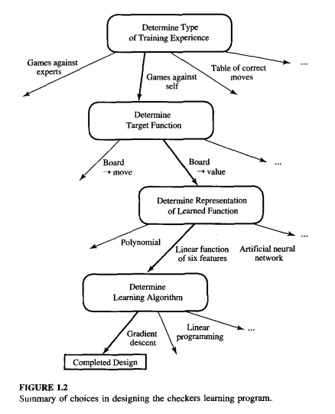

Slide 21
Choosing the Training Experience: impact on Success and Failure of Data:
The first design choice we face is to choose the type of training experience from which our system will learn.
A second important attribute of the training experience is the degree to which the learner controls the sequence of training examples.
A third important attribute of the training experience is how well it represents the distribution of examples over which the final system performance P must be measured.

Slide 22
Type of training experience
Direct information (or training examples) consists of individual checkerboard states and their correct moves.
Indirect information consist of a move sequences and the final outcomes (win or lose).
When using indirect information we are faced with the credit assignment problem: determining how much credit each move should receive for the final outcome.

Slide 23
Experience is the degree to which the learner
Teacher or Not — Supervised — The training experience will be labeled, which means, all the board states will be labeled with the correct move. So the learning takes place in the presence of a supervisor or a teacher. Unsupervised — The training experience will be unlabeled, which means, all the board states will not have the moves. So the learner generates random games and plays against itself with no supervision or teacher involvement. Semi-supervised — Learner generates game states and asks the teacher for help in finding the correct move if the board state is confusi

Slide 24
Experience is the degree to which the learner
For example, the learner might rely on the teacher to select informative board states and to provide the correct move for each. Alternatively, the learner might itself propose board states that it finds particularly confusing and ask the teacher for the correct move. Or the learner may have complete control over both the board states and (indirect) training classifications, as it does when it learns by playing against itself with no teacher present.

Slide 25
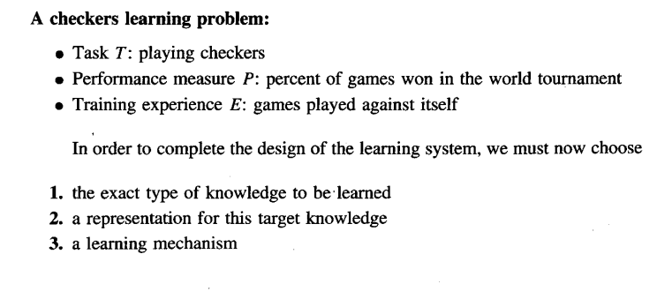
Choosing the Training Experience

Slide 26
2.Choosing the Target Function
The next design choice is to determine exactly what type of knowledge will be learned and how this will be used by the performance program.
The next important step is choosing the target function.

Slide 27
2.Choosing the Target Function
When you are playing the checkers game, at any moment of time, you make a decision on choosing the best move from different possibilities. You think and apply the learning that you have gained from the experience. Here the learning is, for a specific board, you move a checker such that your board state tends towards the winning situation. Now the same learning has to be defined in terms of the target function.

Slide 28
Here there are 2 considerations — direct and indirect experience-For Target Function
.
During the direct experience, the checkers learning system, it needs only to learn how to choose the best move among some large search space. We need to find a target function that will help us choose the best move among alternatives.
Let us call this function ChooseMove and use the notation ChooseMove : B →M to indicate that this function accepts as input any board from the set of legal board states B and produces as output some move from the set of legal moves M.

Slide 29
Here there are 2 considerations — direct and indirect experience-For Target Function
When there is an indirect experience, it becomes difficult to learn such function. How about assigning a real score to the board state. So the function be V : B →R indicating that this accepts as input any board from the set of legal board states B and produces an output a real score. This function assigns the higher scores to better board states.

Slide 30
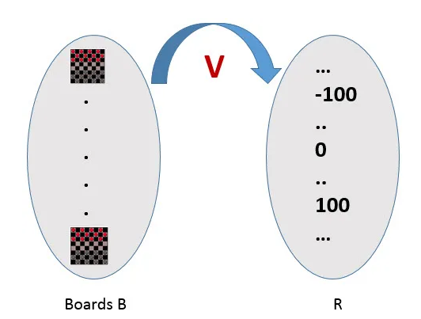
assigning a real score to the board state.

Slide 31
V : B →R
Let us therefore define the target value V(b) for an arbitrary board state b in B, as follows: 1. if b is a final board state that is won, then V(b) = 100 2. if b is a final board state that is lost, then V(b) = -100 3. if b is a final board state that is drawn, then V(b) = 0 4. if b is a not a final state in the game, then V (b) = V (b’), where b’ is the best final board state that can be achieved starting from b and playing optimally until the end of the game.

Slide 32
Step 3- Choosing Representation for Target function:
Now its time to choose a representation that the learning program will use to describe the function ^V that it will learn. The representation of ^V can be as follows.
A table specifying values for each possible board state?
collection of rules?
neural network?
a polynomial function of board features?
…

Slide 33
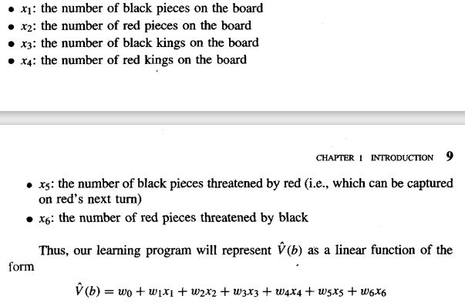
Step 3- Choosing Representation for Target function:

Slide 34
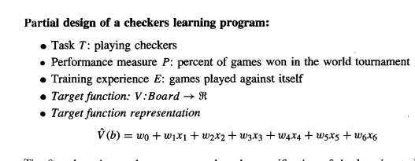
Partial design of a checkers learning program

Slide 35
Step 4- Choosing Function Approximation Algorithm:
To learn the target functionV:B-R(board Value), we require a set of training examples, each describing a specific board state b and the training value (Correct Move ) y for b.
The training algorithm learns/approximates the coefficients u0, u1 up to u6 with the help of these training examples by estimating and adjusting these weights.

Slide 36
Step 4- Choosing Function Approximation Algorithm:
An optimized move cannot be chosen just with the training data.
The training data had to go through with set of example and through these examples the training data will approximates which steps are chosen and after that machine will provide feedback on it.

Slide 37
Step 4- Choosing Function Approximation Algorithm:
In order to learn the target function f we require a set of training examples, each describing a specific board state b and the training value Vtrain(b) for b.
In other words, each training example is an ordered pair of the form (b, V',,,i,(b)). For instance, the following training example describes a board state b in which black has won the game (note x2 = 0 indicates that red has no remaining pieces) and for which the target function value VZrain(b) is therefore +100.

Slide 38

Step 4- Choosing Function Approximation Algorithm:
4.1 ESTIMATING TRAINING VALUES

Slide 39

Step 4- Choosing Function Approximation Algorithm:
4.2 ADJUSTING THE WEIGHTS

Slide 40
5. The Final Design
The final design of our checkers learning system can be naturally described by four distinct program modules that represent the central components in many learning systems. These four modules, summarized in Figure 1.1, are as follows:

Slide 41
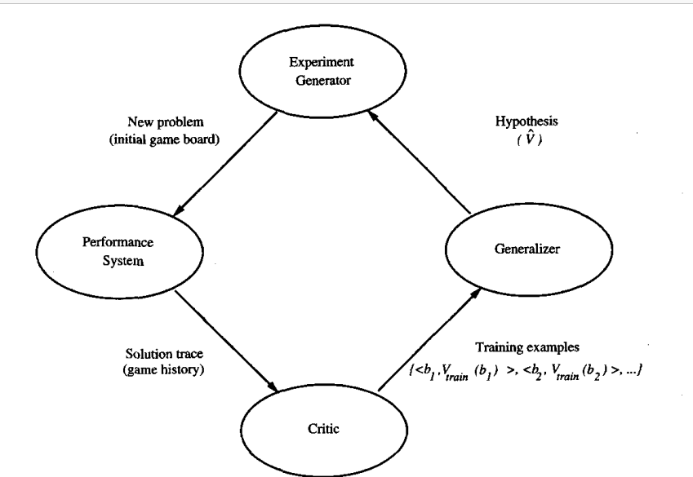

Slide 42
Performance System
The Performance System is the module that must solve the given performance task, in this case playing checkers, by using the learned target function(s).
It takes an instance of a new problem (new game) as input and produces a trace of its solution (game history) as output.
In this strategy used by the Performance System to select its next move at each step is determined by the learned p evaluation function. Therefore, we expect its performance to improve as this evaluation function becomes increasingly accurate.

Slide 43
Critic
The Critic takes as input the history or trace of the game and produces as output a set of training examples of the target function. As shown in the diagram, each training example in this case corresponds to some game state in the trace, along with an estimate Vtrai, of the target function value for this example

Slide 44
Generalizer
The Generalizer takes as input the training examples and produces an output hypothesis that is its estimate of the target function. It generalizes from the specific training examples, hypothesizing a general function that covers these examples and other cases beyond the training examples.

Slide 45
Experiment Generator
The Experiment Generator takes as input the current hypothesis (currently learned function) and outputs a new problem (i.e., initial board state) for the Performance System to explore. Its role is to pick new practice problems that will maximize the learning rate of the overall system.

