Slide 1
Unit-4

Slide 2
Well-Proposed Learning Algorithm
A computer program is said to learn from experience E with respect to some class of tasks T and performance measure P, if its performance at tasks in T, as measured by P, improves with experience E.

Slide 3
Well-Proposed Learning Algorithm
A computer program is said to learn from experience E in context to some task T and some performance measure P, if its performance on T, as was measured by P, upgrades with experience E.

Slide 4
Well Defined Learning Algorithm: Three features:
The class of tasks,
the measure of performance to be improved, and
the source of experience.

Slide 5
Scientific Application of Machine Learning
Machine Learning
CSE 574, Spring 2004
Learning to classify new astronomical structures
Very large databases to learn general regularities implicit in the data
Classify celestial objects from image data
Decision tree algorithms are now used by NASA to classify all objects in sky survey which consists of 3 terabytes of image data

Slide 6
A Robot Driving Learning Problem
Machine Learning
CSE 574, Spring 2004
Task T: driving on public, 4-lane highway using vision sensors
Performance measure P: average distance traveled before an error (as judged by human overseer)
Training experience E: a sequence of images and steering commands recorded while observing a human driver

Slide 7
A Handwriting Recognition Learning Problem
Machine Learning
CSE 574, Spring 2004
Task T: recognizing and classifying handwritten words within images
Performance measure P: percent of words correctly classified
Training experience E: a database of handwritten words with given classifications

Slide 8
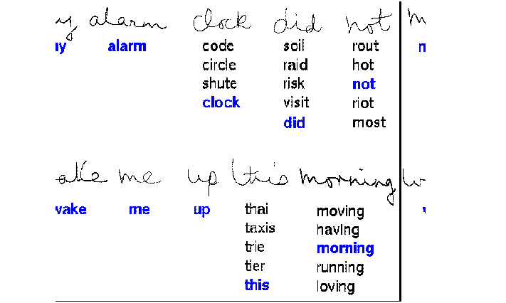
Handwriting Recognition Learning
Machine Learning
CSE 574, Spring 2004

Slide 9
Text Categorization Problem
Machine Learning
CSE 574, Spring 2004
Task T: assign a document to its content category
Performance measure P: Precision and Recall
Training experience E: Example pre- classified documents

Slide 10
To better filter emails as spam or not
Task – Classifying emails as spam or not
Performance Measure – The fraction of emails accurately classified as spam or not spam
Experience – Observing you label emails as spam or not spam

Slide 11
2. A checkers learning problem
Task – Playing checkers game
Performance Measure – percent of games won against opposer
Experience – playing implementation games against itself

Slide 12
Fruit Prediction Problem
Task – forecasting different fruits for recognition
Performance Measure – able to predict maximum variety of fruits
Experience – training machine with the largest datasets of fruits images

Slide 13
Automatic Translation of documents
Task – translating one type of language used in a document to other language
Performance Measure – able to convert one language to other efficiently
Experience – training machine with a large dataset of different types of languages

Slide 14
Learning to recognize spoken words
All of the most successful speech recognition systems employ machine learning in some form. For example, the SPHINX system (e.g., Lee 1989) learns speaker-specific strategies for recognizing the primitive sounds (phonemes) and words from the observed speech signal.
Neural network learning methods (e.g., Waibel et al. 1989) and methods for learning hidden Markov models (e.g., Lee 1989) are effective for automatically customizing to,individual speakers, vocabularies, microphone characteristics, background noise, etc. Similar techniques have potential applications in many signal-interpretation problems.

Slide 15
Learning to drive an autonomous vehicle.
Machine learning methods have been used to train computer-controlled vehicles to steer correctly when driving on a variety of road types. For example, the ALVINN system (Pomerleau 1989) has used its learned strategies to drive unassisted at 70 miles per hour for 90 miles on public highways among other cars. Similar techniques have possible applications in many sensor-based control problems.

Slide 16
Learning to classify new astronomical structures.
Machine learning methods have been applied to a variety of large databases to learn general regularities implicit in the data. For example, decision tree learning algorithms have been used by NASA to learn how to classify celestial objects from the second Palomar Observatory Sky Survey (Fayyad et al. 1995).
This system is now used to automatically classify all objects in the Sky Survey, which consists of three terrabytes of image data.

Slide 17
Learning to play world-class backgammon.
The most successful computer programs for playing games such as backgammon are based on machiie learning algorithms. For example, the world's top computer program for backgammon, TD-GAMMON (Tesauro 1992, 1995). learned its strategy by playing over one million practice games against itself. It now plays at a level competitive with the human world champion. Similar techniques have applications in many practical problems where very large search spaces must be examined efficiently.

Slide 18
DESIGNING A LEARNING SYSTEM
Choosing the Training Experience
Choosing the Target Function
Choosing a Representation for the Target Function
Choosing a Function Approximation Algorithm
The Final Design

Slide 19
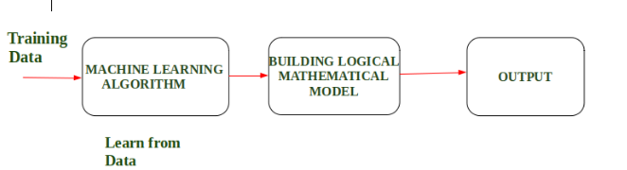
DESIGNING A LEARNING SYSTEM

Slide 20
Choosing the Training Experience
The first design choice we face is to choose the type of training experience from which our system will learn.
A second important attribute of the training experience is the degree to which the learner controls the sequence of training examples.
A third important attribute of the training experience is how well it represents the distribution of examples over which the final system performance P must be measured.

Slide 21
Below are the attributes which will impact on Success and Failure of Data:
The training experience will be able to provide direct or indirect feedback regarding choices. For example: While Playing chess the training data will provide feedback to itself like instead of this move if this is chosen the chances of success increases.
Second important attribute is the degree to which the learner will control the sequences of training examples. For example: when training data is fed to the machine then at that time accuracy is very less but when it gains experience while playing again and again with itself or opponent the machine algorithm will get feedback and control the chess game accordingly.
Third important attribute is how it will represent the distribution of examples over which performance will be measured. For example, a Machine learning algorithm will get experience while going through a number of different cases and different examples. Thus, Machine Learning Algorithm will get more and more experience by passing through more and more examples and hence its performance will increase.

Slide 22
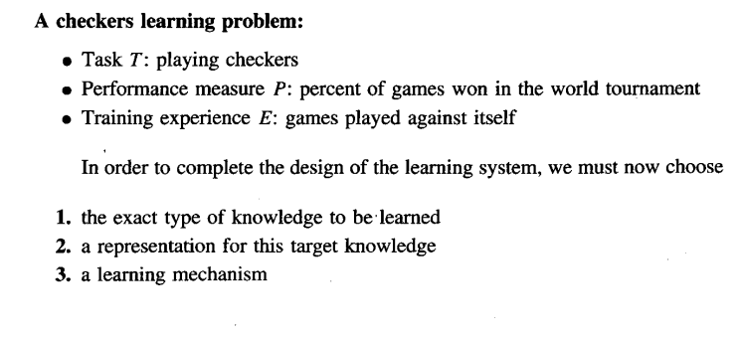
Choosing the Training Experience

Slide 23
Choosing the Target Function
The next design choice is to determine exactly what type of knowledge will be learned and how this will be used by the performance program.
The next important step is choosing the target function.
It means according to the knowledge fed to the algorithm the machine learning will choose NextMove function which will describe what type of legal moves should be taken.
For example : While playing chess with the opponent, when opponent will play then the machine learning algorithm will decide what be the number of possible legal moves taken in order to get success.

Slide 24
Step 3- Choosing Representation for Target function:
When the machine algorithm will know all the possible legal moves the next step is to choose the optimized move using any representation i.e. using linear Equations, Hierarchical Graph Representation, Tabular form etc.
The NextMove function will move the Target move like out of these move which will provide more success rate. For Example : while playing chess machine have 4 possible moves, so the machine will choose that optimized move which will provide success to it.

Slide 25
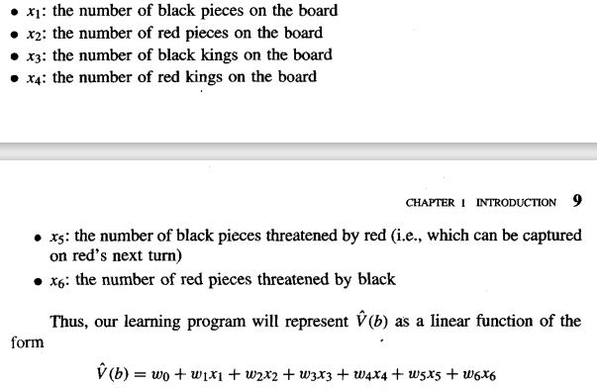
Step 3- Choosing Representation for Target function:

Slide 26
Step 4- Choosing Function Approximation Algorithm:
An optimized move cannot be chosen just with the training data. The training data had to go through with set of example and through these examples the training data will approximates which steps are chosen and after that machine will provide feedback on it.

Slide 27

Step 4- Choosing Function Approximation Algorithm:
4.1 ESTIMATING TRAINING VALUES

Slide 28

Step 4- Choosing Function Approximation Algorithm:
4.2 ADJUSTING THE WEIGHTS

Slide 29
5. The Final Design

