Slide 2
Unit 2
Apply the basic principles of AI in problem solving. (Apply-L3)
UNIT - II Problem Solving: Problem-Solving Agents, Example Problems, Searching for Solutions, Uninformed Search Strategies, Informed (Heuristic) Search Strategies, Local Search Algorithms and Optimization Problems, Searching with Nondeterministic Actions.

Slide 3
Search Algorithms in Artificial Intelligence
3.1 Problem-solving agents:
In Artificial Intelligence, Search techniques are universal problem-solving methods. Rational agents or Problem-solving agents in AI mostly used these search strategies or algorithms to solve a specific problem and provide the best result. Problem-solving agents are the goal-based agents and use atomic representation.

Slide 4
Case Study
Imagine an agent want to enjoy touring vacation from Assam to Kanya Kumari.
Known about map and route

Slide 5
Four-Phase Problem Solving Process by an Agent
Goal Formulation-To reach Kanya Kumari
Problem Formulation-The agent devises description of the states and actions necessary to reach goal.
Search-Find the solution by simulating sequence of action
Execution-Agent execute the solution one at a time

Slide 6
Control System
Control System is a system in which the behavior of the system is determined by a differential equation. It manages the devices and the systems using control loops.
There are Open-Loop Control System -Directly execute goal without conseqeunces
and Closed-Loop Control System-Considers the Consequences and feeback.

Slide 7
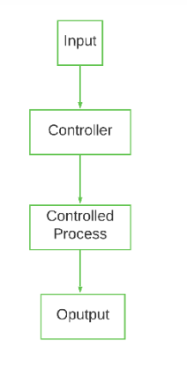
Open-Loop Control System

Slide 8
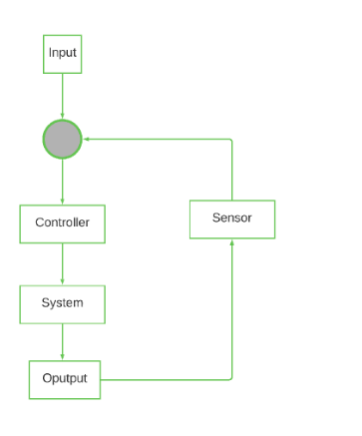
Closed-Loop Control System

Slide 9
Search Problems and Solution
A formal definition of a problem consists of five components:
Initial State
Actions
Transition Model
Goal Test
Path Cost

Slide 10
Search Problems and Solution
Initial State
It is the agent’s starting state or initial step towards its goal. For example, if a taxi agent needs to travel to a location(B), but the taxi is already at location(A), the problem’s initial state would be the location (A).
Actions
It is a description of the possible actions that the agent can take. Given a state s, Actions(s) returns the actions that can be executed in s. Each of these actions is said to be appropriate in s.

Slide 11
Transition Model
It describes what each action does. It is specified by a function Result(s, a) that returns the state that results from doing action an in state s.
The initial state, actions, and transition model together define the state space of a problem, a set of all states reachable from the initial state by any sequence of actions. The state space forms a graph in which the nodes are states, and the links between the nodes are actions.

Slide 12
Goal Test
It determines if the given state is a goal state. Sometimes there is an explicit list of potential goal states, and the test merely verifies whether the provided state is one of them. The goal is sometimes expressed via an abstract attribute rather than an explicitly enumerated set of conditions.

Slide 13
Path Cost
It assigns a numerical cost to each path that leads to the goal. The problem solving agents choose a cost function that matches its performance measure. Remember that the optimal solution has the lowest path cost of all the solutions

Slide 14
3.1.1 Search Problems and Solutions
Search Algorithm Terminologies:
Search: Searching is a step by step procedure to solve a search-problem in a given search space. A search problem can have three main factors:
Search Space: Search space represents a set of possible solutions, which a system may have.
Start State: It is a state from where agent begins the search.
Goal test: It is a function which observe the current state and returns whether the goal state is achieved or not.
Search tree: A tree representation of search problem is called Search tree. The root of the search tree is the root node which is corresponding to the initial state.

Slide 15
Actions: It gives the description of all the available actions to the agent.
Transition model: A description of what each action do, can be represented as a transition model.
Path Cost: It is a function which assigns a numeric cost to each path.
Solution: It is an action sequence which leads from the start node to the goal node.
Optimal Solution: If a solution has the lowest cost among all solutions.
Properties of Search Algorithms:
Following are the four essential properties of search algorithms to compare the efficiency of these algorithms:
Completeness: A search algorithm is said to be complete if it guarantees to return a solution if at least any solution exists for any random input.

Slide 16
Optimality: If a solution found for an algorithm is guaranteed to be the best solution (lowest path cost) among all other solutions, then such a solution for is said to be an optimal solution.
Time Complexity: Time complexity is a measure of time for an algorithm to complete its task.
Space Complexity: It is the maximum storage space required at any point during the search, as the complexity of the problem.

Slide 17
3.1.2 Formulating Problem
Formulating Problem-is a model
Abstraction
Level of abstraction?

Slide 18
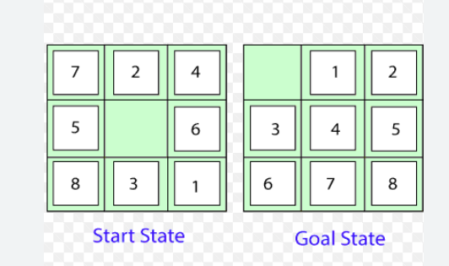
Example Problems-8Puzzle

Slide 19
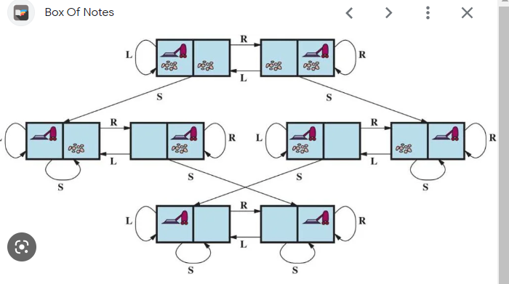
State Space Graph for the two-cell Vaccum Worlds -8 states and three actions

Slide 20
Search Algorithm
A Search Algorithm takes a search problem as input and returns a solution,or indication of failure.
Search tree: A tree representation of search problem is called Search tree. The root of the search tree is the root node which is corresponding to the initial state.

Slide 21
Types of search algorithms
Based on the search problems we can classify the search algorithms into uninformed (Blind search) search and informed search (Heuristic search) algorithms.

Slide 22
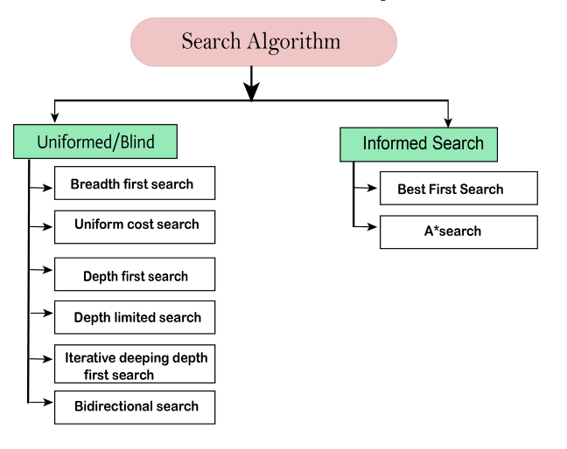
Types of search algorithms

Slide 23
Uninformed/Blind Search:
The uninformed search does not contain any domain knowledge such as closeness, the location of the goal. It operates in a brute-force way as it only includes information about how to traverse the tree and how to identify leaf and goal nodes.
Uninformed search applies a way in which search tree is searched without any information about the search space like initial state operators and test for the goal, so it is also called blind search.It examines each node of the tree until it achieves the goal node.

Slide 24
Informed Search
Informed search algorithms use domain knowledge. In an informed search, problem information is available which can guide the search. Informed search strategies can find a solution more efficiently than an uninformed search strategy. Informed search is also called a Heuristic search.

Slide 26
Types of search algorithms

Slide 27
Informal Search-Best-first Search
Greedy Search:
In greedy search, we expand the node closest to the goal node. The “closeness” is estimated by a heuristic h(x).
Heuristic: A heuristic h is defined as- h(x) = Estimate of distance of node x from the goal node. Lower the value of h(x), closer is the node from the goal.
Strategy: Expand the node closest to the goal state, i.e. expand the node with a lower h value.

Slide 28
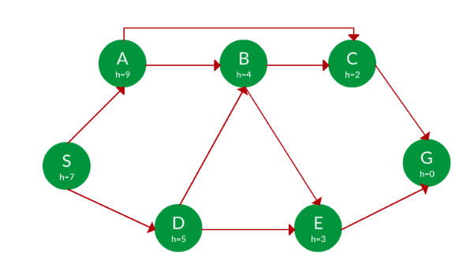
Find the path from S to G using greedy search. The heuristic values h of each node below the name of the node.

Slide 29
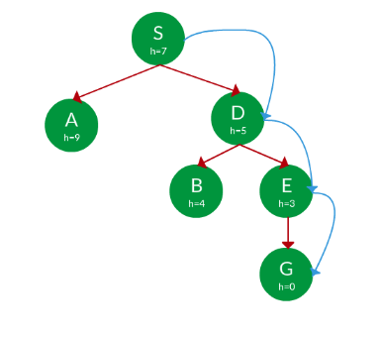
Solution

Slide 30
Greedy best-first search algorithm always selects the path which appears best at that moment. It is the combination of depth-first search and breadth-first search algorithms. It uses the heuristic function and search. Best-first search allows us to take the advantages of both algorithms. With the help of best-first search, at each step, we can choose the most promising node. In the best first search algorithm, we expand the node which is closest to the goal node and the closest cost is estimated by heuristic function, i.e.
f(n)= g(n).
Were, h(n)= estimated cost from node n to the goal.
The greedy best first algorithm is implemented by the priority queue.

Slide 31
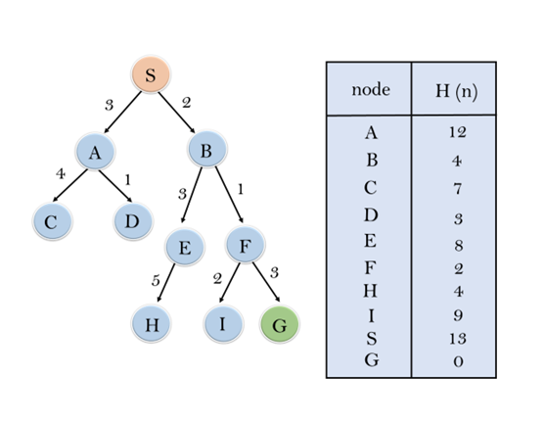

Slide 32
In this search example, we are using two lists which are OPEN and CLOSED Lists. Following are the iteration for traversing the above example.
Expand the nodes of S and put in the CLOSED list
Initialization: Open [A, B], Closed [S]
Iteration 1: Open [A], Closed [S, B]
Iteration 2: Open [E, F, A], Closed [S, B] : Open [E, A], Closed [S, B, F]
Iteration 3: Open [I, G, E, A], Closed [S, B, F] : Open [I, E, A], Closed [S, B, F, G]

Slide 33
Hence the final solution path will be: S----> B----->F----> G
Time Complexity: The worst case time complexity of Greedy best first search is O(b^{m}).

Slide 34
3.3.2 Search Data Structures
node.STATE-The State to which node corresponds
node.PARENT-Node in the tree that generated other nodes
node.Action-The action that was applied to the parent’s state to generate this node.
node.PATH-COST-The total cost of the path from initial state to generated nodes. Mathematically represented as g(n)

Slide 35
Operations on Frontier/Open
IS-Empty-
POP
TOP
ADD

Slide 36
Three Kinds of Queues in Search Algorithms
Priority Queue
FIFO
LIFO

Slide 37
Redundant PAths
Repeated states
Redundant paths

Slide 38
Measuring Problem Solving Performance
Completeness-Is the algorithm guaranteed to give solution
Cost Optimality
Time Complexity
Space Complexity

