Slide 1
Prolog

Slide 2
Prolog is a logic programming language. It has important role in artificial intelligence. Unlike many other programming languages, Prolog is intended primarily as a declarative programming language.
In prolog, logic is expressed as relations (called as Facts and Rules). Core heart of prolog lies at the logic being applied. Formulation or Computation is carried out by running a query over these relations.

Slide 3
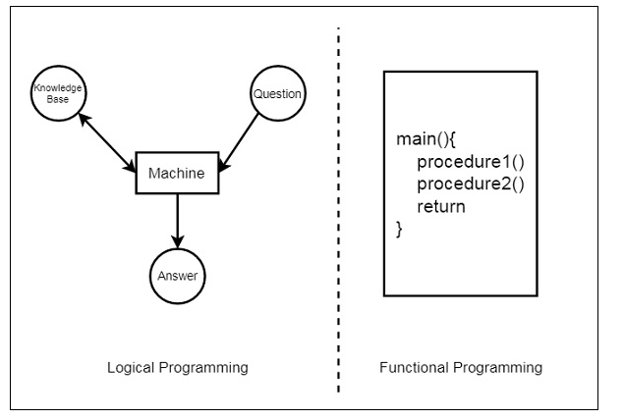

Slide 4
Applications of Prolog
The applications of prolog are as follows:
Specification Language
Robot Planning
Natural language understanding
Machine Learning
Problem Solving
Intelligent Database retrieval
Expert System
Automated Reasoning

Slide 5
Syntax and Basic Fields :
In prolog, We declare some facts. These facts constitute the Knowledge Base of the system.
We can query against the Knowledge Base. We get output as affirmative if our query is already in the knowledge Base or it is implied by Knowledge Base, otherwise we get output as negative.
So, Knowledge Base can be considered similar to database, against which we can query.

Slide 6
Installation
https://www.swi-prolog.org/download/stable

Slide 7
Prolog facts are expressed in definite pattern.
Facts contain entities and their relation. Entities are written within the parenthesis separated by comma (, ).
Their relation is expressed at the start and outside the parenthesis. Every fact/rule ends with a dot (.).
So, a typical prolog fact goes as follows :
Format : relation(entity1, entity2, ....k'th entity).

Slide 8
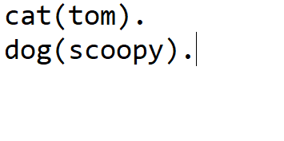
Prolog-Rules/facts

Slide 9
Save is filename.pl

Slide 10


Slide 11
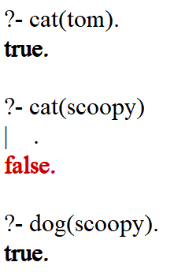
Querying

Slide 12
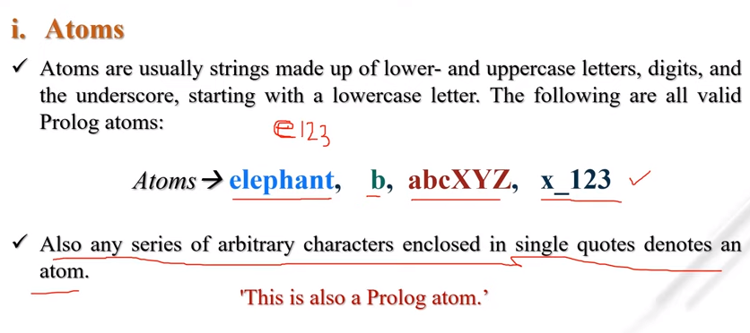
Atoms

Slide 13
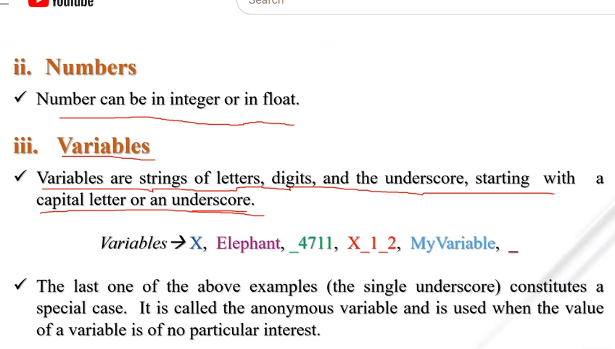
Numbers and varaibles

Slide 14
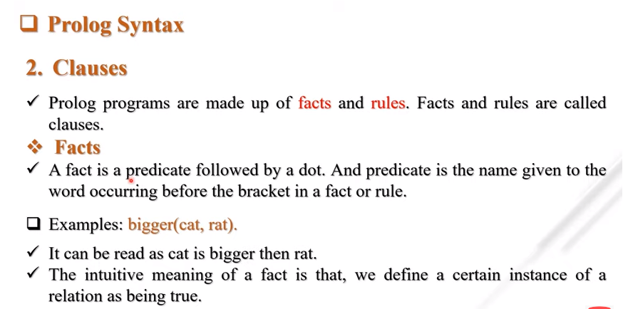
Prolog Syntax

Slide 15
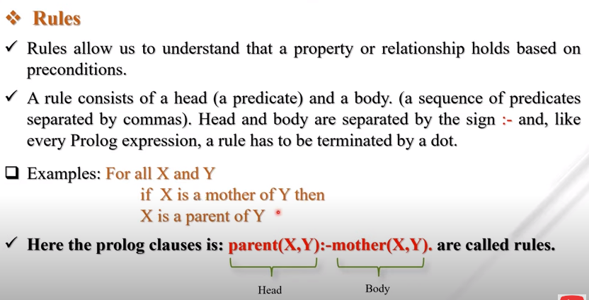

Slide 16
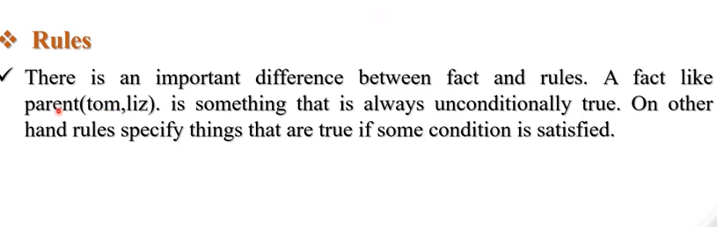

Slide 17
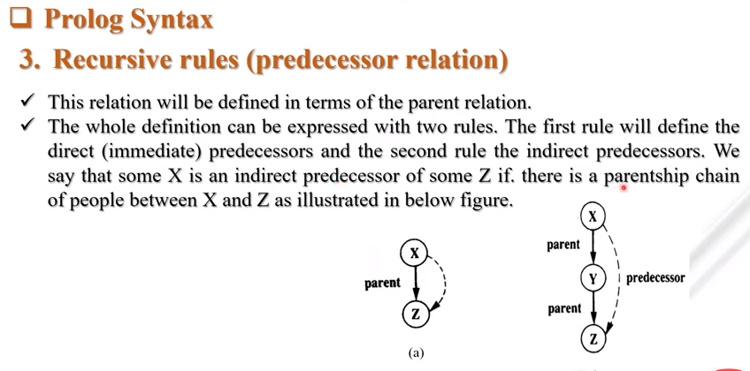

Slide 18
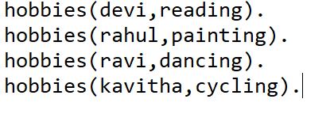
Hobbies Knowledge-save as hobbies.pl

Slide 19
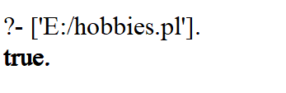
Run it

Slide 20
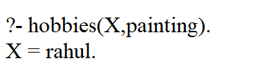
Queriying

Slide 21


Slide 22


Slide 23
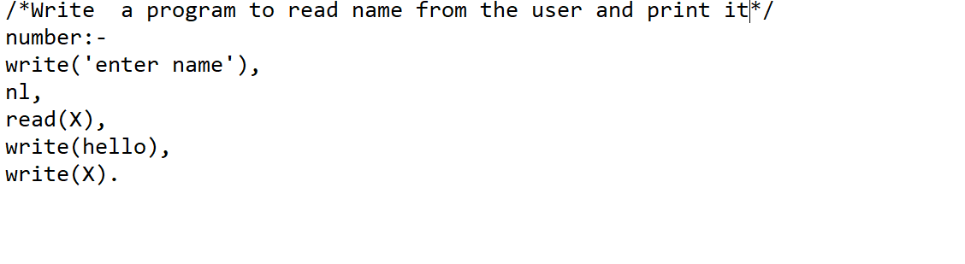
Reading from the console

Slide 24

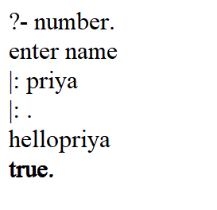
Compile and run

