Slide 1


Slide 2
Introduction
Organizations use various databases to store data and to perform various operations on the data based on the requirements.
Some of the most popular databases are:
Cassandra
MySQL
MongoDB
Oracle
Redis
SQL Server

Slide 3
A user can interact with a database in the following ways.
Using query language of the respective databases - eg: SQL
Using an ODM(Object Data Model) or ORM(Object-Relational Model)

Slide 4
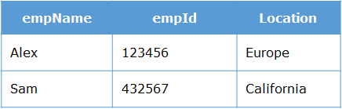
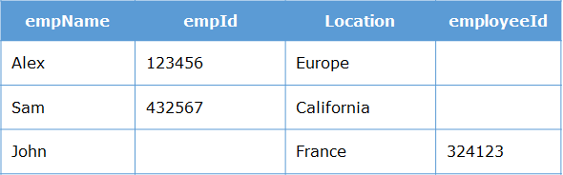
Let us assume, we wish to maintain the details of the employees in the below format in the MongoDB database.
If we insert a new record to the above collection using the command
{empName : "John", employeeId : 324123, Location : "France"}
MongoDB stores the data in the form of a document in the collection. Since there is no predefined structure and constraints on values for fields, a document of any structure having any value for fields can be inserted into the collection.

Slide 5
It is the responsibility of developers to strictly maintain the structure of the document and apply constraints on the values for fields.
So, we need a library that can maintain or model the structure of documents and impose restrictions on the values for fields.
In order to ensure that the structure of the database is maintained, we need an Object Data Modeler, which ensures the maintenance of the collection.
An ODM is used to map the data as JavaScript objects to the underlying database format.
They provide an option to perform validation and checking data to ensure data integrity.
There are many ODM based libraries available on NPM. One such library is ”mongoose”.

Slide 6
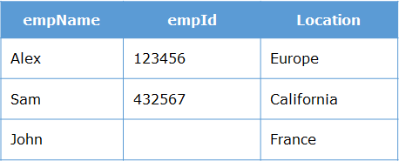
Mongoose is an Object Data Modeling (ODM) tool, which is created to work on an MongoDB environment.
It imposes the restrictions on the structure and constraints on data fields.
While working with Mongoose we need to focus on some common terminologies like Schema and Models.

Slide 7
Schema:
The structure of the document to be inserted in the database collection is defined through 'schema' in mongoose.
Using schema, we can perform validations, provide default values to the properties, etc.
Creation of Schema
const ns=new mongoose.Schema({
name:String,
age:Number
});

Slide 8
Another way to define Schema:
const empSchema = [
{
empId: Number,
empName: String,
address: {
doorNo: String,
lane: String,
pincode: Number,
},
},
];

Slide 9
Models:
Through schema, we can define the structure of the document.
Now, we need to interact with the database collection to store or retrieve data.
In order to perform database interaction, mongoose provides a 'Model' method that takes the predefined schema and creates an instance of a document that is like the records of the relational database.

Slide 10
Step 1 - Installing Mongoose on a Node.js environment
To interact with the Mongodb from node js framework we require ‘mongoose’ library.
For installing the Mongoose library, issue the below command in the Node command prompt.
npm install mongoose --save
To establish a connection to the MongoDB database, we need to create a connection object using Mongoose.

Slide 11
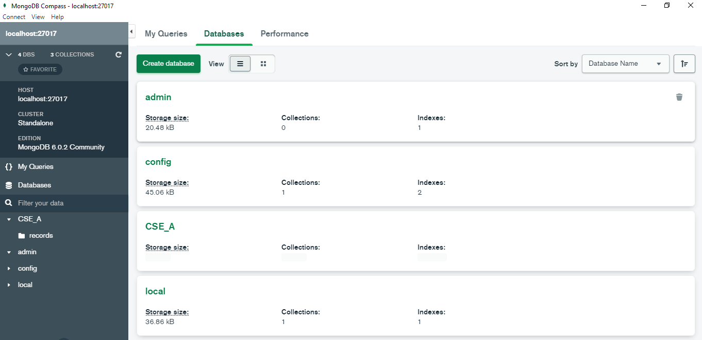
MongoDB Installation:
Install “mongodb-windows-x86_64-6.0.2-signed.exe” in windows10
Default URL is : 'mongodb://localhost:27017’

Slide 12
To establish a connection use the following code:
const mongoose = require('mongoose'); // importing mongoose library
mongoose.connect('mongodb://localhost:27017/Database_Name');
Then Create the Schema
const mongoose = require('mongoose');
const schema = new mongoose.Schema(
{ property_1: Number,
property_2: String }
);

Slide 13
If you want any field to be mandatory, use the required property.
const schema = mongoose.Schema({
name: {
required: true,
},
});
You can declare a schema type using the type directly, or an object with a type property.
const schema = mongoose.Schema({
property_1: {
type: String,
},
property_2: {
type: Number,
},
});

Slide 14
Your schema can define default values for certain properties. If you create a new document without that property set, the default value provided to that property will be assigned.
const schema = mongoose.Schema({
property_1: {
default: "Client"
},
property_2: {
default: 1
},
});

Slide 15
To use our schema definition, we need to wrap the Schema into a Model object we can work with.
The model provides an object which provides access to query documents in a named collection.
Schemas are compiled into models using the model() method.
const Model = mongoose.model(name , schema) ;
The first argument is the singular name of the collection for which you are creating a Model.
Example:
const NotesModel=mongoose.model("mynotes", myNotesSchema);

Slide 16
Mongoose library offers several functions to perform various CRUD (Create-Read-Update-Delete) operations.
var book1 = new Model_Name({ name: 'Introduction to Mongoose', price: 10, quantity: 25 });
Later to save the record; use the function save() Method
book1.save();

Slide 17
Step 2 – Creating the connection:
const express=require('express');
const app=express();
const mongoose=require('mongoose');
mongoose.connect("mongodb://127.0.0.1:27017/CSE_A",(err)=>{
if(err)
console.log("DB Not Connected-Error");
else
console.log("DB Connected");
});

Slide 18
New Schema creation in mongoDB:
const express=require('express');
const app=express();
const mongoose=require('mongoose');
mongoose.connect("mongodb://127.0.0.1:27017/CSE_A",(err)=>{
if(err)
console.log("DB Not Connected-Error");
else
console.log("DB Connected");
});
const ns=new mongoose.Schema({
name:String,
age:Number
});

Slide 19
New Model creation in mongoDB:
const express=require('express');
const app=express();
const mongoose=require('mongoose');
mongoose.connect("mongodb://127.0.0.1:27017/CSE_A",(err)=>{
if(err)
console.log("DB Not Connected-Error");
else
console.log("DB Connected");
});
const ns=new mongoose.Schema({
name:String,
age:Number,
rno:Number
});
const nm=new mongoose.model("records",ns);

Slide 20
Insert Record into DB:
const express=require('express');
const app=express();
const mongoose=require('mongoose');
mongoose.connect("mongodb://127.0.0.1:27017/CSE_A",(err)=>{
if(err)
console.log("DB Not Connected-Error");
else
console.log("DB Connected");
});
const ns=new mongoose.Schema({
name:String,
age:Number
});
const nm=new mongoose.model("records",ns);
const data=new nm({name:'SURESH',age:29});
data.save();

Slide 21
Change Schema & Insert Record into DB:
const express=require('express');
const app=express();
const mongoose=require('mongoose');
mongoose.connect("mongodb://127.0.0.1:27017/CSE_A",(err)=>{
if(err)
console.log("DB Not Connected-Error");
else
console.log("DB Connected");
});
const ns=new mongoose.Schema({
name:String,
age:Number,
phno:Number
});
const nm=new mongoose.model("records",ns);
const data=new nm({name:’SOHAIL',age:27,PHNO:1234567890});
data.save();

Slide 22
Insert Multiple Record into DB:
const express=require('express');
const app=express();
const mongoose=require('mongoose');
mongoose.connect("mongodb://127.0.0.1:27017/CSE_A",(err)=>{
if(err)
console.log("DB Not Connected-Error");
else
console.log("DB Connected");
});
const ns=new mongoose.Schema({
name:String,
age:Number,
rno:Number
});
const nm=new mongoose.model("records",ns);
const data1=new nm({name:’Anand',age:23,rno:122});
data1.save();
const data2=new nm({name:’KIRAN',age:24,rno:123});
data2.save();
const data3=new nm({name:’SUKUMAR',age:28,rno:124});
data3.save();

Slide 23
Node.js MongoDB Find a Single Record:
Find One
To select data from a collection in MongoDB, we can use the findOne() method.
The findOne() method returns the first occurrence in the selection.
The first parameter of the findOne() method is a query object. In this example we use an empty query object, which selects all documents in a collection (but returns only the first document).
nm.findOne({}, function (err, data) {
if (err){
console.log(err);
}
else{
console.log("First function call : ", data);
}
});

Slide 24
Node.js MongoDB Display All Record:
Find All
To select data from a table in MongoDB, we can also use the find() method.
The find() method returns all occurrences in the selection.
The first parameter of the find() method is a query object. In this example we use an empty query object, which selects all documents in the collection.
find({}, function (err, data) {
if (err){
console.log(err);
}
else{
console.log("First function call : ", data);
}

Slide 25
Node.js MongoDB Find a Specific Record:
Find One
To select data from a collection in MongoDB, we can use the findOne() method.
The findOne() method returns the first occurrence in the selection.
The first parameter of the findOne() method is a query object. In this example we use an empty query object, which selects all documents in a collection (but returns only the first document).
nm.find({age:34}, function (err, data) {
if (err){
console.log(err);
}
else{
console.log("First function call : ", data);
}
});

Slide 26
Node.js MongoDB Delete
To delete a record, or document as it is called in MongoDB, we use the deleteOne() method.
The first parameter of the deleteOne() method is a query object defining which document to delete.
nm.deleteOne({ name: 'Gopal'}).then(function(){
console.log("Data deleted") // Success
}).catch(function(error){
console.log(error) // Failure
});

Slide 27
Node.js MongoDB Update
You can update a record, or document as it is called in MongoDB, by using the updateOne() method.
The first parameter of the updateOne() method is a query object defining which document to update.
var myquery = { name: “SOHAIL" }; var newvalues = { $set: { phno: 9856341212 } };
nm.updateOne(myquery, newvalues, function(err, res)
{
if (err) throw err;
console.log("1 document updated");
db.close();
});

Slide 28
Update Many Documents
To update all documents that meets the criteria of the query, use the updateMany() method.

