Slide 1
Machine Learning
Dr.K DeviPriya
Assoc.Professor
CSE
Lakireddy Bali Reddy College of Engineering
Mylavaram

Slide 2
Types of Machine Learning
Supervised Machine Learning
The main goal of the supervised learning technique is to map the input variable(x) with the output variable(y).
train the machines using the "labeled" dataset
Types of Problems Solved under Supervised ML---Regression, Classification

Slide 3
Unsupervised Learning
The main aim of the unsupervised learning algorithm is to group or categories the unsorted dataset according to the similarities, patterns, and differences.
Machines are instructed to find the hidden patterns from the input dataset.

Slide 4
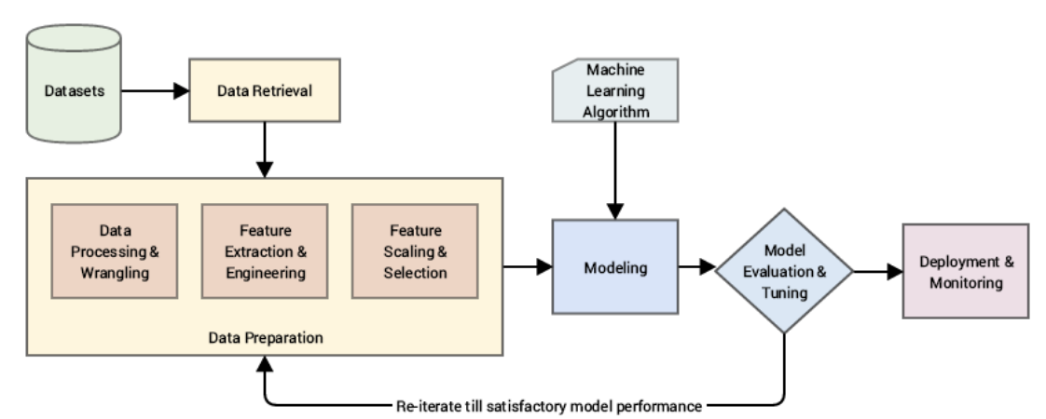
Modeling Steps

Slide 5
Regression Models
Prediction of Numerical(Continiuos) target based on numerical data.
Regression analysis is a predictive modeling technique that analyzes the relation between the target or dependent variable and independent variable in a dataset.

Slide 6
Regression Models
Different types of regression analysis techniques get used when the target and independent variables show a linear or non-linear relationship between each other, and the target variable contains continuous values.

Slide 7
Linear Regression
The below-given equation is used to denote the linear regression model:
y=mx+c+e
where m is the slope of the line, c is an intercept, and e represents the error in the model.

Slide 8
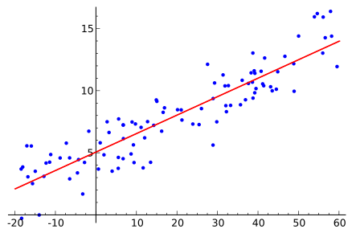
Best Regression Line
The best fit line is determined by varying the values of m and c. The predictor error is the difference between the observed values and the predicted value. The values of m and c get selected in such a way that it gives the minimum predictor error.

Slide 9
Evaluation Parameters
R2 Score-How the model is good/fit
Mean Absolute Error-Difference between actual value and predicted value

Slide 10
Bottle.CSV
CalCOFI | Kaggle
The CalCOFI data set represents the longest (1949-present) and most complete (more than 50,000 sampling stations) time series of oceanographic and larval fish data in the world. It includes abundance data on the larvae of over 250 species of fish;
larval length frequency data and egg abundance data on key commercial species; and oceanographic and plankton data. The physical, chemical, and biological data collected at regular time and space intervals quickly became valuable for documenting climatic cycles in the California Current and a range of biological responses to them.
CalCOFI research drew world attention to the biological response to the dramatic Pacific-warming event in 1957-58 and introduced the term “El Niño” into the scientific literature.

Slide 11
scikit-learn Machine Learning in Python [scikit-learn: machine learning in Python — scikit-learn 1.1.2 documentation ]
Simple and efficient tools for predictive data analysis
Accessible to everybody, and reusable in various contexts
Built on NumPy, SciPy, and matplotlib

Slide 12
API’s for Regression
from sklearn.linear_model import LinearRegression
from sklearn.metrics import mean_absolute_error, mean_squared_error,r2_score

Slide 13
Read CSV file
pandas.read_csv()
Syntax: pd.read_csv(filepath_or_buffer, sep=’ ,’ , header=’infer’, index_col=None, usecols=None, engine=None, skiprows=None, nrows=None)

Slide 14
Data Preprocessing
Replacing null values with mean
fillna()
How to Fill NaN Values with Mean
df['col1'] = df['col1'].fillna(value=df['col1'].mean())
data['Salnty']=data['Salnty'].fillna(value=data['Salnty'].mean())

Slide 15
How to Drop Rows with NaN Values in Pandas
Drop Rows with Any NaN Values
We can use the following syntax to drop all rows that have any NaN values:
df.dropna()

Slide 16
Example 2: Drop Rows with All NaN Values
We can use the following syntax to drop all rows that have all NaN values in each column:
df.dropna(how='all')

Slide 17
Drop Row with Nan Values in a Specific Column
We can use the following syntax to drop all rows that have a NaN value in a specific column:
df.dropna(subset=['assists'])

Slide 18
Reset Index After Dropping Rows with NaNs
We can use the following syntax to reset the index of the DataFrame after dropping the rows with the NaN values:
#drop all rows that have any NaN values df = df.dropna() #reset index of DataFrame df = df.reset_index(drop=True) How to Drop Rows with NaN Values in Pandas (statology.org)

Slide 20
While working with datasets, a machine learning algorithm works in two stages — the testing and the training stage. Normally the data split between test-train is 20%-80%.

Slide 21
from sklearn.model_selection import train_test_split
Training and test of splitting dataset
sklearn.model_selection.train_test_split(*arrays, test_size=None, train_size=None, random_state=None, shuffle=True, stratify=None)[source]

Slide 22
dataset_url = 'http://www.dsi.uminho.pt/~pcortez/forestfires/forestfires.csv‘
data = pd.read_csv(dataset_url)
print data.head()

Slide 23
y = data.temp
X = data.drop('temp', axis=1)

Slide 24
X_train, X_test, y_train, y_test = train_test_split(X, y,test_size=0.2)

Slide 25
print("\nX_train:\n")
print(X_train.head())
print(X_train.shape)
print("\nX_test:\n")
print(X_test.head())
print(X_test.shape)

Slide 26
Model Creation
Model=LinearRegression()
Model.fit(Xtrain,Ytrain)
#built model on training data
#test model
Result=model.predict(newinstance)

Slide 27
Parameters Evaluation
What is R2 score used for?
Coefficient of determination also called as R2 score is used to evaluate the performance of a linear regression model. It is the amount of the variation in the output dependent attribute which is predictable from the input independent variable(s)

Slide 28
R2=r2_score( y_test, y_pred )

