Slide 1
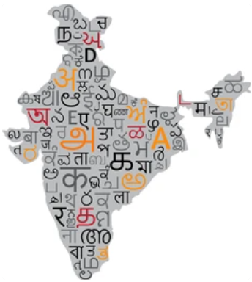
ONE MESSAGE, MANY LANGUAGES:
ENHANCING OUTREACH IN INDIA.

Slide 2
ONE MESSAGE, MANY LANGUAGES:
ENHANCING OUTREACH IN INDIA.
MENTOR
TEAM
D. CHAITANYA NANDINI(21761A05E9)
G. LAKSHMI PRASANNA(21761A05F2)
G. M A NARASIMHA(21761A05F6)
K. PAVAN KUMAR(21761A05G2)
M. V R SURYA KUMAR(21761A05G8)
Sd. A AZIZ SHAHID(21761A05I8)
Mr. S. SRINIVASA REDDY
Sr. Asst. Professor

Slide 3
PROBLEM STATEMENT
"We aim to develop software capable of dubbing English videos into various Indian regional languages, addressing the need for promoting awareness of Intellectual Property in India. This software will enable us to achieve a broader public outreach. It should generate human-like voiceovers and translated text supers in languages such as Hindi, Marathi, Bengali, Gujarati, Tamil, Telugu, and more. The translated content must be presented in a simple, easily understandable manner. To guide our efforts, we have a sample video for reference."

Slide 4

INTRODUCTION
In our quest to promote awareness of Intellectual Property rights in India, we face a challenge—how to effectively convey this critical information in a linguistically diverse nation.
Conveying information in regional languages in India is crucial for reaching a wide and diverse audience. India's linguistic diversity is immense, and regional languages are often the preferred means of communication for a significant part of the population. Using these languages ensures that people can understand and engage with information more effectively, enhancing education and preserving culture.

Slide 5

METHODOLOGY
**The Methodology required WaterFall Process Model to represent the idea which we got.
Extract Audio from Video.
Extract Text from Audio.
Translate the Text.
Convert Text into Audio File.

Slide 6
Contd…
Remove Audio from Input Video.
Sync the Audio with Video
Integrate all the Modules.
Test with Sample Test Case.

Slide 7
TECHNOLOGY USED
"Our project's core component lies in developing Python-based technology for the dubbing of promotional and awareness videos from English to various Indian regional languages. This technology aims to bridge language gaps, enabling mass outreach and easy comprehension for public awareness campaigns on Intellectual Property in India."
Libraries Used in Python:
moviepy.video.io.ffmpeg_tools
Used for Extracting Audio from the Input Video File.The Extracted Audio file is saved in .wav Format.
speech_recognition
Able to Recognize Speech in a audio(.wav) file, which is used further to translate into user selected language.
googletrans
It Consists of methods and classes which are capable of converting an English text into regional languages.

Slide 8
Contd…
langdetect
The Purpose of the langdetect is to detect the Language of the text file which contains translated text.
gtts (gTTS - Google Text-to-Speech)
To produce an audio file of translated text, gTTS – Google Text-to-Speech Library can be helpful to read the text and save it in audio(.wav) format.
moviepy.editor.VideoFileClip
To Remove Audio from the Input Video File.
moviepy.editor.AudioFileCli
To Sync the Translated Audio with the Video(without audio).

Slide 9
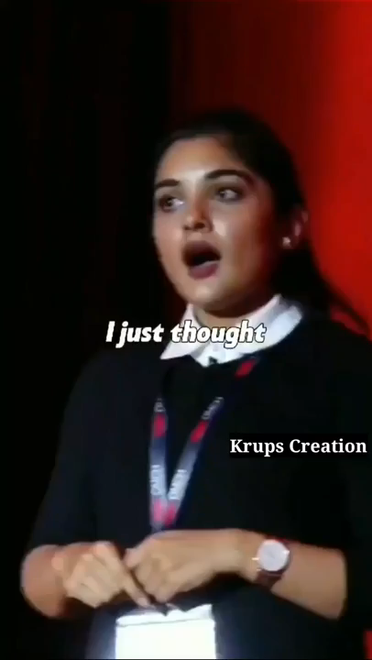
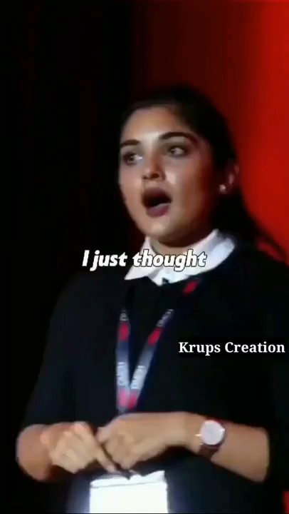
Sample Test Case.
ORIGINAL VIDEO in ENGLISH
VIDEO DUBBED into TELUGU
Applying the Methodology
in Python with help of Libraries that are mentioned.

Slide 10

CONCLUSION
In conclusion, our software solution represents a transformative step in bridging language barriers and enhancing public awareness. By seamlessly dubbing videos from English into various Indian regional languages, we empower content creators to connect with diverse audiences across the nation.
Our technology's ability to produce human-like voiceovers to ensure that the message remains clear, simple, and easily comprehensible. As exemplified by our sample video, our software holds the potential to drive mass outreach and foster broader understanding of vital topics, such as Intellectual Property in India.

Slide 11
THANK YOU

