Slide 1
IBM University Engagement Project Submission
“Exploring the Power of Agentic AI with IBM Granite and LangFlow”

Slide 2
ProjectTile–[Startup Blueprint Generator Agent]
DomainofProject–[Generative AI & Startup Innovation]

Slide 3
Problem Statement-
Problem Statement:
Entrepreneurs and innovators often struggle to transform their startup ideas into structured and actionable business plans due to limited access to market research, business strategy guidance, technical expertise, and financial planning knowledge.
The Objective:
To develop an AI-powered Startup Blueprint Generator Agent that helps users convert startup ideas into complete business blueprints by providing AI-driven recommendations for problem identification, target audience analysis, market opportunities, business models, technology stack selection, and step-by-step execution roadmaps. The agent aims to simplify startup planning, improve decision-making, and support aspiring entrepreneurs in building scalable solutions.
The solution should:
Startup Idea Analysis – Analyze user-provided startup ideas by identifying the problem, target audience, market opportunity, and feasibility of the business concept.
Startup Blueprint Generation – Generate complete startup blueprints including value proposition, business model, revenue strategy, customer segments, and growth plans.
Market Research & Competitor Analysis – Retrieve and summarize market trends, customer needs, competitor insights, and opportunities for differentiation.
Technology Stack Recommendation – Suggest suitable technologies, tools, platforms, and frameworks required for developing and scaling the startup solution.
Business Strategy & Planning – Provide recommendations for marketing strategies, resource planning, funding approaches, and long-term business growth.
Visualization Dashboard – Display startup blueprint details, market insights, business model analysis, execution timeline, and progress tracking toward startup goals.
AI-Powered Entrepreneur Assistance – Provide interactive guidance, answer startup-related queries, and continuously support entrepreneurs throughout the startup development journey.

Slide 4
Proposed Solution-
Proposed Solution – AI-Powered Startup Blueprint Generator
The proposed solution is a multi-agent AI-powered Startup Blueprint Generator built using IBM watsonx Orchestrate, GPT-OSS 120B, Langflow, and Retrieval-Augmented Generation (RAG) to help entrepreneurs transform business ideas into comprehensive startup blueprints. The system combines a curated startup knowledge base with real-time web search to provide accurate and personalized recommendations.
The solution consists of six specialized agents: the Startup Analysis Agent understands the business idea, the Business Model Canvas Agent creates a complete business model, the Market Research Agent performs competitor and SWOT analysis, the Funding Advisor Agent recommends funding opportunities and government schemes, the Go-to-Market Strategy Agent develops marketing and sales plans, and the Roadmap Agent generates a 30-60-90 day implementation plan.
Langflow orchestrates the multi-agent workflow, while GPT-OSS 120B powers reasoning and content generation. Overall, the solution acts as an intelligent virtual startup mentor, delivering personalized, investor-ready business plans that help entrepreneurs validate, plan, and launch their startups efficiently.

Slide 5
Technology Used
Generative AI - Used to understand startup ideas, generate business strategies, create blueprints, and provide intelligent recommendations.
•
IBM watsonx Orchestrate - Used to build and manage the AI agent workflow,
coordinate multiple agents, and automate startup planning tasks.
•
Large Language Models(LLMs) – Used for natural language understanding, reasoning, content generation, and interactive conversations with users.
•
RAG – Used to retrieve relevant information from knowledge sources such as market reports, business resources, and startup databases to improve response accuracy.
•
Multi-Agent AI Architecture – Implemented multiple specialized agents for idea analysis, market research, technology recommendations, and business strategy generation.
•
Natural Language Processing(NLP) – Enables users to interact with the agent using natural language queries and receive meaningful responses.

Slide 6
Langflow components Used-
Chat Input–
Interface where users enter their startup ideas, requirements, business goals, or queries through natural language input.
IBM watsonx AI Agent–
Processes user inputs using IBM Granite models to generate AI-powered startup insights, business strategies, and blueprint recommendations.
Name of IBM Granite Model–
Granite-4.0-8B-Instruct → Fast and efficient language model used for real-time startup idea analysis, business planning, and intelligent recommendations.
Chat Output–
Displays AI-generated responses such as startup blueprints, business models, technology suggestions, market insights, and execution roadmaps.
File Component–
Stores and retrieves startup-related documents, market research data, business templates, and knowledge resources for generating accurate recommendations.

Slide 7
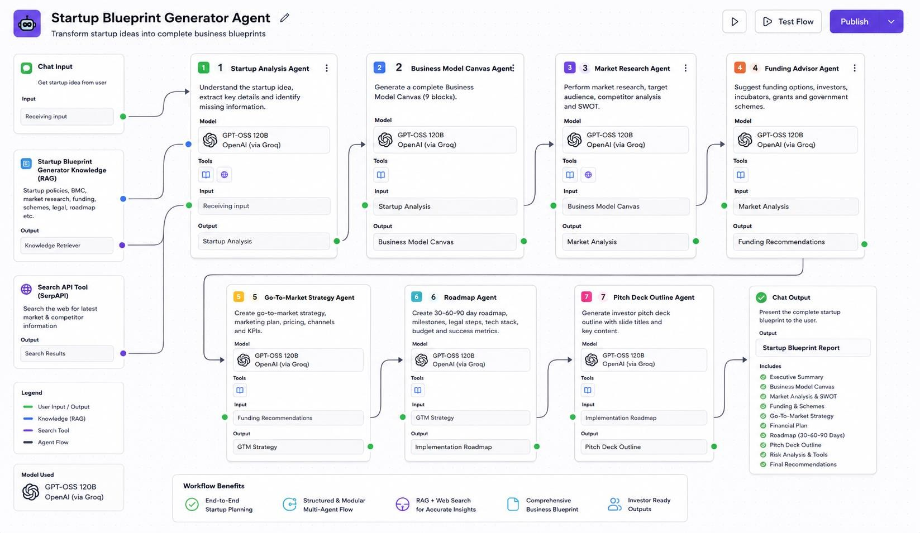
Langflow workflow-

Slide 8
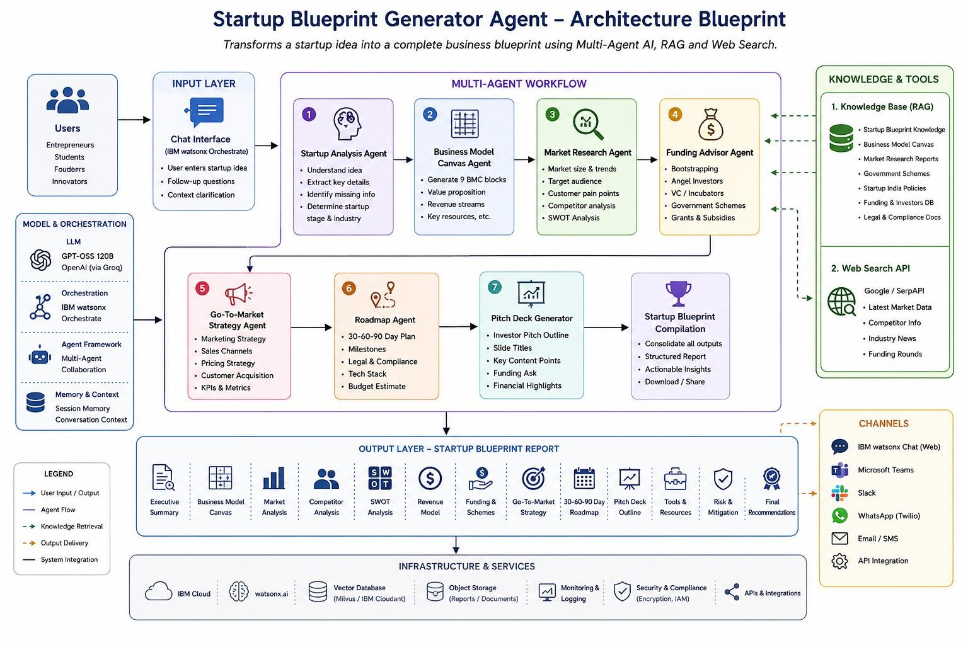
Architecture blueprint

Slide 9

Role of Agentic AI in the solution
Agentic AI enables the Startup Blueprint Generator to function as an intelligent, autonomous system rather than a simple chatbot. Using IBM watsonx, GPT-OSS 120B, and Retrieval – Augmented Generation(RAG), it coordinates multiple specialized agents to generate a complete startup blueprint.
Each agent performs a specific task – such as analyzing the startup idea, creating a Business Model Canvas, conducting market and competitor analysis, recommending funding opportunities, developing go-to-market strategies, and generating implementation roadmaps —while working collaboratively. This multi-agent approach ensures efficient task execution and comprehensive business planning.
Agentic AI also provides context awareness by understanding the user's business idea, industry, target audience, and startup stage to deliver personalized recommendations. It continuously adapts its responses based on user inputs and knowledge retrieved from the RAG knowledge base and web search, ensuring accurate and up-to-date insights.
Additionally, the agents communicate and share information with one another, enabling better decision-making and producing a cohesive, investor-ready startup blueprint. Overall, Agentic AI makes the system proactive, intelligent, and goal-driven, acting as a virtual startup mentor that helps entrepreneurs transform innovative ideas into successful business ventures.

Slide 10
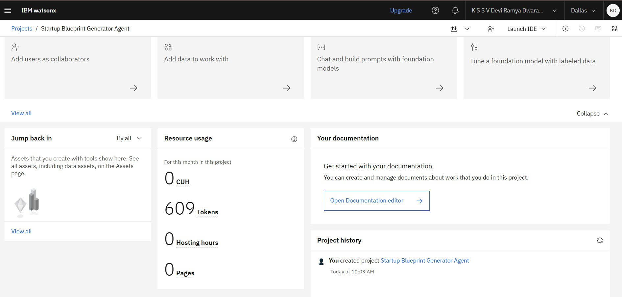
Tokens Used
After the Prompt
·
·
·

Slide 11
Novelty and Uniqueness
The Startup Blueprint Generator stands out by combining Agentic AI, Retrieval-Augmented Generation (RAG), and GPT-OSS 120B to deliver an end-to-end startup planning solution.
Unlike traditional chatbots that provide generic responses, the system uses multiple specialized AI agents that collaborate to analyze startup ideas, generate a Business Model Canvas, perform market and competitor analysis, recommend funding opportunities and government schemes, develop go-to-market strategies, and create implementation roadmaps.
By integrating a curated startup knowledge base with real-time web insights, the solution provides accurate, personalized, and actionable recommendations.
Its autonomous, context-aware, and collaborative approach acts as a virtual startup mentor, enabling entrepreneurs to transform innovative ideas into investor-ready business plans efficiently.

Slide 12
GitHubLink
https://github.com/deviramya1612/Startup-Blueprint-Generator

Slide 13
Future Scope
1.Integration with Business & Startup Ecosystems –
The system can be integrated with startup incubators, accelerator programs, government startup portals (such as Startup India), CRM tools, and financial platforms. This will enable entrepreneurs to access funding opportunities, business registrations, mentorship programs, and financial planning services directly through the platform.
2. AI-Powered Virtual Startup Mentor & Multilingual Support –
The solution can be enhanced with a voice-enabled AI startup mentor and multilingual support to improve accessibility.
Entrepreneurs can interact naturally in their preferred language and receive personalized startup guidance, making the platform more inclusive and suitable for users from diverse backgrounds.

Slide 14
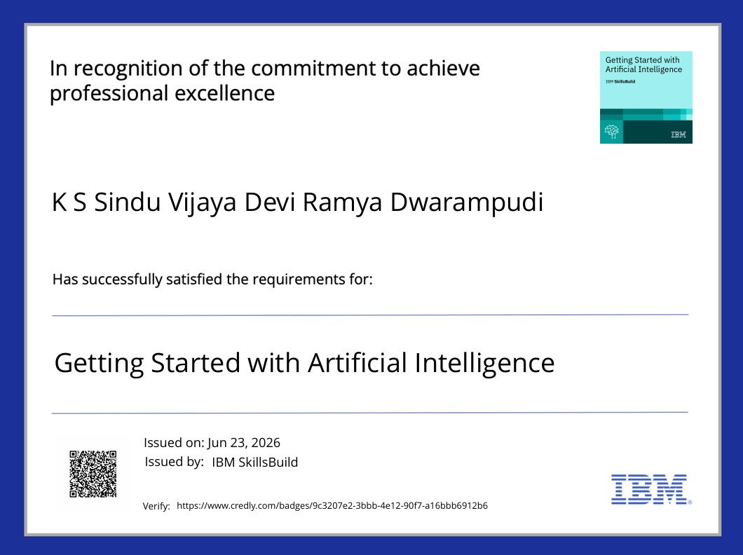
Certificates Earned:

Slide 15
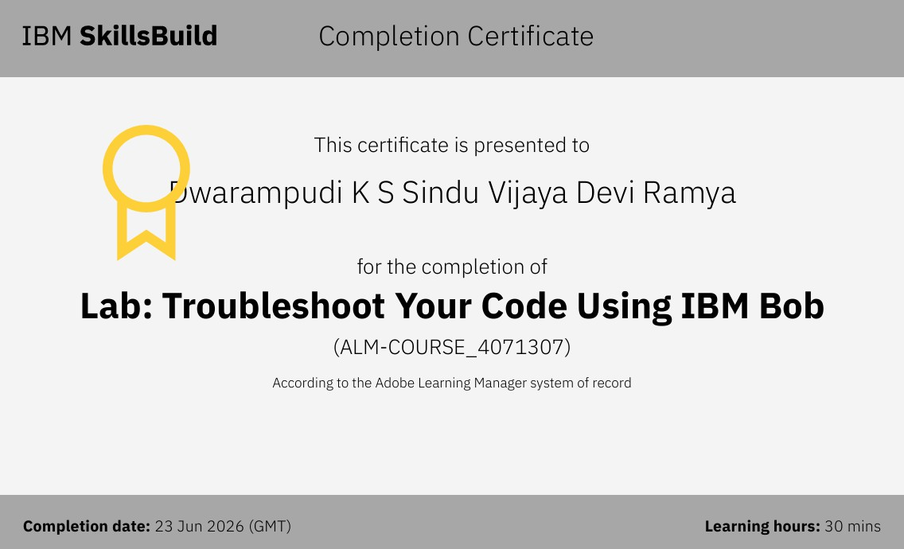
Certificates Earned:

Slide 16
an
Thank you for your time and interest.

