Slide 1
Hash values
Hash values can be thought of as fingerprints for files.
The contents of a file are processed through a cryptographic algorithm, and a unique numerical value – the hash value - is produced that identifies the contents of the file.
A hash value is a numeric value of a fixed length that uniquely identifies data.
Hash values represent large amounts of data as much smaller numeric values, so they are used with digital signatures.
You can sign a hash value more efficiently than signing the larger value.
If the contents are modified in any way, the value of the hash will also change significantly.
Two algorithms are currently widely used to produce hash values: MD5 and SHA1 algorithms.

Slide 2
Hashing is an algorithm performed on data such as a file or message to produce a number called a hash (sometimes called a checksum).
The hash is used to verify that data is not modified, tampered with, or corrupted.
In other words, you can verify the data has maintained integrity.
Hashing is the process of transforming any given key or a string of characters into another value.
This is usually represented by a shorter, fixed-length value or key that represents and makes it easier to find or employ the original string
A key point about a hash is that no matter how many times you execute the hashing algorithm against the data, the hash will always be the same if the data is the same
The most popular use for hashing is the implementation of hash tables

Slide 3
Hashing Algorithms
MD5
Definition
MD5 (Message-Digest Algorithm 5) is a cryptographic hash algorithm that converts a message of any length into a fixed-size 128-bit message digest.
Message Digest 5 (MD5) is a common hashing algorithm that produces a 128-bithash.
Hashes are commonly shown in hexadecimal format instead of a stream of 1s and 0s.
---> For example, an MD5 hash is displayed as 32 hexadecimal characters instead of 128 bits.
MD5 was developed as an improvement of MD4, with advanced security purposes. The output of MD5 (Digest size) is always 128 bits.
MD5 was developed in 1991 by Ronald Rivest

Slide 4
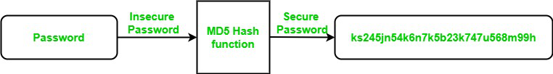
Use Of MD5 Algorithm
It is used for file authentication.
In a web application, it is used for security purposes. e.g. Secure password of users etc.
Using this algorithm, We can store our password in 128 bits format.

Slide 5
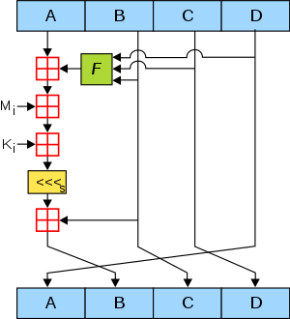

Slide 6
Working of the MD5 Algorithm
MD5 algorithm follows the following steps
1. Append Padding Bits: In the first step, we add padding bits in the original message in such a way that the total length of the message is 64 bits less than the exact multiple of 512.
Suppose we are given a message of 1000 bits. Now we have to add padding bits to the original message. Here we will add 472 padding bits to the original message. After adding the padding bits the size of the original message/output of the first step will be 1472 i.e. 64 bits less than an exact multiple of 512 (i.e. 512*3 = 1536). Length(original message + padding bits) = 512 * i – 64 where i = 1,2,3 . . .

Slide 7
2. Append Length Bits: In this step, we add the length bit in the output of the first step in such a way that the total number of the bits is the perfect multiple of 512. Simply, here we add the 64-bit as a length bit in the output of the first step. i.e. output of first step = 512 * n – 64 length bits = 64. After adding both we will get 512 * n i.e. the exact multiple of 512.
3. Initialize MD buffer: Here, we use the 4 buffers i.e. A, B, C, and D. The size of each buffer is 32 bits.
- A = 0x67425301
- B = 0xEDFCBA45
- C = 0x98CBADFE
- D = 0x13DCE476

Slide 8
4. Process Each 512-bit Block:
This is the most important step of the MD5 algorithm. Here, a total of 64 operations are performed in 4 rounds.
In the 1st round, 16 operations will be performed, 2nd round 16 operations will be performed, 3rd round 16 operations will be performed, and in the 4th round, 16 operations will be performed.
We apply a different function on each round i.e. for the 1st round we apply the F function, for the 2nd G function, 3rd for the H function, and 4th for the I function. We perform OR, AND, XOR, and NOT (basically these are logic gates) for calculating functions. We use 3 buffers for each function i.e. B, C, D.
- F(B,C,D) = (B AND C) OR (NOT B AND D)
- G(B,C,D) = (B AND C) OR (C AND NOT D)
- H(B,C,D) = B XOR C XOR D
- I(B,C,D) = C XOR (B OR NOT D )
After applying the function now we perform an operation on each block.
For performing operations we need
add modulo 2³²
M[i] – 32 bit message.
K[i] – 32 bit constant.
<<<n – Left shift by n bits.

Slide 9
Application Of MD5 Algorithm:
We use message digest to verify the integrity of files/ authenticates files.
MD5 was used for data security and encryption.
It is used to Digest the message of any size and also used for Password verification.
MD5 is faster and simple to understand.
MD5 algorithm generates a strong password in 16 bytes format. All developers like web developers use the MD5 algorithm to secure the password of users.
To integrate the MD5 algorithm, relatively low memory is necessary.
It is very easy and faster to generate a digest message of the original message.
Disadvantages of MD5 Algorithm:
MD5 generates the same hash function for different inputs.
MD5 provides poor security over SHA1.
MD5 has been considered an insecure algorithm. So now we are using SHA256 instead of MD5
MD5 is neither a symmetric nor asymmetric algorithm.

Slide 10
