Slide 1

Airline Ticket Price Analysis
S.Devi

Slide 2
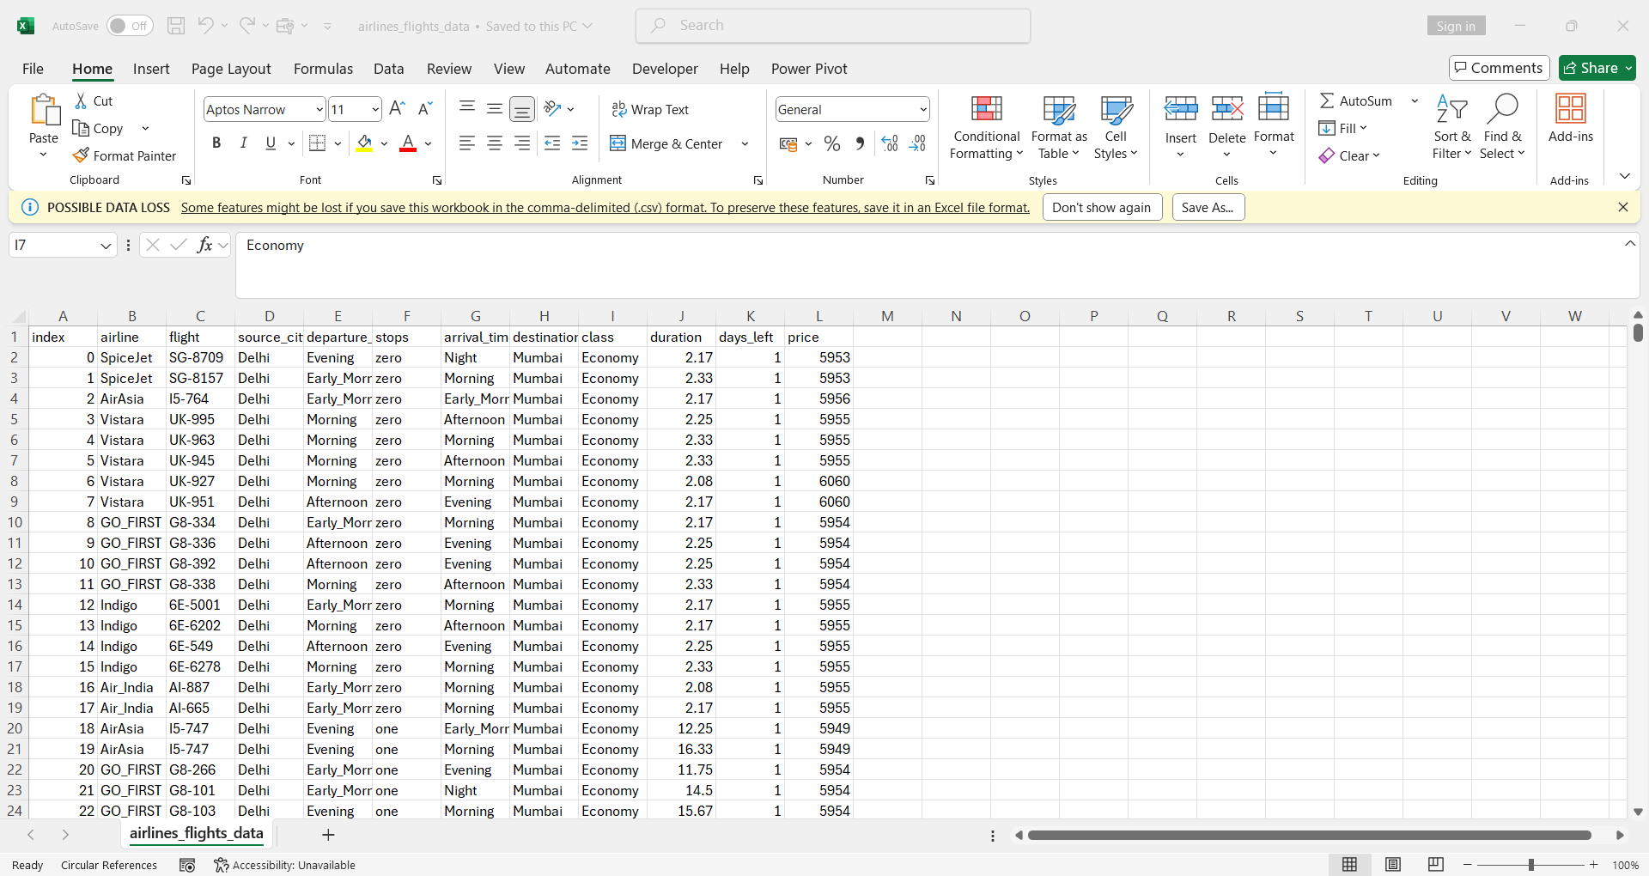
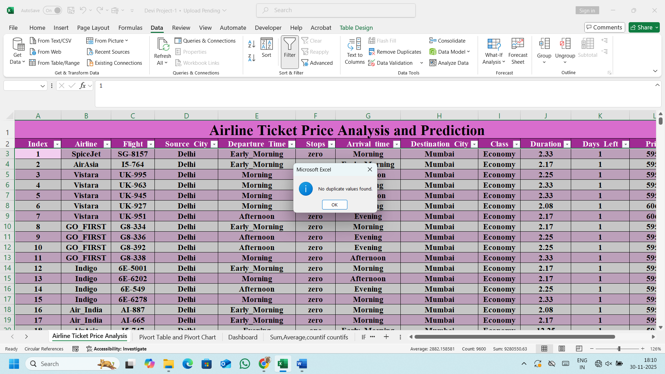
Clean data by handling missing values, duplicates and inconsistent entries
The dataset used is clean and this table has no duplicate in the entire list, ensuring accurate analysis.
I Collected the Dataset from Kaggle
Dataset: 800 rows and 12 Column

Slide 3
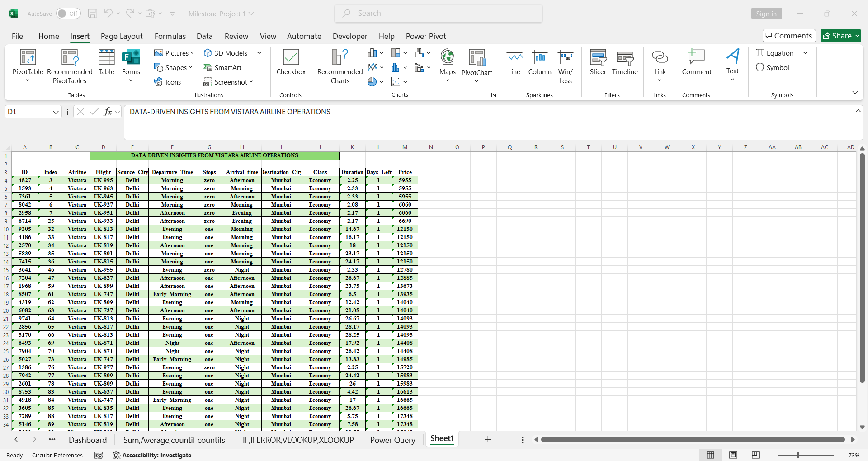
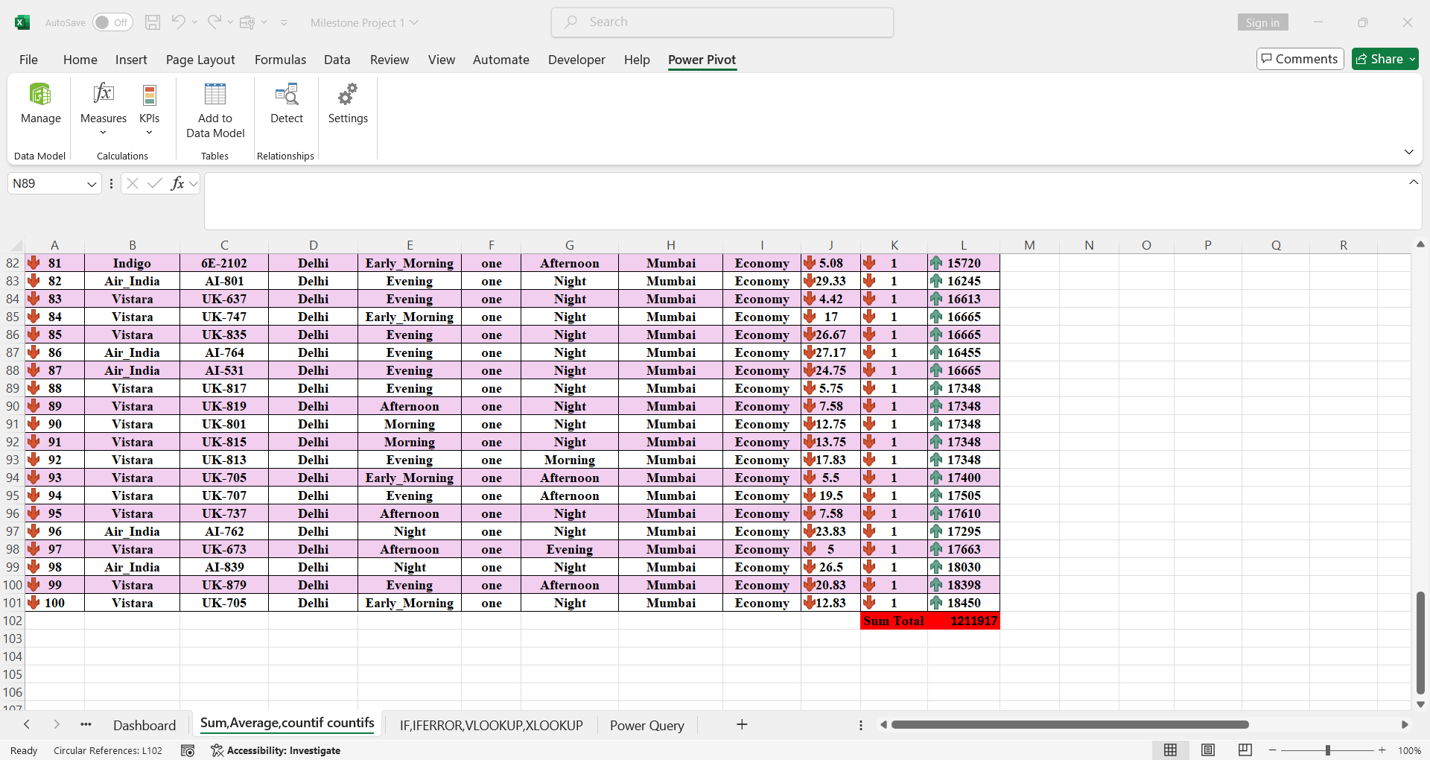
Create new derived metrics or calculated columns for deeper analysis
Since Vistara airline has more data, we can clearly observe how early booking influences Vistara ticket costs.
It helps compare whether a shorter or longer flight is more cost-efficient. It shows how early or late bookings affect ticket price.

Slide 4
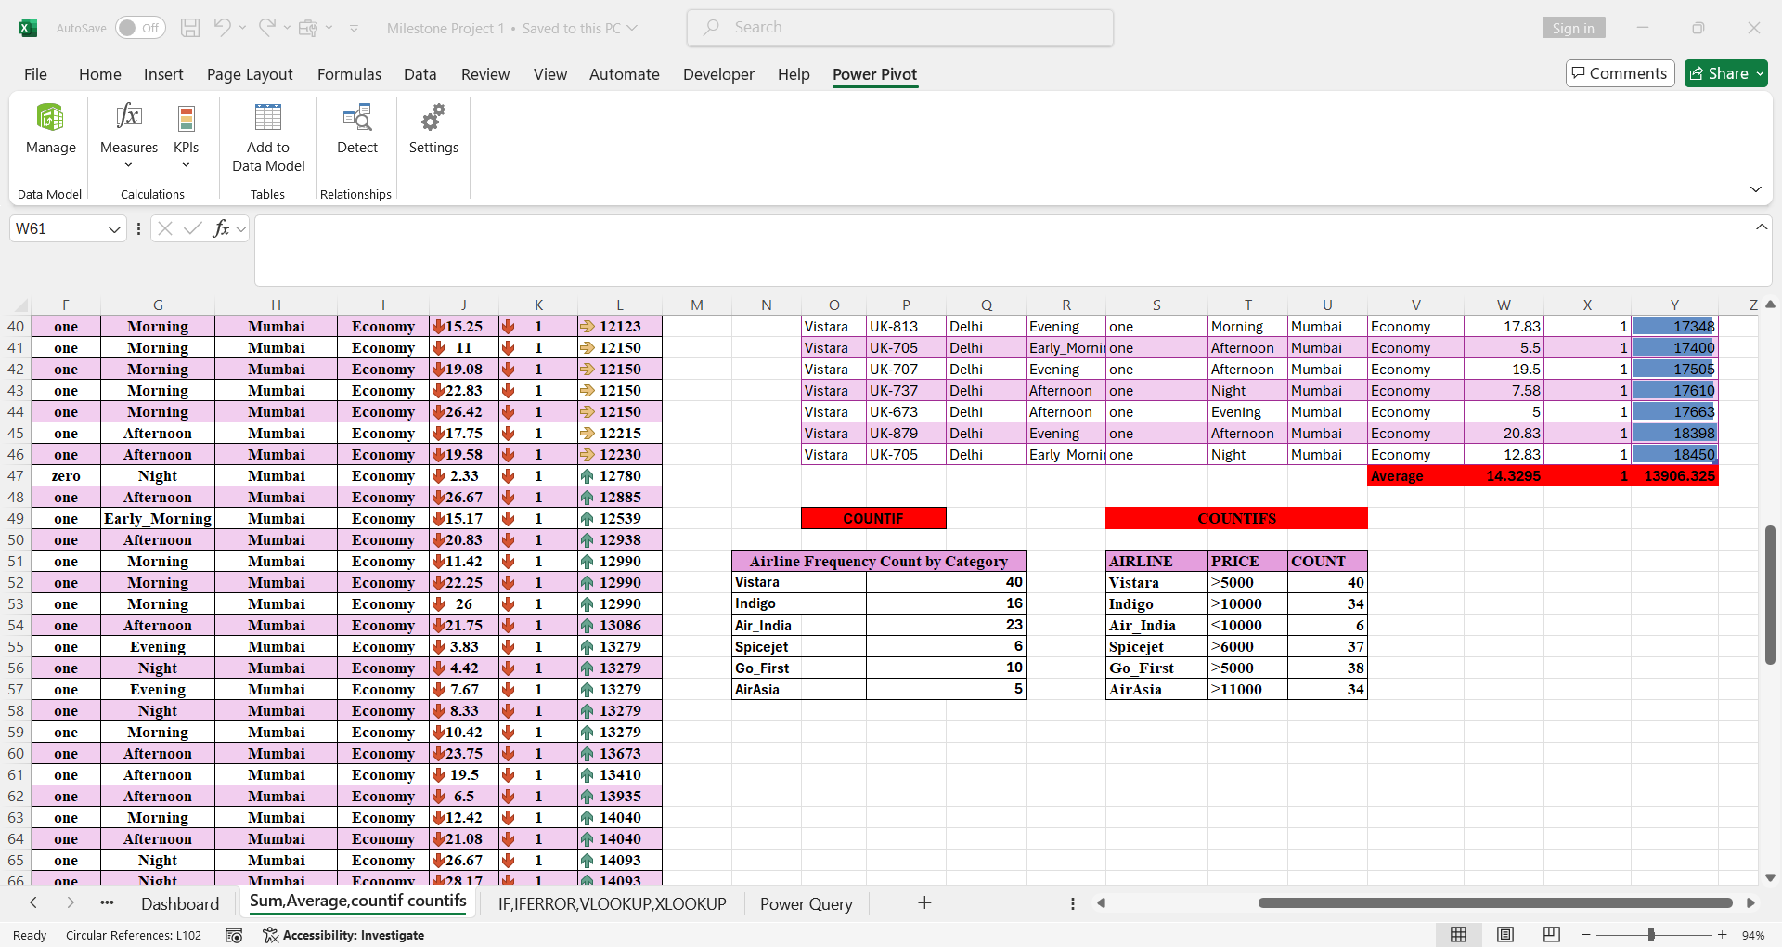
Frequency Calculation Of Airline Dataset Using COUNTIF AND COUNTIFS
Countif is used to count how many times a single condition appears in a dataset.
Example: Counting how many bookings belongs to Vistara or Indigo.
Countifs allows counting values based on two or more conditions.
Example: Counting tickets where Airline=Vistara and Price>5000.

Slide 5
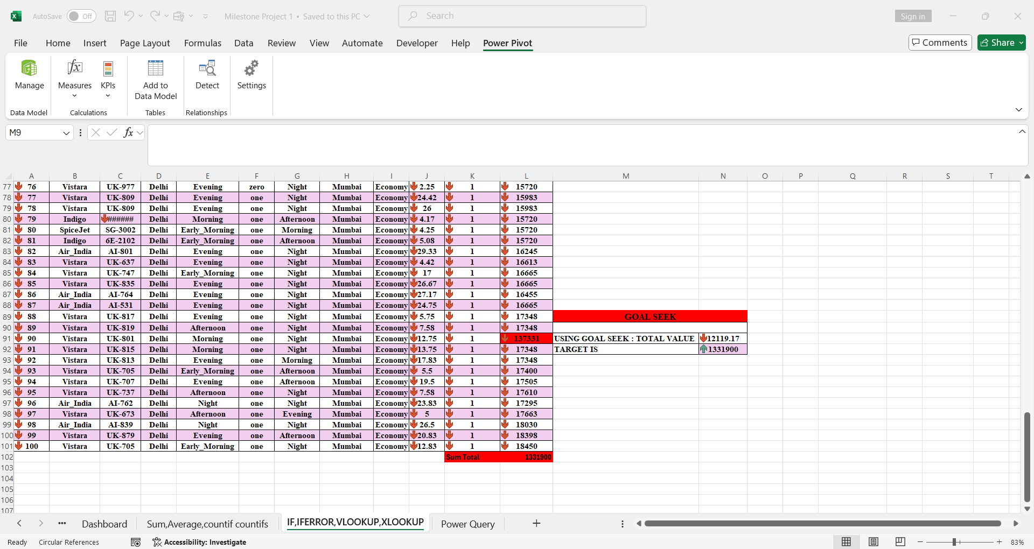
Whatif-If Analysis and Goal Seek
I use Goal Seek to adjust the data until the total value reached the target.
Example: A Flight company wants revenue to reach 5,00,000. goal seek calculates how many tickets must be sold to reach that revenue.
Saves time and avoids manual trial and error

Slide 6
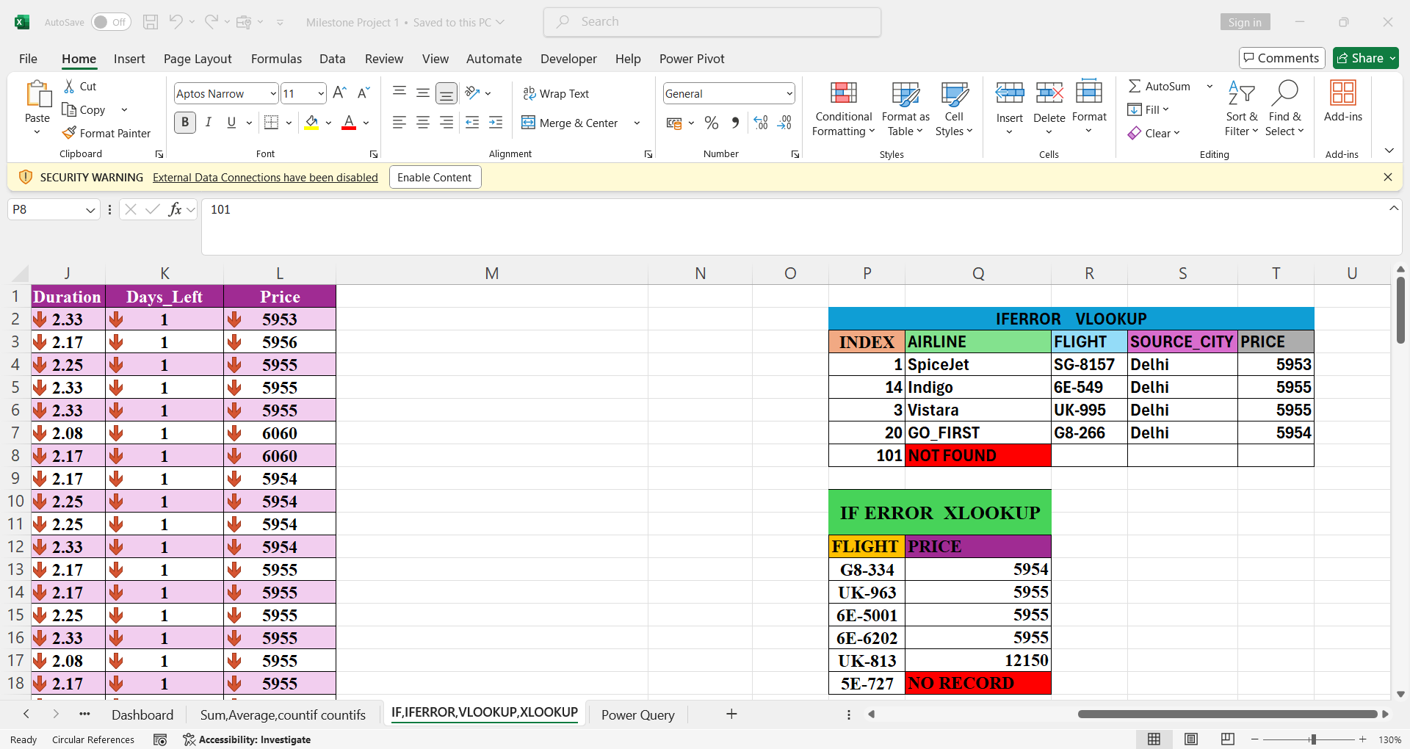
HANDLING MISSING DATA USING IFERROR WITH LOOKUP FUNCTIONS
IFERROR Helps avoid errors like “N/A” when data is missing.
Instead of showing an error, we can show clean text such as “NOT FOUND” or 0
VLOOKUP searches from left to right in a table. Best for small or fixed tables.
XLOOKUP is more flexible than VLOOKUP we don’t need to count columns manually.

Slide 7
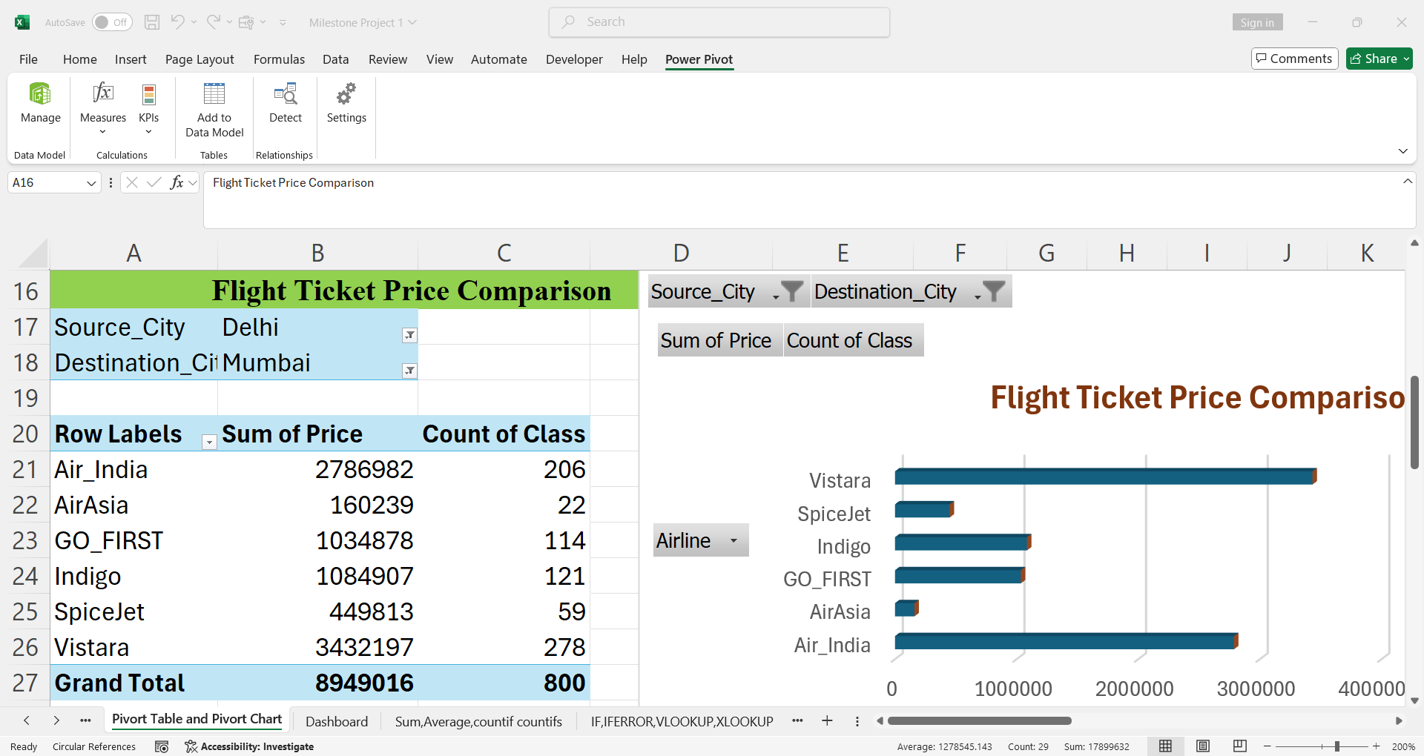
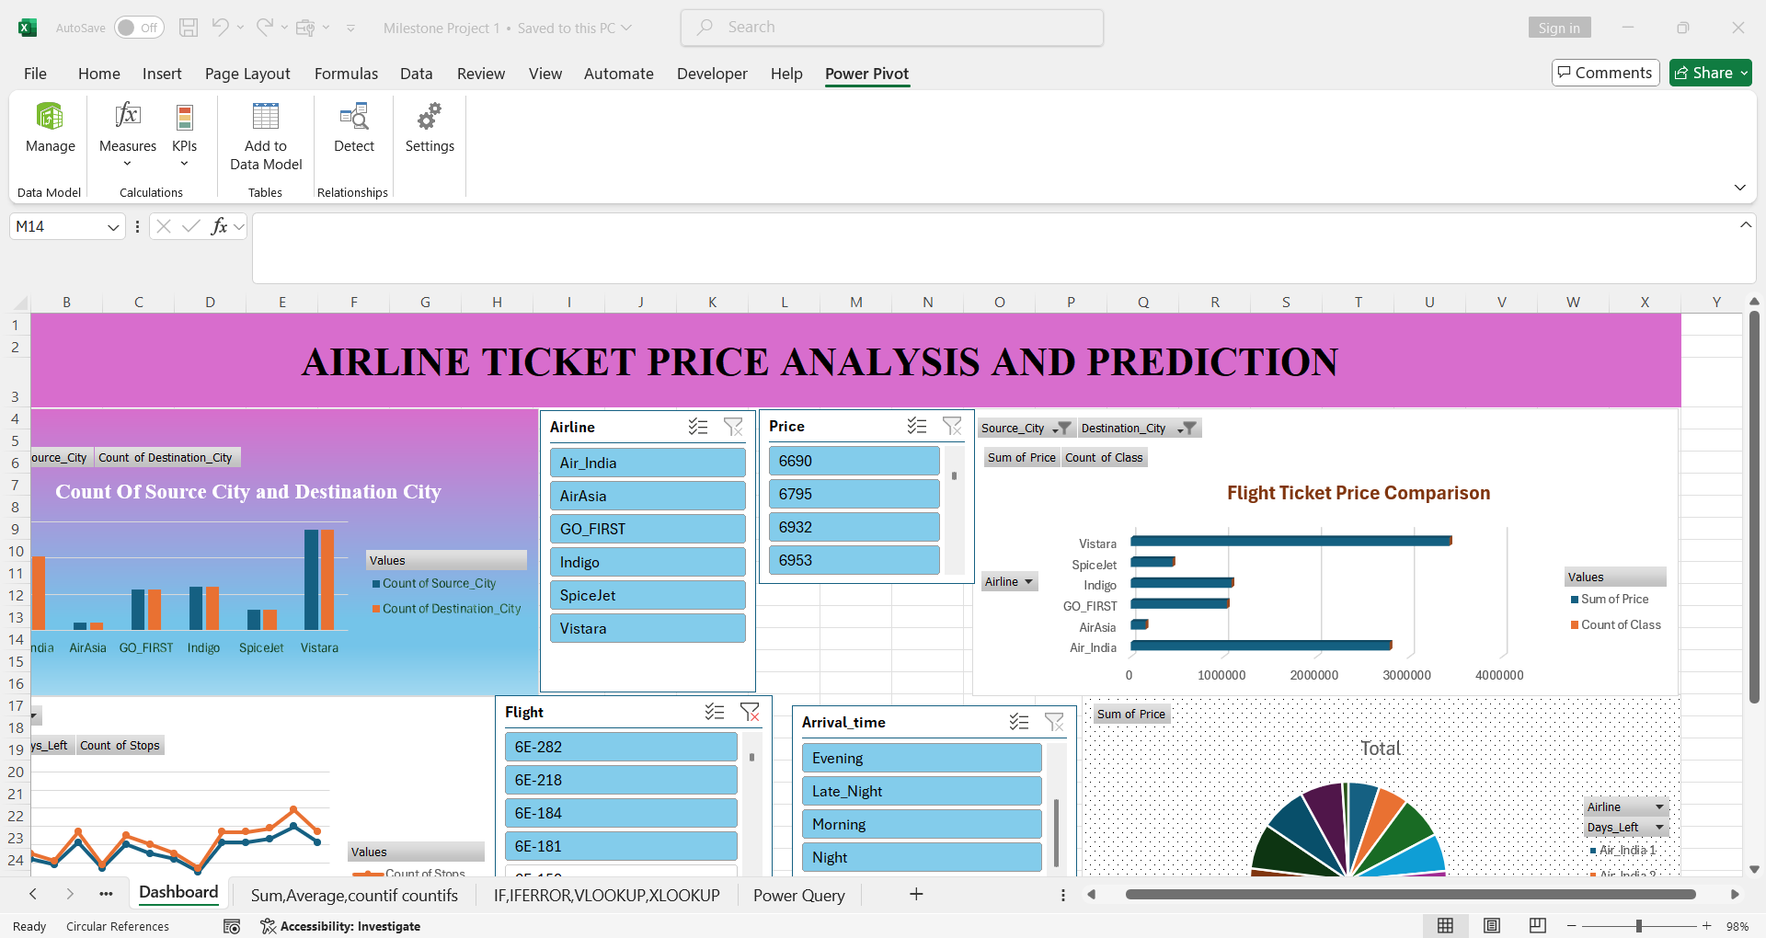
Pivot chart and Dashboard Visualization
Visual Flight Trends
The Pivot chart shows how different airlines perform across source and destination cities, helping identify which routes have higher flight volumes.
Price Comparison
Dashboard visuals compare ticket prices between airlines, allowing quick identification of low-cost and premium carriers.
Interactive slicers allow quick filtering and instant insights.

Slide 8
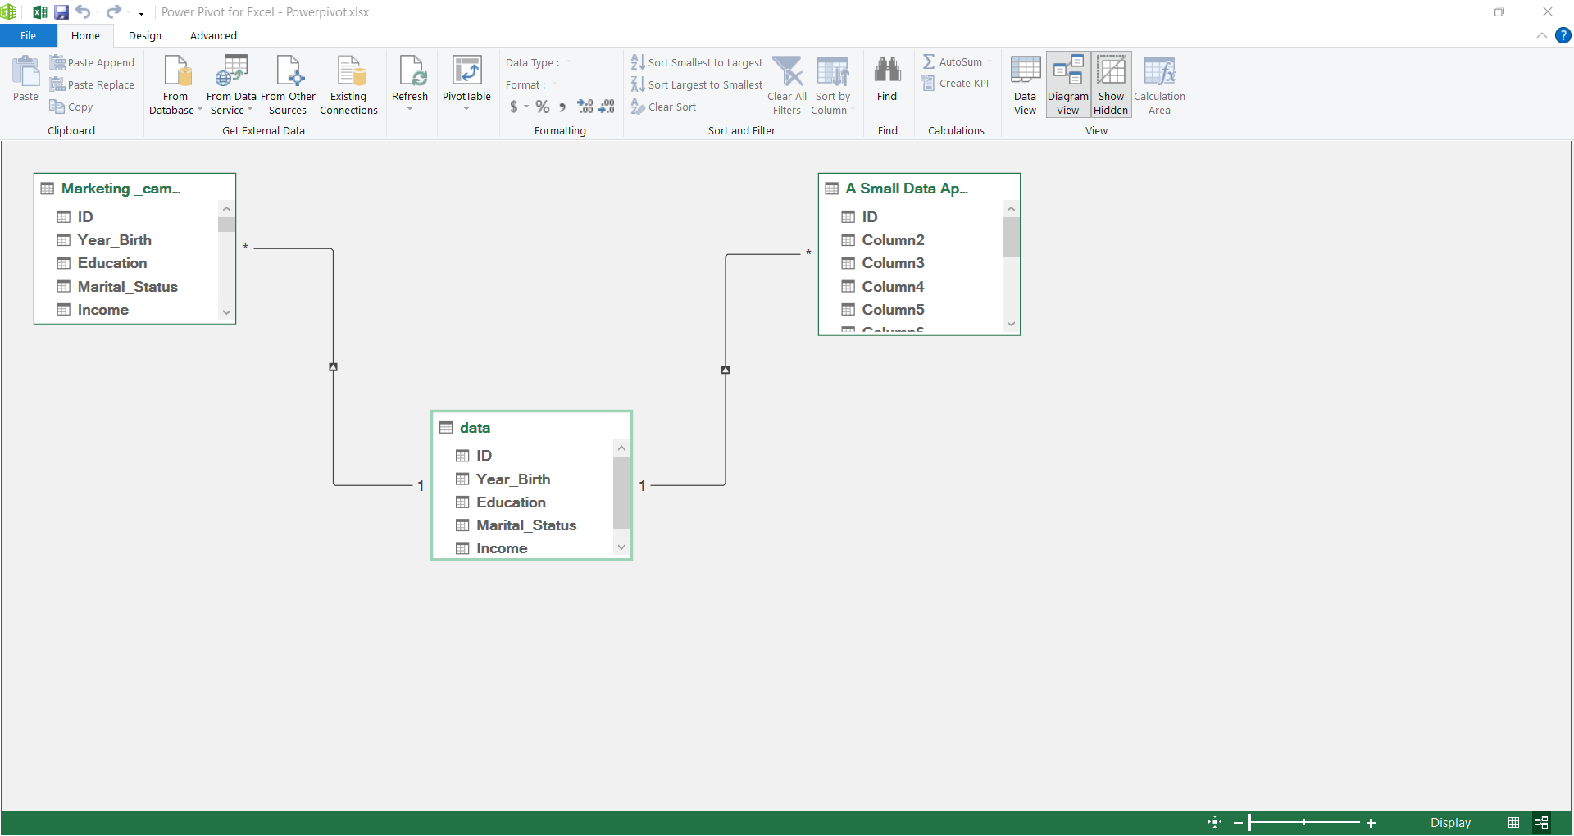
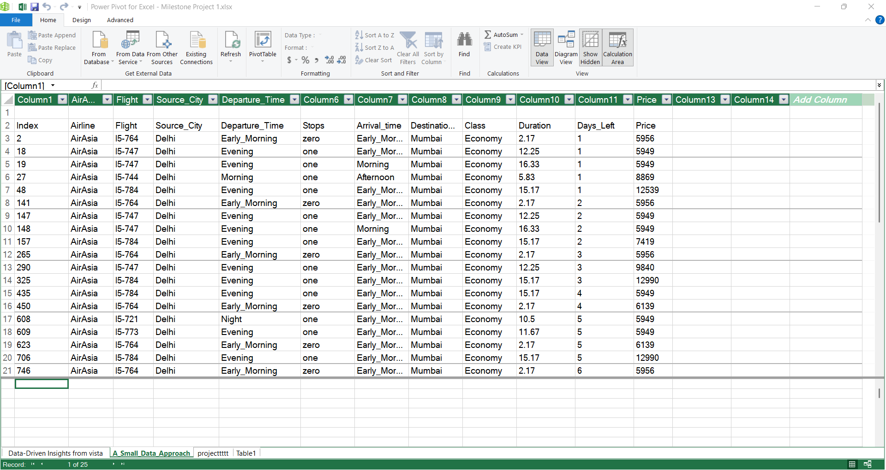
Build data models and relationships using power pivot
A relational data model makes updates easier because new records in any table automatically reflect in reports.
Power Pivot improves performance when working with large datasets compared to normal excel sheets.

Slide 9
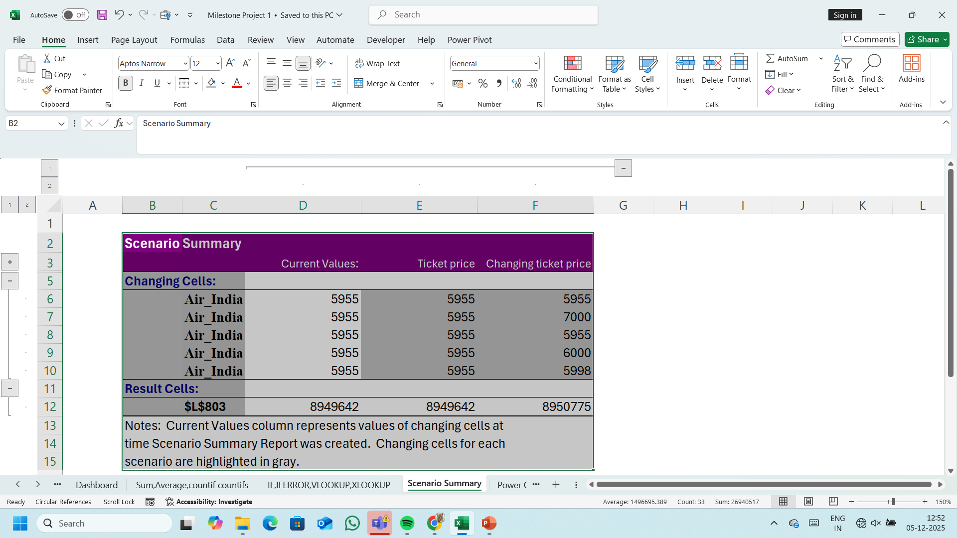
Scenario Summary
Current Values Vs Scenario Price
Current value Original ticket price
Scenario Values new ticket prices tested under each scenario
This helps to quickly see how each new price affects the outcome.

Slide 10
THANK YOU

