Slide 1
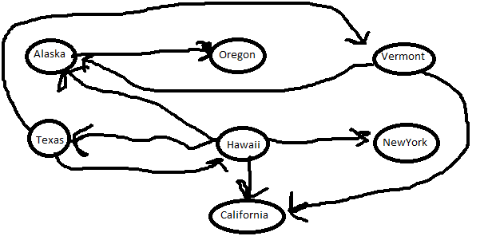
CMSC204
Kartchner
V(StateGraph) = {Oregon, Alaska, Texas, Hawaii, Vermont, NewYork, California}
E(StateGraph) = {(Alaska, Oregon), (Hawaii, Alaska), (Hawaii, Texas), (Texas, Hawaii), (Hawaii, California), (Hawaii, New York), (Texas, Vermont), (Vermont, California), (Vermont, Alaska)}
1. Draw the StateGraph
{Oregon, Alaska, Texas, Hawaii, Vermont, NewYork, California}
{(Alaska, Oregon), (Hawaii, Alaska), (Hawaii, Texas), (Texas, Hawaii), (Hawaii, California), (Hawaii, New York), (Texas, Vermont), (Vermont, California), (Vermont, Alaska)}
No
Yes
Texas

Slide 2
a. Show the adjacency matrix that would describe the edges in the graph. Store the vertices in alphabetical order
Oregon Alaska Texas Hawaii Vermont NewYork California
States
0 0 0 0 0 0 0
1 0 0 0 0 0 0
0 0 0 1 1 0 0
0 1 1 0 0 1 1
0 1 0 0 0 0 1
0 0 0 0 0 0 0
0 0 0 0 0 0 0
Oregon
Alaska
Texas
Hawaii
Vermont
NewYork
California
State
3. b. Show the adjacency lists
that would describe the edges in the graph
Oregon
Alaska
Texas
Hawaii
Vermont
NewYork
California
Oregon
Hawaii
Vermont
Alaska
New York
California
Texas
Alaska
California

Slide 3
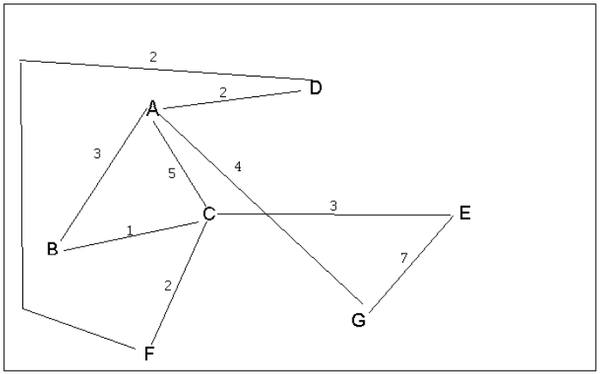
4 a. Which of the following lists the graph nodes in depth first order beginning with E?
A) E, G, F, C, D, B, A
B) G, A, E, C, B, F, D
C) E, G, A, D, F, C, B
D) E, C, F, B, A, D, G
4 b. Which of the following lists the graph nodes in breadth first order beginning at F?
A) F, C, D, A, B, E, G
B) F, D, C, A, B, C, G
C) F, C, D, B, G, A, E
D) a, b, and c are all breadth first traversals

Slide 4
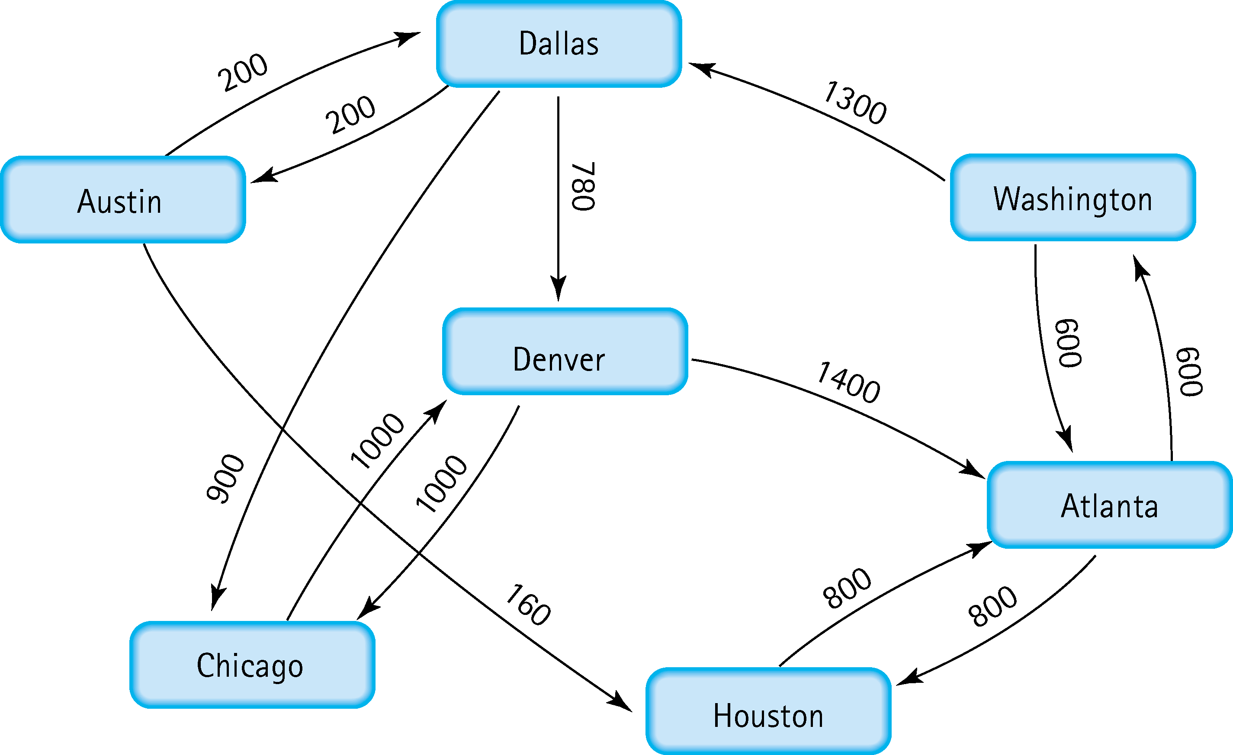



5. Find the shortest distance from Atlanta to every other city

Slide 5
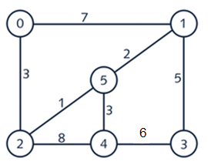











6. Find the minimal spanning tree using Prim’s algorithm. Use
0 as the source vertex . Show the steps.

Slide 6
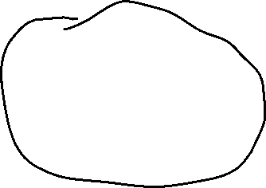







7. Find the minimal spanning tree using Kruskal’s algorithm.
Show the weights in order and the steps.

Slide 7
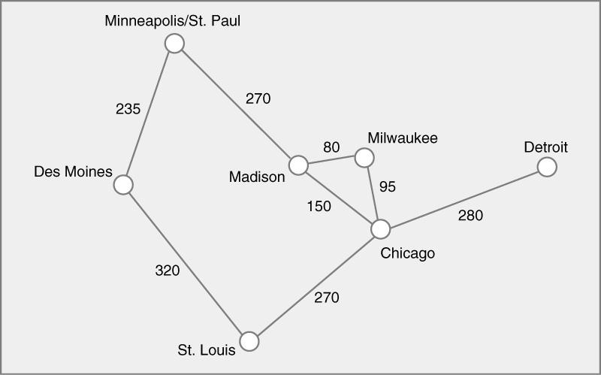













8. Find the minimal spanning tree using the algorithm you prefer. Use
Minneapolis/St. Paul as the source vertex

Slide 8
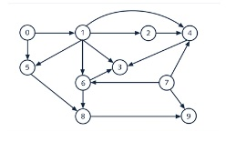


9. List the nodes of the graph in a breadth first topological ordering. Show the
steps using arrays predCount, topologicalOrder and a queue

Slide 9
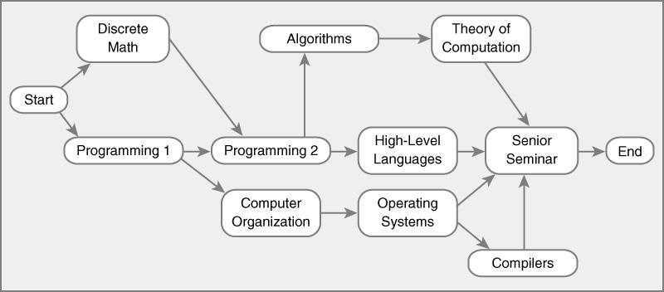

10. List the nodes of the graph in a breadth first topological ordering.

