Slide 1



Garbage Classification Using Deep Learning and Transfer Learning

Slide 2

Learning Objectives
Understand how deep learning can automate waste classification
Learn image classification using pre-trained models (Transfer Learning)
Implement a machine learning model using TensorFlow & Keras
Develop and deploy a web app to classify garbage images
Improve environmental awareness through AI applications
GOAL
Source :
www.freepik.com/

Slide 3
Tools and Technology used
Programming Language: Python
Frameworks/Libraries: TensorFlow, Keras, NumPy, Matplotlib, Streamlit
Model Used: MobileNetV2 (Transfer Learning)
IDE: Visual Studio Code, Jupyter Notebook
Deployment Tool: Streamlit
Version Control: Git & GitHub

Slide 4
Methodology
Data Preparation
Collected labeled garbage images
Preprocessed and augmented data
2. Model Development
Used MobileNetV2 (Transfer Learning)
Added custom classification layers
Trained on 6 classes of waste
3. Evaluation
Achieved 91% validation accuracy
Evaluated with classification report & confusion matrix
4. Deployment
Built a user-friendly Streamlit web app
Allows image upload and real-time classification

Slide 5
Problem Statement:
Waste management has become a critical global issue due to increasing population and urbanization.
A major challenge in waste processing is the inefficient and manual segregation of garbage. This leads to:
Incorrect disposal of recyclable materials
Increased workload on sanitation workers
Higher environmental pollution
Difficulty in automating waste processing plants
Despite efforts in public awareness, manual sorting is slow, inconsistent, and error-prone. There’s a clear need for an automated, reliable, and scalable solution to classify and segregate waste efficiently.

Slide 6
Solution:
We propose an AI-based image classification system that can automatically identify the type of garbage from an image and classify it into one of six categories:
Cardboard
Glass
Metal
Paper
Plastic
Trash (non-recyclable)
Key Features:
Uses MobileNetV2 (a lightweight CNN) via Transfer Learning
Trained on a labeled dataset of real-world waste images
Achieves ~76% accuracy across multiple waste types
Offers a Streamlit-based web application where users can upload an image and get instant predictions
This solution provides:
Fast, consistent garbage classification
Scalability in waste management automation
A step toward smarter, AI-powered sustainable environments

Slide 7
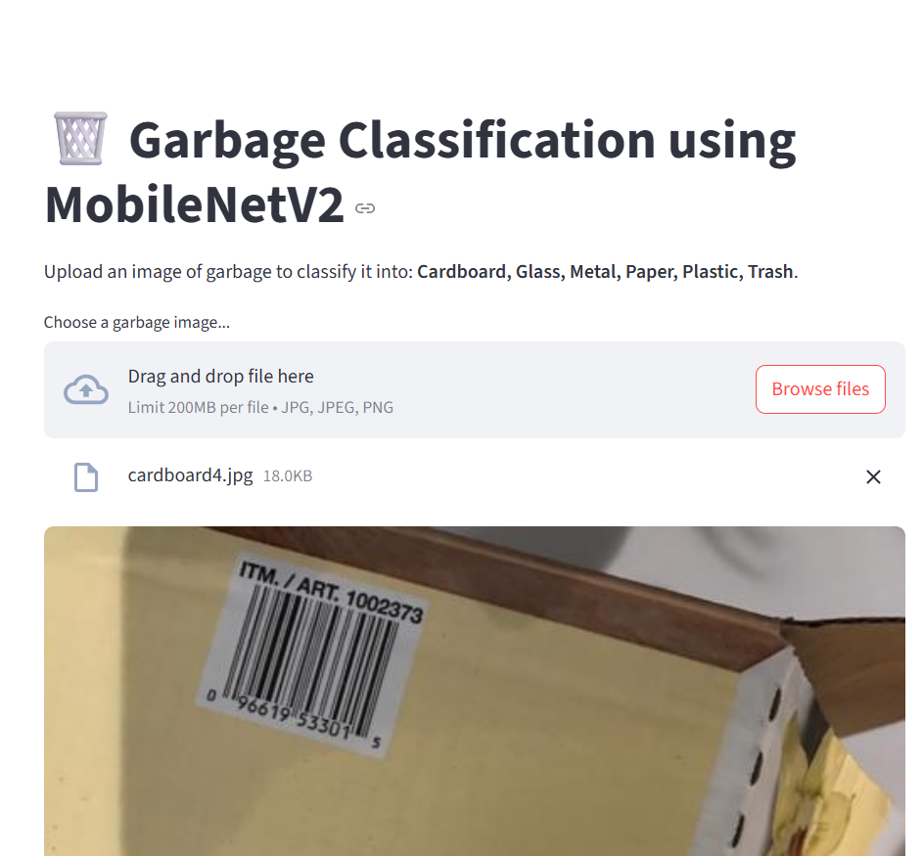
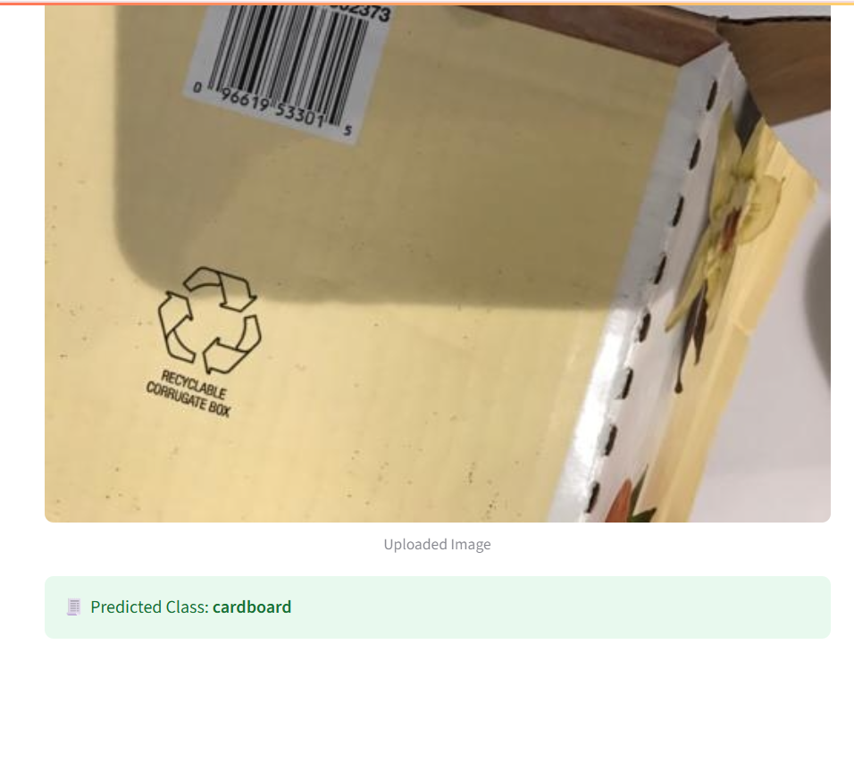
Screenshot of Output:
GitHub repo link : https://github.com/devisri36/Garbage-Classification

Slide 8
Conclusion:
Successfully built a deep learning model for garbage classification
Achieved reliable accuracy using Transfer Learning (MobileNetV2)
Demonstrated real-time prediction using a web app
The project promotes smarter waste management using AI
Future improvements can include real-time camera integration and mobile app deployment

