Slide 1
TASK 4
Data Storytelling &
Statistical Validation
Turning analysis into a business narrative — and proving it with statistics
ApexPlanet Software Pvt. Ltd.
60-Day Data Analytics Internship | Dataset: 5,000 Orders (2023-2024)
NAME: S.Devi Sri Sarika

Slide 2
The Business Story
Five chapters connecting Tasks 1-3 into one narrative
1
Setting the Scene
5,000 orders analysed across 2023-2024, generating Rs.6.29 Cr in total revenue from delivered orders.
2
The Problem
Month-1 retention is only 6%. Beauty has a 10.4% return rate. Cancellation rate sits at 10.1%.
3
The Opportunity
October consistently spikes (festive season). Mobile App leads revenue. 36-45 age group has the highest AOV.
4
The Recommendations
Post-purchase email flows, review Beauty listings, invest in Mobile App UX, plan festive campaigns early, target premium segment.
5
The Call to Action
Fix retention first - raising Month-1 retention from 6% to 12% would roughly double repeat revenue.

Slide 3
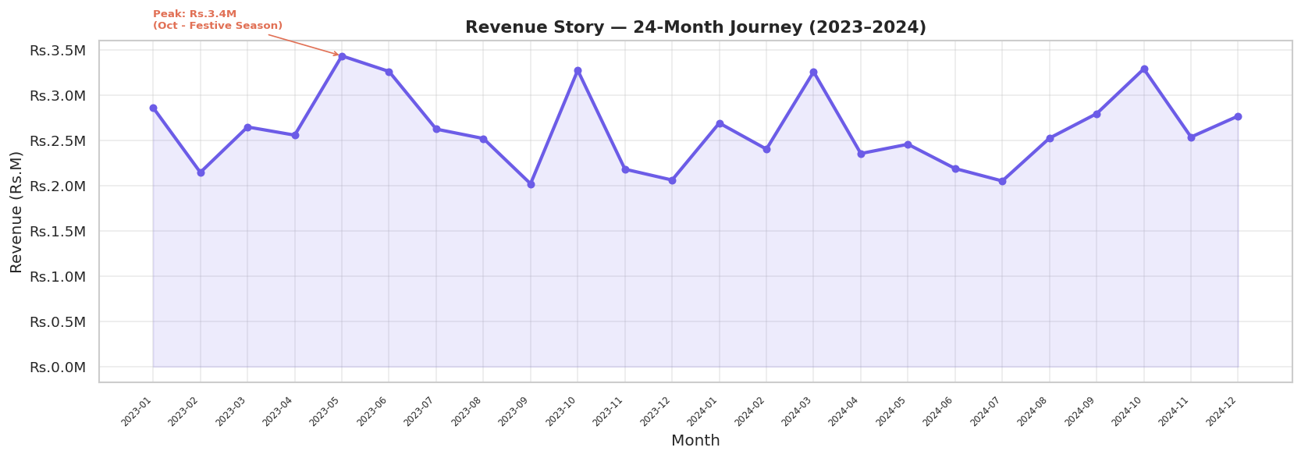

Chapter 1: The Revenue Journey
24 months of revenue tell a clear seasonal story
Rs.6.29 Cr
Total Revenue
October
Peak Month
5,000
Total Orders
What the data shows: Revenue rises through the year with a sharp spike in October, driven by festive-season demand (Diwali/Dussehra). This pattern repeats in both 2023 and 2024, suggesting a reliable seasonal trend that can be planned for in advance.

Slide 4
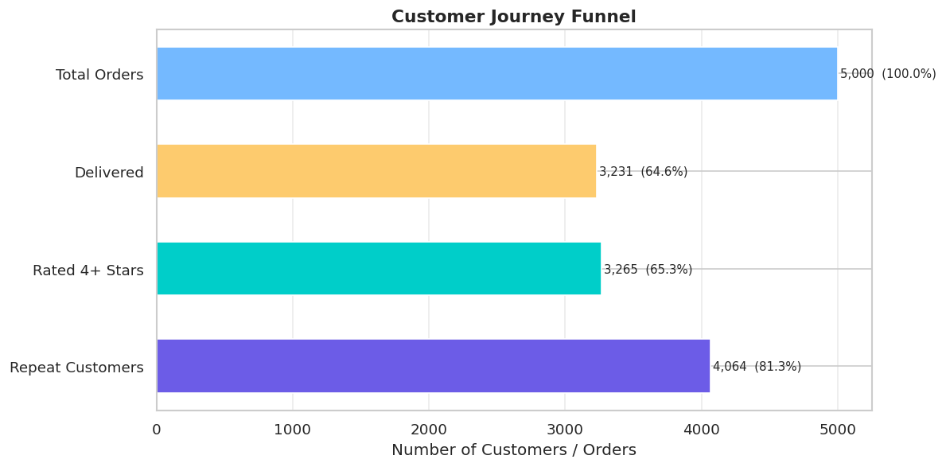
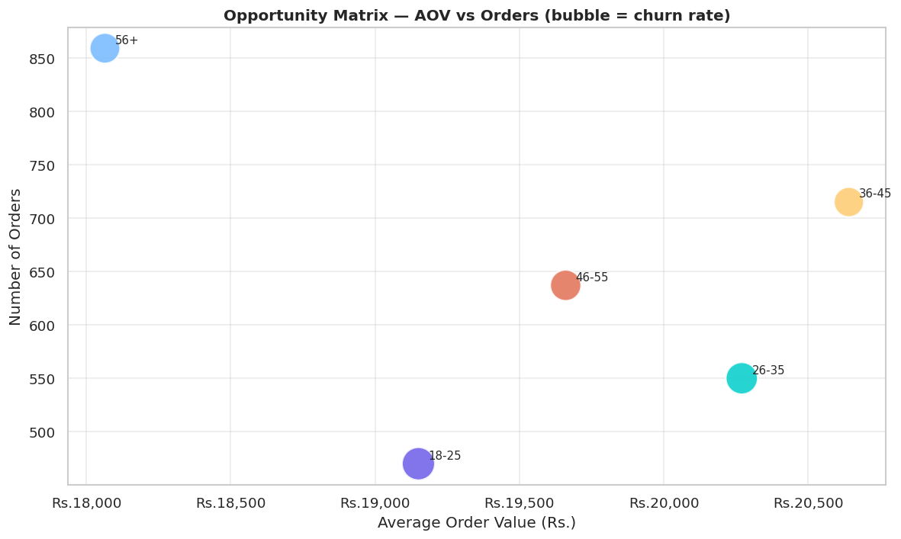



Chapter 2 & 3: The Problem and The Opportunity
Customer Journey Funnel
Segment Opportunity Matrix
6% Month-1 Retention
10.4% Return Rate
10.1% Cancellation Rate
94% of customers never reorder the next month
Beauty category has the highest returns
1 in 10 orders is cancelled before delivery
Insight: the highest-revenue segments (Mobile App, 36-45 age group, October) are also where the biggest gaps (retention, returns, cancellations) sit - fixing these gaps compounds the existing strengths.

Slide 5


Hypothesis Testing - Validating the Story with Statistics
Four business hypotheses were tested using T-Tests and a Chi-Squared test (alpha = 0.05)
Hypothesis | Test | P-Value | Result
H1: Mobile App AOV > Website AOV | T-Test | 0.0828 | Not Significant
H2: 36-45 AOV > 18-25 AOV | T-Test | 0.2317 | Not Significant
H3: Cancellation rate differs by channel | Chi-Squared | 0.7467 | Not Significant
H4: October AOV > Other months | T-Test | 0.0075 | Significant
Key statistical finding: Only H4 is statistically significant (p = 0.0075 < 0.05). This proves the October revenue spike is a real, repeatable seasonal pattern - not random variation - and justifies investing in festive-season campaigns ahead of time. The other three hypotheses (channel AOV, age-group AOV, channel cancellation) show differences in the raw numbers, but those differences are not statistically significant at the 5% level - meaning they could be due to chance.

Slide 6
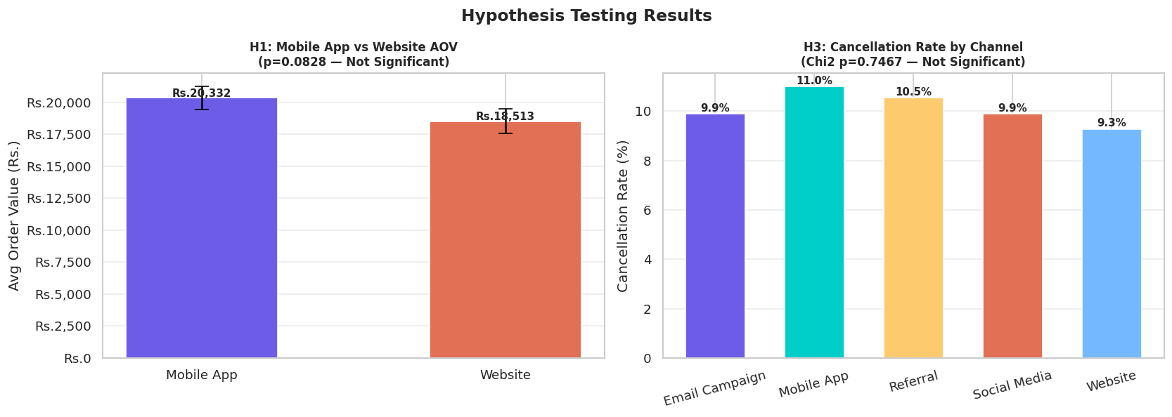

Hypothesis Testing - Visual Comparison
H1 (Mobile App vs Website AOV) and H3 (Cancellation rate by channel)
Reading the charts: Mobile App's average order value (Rs.20,332) is visibly higher than Website's (Rs.18,513), and Mobile App also shows the highest cancellation rate (11.0%) among channels - but neither difference clears the p < 0.05 bar, so larger sample sizes or longer time windows would be needed to confirm these patterns.

Slide 7



Chapter 4: Recommendations
Five actions to convert insight into business impact
Boost Month-1 Retention
Reduce Beauty Returns
Launch a 30-day post-purchase email sequence with personalised recommendations to lift retention from 6% toward 12-15%.
Review product descriptions, sizing guides and images for the Beauty category to bring the 10.4% return rate down.
Invest in Mobile App
Plan Festive Campaigns Early
Mobile App drives the most revenue (Rs.2.14 Cr) - prioritise app UX improvements and push-notification campaigns.
October's spike is statistically proven (p=0.0075) - prepare inventory and marketing 4 weeks ahead of the festive season.
Target the Premium Segment
Highest priority: Fix retention first
The 36-45 age group has the highest AOV (Rs.20,641) - create premium product bundles aimed at this group.
Of all five actions, improving Month-1 retention has the largest compounding effect on long-term revenue.

Slide 8
Chapter 5: Call to Action
Increasing Month-1 retention from 6% to 12% would roughly double repeat revenue - the single highest-impact action available from this analysis.
Rs.6.29 Cr
6%
October Spike
Age 36-45
Total Revenue
Month-1 Retention
Statistically Proven Trend
Target Segment
Tasks completed:
Task 1 - Data Wrangling | Task 2 - EDA & BI | Task 3 - Deep-Dive & Power BI Dashboard | Task 4 - Storytelling & Hypothesis Testing
ApexPlanet Software Pvt. Ltd. | 60-Day Data Analytics Internship | Devi Sri

