Slide 1
Data Mining Project
Oyo Hotels in Goa on a weekend

Slide 2
Data Mining
The data mining project is about the data of hotels in Goa state. We collected this data from the official website of OYO hotels. In this project we analysed the collected data and visualized it which is understandable to everyone.
The hotels data was collected from the following areas of Goa
1) Baga beach 4)Anjuna
2) Panjim 5) Vagator
3) Calangute 6) South Goa

Slide 3
Data set
The dataset has 21 columns and 380 rows.
Hotel names are in the rows.
The data set consists of following columns
1) Hotel 8) Bar 15)In house restaurant
2) Rating 9) Amenities 16) Kitchen
3) Count 10) Parking 17) TV
4) Location 11) Card payment 18) CCTV
5) Actual price 12) Ac 19)First aid
6) Discount 13) Break fast 20) Power backup
7) Price (after discount) 14) Attached bathroom 21) Other

Slide 4
Data Cleaning
There are 2 columns with missing data.
Each of the 2 columns have missing data in 33 rows.
Mean and median of the 2 columns are almost same.
Imputing the missing values with median.
After the imputation of NaN values with median the average rating is each hotel is 4.14 which indicates almost every hotel is a best choice.
The average price of each hotel is 3860 rupees before discount.
The average price of each hotel is 2312 rupees after discount which indicates the discounts on weekends are at their best.

Slide 5
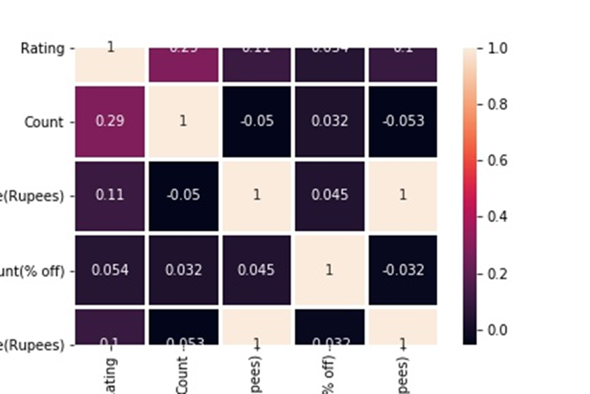
Correlation between the columns of dataset
All the columns in data set are weekly correlated.
Note: We have a strong relation between actual price, discount and price -- because the discount is same across hotels.

Slide 6
Uni-variate analysis on Price
Hotels price in Goa range between 858-6034
Least expensive hotel is SPOT ON 37412 Hotel Priti International in Mapusa with a rating of 3.8 and price of 858 rupees.
Most expensive hotel is Capital O 64180 Adam's Beach Resort in Baga Beach and Calangute with a rating of 4.8 and price of 6034 rupees.
Median value for price is 2413 which is same as Q3 and almost equal to mean
We can infer that the frequency distribution is a left skewed (Outliers are on the lower boundry side.

Slide 7
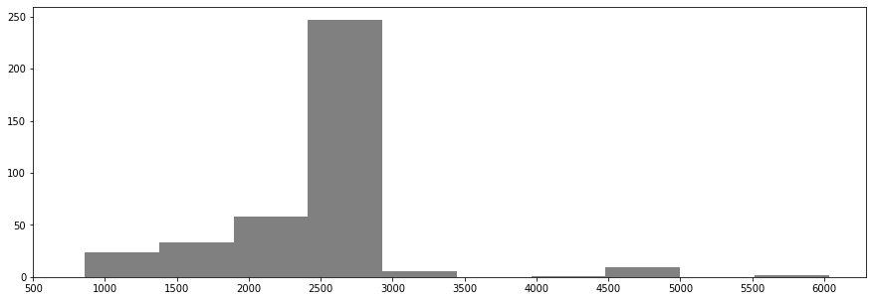
Histogram plot of price
Histogram plot shows that there are max no. of hotels around the price range of 2400

Slide 8
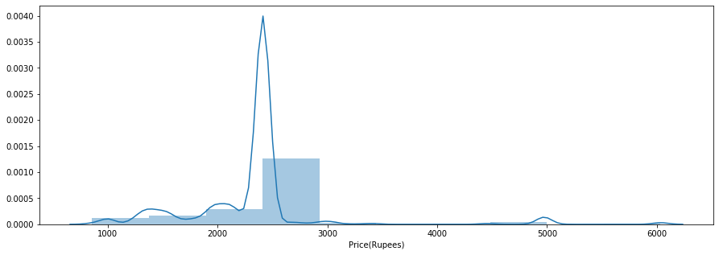
Kernal density plot and histogram plot of price
Kernal density plot and histogram plot shows that there are max no. of hotels around the price range of 2400

Slide 9
RATING
The minimum rating is 3
The maximum rating is 5
Most number of hotels(65) have a rating of 4.2
There are 40 hotels with a rating of 4.4
The average rating of hotels is 4.1

Slide 10
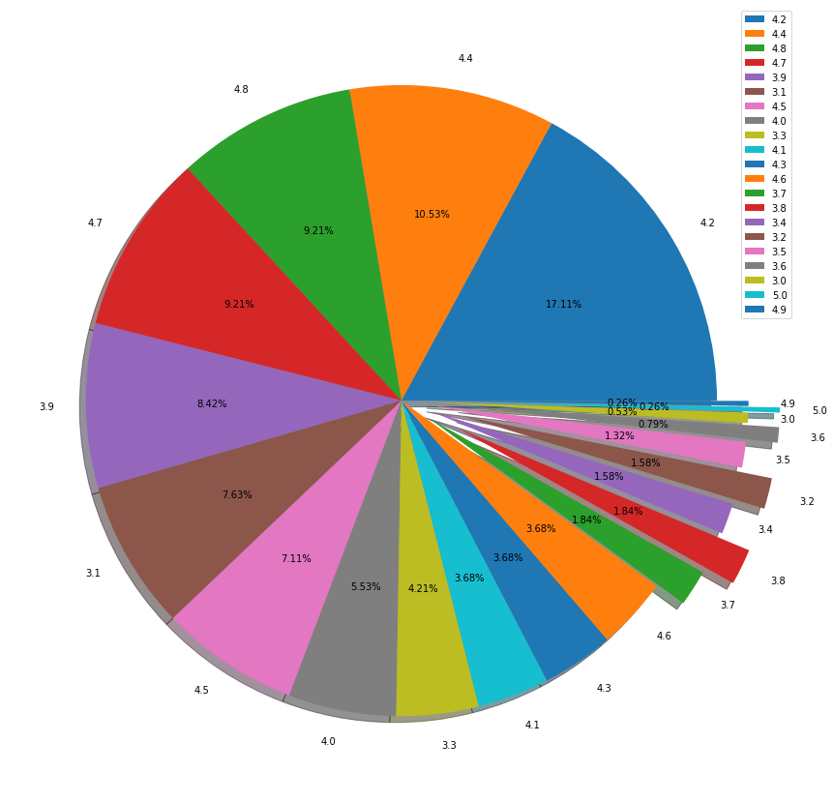
Visualization of rating using pie plot

Slide 11
Uni-variate analysis on amenities
Most number of hotels in Goa offer the following amenities:
17.80% Hotels offer parking facility
14.26% Hotels have AC
12.50% Hotels have Kitchen
11.69 % Hotels have Attached bathrooms
9.03% Hotels have CCTV Cameras
All the hotels which offer parking AC and kitchen have same price - 2413
Rating for these hotels range between 3.1-4.7 with average rating of 3.9
Arambol has highest rated hotel (4.7) with parking AC and kitchen facilities
Colva has Lowest rated hotel (3.1) with parking AC and kitchen facilities

Slide 12
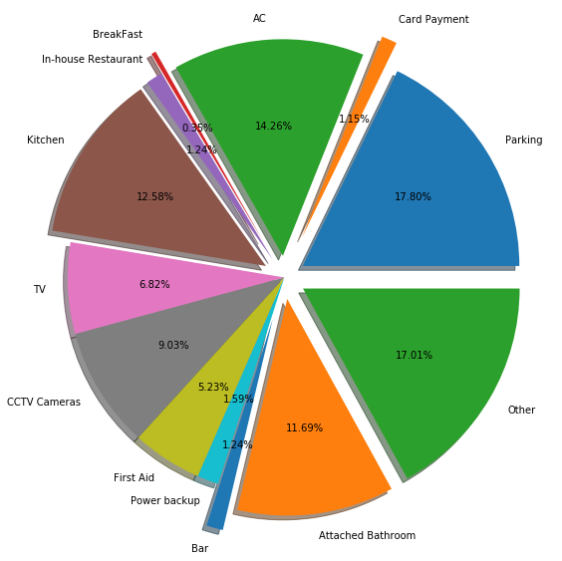
Visualization of amenities using pie plot

Slide 13
Uni-variate analysis on hotels
Average price of top 10 highest rated hotels in goa is 3160 ranging between 1439-6034
Highest rated hotels with a rating of 5 are
OYO Home 24689 Classic 2BHK Near Mandrem Beach(Price=2413 , Location= Arambol)
SPOT ON 64361 Casa Arambol Homestay SPOT(Price=1744 , Location= Arambol)
Lowest priced hotel is OYO 12855 The Goan Courtyard(Price=1439, Location=Colva)
Out of these 10 hotels top 4 are located in Arambol
Common amenities provided in these top 10 hotels are AC and Attached Bathroom
Average rating of 10 hotels with lowest price in Goa is 3.95 ranging between 3.5-4.6
South Goa has 3 hotels out of these 10 lowest priced hotels.

Slide 14
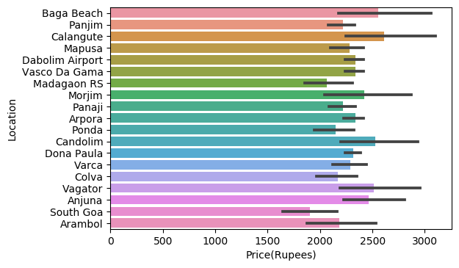
Bi-variate analysis (price vs location)
Hotels in Baga Beach, Calangute, Candolim, Vagator, Anjuna have high prices.

Slide 15
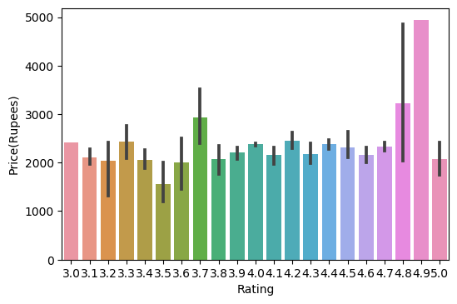
Price vs rating(bar plot)
Hotels with 4.8 and 4.9 rating are expensive

Slide 16
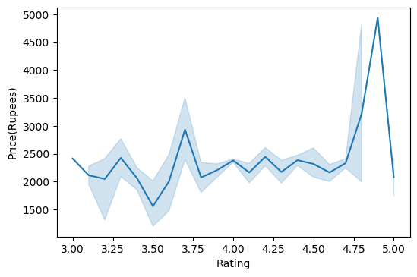
Price vs rating(line plot)
Hotels with rating from 3.75 to 4.75 has almost same price range 2000-2500

Slide 17
Price vs amenities
Hotels which provide parking and bar has price range between 2001-4977.
Average price of hotels which provide parking bar is 2695.
We can expand this with all combinations of ameinities as per the requirement
Average rating of hotels that provide Parking and Bar is 4.12
Rating of these hotels range between 3.7-4.4
We can expand this analysis with all combination of amenities

Slide 18
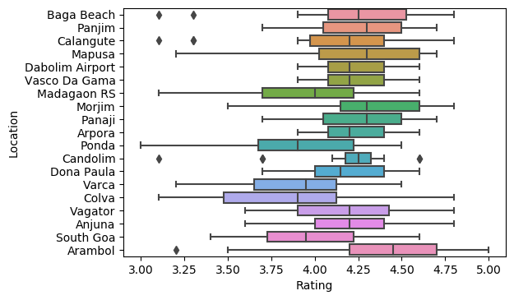
Rating vs location
Highest rating hotels are location in Arambol with 4.365
Lowest rating hotesl are location in Colva with 3.850

Slide 19
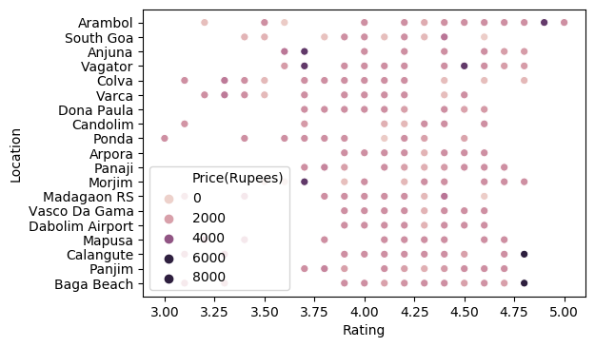
Multi-variate analysis(price vs rating vs location)
Highest average hotel price is for the location Candolim 4.1.
Lowest average hotel price is for the location South goa 3.9.
Hight average rating hotels are located in Arambol(Avg Price= 2187.30) with 4.3
Lowest average rating hotels are located in Colva(avg price=2172) with 3.8
Price for more hotels are at the range of 2000-2500
Rating for most hotels range between 4-4.75

Slide 20
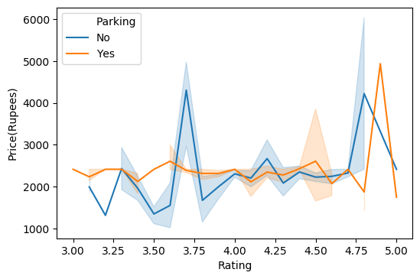
Price vs rating vs parking
Average price of hotels with parking across locations is 2417 and without parking is 2295

Slide 21
Price vs location vs parking
Highest avg price for hotels with Parking is 2660, location is Morjim
Lowest avg price for hotesl with parking is 2013, location is South Goa.
Highest avg price for hotels without Parking is 2850, location is Calangute
Lowest avg price for hotesl without parking is 1745, location is South Goa

Slide 22
Rating vs location vs parking
Highest avg rated hotels with Parking are located in Arambol(4.39)
Lowest avg rated hotels with Parking are located in Varca(3.90)
Highest avg rated hotels without Parking are located in Panaji(4.37)
Lowest avg rated hotesl without parking are located in Colva(3.7)

Slide 23
CLIENT REQUIREMENT

