Slide 1
Customer Segmentation
using RFM Analysis and K-means
Deviyanti Aryani
JCDS03

Slide 2
Segment | RFM | Description | Marketing
Best Customers | 111 | Bought most recently, most often, and spend the most | No price incentives, new products ads, and loyalty programs
Loyal Customers | X1X | Buy most frequently | Use R and M for further segmentation
Big Spenders | XX1 | Spend the most | Market your expensive products
Almost Lost | 311 | Haven’t purchased for some time, but purchased frequently and spend the most | Aggressive price incentives
Lost Customers | 411 | Haven’t purchased for some time but purchased frequently and spend the most | Aggressive price incentives
Lost Cheap | 444 | Last purchased long ago, purchased few, and spent little | Don’t spend too much trying to re-acquire

Slide 3
Outline
Load dataset
Data Preparation
RFM
Clustering based on quintile
Data Preparation
K-means
Model & Train
Parameter tuning
Visualization and Comparison

Slide 4
Load Dataset
import numpy as np
import pandas as pd
import seaborn as sns
import matplotlib.pyplot as plt
import findspark
findspark.init('/usr/local/Cellar/apache-spark/2.4.0/libexec')
from pyspark.sql import SparkSession
spark = SparkSession.builder \
.master("local") \
.appName("RFM Analysis") \
.config("spark.some.config.option", "some-value") \
.getOrCreate()
df = spark.read.format('com.databricks.spark.csv').\
options(header='true', \
inferschema='true').\
load("onlineretail.csv”)

Slide 5
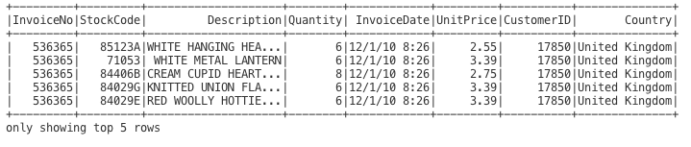
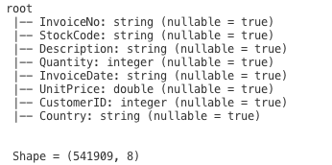
Load Dataset
df.show(5)
df.printSchema()
print('\n Shape =', (df.count(), len(df.columns)))

Slide 6
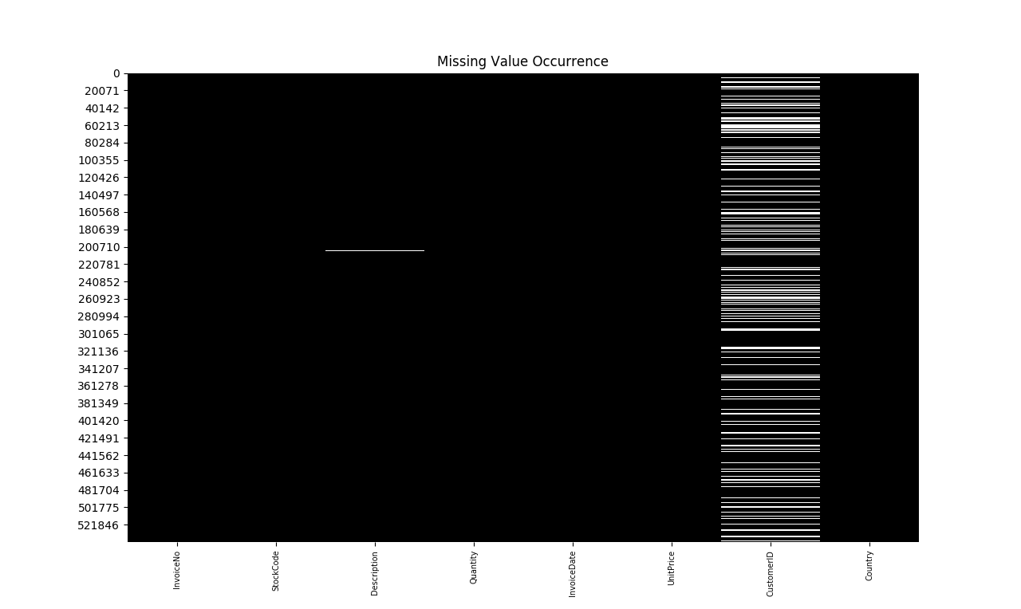
Data Preparation
## Check for missing value
from pyspark.sql import functions as F
ax=plt.subplot(111)
sns.heatmap(df.select([F.isnull(c) for c in df.columns]).collect(),cbar=False,cmap='Greys_r')
ax.set_xticklabels(df.columns, rotation='vertical',fontsize=7)
plt.title('Missing Value Occurrence')
plt.show()

Slide 7
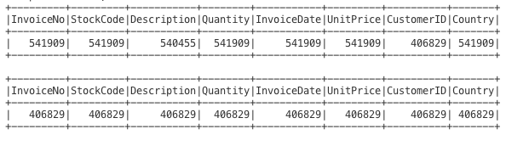
Data Preparation
## Delete rows with null value
from pyspark.sql.functions import count
def data_count(inp):
inp.agg(*[count(i).alias(i) for i in inp.columns]).show()
data_count(df) # raw data
df_new = df.dropna(how='any’)
data_count(df_new) # after we drop rows with null values

Slide 8
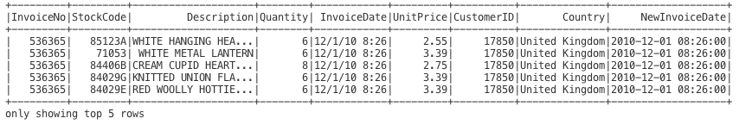
Data Preparation
## Change datetime format
from pyspark.sql.functions import to_utc_timestamp, unix_timestamp, lit, datediff, col
time_format = "MM/dd/yy HH:mm"
df_new = df_new.withColumn('NewInvoiceDate', to_utc_timestamp(unix_timestamp(col('InvoiceDate'),time_format).cast('timestamp'),'UTC'))
df_new.show(5)

Slide 9
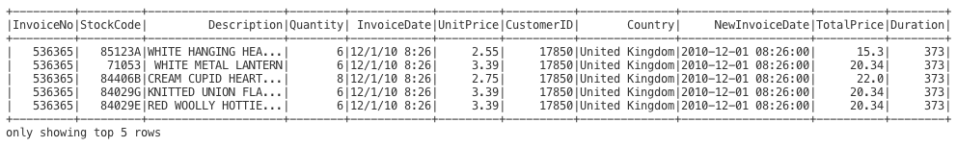
Data Preparation
## Calculate total price and create the column
from pyspark.sql.functions import round
df_new = df_new.withColumn('TotalPrice', round( df.Quantity * df.UnitPrice, 2 ))
## Calculate time diff – find the latest date
from pyspark.sql.functions import mean, min, max, sum
date_max = df_new.select(max('NewInvoiceDate')).toPandas()
## Calculate duration
df_new = df_new.withColumn('Duration', datediff(lit(date_max.iloc[0][0]), 'NewInvoiceDate'))
df_new.show(5)

Slide 10
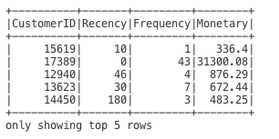
Data Preparation
## Calculate rfm
recency = df_new.groupBy('CustomerID').agg(min('Duration').alias('Recency'))
frequency = df_new.groupBy('CustomerID', 'InvoiceNo').count().groupBy('CustomerID').agg(count("*").alias("Frequency"))
monetary = df_new.groupBy('CustomerID').agg(round(sum('TotalPrice'), 2).alias('Monetary'))
rfm = recency.join(frequency,'CustomerID', how = 'inner').join(monetary,'CustomerID', how = 'inner')
rfm.show(5)

Slide 11
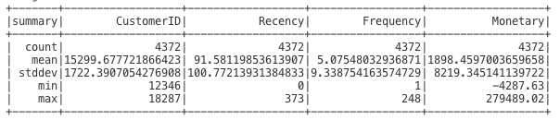
Data Preparation
rfm.describe().show()

Slide 12

Data Preparation-RFM
## Cutting point
def describe_quintile(df_in, columns):
quintiles = [25, 50, 75]
quars = np.transpose([np.percentile(df_in.select(x).collect(),quintiles) for x in columns])
quars = pd.DataFrame(quars, columns=columns)
quars['quintile'] = [str(p) + '%' for p in quintiles]
new_df = quars
new_df = new_df.set_index('quintile')
new_df = new_df.round(2)
return new_df
cols = ['Recency','Frequency','Monetary']
df_quar = describe_quintile(rfm,cols)
print(df_quar)

Slide 13
RFM-based on quintile
def RScore(x):
rs=0
for i in range(3):
if x <= df_quar.iloc[i,0]:
rs=i+1
break
elif x > df_quar.iloc[2,0]:
rs=4
break
return rs

Slide 14
RFM-based on quintile
def FScore(x):
fs=4
for i in range(3):
if x <= df_quar.iloc[i,1]:
fs-=i
break
elif x > df_quar.iloc[2,1]:
fs=1
break
return fs

Slide 15
RFM-based on quintile
def MScore(x):
ms=4
for i in range(3):
if x <= df_quar.iloc[i,2]:
ms-=i
break
elif x > df_quar.iloc[2,2]:
ms=1
break
return ms

Slide 16
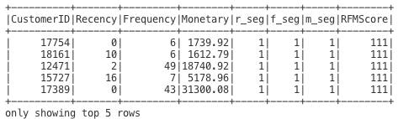
RFM-based on quintile
from pyspark.sql.functions import udf
from pyspark.sql.types import IntegerType
R_udf = udf(lambda x: RScore(x), IntegerType())
F_udf = udf(lambda x: FScore(x), IntegerType())
M_udf = udf(lambda x: MScore(x), IntegerType())
##segmentation
rfm_seg=rfm.withColumn('r_seg',R_udf('Recency'))
rfm_seg=rfm_seg.withColumn('f_seg',F_udf('Frequency'))
rfm_seg=rfm_seg.withColumn('m_seg',M_udf('Monetary'))
rfm_seg=rfm_seg.withColumn('RFMScore',F.concat(F.col('r_seg'),F.col('f_seg'),F.col('m_seg')))
rfm_seg.sort(F.col('RFMScore')).show(5)

Slide 17
K-means

Slide 18
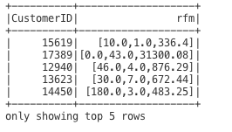
Data Preparation – K-means
## prepare the data in vector dense
from pyspark.ml.linalg import Vectors
def transData(data):
return data.rdd.map(lambda r: [r[0],Vectors.dense(r[1:])]).toDF(['CustomerID','rfm'])
transformed=transData(rfm)
transformed.show(5)

Slide 19
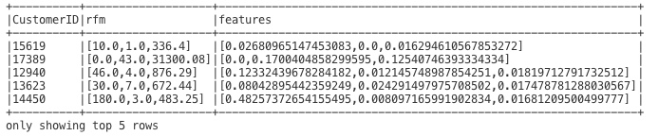
Data Preparation – K-means
## normalization
from pyspark.ml.feature import MinMaxScaler
scaler = MinMaxScaler(inputCol="rfm",outputCol="features")
scalerModel = scaler.fit(transformed)
scaledData = scalerModel.transform(transformed)
scaledData.show(5,False)

Slide 20
K-means – Parameter Tuning
## find optimal parameter
from pyspark.ml.clustering import KMeans
cost = np.zeros(10)
for k in range(2,10):
kmeans = KMeans().setK(k)\
.setSeed(1)
model = kmeans.fit(scaledData)
cost[k] = model.computeCost(scaledData)

Slide 21
K-means – Parameter Tuning
## plot elbow
fig, ax = plt.subplots(1,1, figsize =(8,6))
ax.plot(range(2,10),cost[2:10], marker = "o",color='indianred')
plt.title('Elbow Method for Optimal K')
ax.spines['right'].set_visible(False)
ax.spines['top'].set_visible(False)
ax.set_xlabel('K')
ax.set_ylabel('Cost')
plt.show()

Slide 22
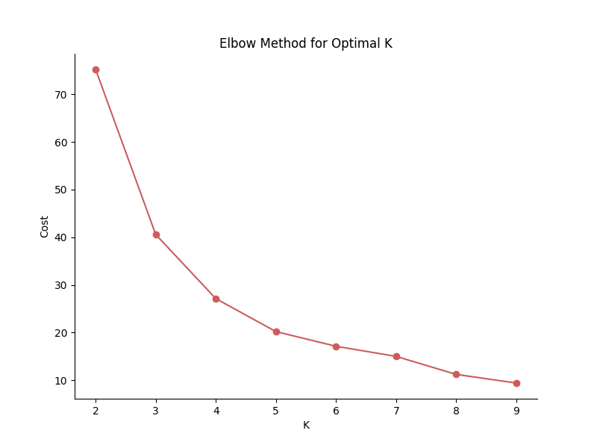

Slide 23
K-means – Parameter Tuning
## Silhouette method
from pyspark.ml.evaluation import ClusteringEvaluator
k_min=3
k_max=10
k_lst = np.arange(k_min, k_max+1)
silh_lst = []
for k in k_lst:
# Trains a k-means model
kmeans = KMeans().setK(k).setSeed(int(np.random.randint(100, size=1)))
model = kmeans.fit(scaledData)
# Make predictions
predictions = model.transform(scaledData)
# Evaluate clustering by computing Silhouette score
evaluator = ClusteringEvaluator()
silhouette = evaluator.evaluate(predictions)
silh_lst.append(silhouette)
silhouette = pd.DataFrame(list(zip(k_lst,silh_lst)),columns = ['k','silhouette'])
spark.createDataFrame(silhouette).show()

Slide 24
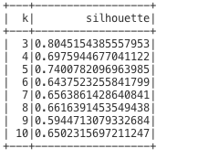
K-means – Parameter Tuning

Slide 25
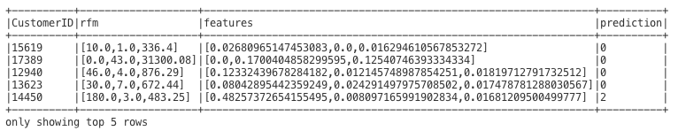
K-means
k = 3
kmeans = KMeans().setK(k).setSeed(1)
model = kmeans.fit(scaledData)
predictions = model.transform(scaledData)
predictions.show(5,False)
# predictions.toPandas().to_csv('kmeans_rfm.csv',index=False)

Slide 26
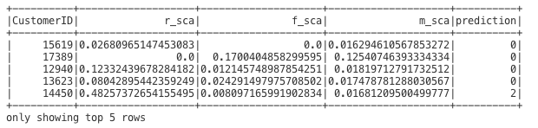
K-means
## extract scaled rfm to different columns
def extract(row):
return (row.CustomerID, ) + tuple(row.features.toArray().tolist()) + (row.prediction,)
d_sc=predictions.rdd.map(extract).toDF(["CustomerID",'r_sca','f_sca','m_sca','prediction'])
d_sc.show(5)

Slide 27
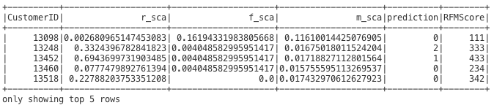
K-means
from pyspark.sql.functions import *
df1 = d_sc.alias('df1')
df2 = rfm_seg.alias('df2')
df_baru=df1.join(df2, df1.CustomerID == df2.CustomerID).select('df1.*','df2.RFMScore')
df_baru.show(5)

Slide 28
Visualization

Slide 29
Preparation
df_p=df_baru.rdd.sample(False,0.5,seed=1000)
df_p=spark.createDataFrame(df_p)
def XScore(x):
xs=0
if x == 111:
xs=0
elif x in (112,113,114,212,213,214,312,313,314,412,413,414):
xs=1
elif x in (121,131,141,211,221,231,241,321,331,341,421,431,441):
xs=2
elif x == 331:
xs=3
elif x == 411:
xs=4
elif x == 444:
xs=5
else:
xs=6
return xs

Slide 30
Preparation
from pyspark.sql.functions import udf
from pyspark.sql.types import IntegerType
X_udf = udf(lambda x: XScore(x), IntegerType())
df_p=df_p.withColumn('rfm_class',X_udf('RFMScore'))
df_p.show(5)
df_plot=df_p.select('*').toPandas()

Slide 31
Raw Data
j=plt.subplot2grid((1,1),(0,0),projection='3d')
j.scatter(xs=df_plot['r_sca'],ys=df_plot['f_sca'],zs=df_plot['m_sca'],s=30, c='indianred')
j.set_xlabel('R')
j.set_ylabel('F')
j.set_zlabel('M')
plt.legend()
# j.set_ylim3d(0,0.2)
# j.set_zlim3d(0,0.2)
plt.title('Raw Data').set_position([.5, 1])
plt.show()

Slide 32
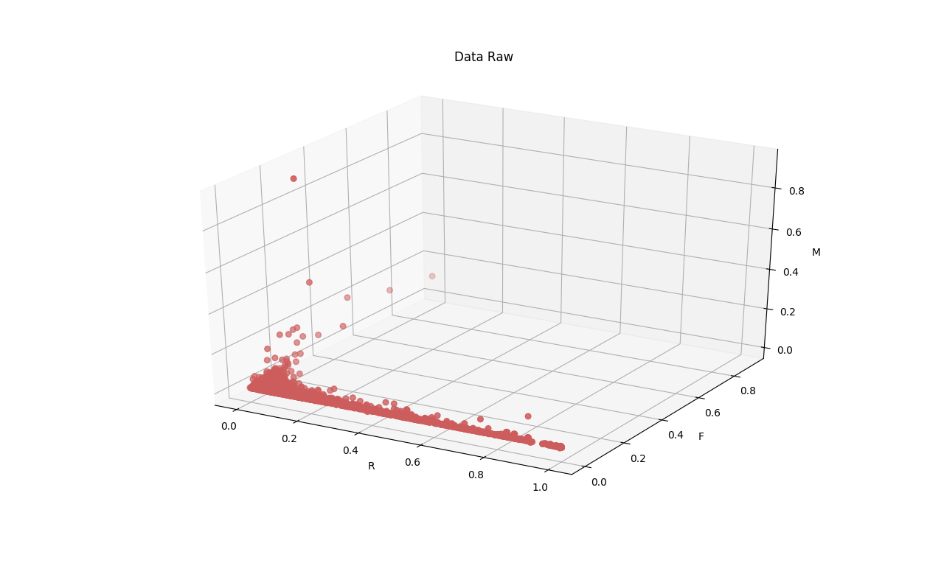

Slide 33
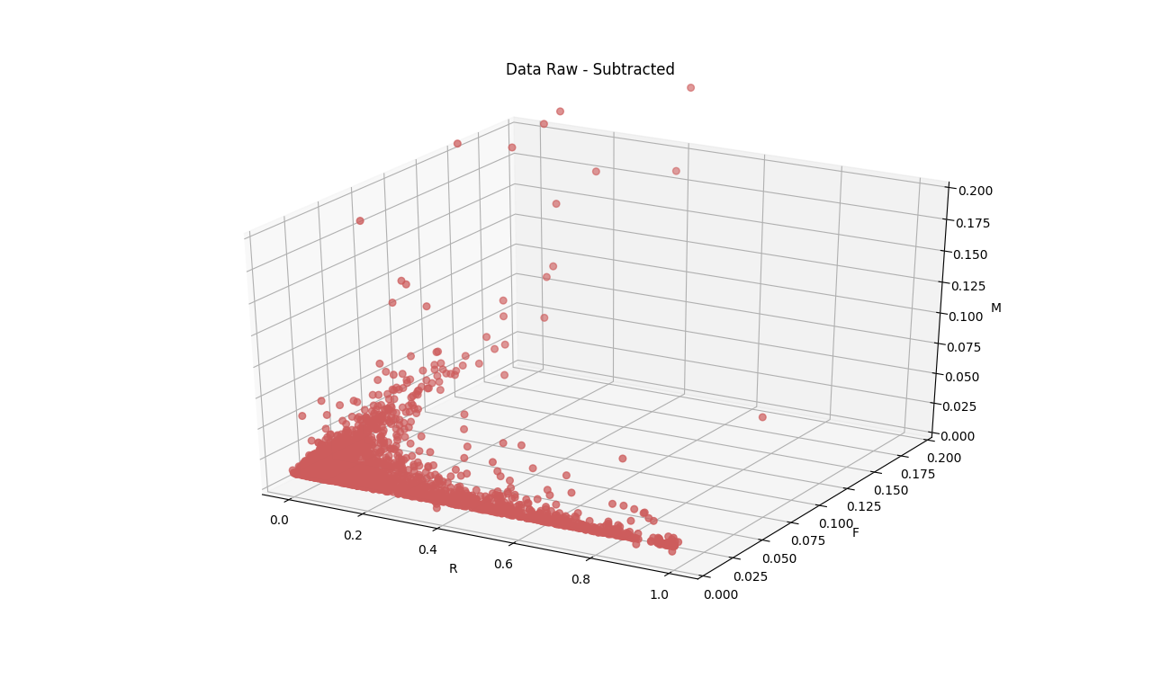
To subtract some exceptional data, add the commands below before plt.show()
j.set_ylim3d(0,0.2)
j.set_zlim3d(0,0.2)

Slide 34
RFM Analysis
color_plot={0:'maroon',1:'indianred',2:'darkgray',3:'mediumvioletred',4:'goldenrod',5:'teal',6:'dimgray'}
cust_label={0:'Best Customers',1:'Loyal Customers',2:'Big Spenders',3:'Almost Lost',4:'Lost Customers',5:'Lost Cheap',6:'Others'}
## R_F graph
for c in color_plot: # iterate over color dictionary keys
df_temp = df_plot[df_plot['rfm_class'] == c]
plt.scatter(x = 'r_sca', y = 'f_sca',
data = df_temp,
color=color_plot[c],label=cust_label[c])
plt.xlabel('R')
plt.ylabel('F')
plt.legend()
plt.title('Cluster of Customers - RF (Subtracted)')
plt.ylim(0,0.2)
plt.show()

Slide 35
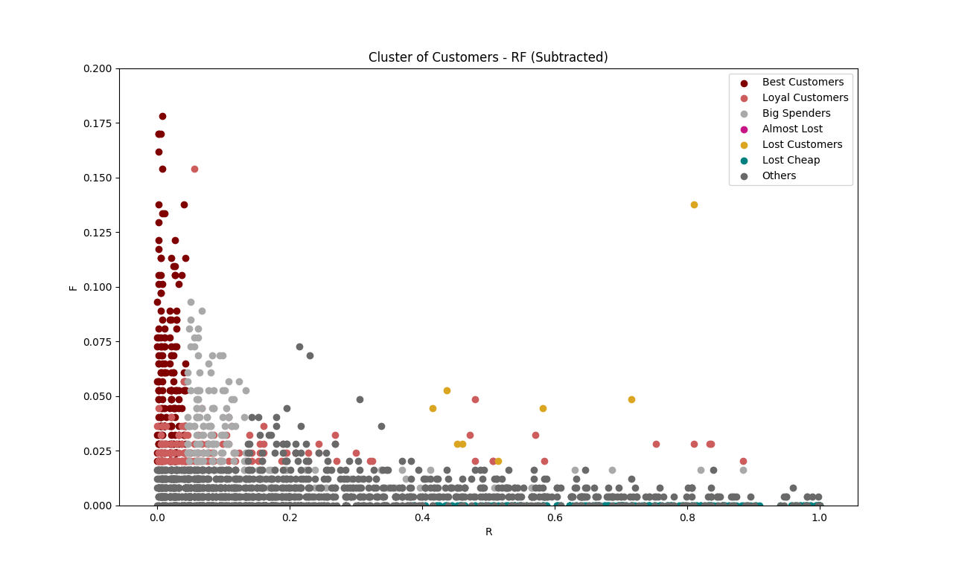
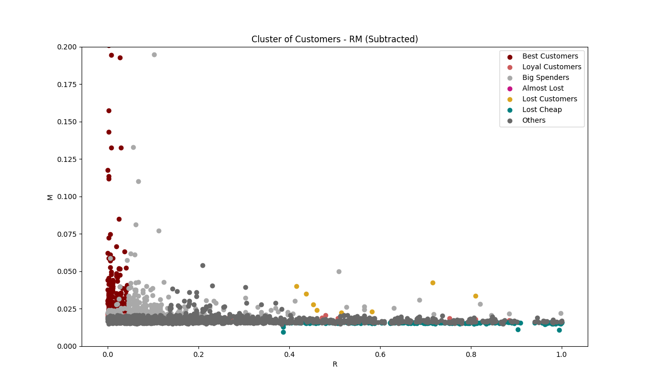
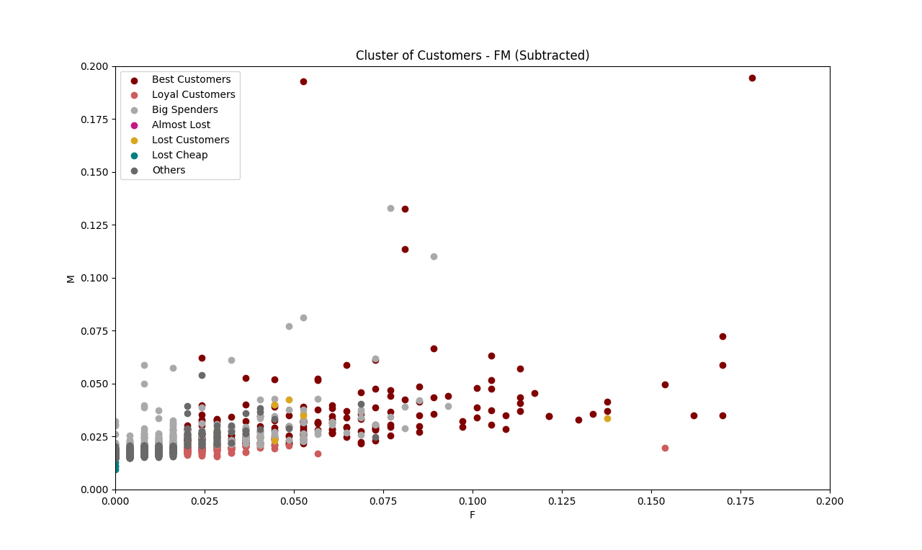
RFM Analysis

Slide 36
RFM Analysis
j=plt.subplot2grid((1,1),(0,0),projection='3d')
for c in color_plot:
df_temp = df_plot[df_plot['rfm_class'] == c]
j.scatter(xs=df_temp['r_sca'],ys=df_temp['f_sca'],zs=df_temp['m_sca'],s=30, c=color_plot[c],label=cust_label[c])
j.set_xlabel('R')
j.set_ylabel('F')
j.set_zlabel('M')
plt.legend()
j.set_ylim3d(0,0.2)
j.set_zlim3d(0,0.2)
plt.title('Cluster of Customers based on RFM Analysis').set_position([.5, 1])
plt.show()

Slide 37
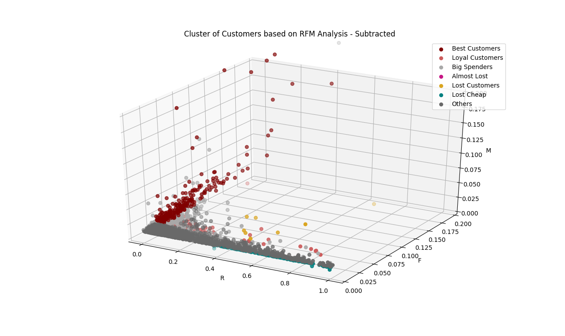

Slide 38
K-means
color_plot={0:'maroon',1:'dimgray',2:'darkgray'}
cust_label={0:'Cluster 1',1:'Cluster 2',2:'Cluster 3'}
## R-F graph
for c in color_plot:
df_temp = df_plot[df_plot['prediction'] == c]
plt.scatter(x = 'r_sca', y = 'f_sca',
data = df_temp,
color=color_plot[c],label=cust_label[c])
plt.xlabel('R')
plt.ylabel('F')
plt.legend()
plt.title('Cluster of Customers using Kmeans - RF (Subtracted)')
plt.ylim(0,0.2)
plt.show()

Slide 39
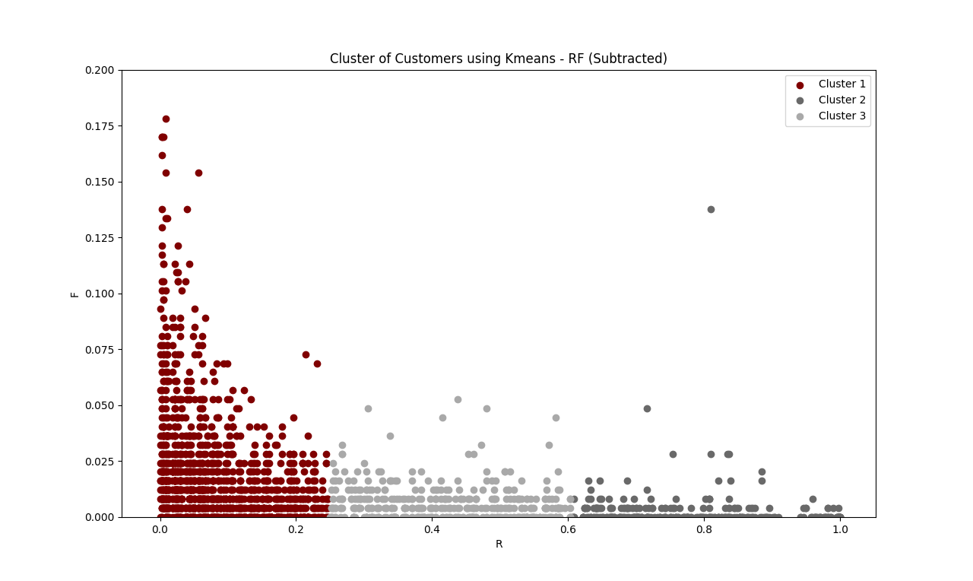
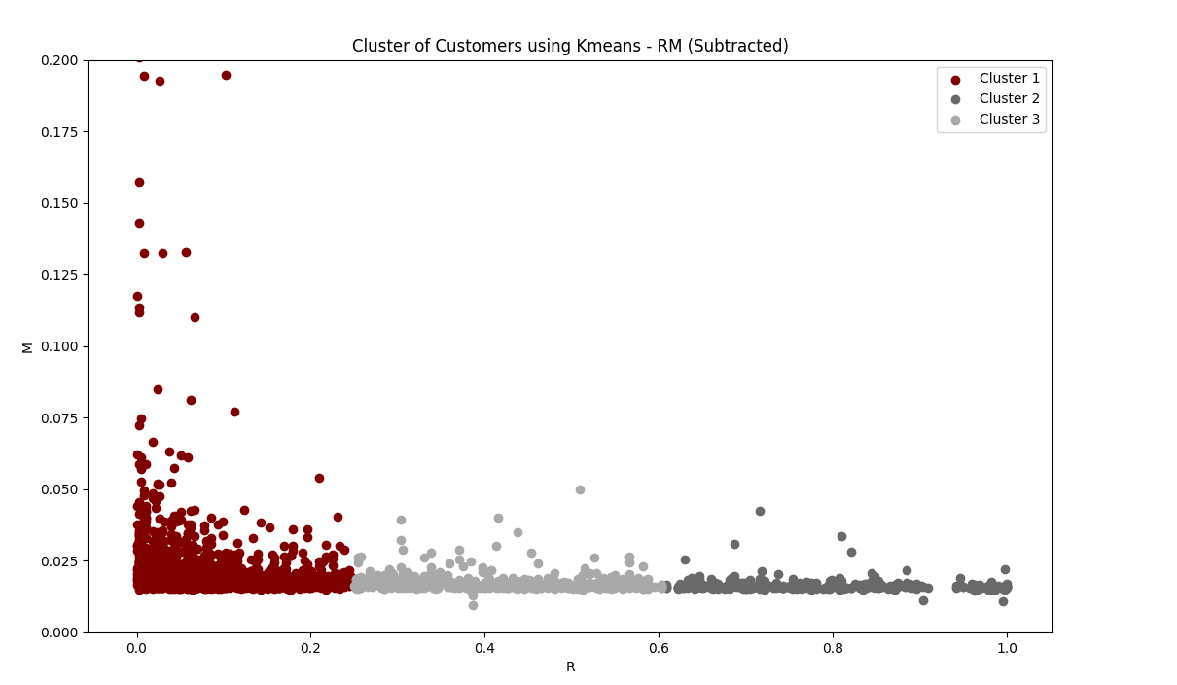
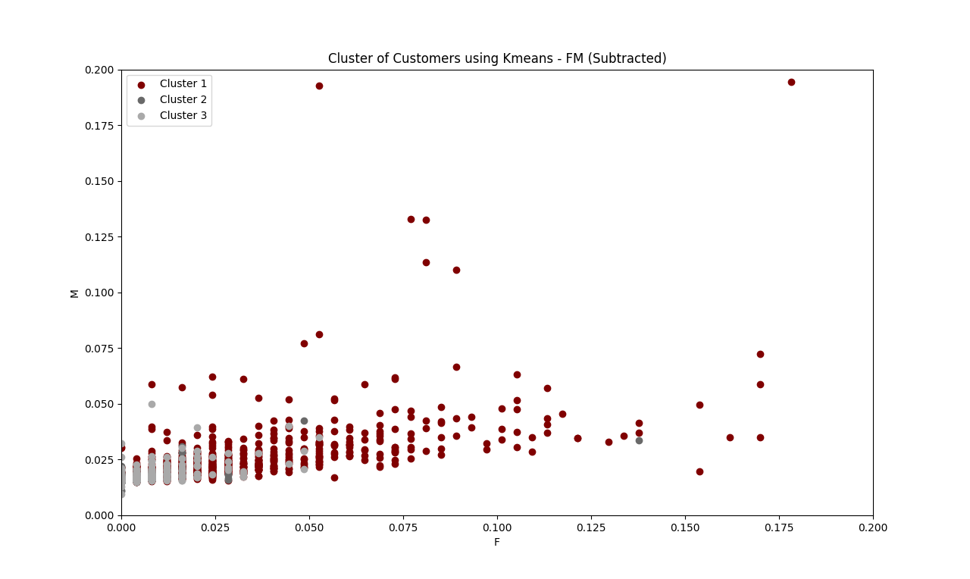

Slide 40
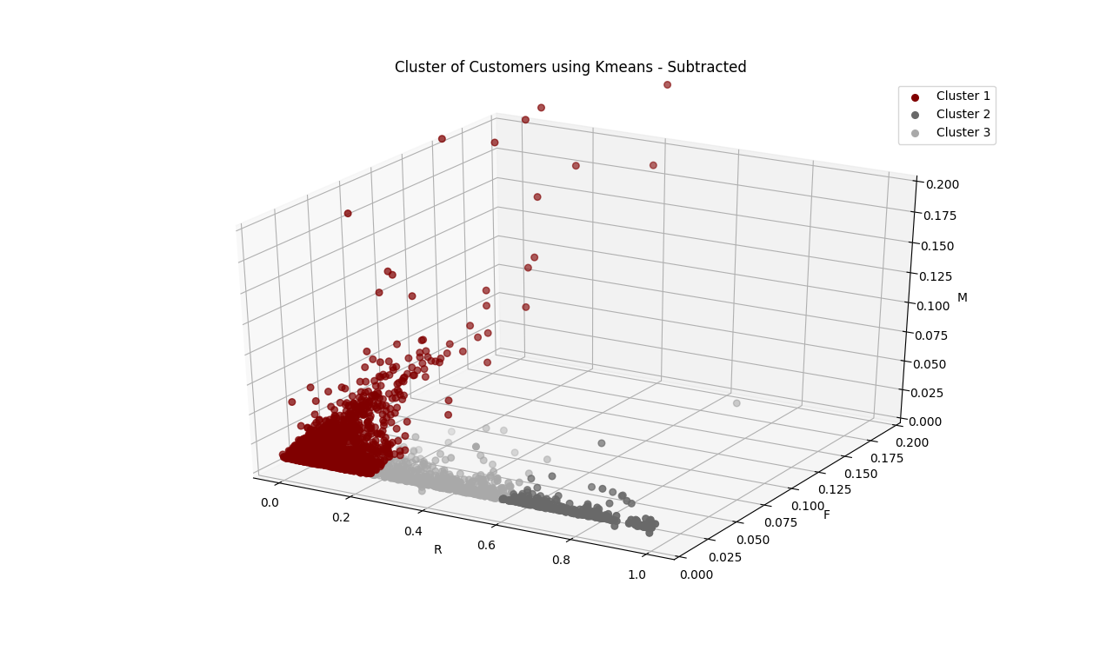

Slide 41
K-means
j=plt.subplot2grid((1,1),(0,0),projection='3d')
for c in color_plot:
df_temp = df_plot[df_plot['prediction'] == c]
j.scatter(xs=df_temp['r_sca'],ys=df_temp['f_sca'],zs=df_temp['m_sca'],s=30, c=color_plot[c],label=cust_label[c])
j.set_xlabel('R')
j.set_ylabel('F')
j.set_zlabel('M')
j.set_ylim3d(0,0.2)
j.set_zlim3d(0,0.2)
plt.title('Cluster of Customers using Kmeans - Subtracted').set_position([.5, 1])
plt.legend()
plt.show()

