Slide 1
SECURE DATA HIDING IN IMAGE USING sTEGANOGRAPHY
CAPSTONE PROJECT
Presented By:
Student Name : Dev Jindal
College Name & Department : GLA University (Btech- CSE)

Slide 2
OUTLINE
Problem Statement
Technology used
Wow factor
End users
Result
Conclusion
Git-hub Link

Slide 3
Problem Statement
Traditional encryption methods are easily detectable.
Need for secure yet hidden communication.
Existing steganography tools lack a user-friendly interface.
Steganography solves this by embedding messages in images.

Slide 4
Technology used
Flask (Backend framework)
OpenCV (Image processing)
Tailwind CSS & Bootstrap Icons (Frontend design)
Python (Core programming language)

Slide 5
Wow factors
Unique cyberpunk-inspired UI.
Uses pixel-based encoding for hidden messages.
Simple and intuitive web interface.
Provides password-protected encryption.

Slide 6
End users
Journalists and whistleblowers needing secure communication.
Cybersecurity enthusiasts and researchers.
Individuals seeking private message exchange.
Educational institutions for learning cryptography.

Slide 7
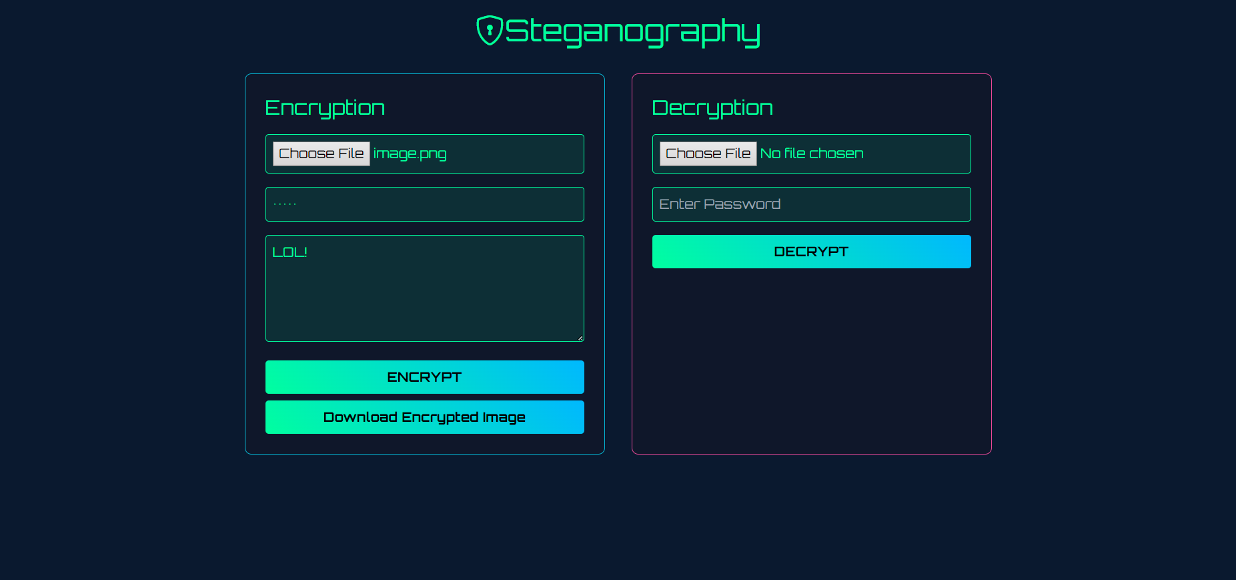
Results

Slide 8
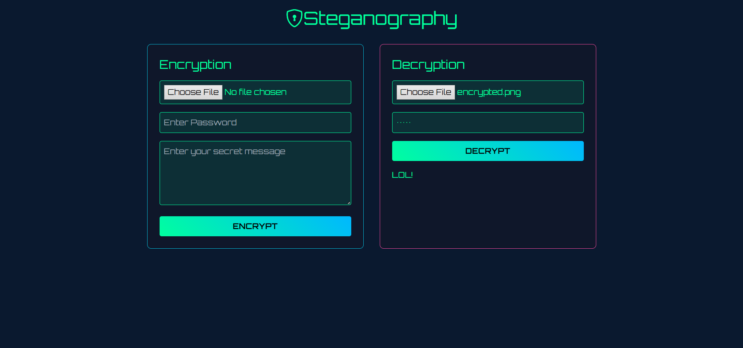
Results

Slide 9
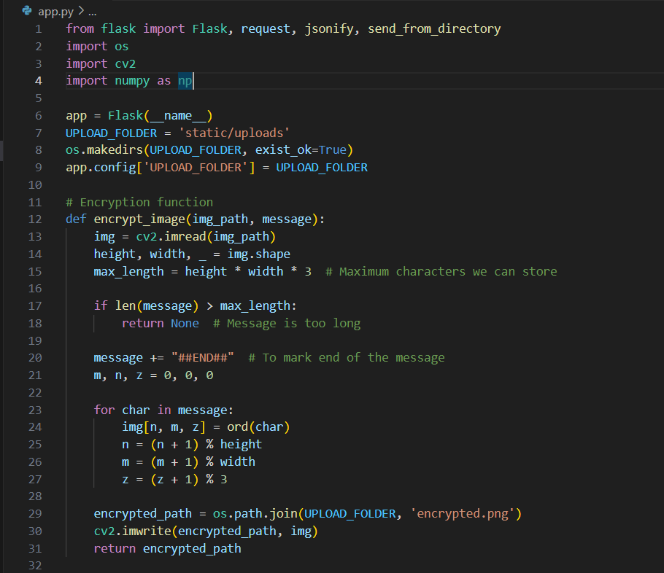
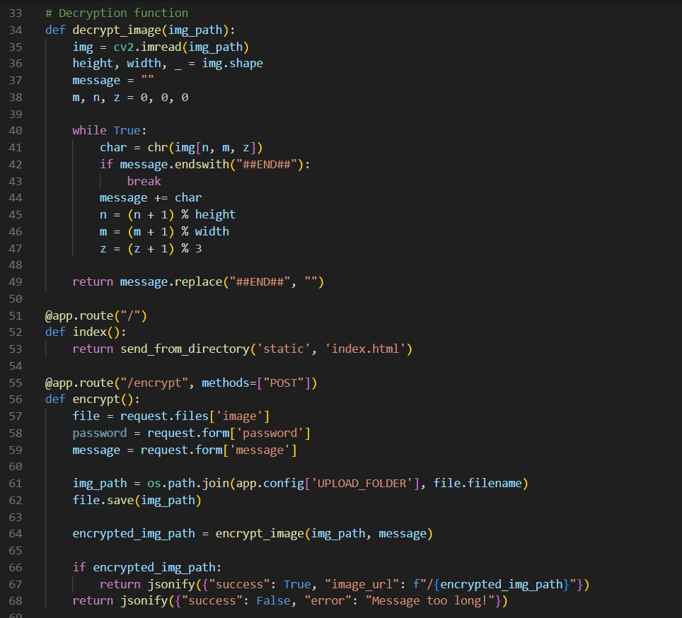
Results

Slide 10
Conclusion
Cyberpunk Steganography offers a secure and innovative way to hide messages.
Combines strong encryption with an easy-to-use interface.
Ideal for individuals who value privacy and security.
Future scope includes stronger encryption and support for different image formats.

Slide 11
GitHub Link
https://github.com/devjindal135/Steganograph

Slide 12
THANK YOU

