Slide 1
Smart Restaurant FX
By Frozen Picnic

Slide 2
Primary goals
Full redesign of the display unit
Intuitive understandable and informative display unit
Helpful mobile application which can provide the detailed information on the collected data.

Slide 3
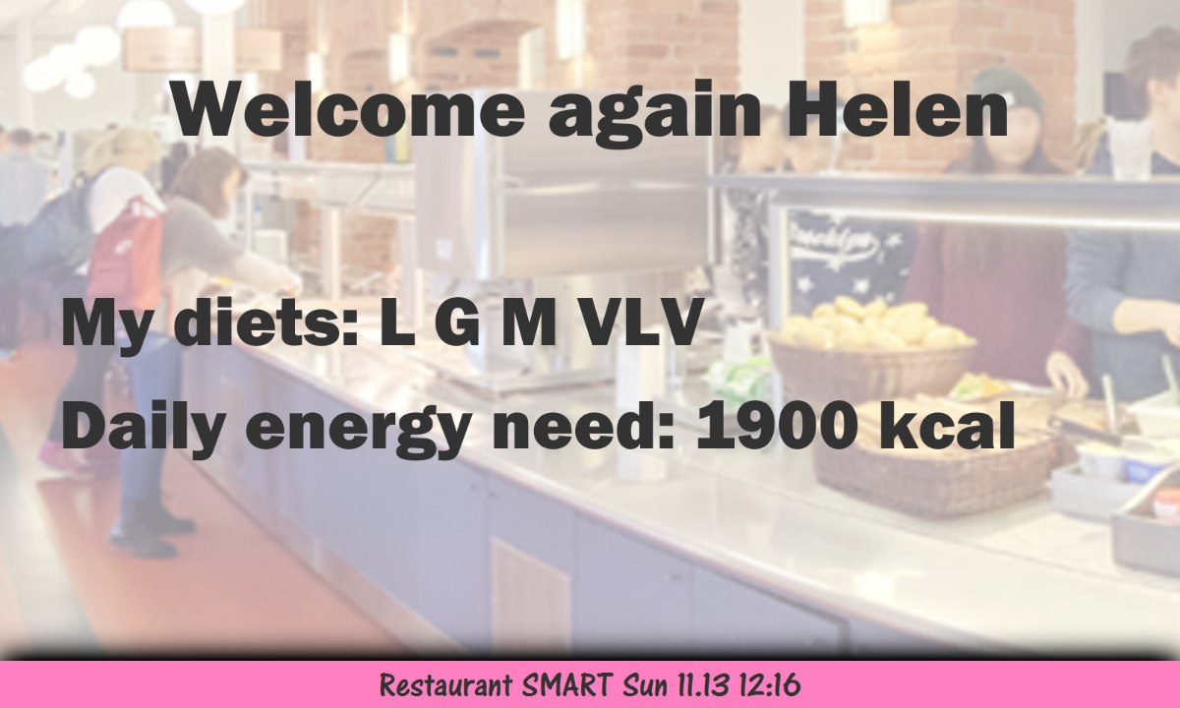
New design

Slide 4
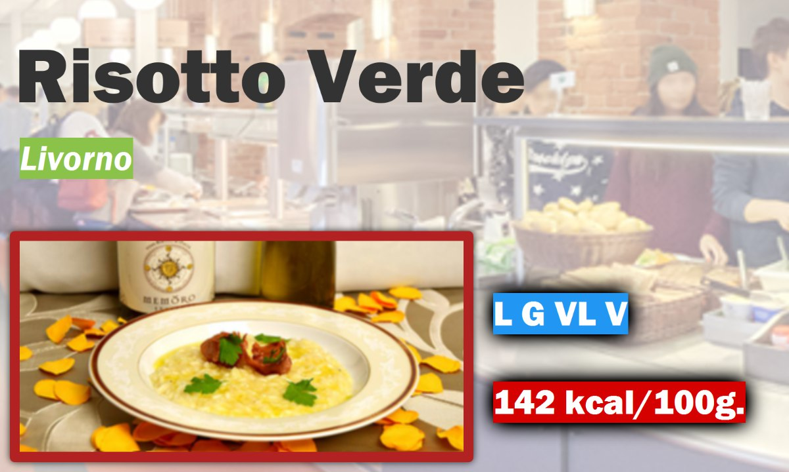
New design

Slide 5

Primary goals
Full redesign of the display unit
Intuitive understandable and informative display unit
Something completely new

Slide 6
Mobile Companion
Helpful mobile application which can provide the detailed information on the collected data.

Slide 7

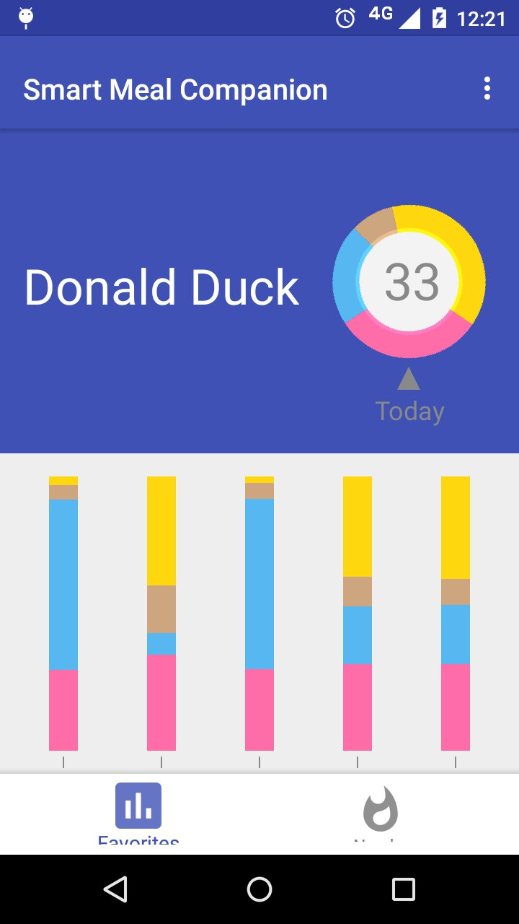
Mobile companion

Slide 8
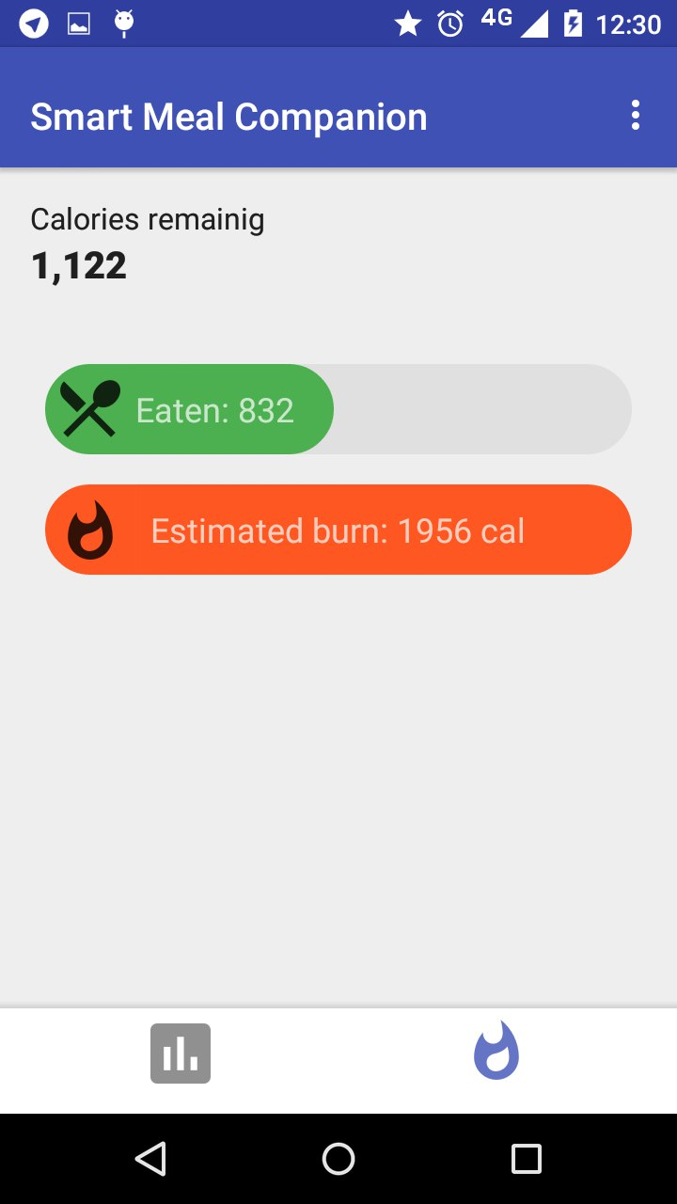
Mobile companion

Slide 9
Primary goals
Full redesign of the display unit
Intuitive understandable and informative display unit
Something completely new

