Slide 1

What’s Wrong with Me?

Slide 2

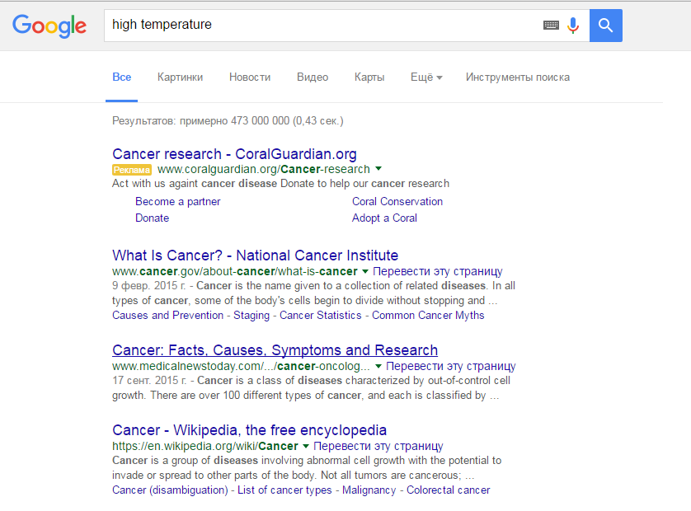
Main Problem “Self-discover diseases based on symptoms”
How to use natural language processing and medical databases for “better than Google” symptoms-based self-diagnosis

Slide 3



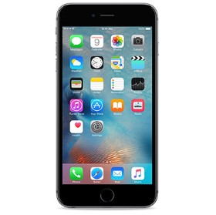
How this works..

Slide 4
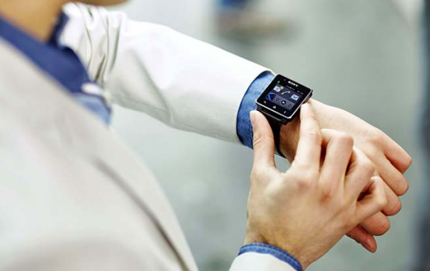


Sources of data

Slide 5
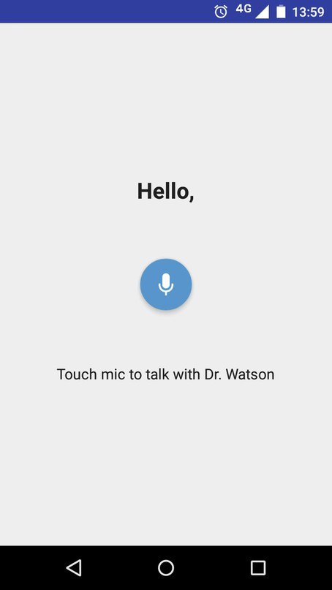
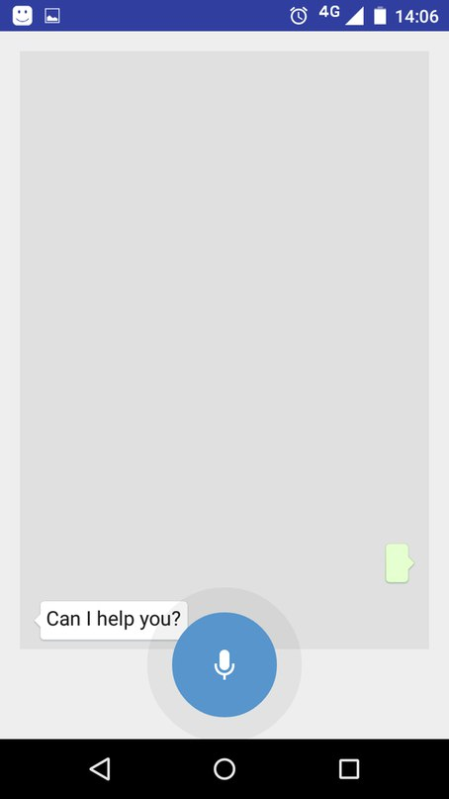
Application’s idea..

Slide 6

https://github.com/devjn/WhatsWithMe-Hack

