Slide 1
MAHAKRISHI
Atharva Parulekar -123A1084
Vivek Patil -123A1087
Dev Sharma -123A1108
Vignesh Narayanan -123A1122
Project Guide: Prachi Sahane

Slide 2
Introduction:
The MahaKrishi project is a web-based platform designed to consolidate and provide key agricultural information to farmers in Maharashtra, ultimately aiming to simplify access to relevant data for basic operational decisions. The system integrates five core functional modules—Dashboard (weather/suggestions), Crop Recommendation, Pest Detection, Market Prices, and a Chatbot—into a single interface. These modules are powered by functional techniques: Machine Learning (ML) for crop matching, Image Processing for pest identification, API Integration for weather data, and Conversational Logic for text queries. This centralized access helps farmers to streamline planning by quickly checking options, aid diagnostics through automated pest detection, and support sales by providing basic market price information.

Slide 3
Motivation:
Simplifying Access to Farming Information
The project is motivated by the need for a straightforward tool that centralizes diverse agricultural data points.
The Problem: Fragmented Data Sources
Farmers often need to check multiple sources—separate apps for weather, expert advice, and market prices. This process is time-consuming and often involves dealing with incomplete or non-localized data.
The Opportunity: Integrating Functional Modules
Recent technology allows us to combine these functionalities into one easy-to-use web application.
The Goal: To build an accessible platform that provides basic guidance and data consolidation to support day-to-day farming activities.

Slide 4
Problem Statement
The central problem addressed by the MahaKrishi project is the fragmentation of essential agricultural information, forcing farmers to consult multiple, non-integrated sources for critical decision-making. To solve this, the objective is to develop a unified web platform that can efficiently integrate four distinct, practical utilities: 1) a dashboard for localized weather and general crop guidance; 2) a parameter-based system to provide a single, data-driven crop recommendation; 3) an image tool for basic, automated pest identification; 4) a utility for retrieving current market price information. The core challenge is the seamless integration and user-friendly presentation of these varied data processing and analytical tools.

Slide 5
Objectives
The project is guided by key objectives that emphasize practical function:
To set up a basic Dashboard that fetches and displays current weather and initial crop ideas based on location selection.
To implement a Crop Recommendation Model that takes 7 user-defined parameters and outputs a single, predicted crop.
To integrate an Image Processing Utility that allows a user to upload an image and receive a pest label and a confidence score.
To provide access to a Market Price Finder based on State, Crop, and Market selection.
To include an "Ask MahaKrishi" Chat interface for providing basic text-based farming information.

Slide 6
Literature Survey
Paper Title | Summary | Citation
Smart Agriculture: A Literature Review | Explains how IoT, AI, and data analytics are transforming agriculture. Most systems focus on specific tasks like sensing and automation rather than offering a complete integrated platform. Highlights key challenges such as interoperability issues, infrastructure costs, and limited adoption among small-scale farmers. | X. Li and Y. Zhang, “Smart Agriculture: A Literature Review,” Smart Agricultural Technology, vol. 2, 2022, doi: 10.1016/j.atech.2022.100009
Agricultural Product Price Forecasting Methods — A Review | Compares statistical forecasting methods with machine learning and hybrid models. Concludes that ML-based methods generally achieve better accuracy but rely on high-quality datasets and strong preprocessing. | Wang, Chen, and Rui Liu, “Agricultural Product Price Forecasting Methods: A Review,” Agriculture, vol. 13, no. 9, 2023, doi: 10.3390/agriculture13091671
Enhancing Agricultural Commodity Price Forecasting with Deep Learning | Studies deep learning models such as LSTM and hybrid neural networks for agricultural price prediction. Finds that these models effectively capture complex nonlinear trends but require large datasets and careful design to avoid overfitting. | R. Sharma and P. Singh, “Enhancing Agricultural Commodity Price Forecasting with Deep Learning,” Scientific Reports, vol. 15, no. 102, 2025, doi: 10.1038/s41598-025-05103-z
eNAM: Key Features & Limitations
Key Features: • Integrates multiple state mandis (APMCs) into a unified trading platform • Shows real-time mandi prices, arrivals, and trade data • Supports online payments and quality testing • Access via web portal and mobile app in multiple languages • Uses Agmarknet data to help farmers compare prices
Limitation: eNAM is focused primarily on commodity trading and price discovery—it does not incorporate real-time weather updates, AI chatbots, pest detection, or crop planning recommendations.

Slide 7
PROPOSED SYSTEM
A Simple Multi-Stage Workflow
The application functions as a set of separate modules, each following a straightforward process:
Dashboard Access: User selects a location (e.g., Konkan, Thane). The system fetches and displays corresponding data.
Recommendation Input: The user provides seven numerical values for soil and weather conditions. A model runs to provide a result.
Pest Image Input: The user uploads an image file (e.g., download.jpg). The system processes the image and shows a detection result.
Information Query: The user inputs a text query (e.g., "Crops for growing in pune") into the chat interface. The system returns a text-based answer.

Slide 8
ARCHITECTURE
The MahaKrishi system uses a three-tier architecture for practical functionality:
Presentation Tier (Frontend): The Web Application serves as the unified interface for all five modules (Dashboard, Crop Recommendation, etc.).
Application Tier (Backend Logic): A Python Server manages user requests and routes them to the correct data or model component.
Data/Model Tier: This layer houses the specialized tools:
ML Model: Predicts crop type.
Image Processing Model: Identifies pests.
External APIs: Fetch real-time weather and market prices.
Knowledge Base: Supplies Chatbot answers.
This structure separates concerns, ensuring a simple user experience while efficiently managing complex internal processes.

Slide 9
ALGORITHM
The system utilizes specialized algorithms for its core functions:
Crop Recommendation:
Input: 7 features ($N, P, K$, Temp, Hum, $pH$, Rain).
Process: Input is fed to a trained ML Classification Model.
Output: Predicted Crop (e.g., coffee).
Pest Detection:
Input: User-uploaded Image.
Process: Image is analyzed by a Deep Learning Model (CNN).
Output: Detected Pest Label and Confidence Score.
Other Modules:
Dashboard: Location ➡️Weather API ➡️ Display Weather/General Crops.
Chatbot: Text Query ➡️ Conversational Logic ➡️ Display Answer from Knowledge Base.

Slide 10
Methodology
The project followed a modular and iterative development process:
Data Sourcing & Analysis: Acquired and prepared specific datasets for model training (ML/DL) and integrated external APIs for real-time data feeds (weather, market prices).
Model Training:
Trained the ML classification model for accurate Crop Recommendation.
Trained the CNN model for reliable Pest Identification from images.
Backend Development: Created the server-side logic to efficiently handle user requests and route them to the appropriate model or API.
Frontend Integration: Designed the unified web interface and connected all backend APIs and data feeds to the UI for seamless user interaction.
Testing: Conducted unit and integrated testing to validate functionality, accuracy, and overall system performance.

Slide 11
FUTURE SCOPE
Impact and Future Enhancements MahaKrishi is designed to be practical and scalable. Potential future improvements include:
Building a mobile-friendly app version.
Multi-language support for rural users.
Adding voice input for farmers.
Making it available for bigger regions / areas.
Farmer Financial Analytics Dashboard.
Farmer Training & Education Module

Slide 12
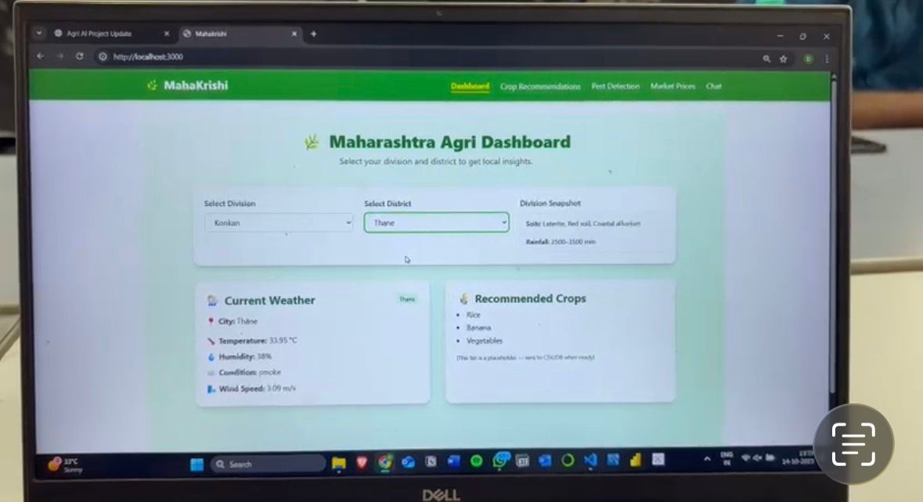
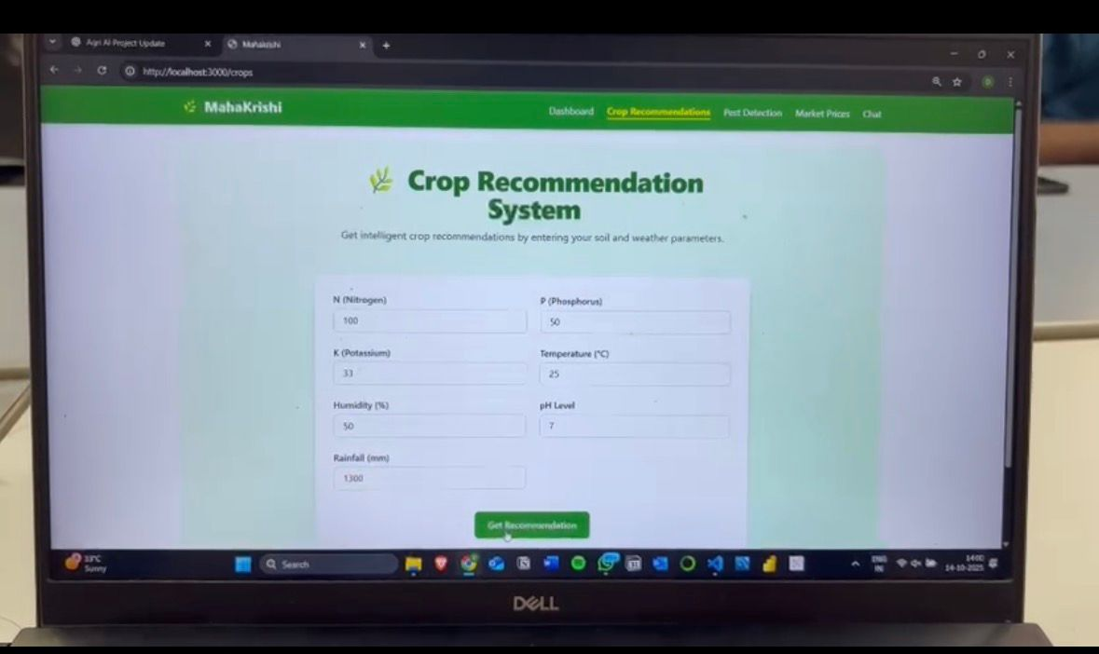
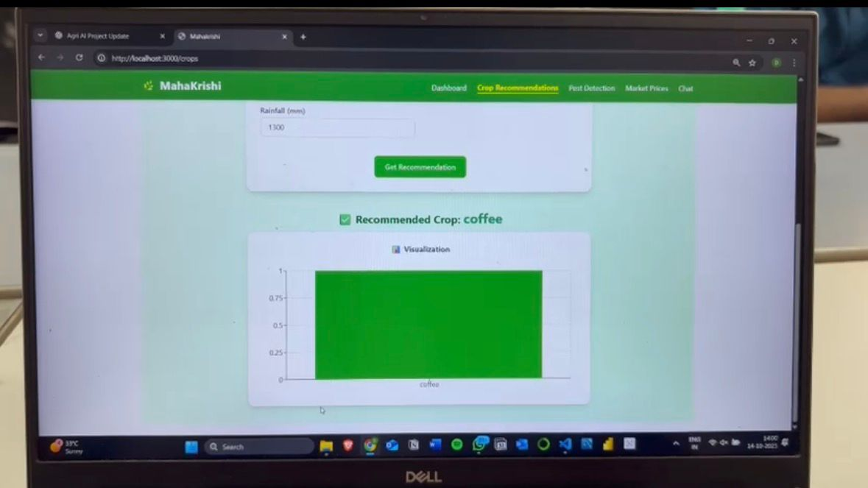
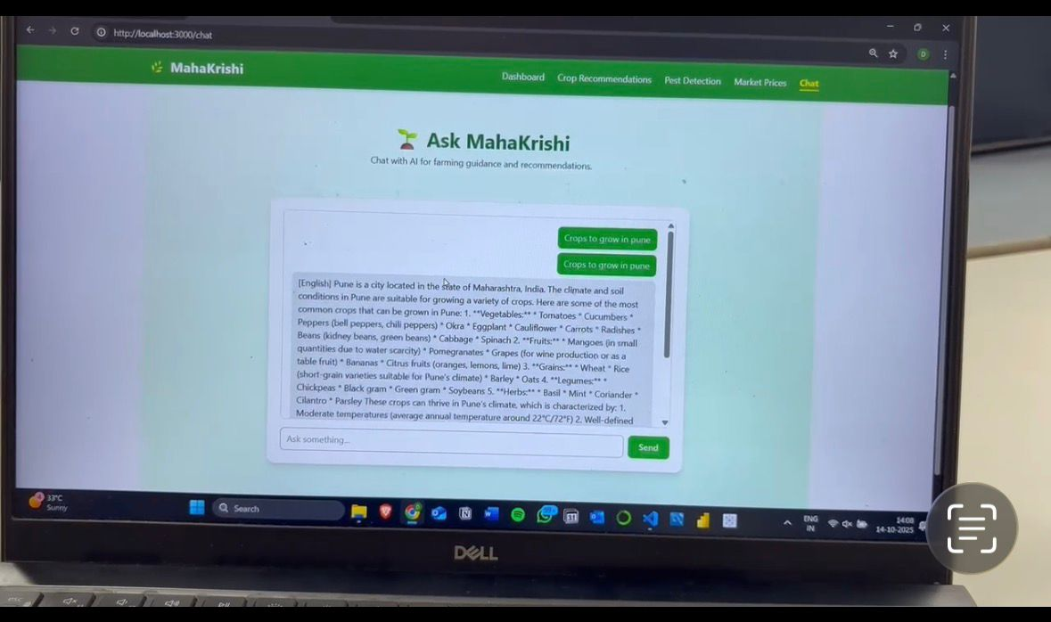
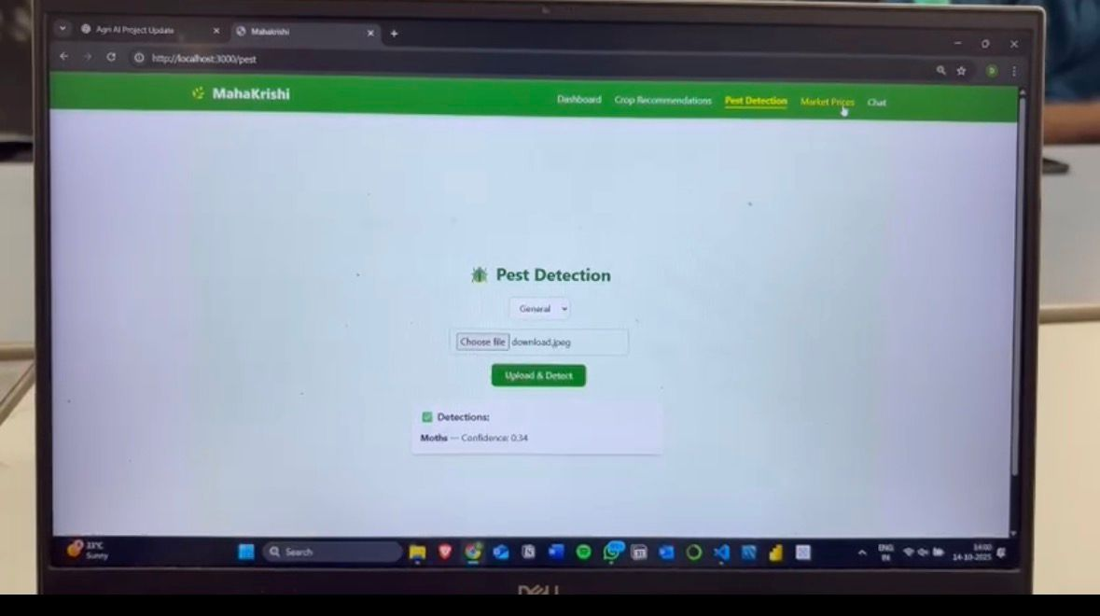
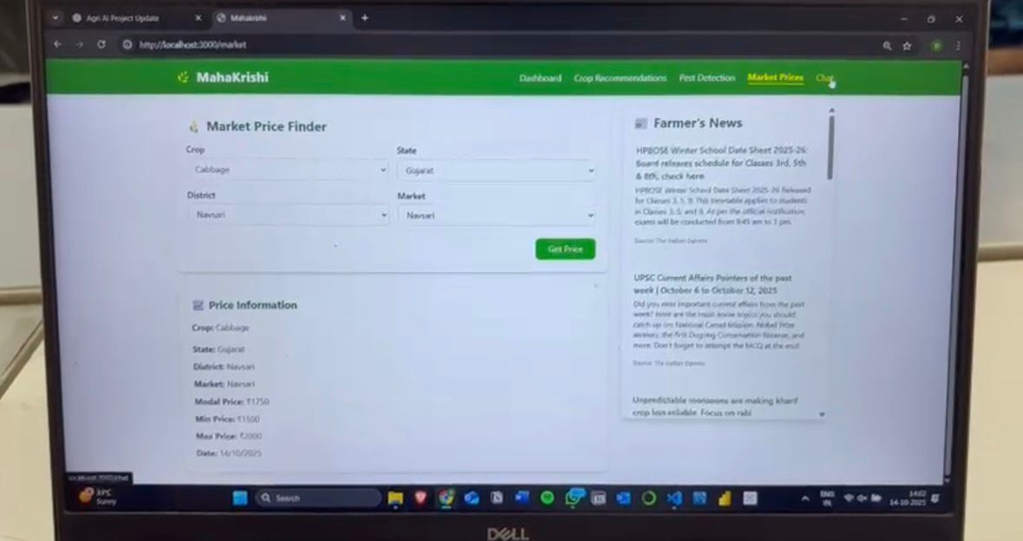
RESULTS

Slide 13
CONCLUSION
MahaKrishi helps farmers make better farming decisions using AI. It gives information about crops, weather, soil, and market prices in one place.
The system aims to improve crop growth and save farmers’ time and effort. In the future, it can become more helpful with features like voice support, mobile access, and regional languages making farming smarter and easier for everyone.

Slide 14
References:
[1] X. Li and Y. Zhang, “Smart Agriculture: A Literature Review,” Smart Agricultural Technology, vol. 2, 2022. [Online]. Available: https://doi.org/10.1016/j.atech.2022.100009
[2] J. Wang, C. Chen, and R. Liu, “Agricultural Product Price Forecasting Methods: A Review,” Agriculture, vol. 13, no. 9, 2023. [Online]. Available: https://doi.org/10.3390/agriculture13091671
[3] R. Sharma and P. Singh, “Enhancing Agricultural Commodity Price Forecasting with Deep Learning,” Scientific Reports, vol. 15, no. 102, 2025. [Online]. Available: https://doi.org/10.1038/s41598-025-05103-z
[4] “eNAM: Electronic National Agriculture Market,” Government of India, Ministry of Agriculture and Farmers Welfare. [Online]. Available: https://www.enam.gov.in/
[5] F. Pedregosa, G. Varoquaux, A. Gramfort, et al., “Scikit-learn: Machine Learning in Python,” Journal of Machine Learning Research, vol. 12, pp. 2825–2830, 2012. [Online]. Available: https://scikit-learn.org/
[6] “API Documentation | TensorFlow,” TensorFlow. [Online]. Available: https://www.tensorflow.org/api_docs
[7] “OpenWeatherMap API Guide,” OpenWeatherMap. [Online]. Available: https://openweathermap.org/guide
[8] “How to Build Object Detection APIs Using TensorFlow and Flask,” YouTube Tutorial, 2024. [Online]. Available: https://www.youtube.com/watch?v=_UqmgHKdntU
[9] “Kaggle Datasets for Agriculture,” Kaggle. [Online]. Available: https://www.kaggle.com/datasets

