Slide 1
Smart Surveillance
By
Kranthi
Research Methodology
Prof Abrar Qureshi, Ph.D.

Slide 2
Statement
The task of this project is use AI and digital image processing models in camera surveillance to detect objects and identify person.

Slide 3
Introduction
Object detection & Face recognition are technology related to computer vision and image processing that deals with detecting instances of semantic objects of a certain class and person name in digital images and videos.

Slide 4
Object Detection
In object detection the algorithm classify detected objects into different names for example people, cars, animals, animals name.
The limitation on OD is to collection of large amount of training data.
The method I am using in this model uses online to learn background model and offline we use small number of dataset to for object model.

Slide 5
Face Recognition
In this FR(face recognition) the algorithm must identify skin and its classification.
To identify individual faces with among faces the algorithm must identify center od objects.
To built FR we using KNN machine learning model. It’s simple machine learning model uses data and it classify new points based simplest measures.

Slide 6
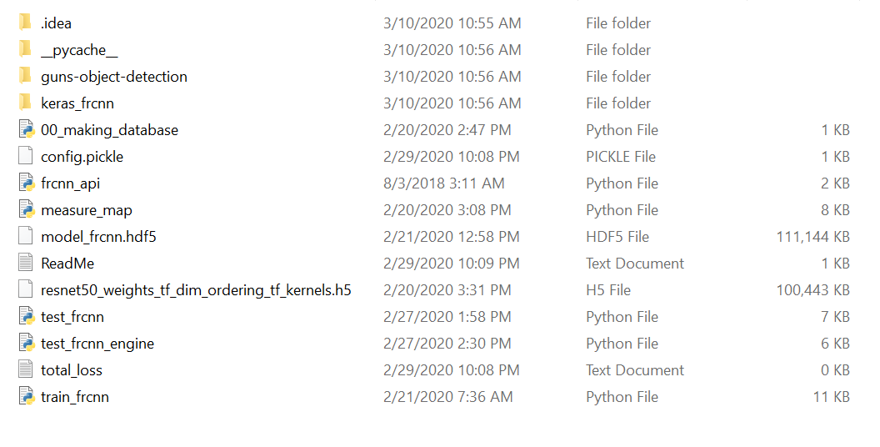
Setup
To setup smart surveillance following two libraries must use together.
Object detection(This library help computer to identify specification of object)
Face recognition(This library helps to identify specific person name)

Slide 7
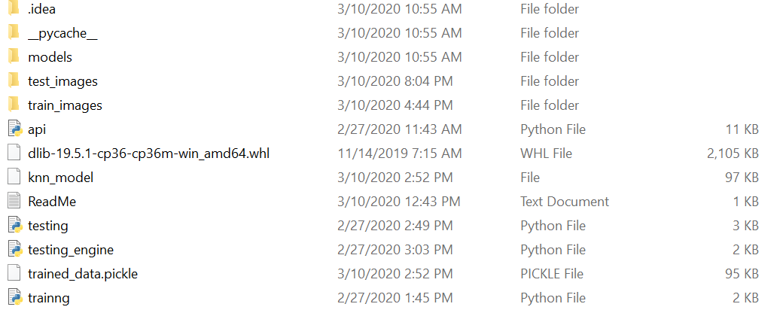
Setup

Slide 8
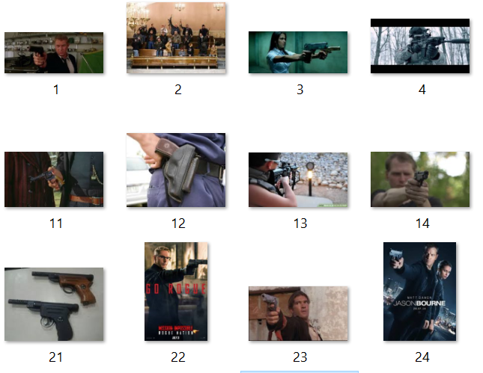
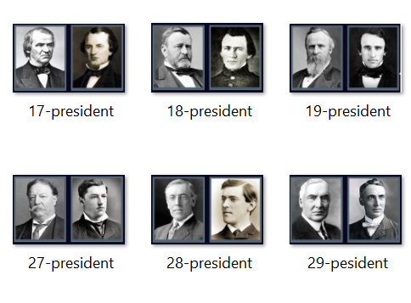
Data
The data we using is picture of objects and faces of persons to train.
For object detection we using Gun.
For face recognition we using US presidents.

Slide 9
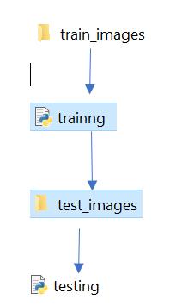
FR Training Model
First, we must choose faces of persons and store in Train_images folder and click training to train model.
After Training we must store same person faces that use to train model but different background and click on testing to test FR program.

Slide 10
OD Training Model
While compare to FR training it different to train object detection.
First, we must collect the images of object with different backgrounds and label them with labeling GUI tool.
After labeling same steps as FR training model training, store testing images and testing.

Slide 11
OD Training Model
While compare to FR training it different to train object detection.
First, we must collect the images of object with different backgrounds and label them with labeling GUI tool.
After labeling same steps as FR training model training, store testing images and testing.

Slide 12
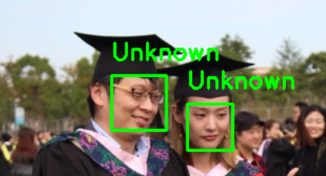
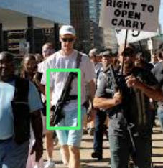
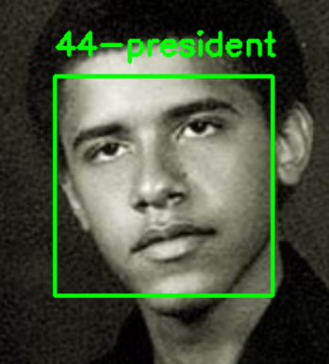
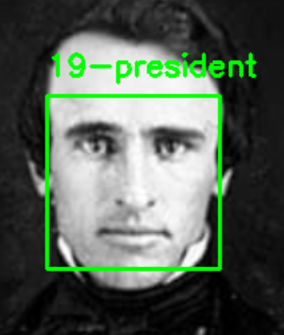
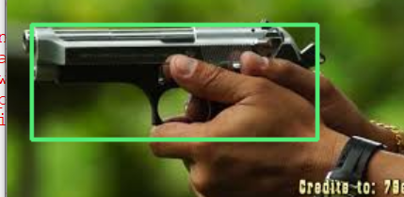
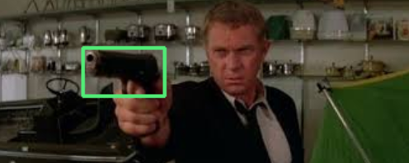
Results
The above pictures are resulting of our python surveillance program.
It’s detected presidents name and guns from different pictures.

Slide 13
Advantages
The main advantages od this program is lower human effort.
The computer stores large amount to criminals or unwanted faces to detect incase they come Infront of camera.
Effectively train model can run without human presence.

Slide 14
Disadvantages
It expensive to built.
Need high resolution of picture to identify.
It difficult to create large amount of data.
Need high processing power to run this program.

Slide 15
Conclusion
It expensive and hard to built this system in present world. As new algorithm developed the system can identify treats easily with lower resolution pictures or video.

