Slide 1
PROJECT DETAILS
CHATTRA VISHWAKARMA AWARD
THEME:-HOW TO ENHANCE THE ECONOMY OF VILLAGE

Slide 2
TEAM DETAILS
COLLEGE-G.B. PANT GOVERNMENT COLLEGE
TEAM NAME – EDUSCENT
APPLICATION NO. - VISH20191548
PROJECT NAME-JOB RECOMMENDER
MEMBERS:-
KAPIL BANSAL
SANDIP BAIDYA
ARCHANA KUMARI
RAVI PAWAR

Slide 3
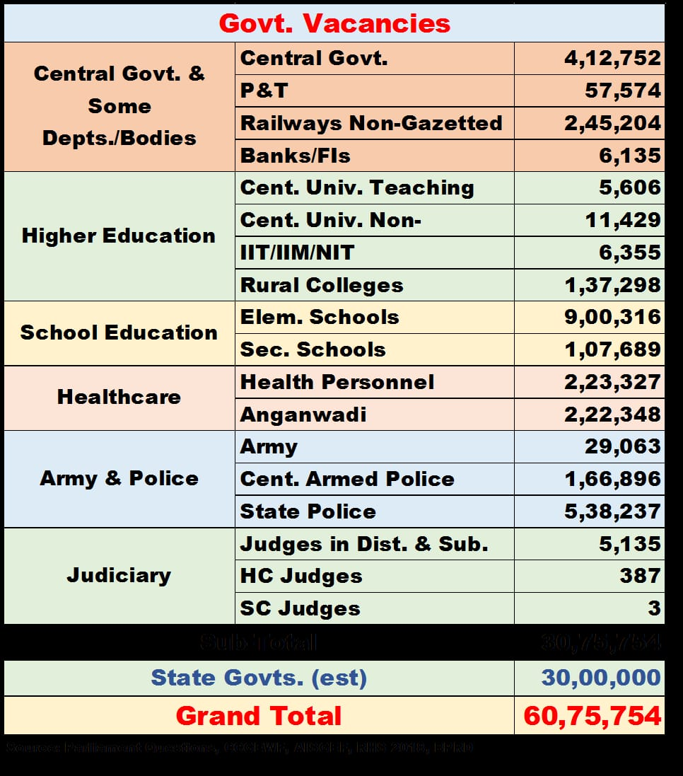
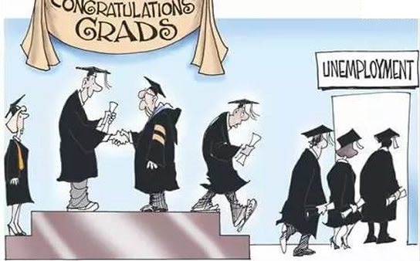
PROBLEM STATEMENT
According to various questions asked last year in the Parliament approx. 60 lakhs government jobs were left vacant.
Approx. 12 lakhs jobs were left vacant only in the field of primary education and healthcare.
Despite these stats, unemployability rate is increasing in India with less job security.
The economy of Rural Area can be increased by building a bridge between
Govt. jobs and the unemployed/employed with less pages/no job security
DECEMBER 2018 STATISTICS

Slide 4
PROPOSED SOLUTION
The following points will be taken into account:
Provide IT centres/support with required hardware or software.
We would provide the application that can help citizens in finding the jobs.
Students/Job seekers capable of using application can connect to it directly else they can avail the facility by IT centres.
Recruiters can also join by accepting some basic terms and conditions.
RECRUITER
ORGANISATION
WEB INTERFACE
USER
WEB INTERFACE
WEB INTERFACE

Slide 5
IMPLEMENTATION

Slide 6
IMPACT
There will be various direct and indirect benefits as follows:
The jobs vacant will start filling to some extent which will help the government to fulfil its needs.
The small recruiters will be able to find the employees provided they will give the job security etc.
As the unemployment decreases it will contribute to our country’s gdp.

Slide 7
OUTREACH PLAN
For the implementation we can organise workshops in rural areas with the help of organizations and volunteer support.
The app will be make public and digital marketing would be used so that the application can reach to everyone

Slide 8
FINANCIAL IMPLICATION

Slide 9
TECHNOLOGY STACK

