Slide 1
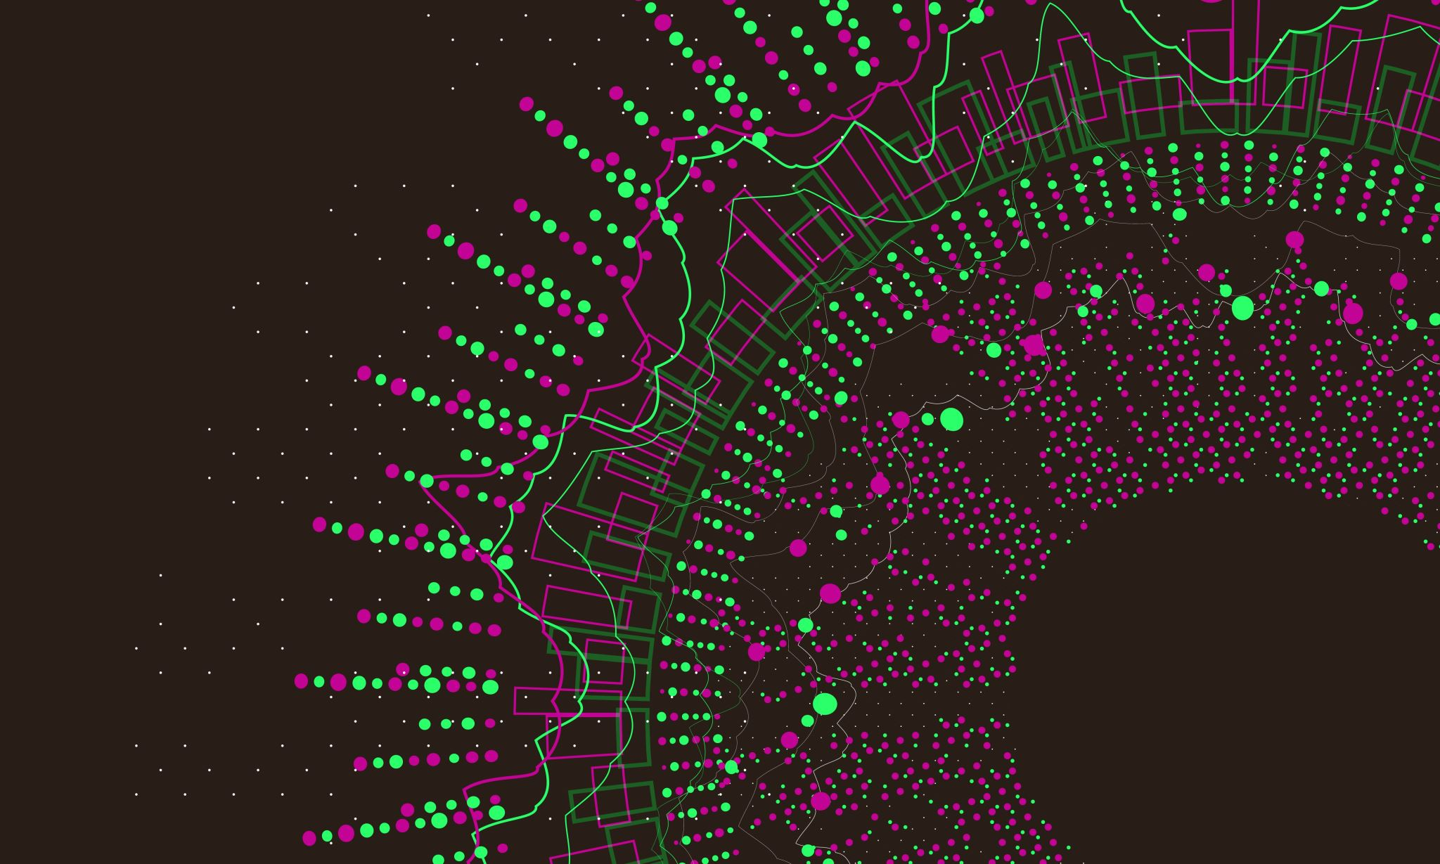
Chronic Kidney Disease
By Preet, Enoc and Evelyn
Professor. Fatima Nafa
CSC455- Machine Learning

Slide 2

Overview
Introduction
Related Work
Problem Description
Data Information
Methodologies
Results
Discussion
References
Notes:
Preet

Slide 3
CKD
Abbreviates to Chronic Kidney Failure – meaning the organ Kidneys are damaged and unable to filter blood. The symptoms of this disease develop slowly, and are not specific. The 3 early stage for this disease are dizziness, edema, and change in urination.
Notes:
Preet

Slide 4
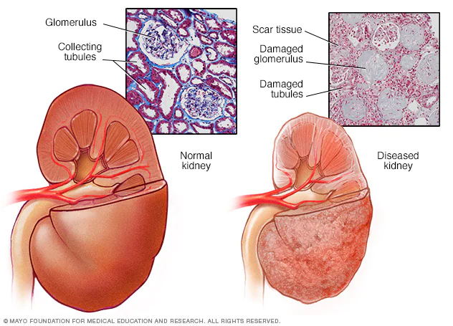

Slide 5
Related Work
Nowadays, the development of tools and methods for monitoring and predicting various diseases has gained researchers’ and clinicians’ interest, focusing on those which commonly occur in human life. Previous studies have used different machine learning algorithms, such as support vector machines, neural networks, KNN, and decision trees, to develop models for the early diagnosis of CKD. Other studies have used machine learning techniques to predict the progression of CKD or to identify novel biomarkers for the disease.

Slide 6
Problem Description
The aim of this project is to develop a machine learning-based model for the early diagnosis of CKD. The model should be able to accurately classify patients as CKD positive or CKD negative, based on their clinical and laboratory data.
Notes:
Enoc

Slide 7
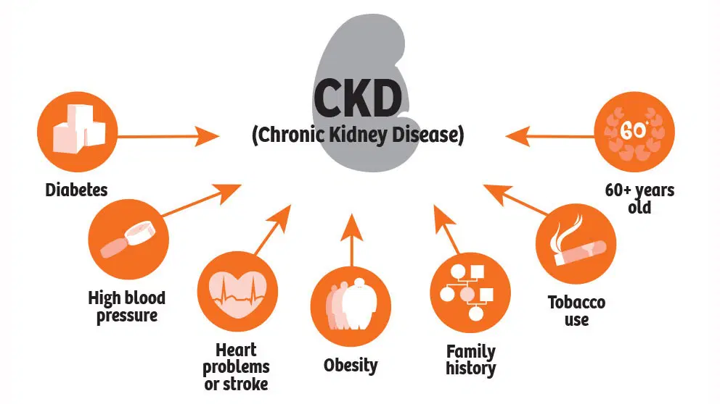

Slide 8
Data Information
Our data is CSV file from kaggle.com. The data has 400 rows for patients and 26 columns for the diagnosis.
Notes:
Enoc

Slide 9
Methodologies
A machine learning model will be developed using a supervised learning approach. The dataset consists of a subset of patients health statistics with CKD, as well as another subset of healthy patients health records.
The dataset will include clinical and laboratory data, such as age, gender, etc. Three machine learning models will be applied to the dataset in comparison to determine which models produced higher accuracy scores. These models will be Decision Tree, SVM, and KNN with hypertuning.
Notes:
Evelyn

Slide 10
Results
Decision Tree – 0.95%
SVM – 0.97%
KNN w/GridSearchCV 99.52%
Notes:
DT - Preet
SVM - Enoc
KNN- Evelyn

Slide 11
Discussion
This research demonstrates the potential of machine learning for the early diagnosis of CKD. The results of this project are encouraging and suggest that machine learning can be used to develop an accurate model for the early diagnosis of CKD. However, further research is needed to investigate the use of other machine learning algorithms, such as KNN, SVM and decision trees, for the early diagnosis of CKD.
Notes:
Evelyn 9,10,11

Slide 12
Treatments
For CKD treatments can help but condition can’t be cure.
Dialysis
Kidney Transplant
Hemofiltration
Low protein diet
Notes:
Evelyn

Slide 13
References
Levey, Andrew S., et al. "Definition and classification of chronic kidney disease: a position statement from Kidney Disease: Improving Global Outcomes (KDIGO)." Kidney international 67.6 (2005): 2089-2100.
El Nahas, A. Meguid, and Aminu K. Bello. "Chronic kidney disease: the global challenge." The lancet 365.9456 (2005): 331-340.
https://www.google.com (PHOTOS)
Notes:
Preet

Slide 14

Thank you

