Slide 1


Comparative study of text generation between GAN and Transformer.

Slide 2


OUR GROUP MEMBERS
Jordan Dsouza
Roshan Devkota

Slide 3
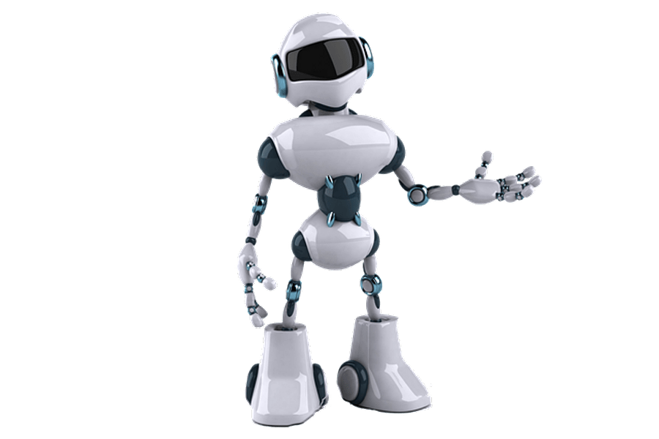
Agenda
Overview of Neural Network
Generative adversarial networks
Transformer
Code and Demo

Slide 4
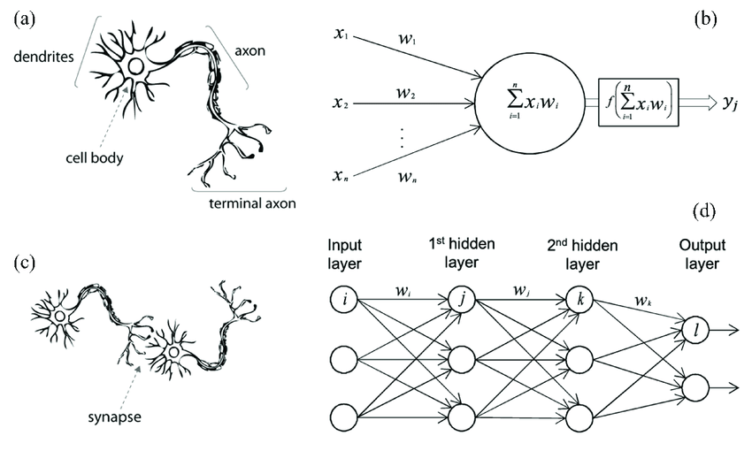
Neural Network
Computational model inspired by the brain's structure, used for pattern recognition and data analysis

Slide 5
GAN(Generative Adversarial Network)
Generative tasks – instances to resemble a given dataset.
Consists of:
Generator – Produce synthetic data. Goal: To generate instances that are indistinguishable from the original instances.
Discriminator – Binary Classifier. Goal: To distinguish between real instances and the synthetic data produced by generator.
A rat race: Generator convincing, Discriminator knocking back the request on evaluation.
The generator has to eventually convince the discriminator.

Slide 6
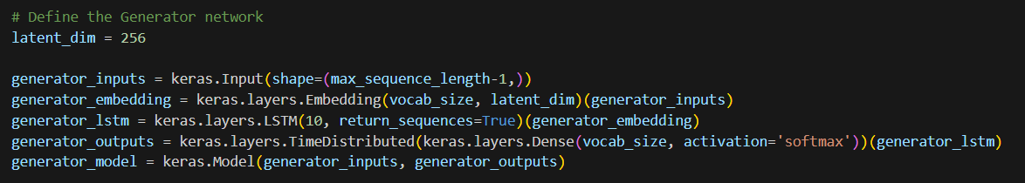
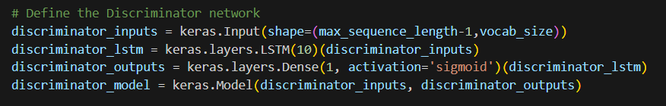
Generator & Discriminator Models

Slide 7
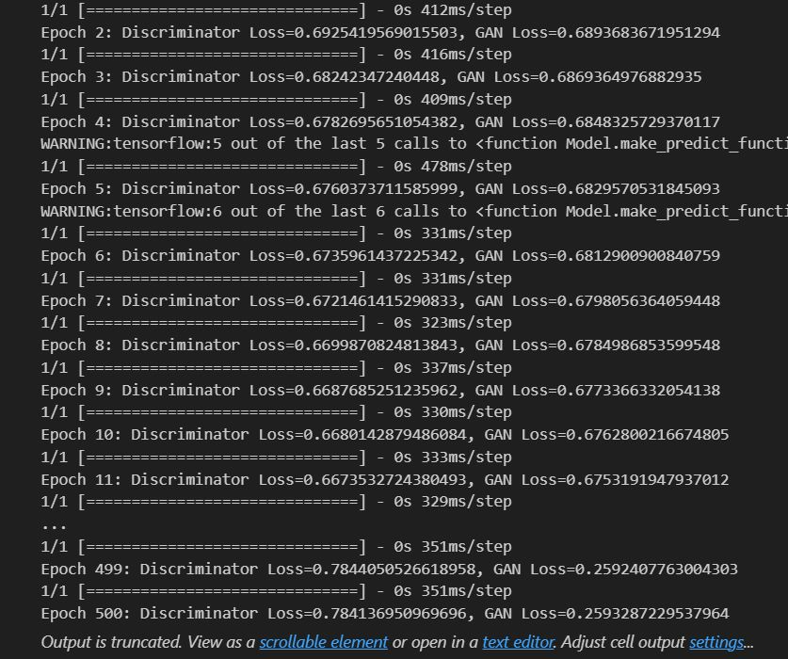
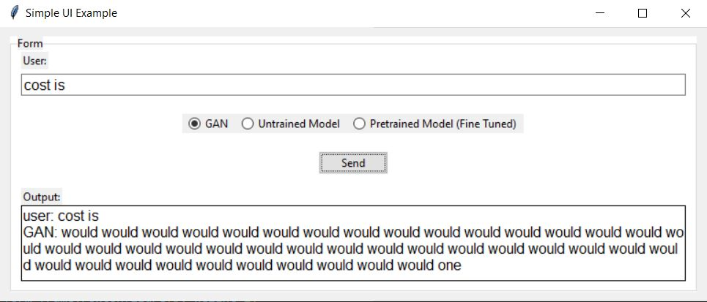
Loss and Output

Slide 8
Problems with GAN:
Ineffective optimization of the generator.
Text Sequences are evaluated as discrete tokens whose values are non differentiable.

Slide 9
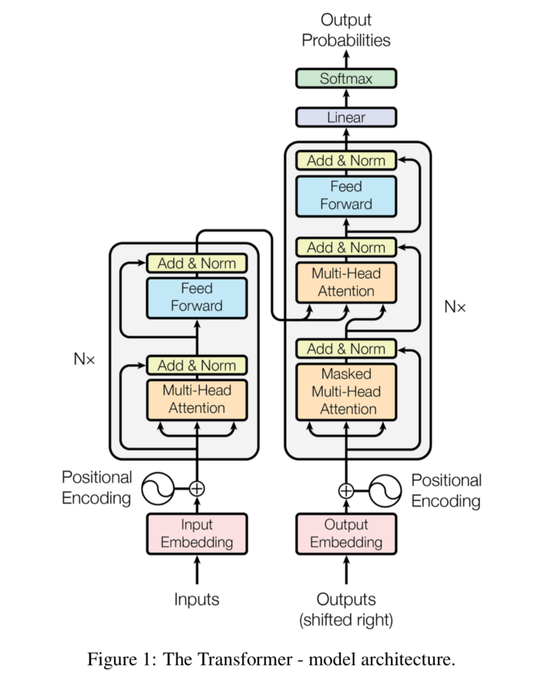
Transformer
Definition: "Attention is All You Need" in 2017
Purpose: introducing the attention mechanism.
Examples
GPT-3 (Generative Pre-trained Transformer 3)
BERT (Bidirectional Encoder Representations from Transformers)
T5 (Text-to-Text Transfer Transformer)
GPT-2 (Generative Pre-trained Transformer 2)

Slide 10
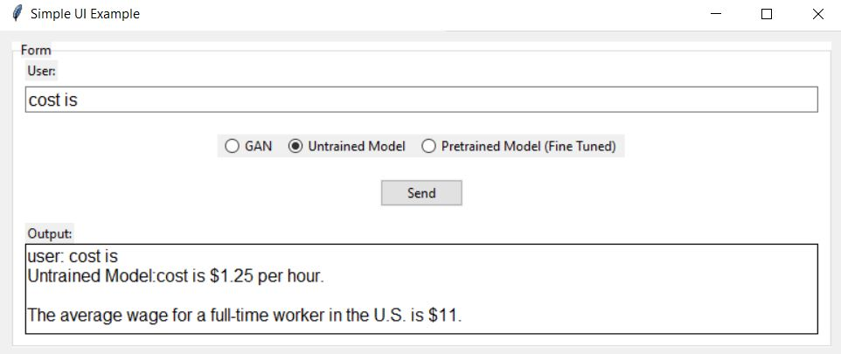
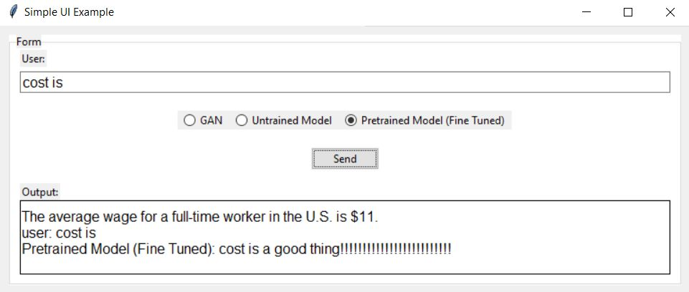
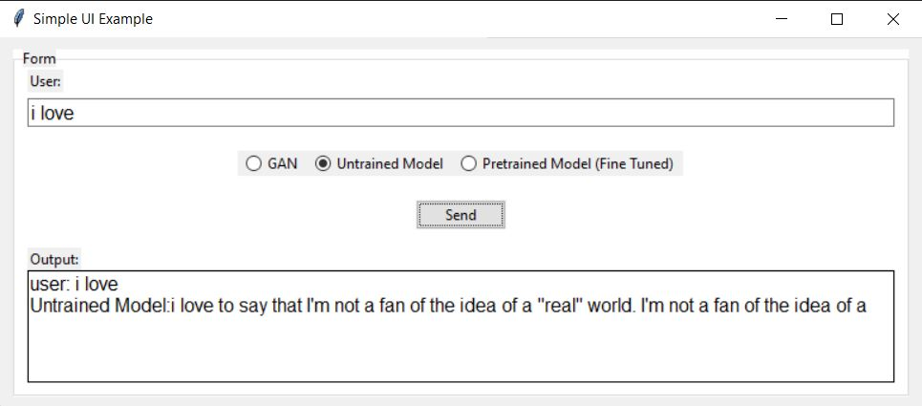
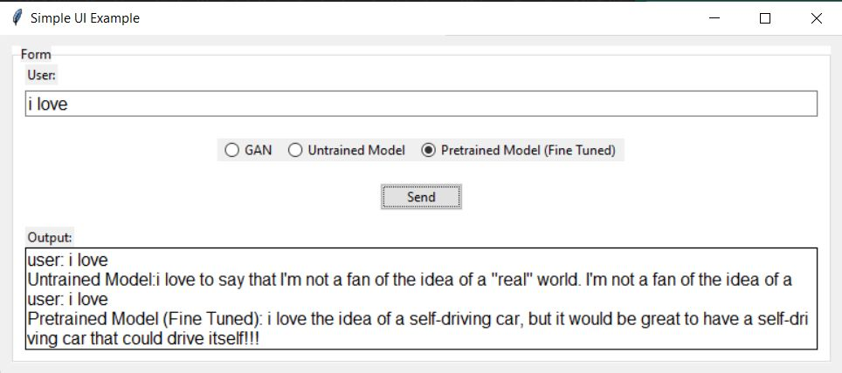
Output

Slide 11
Demo…

