Slide 1


Code Craft Chase Edition 2.0 2026
“Flow Lock”
Team Name – Vegabond
Date of Submission – 5th February, 2026

Slide 2
Introduction
VEGABOND
Modern applications depend heavily on APIs to deliver core functionality, integrate third-party services, and process sensitive data. As API usage grows, APIs increasingly become high-value targets for abuse, including excessive automated requests, scraping, credential stuffing, and sophisticated rate-limit bypass techniques. Traditional rate-limiting approaches are often static and threshold-based, making them predictable and easy to exploit.
Why this problem matters:
Security risks: API abuse can lead to data breaches, account takeovers, and exposure of sensitive endpoints.
Service availability: Unchecked traffic can cause performance degradation or complete denial of service for legitimate users.
Financial impact: Abuse increases infrastructure costs due to unnecessary compute and bandwidth usage.
Scalability challenges: Static limits fail to adapt to dynamic traffic patterns and evolving attack strategies.
Flow Lock addresses these challenges by introducing intelligent, flow-aware protection that detects abnormal API usage patterns and prevents rate-limit bypass attempts in real time while simultaneously ensuring secure, scalable, and reliable API access without disrupting legitimate users.

Slide 3
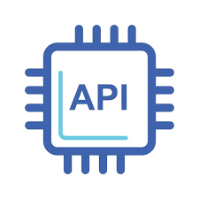
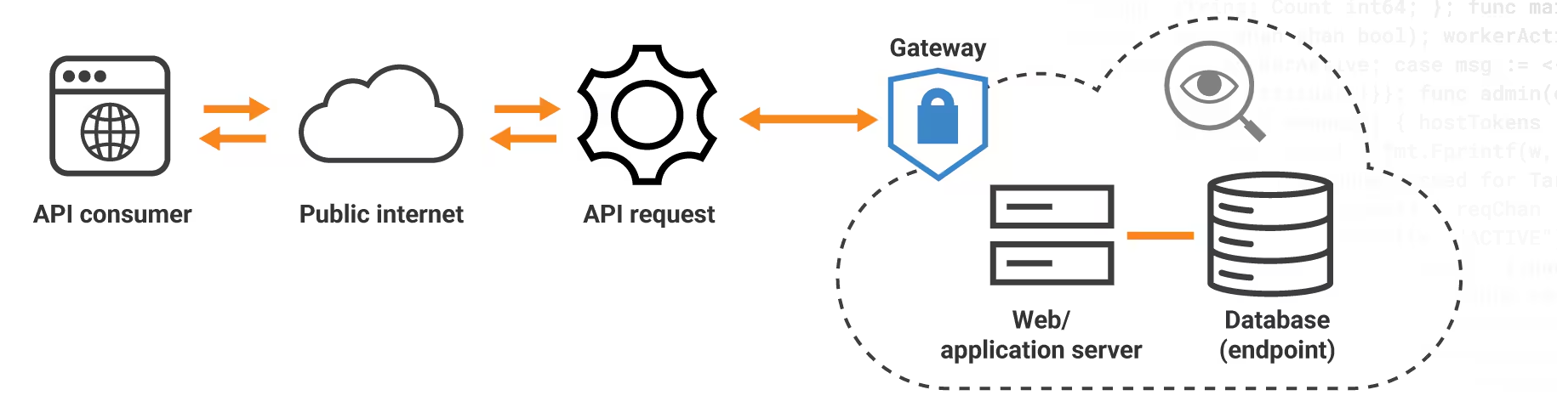
PROBLEM STATEMENT
VEGABOND
Secure API Abuse & Rate-Limit Bypass Detection
API usage is often exploited by attackers, compromising personal data, causing service disruptions and enabling financial fraud.
And since API is so vital in the modern digital world, it has become a major target to attackers.
However, most individuals and organizations still use primitive methods for API protection, which aren’t entirely affective and can be easily by-passed by attackers using simple methods. This is where we come in….

Slide 4
ABSTRACT
VEGABOND
FLOWLOCK
Behavior-Based API Abuse Detection
It detects abuse by how APIs are used, not just how often, which is the fatal flow in most API protection.
What We Do
Monitor API traffic in real time
Analyse request behaviour patterns
Score abuse risk (0–100)
Adaptively allow, throttle, or block traffic
Signals We Analyse
Request bursts & timing regularity
Endpoint sequencing (scraping)
Failure rates (credential stuffing)
IP / token switching

Slide 5
SOLUTION PROPOSED
VEGABOND
Our proposed solution is a behavior-based API security system that detects abuse patterns instead of relying on fixed rate limits.
The system continuously monitors API request behavior in real time.
It analyzes request timing, frequency, endpoint access patterns, and failure rates.
A behavioral risk score is calculated for each client/session.
Based on the risk score, the system applies adaptive rate-limiting:
  Normal users → uninterrupted access
  Suspicious users → throttled responses
  Malicious users → temporary blocking or challenge
This approach prevents credential stuffing, scraping, and rate-limit bypass attacks without impacting legitimate users.
API Request
Behavior Analysis
Risk Scoring
Adaptive Response

Slide 6

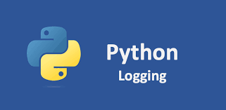
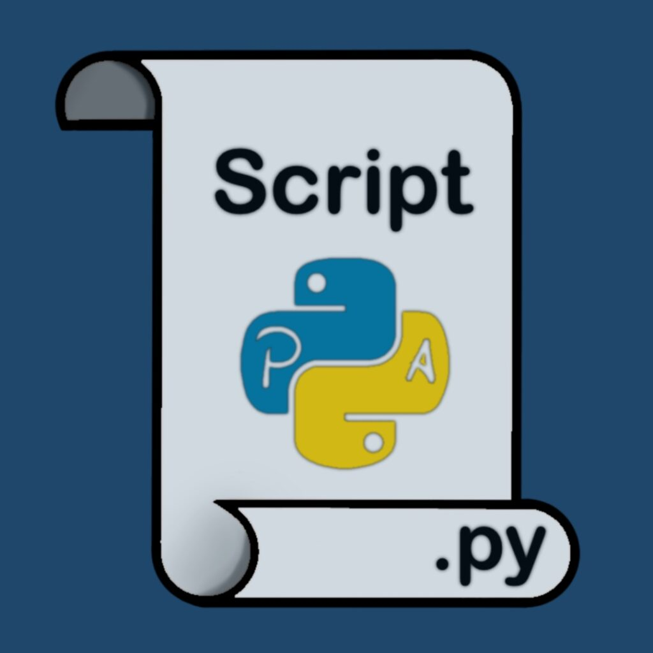

TECH TO BE USED
VEGABOND
FastAPI (Python) – high-performance, async API framework
Uvicorn – ASGI server for running APIs
🧠 Backend & API Layer
📊 Behavior Monitoring & Logging
Python Logging / In-Memory Storage store API request logs
Request Metadata timestamp,
endpoint,response code,IP/session ID
Rule-Based Heuristics – burst detection, failure ratio checks
Statistical Analysis – request timing variance, sequence entropy
🔍 Detection & Analysis
Adaptive Rate Limiting – dynamic throttling based on risk score
Temporary Blocking – short-term mitigation for high-risk sessions
🔐 Security & Control Layer
cURL / Python Scripts simulate normal users and attackers
Synthetic Traffic Generation credential stuffing & scraping patterns
🧪 Testing & Simulation

Slide 7
Unique Selling Point (USP)
VEGABOND
The "Behavior-First" Advantage
Behavior Over Identity
  Others: Block IPs (ineffective against VPNs/Proxies).
  Us: Detects patterns (timing, sequence, frequency). Behavior cannot be spoofed easily.
Agnostic to IP Rotation
  Detects abuse even if the attacker changes their IP address for every single request.
Smart Throttling Instead of hard blocking (which alerts the attacker), we introduce artificial latency.Destroys the attacker's ROI while keeping the API open for genuine users.
Zero Friction UX
  No CAPTCHAs. No puzzles. Invisible security that doesn't annoy real humans.

Slide 8
Conclusion
VEGABOND
Key Takeaways
    Paradigm Shift: Successfully moved security from Static Identity (IPs) to Dynamic Behavior.
    Resilient Defense: Stops sophisticated attackers even when they rotate IPs or use proxies.
    User-Centric: Prevents abuse without using CAPTCHAs or hurting genuine users.
Future Scope
    AI Models: Integrate unsupervised learning to detect unknown attack patterns automatically.
    Device Fingerprinting: Add browser canvas/audio fingerprinting for deeper tracking.
    Global Scaling: Deploy Redis Cluster to sync limits across multiple geographic regions.

