Slide 1
XeroStation : A web based smart printing and stationary platform
PIP2001 Capstone Project
VIVA VOCE
Group Number: G-102
Roll Number | Student Name
20211CSE0459 | KUSHAL S
20211CSE0418 | HARSHAVARDHAN S
20211CSE0423 | RAMYA KUNDAR
20211CSE0432 | GOWTHAMI
Under the Supervision of,
Dr. Taranath N L
Associate Professor
School of Computer Science and Engineering
Presidency University
Name of the Program: Bachelor Of Technology
Name of the HOD: Dr. Asif Mohammed
Name of the School Project Coordinators: Dr. Sampath A K / Dr. Abdul Khadar A / Mr. Md Ziaur Rahman

Slide 2
Introduction
In today’s fast-paced environment, waiting in long queues for essential tasks like document printing can be a major inconvenience, particularly in bustling areas like university campuses. Photocopy shops often become overcrowded with students needing to print assignments and reports, resulting in prolonged wait times, internet connectivity issues, payment delays, and confusion in order management. This not only causes students to miss classes and endure unnecessary stress but also creates inefficiencies for shopkeepers struggling to handle high demand.
To tackle these issues, we introduce XeroStation—a smart, web-based printing and stationery solution. Built using Node.js, Express.js, and MongoDB, XeroStation offers a user-friendly interface that bridges the gap between students and stationery shops. The platform enables students to upload documents, monitor printing queues, track order statuses, and make secure payments—all through the app. Meanwhile, shop owners gain access to a dedicated interface to streamline order management.
By simplifying the printing process, XeroStation reduces waiting times, prevents order confusion, and enhances the overall experience for both students and shopkeepers.

Slide 3
Literature Review
Margareth Rumondang Tampubolon and Zainal Rahman Malik (2024):
- Developed a mobile application to locate nearby photocopy shops.
- The app lacks a secure payment gateway, requiring in-person payments.
- No mention of encryption or security protocols for transaction data.
- The absence of secure online payments undermines convenience and increases vulnerability to fraud.
Nur Izhatie Aisyah Ishak and Nahdatul Akma Ahmad (2023):
- Designed a website using HTML, CSS, PHP, and MySQL with separate admin and customer panels.
- Facilitates order management and print request tracking.
- Limited to a single stationery shop, restricting scalability.
- The website lacks mobile responsiveness, making it less practical for students who rely on mobile devices.
Di Lu and Xi Wang (2019):
- Developed a system using Struts, Spring, Hibernate, and a Browser/Server (B/S) structure.
- Supports document uploads and printing but lacks a payment system, requiring manual payments.
- This limits the system’s potential for a fully automated solution.

Slide 4
Literature Review
Yanto Hermawan and Mochammad Rizky Son Adi Nugroho (2023):
- Created a website focused on printing marketing materials like brochures and pamphlets.
- The system does not support basic document printing, making it less suitable for educational institutions.
- Better suited for commercial users, not for students in need of academic document printing.
Richard Joseph and Suren Sughand (2019):
- Developed a smart printing application using the Particle Swarm Optimization (PSO) algorithm to optimize user activity.
- The system lacks an integrated payment gateway and queue transparency for print jobs.
- Absence of secure payment options and queue management reduces efficiency in busy environments like universities.
Thivya Tamilareson and Noryusliza Abdullah (2020):
- Developed a web application for bulk print services such as flyers and leaflets.
- The system does not support academic document printing, which is critical for students.
- More suitable for marketing-related print orders, with limited relevance in a university setting.

Slide 5
Research Gaps Identified
Lack of Digital Solutions for Document Printing Services :
Limited or no platforms exist for managing document printing and xerox services efficiently in busy areas like universities.
Absence of an integrated system to streamline the process from document submission to collection.
Inefficient Queue Management :
Traditional xerox shops struggle with handling large crowds, leading to longer waiting times and customer dissatisfaction.
Lack of real-time order tracking increases frustration among customers.
Limited Payment Options :
Most xerox shops rely on cash-based transactions, creating inconvenience for customers preferring digital payment methods.
No seamless integration of payment gateways into the current process.

Slide 6
Research Gaps Identified
Unorganized Workflow for Shop Owners
Shop owners face challenges in managing multiple orders, prioritizing tasks, and tracking the status of each job.
Manual processes result in inefficiency and errors.
Minimal Use of Technology for Customization
Customers are unable to pre-select print options (e.g., color, paper size, single/double-sided) before visiting the shop, leading to delays.
No personalized customer experience to meet specific printing needs.
Missed Opportunities for Revenue Growth
Lack of digital presence limits the customer base for xerox shops.
Inefficient operations reduce the potential for handling higher order volumes and increasing sales.

Slide 7
Proposed Methodology
User Profiles: Allowing users to save preferences and manage purchase history.
Smart Printing Options: Users can upload documents for printing, schedule orders, and have flexible time of pickup.
Personalized Suggestions: Tailored product recommendations based on users' purchasing habits.
Eco-friendly Product Promotion: Recommending sustainable stationery options.
Search and Filter Features: Offering tools to help users find the right products and services quickly.
Technology Stack
Programming Language: JavaScript
Web Framework: Express.js
Database: MongoDB
Front-End: HTML, CSS, JavaScript

Slide 8
Objectives
1. Implementation of Secure Payment Gateway.
- Introduce a secure, encrypted online payment system to protect user data and automate transactions.
- Addresses gaps in previous systems lacking security (Tampubolon & Malik, 2024; Joseph & Sughand, 2019; Lu & Wang, 2019).
2. Mobile-Friendly Design & Multi-Store Scalability.
- Develop a mobile-responsive interface for smartphones and tablets.
- Enable scalability to support multiple stores, improving accessibility and convenience (Ishak & Ahmad, 2023).
3. Queue Management & Order Tracking.
- Implement real-time queue management and order tracking to enhance efficiency, especially in high-traffic areas like universities (Joseph & Sughand, 2019).
4. Comprehensive Document Printing Services.
- Provide support for both commercial and academic document printing, addressing the needs of students and educational institutions (Hermawan & Nugroho, 2023; Tamilareson & Abdullah, 2020).

Slide 9
System Design & Implementation
Design Procedure
Requirements Analysis:
Identified pain points such as long wait times and inefficiencies at stationery stores.
Defined features like secure payment, document upload, queue monitoring, and order tracking.
System Architecture Design:
Client-server model using Express.js for backend and MongoDB for data storage.
Integrated secure payment gateway.
Database Design:
Collections for users, orders, and payment transactions, using MongoDB for scalability.
UI/UX Design:
Simple, intuitive interfaces for both students (document upload, print preferences) and shop owners (order management).
Implementation:
Key features: document upload, printing options, queue management, secure payment integration, and real-time order tracking.

Slide 10
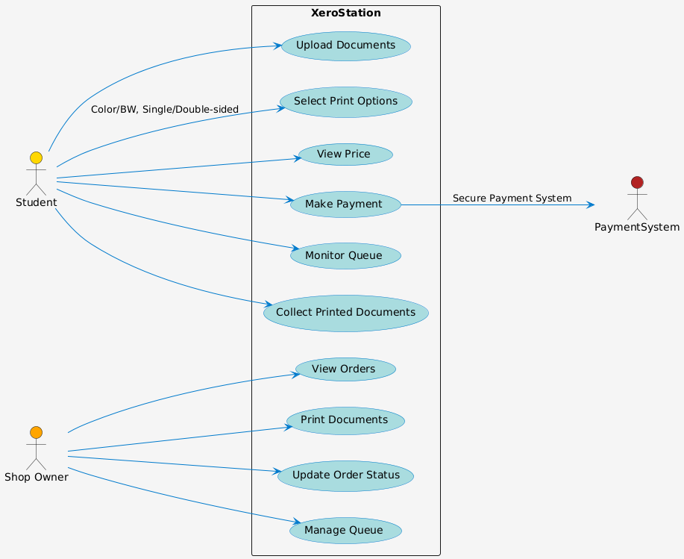
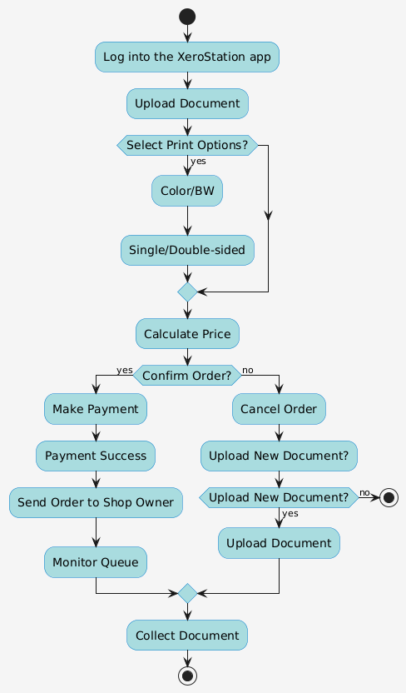
Use Case Diagram
Flow Chart

Slide 11
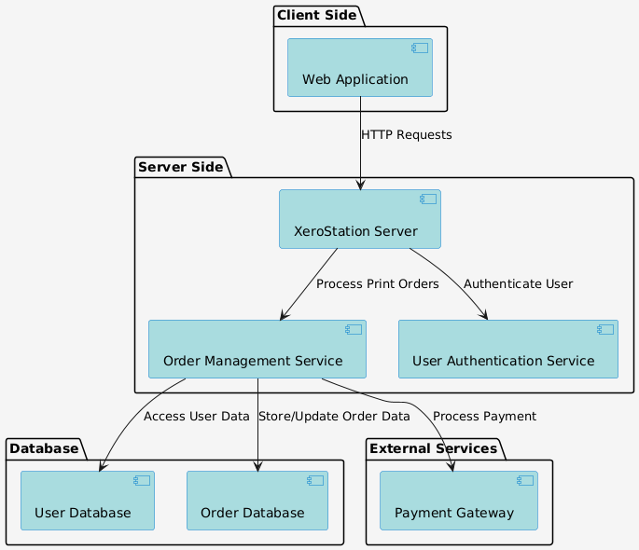
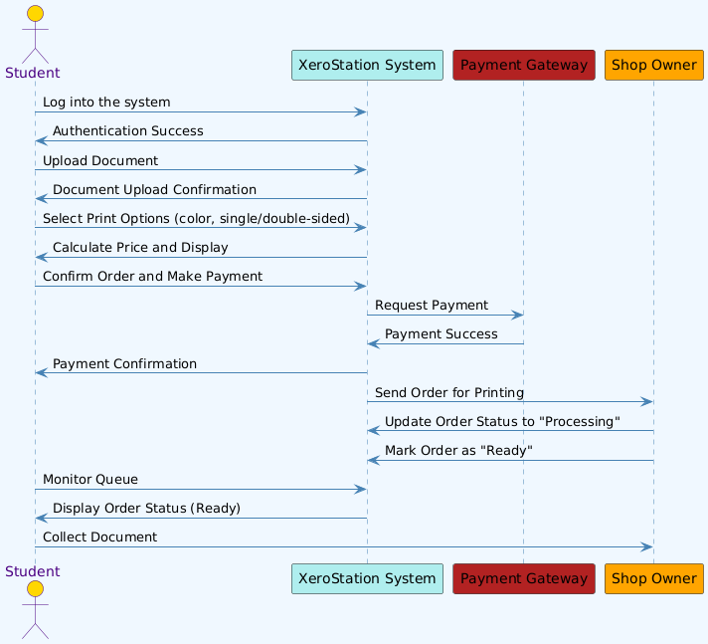
Architecture Diagram
Sequence Diagram

Slide 12
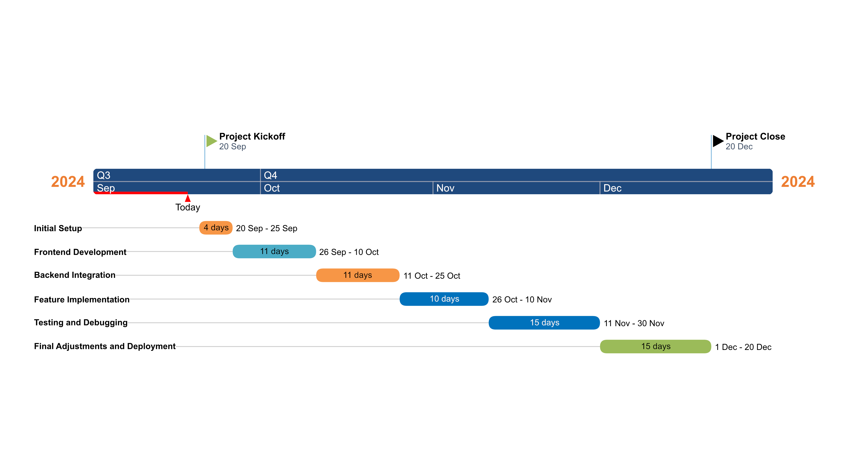
Timeline of Project

Slide 13
Outcomes / Results Obtained
User-Friendly Design: The app is designed with user-friendliness in mind, allowing students to upload documents easily, select printing options, and monitor their orders without any difficulties.
Secure Payments: A seamless payment system has been implemented, ensuring high security and a low risk of fraud. This guarantees the integrity of transactions and protects user data.
Efficient Queue Management: The app enables students to check the crowd levels at different shops, allowing them to choose where to print based on real-time information. They can also easily monitor the status of their print orders.
Increased Accessibility: By functioning as a web app, it is accessible to all students with an internet connection, whether they are using mobile phones or laptops, eliminating concerns about device compatibility.
Impact on Campus Printing Services: The implementation of XeroStation streamlines the printing process on campus, reducing congestion at print shops and saving student's time.

Slide 14
Conclusion
In conclusion, the XeroStation app represents a significant advancement in campus printing services, addressing the common challenges faced by students in accessing and managing their printing needs.
By integrating user-friendly design principles, secure payment options, and efficient queue management, the app enhances the overall printing experience, making it more convenient and accessible.
The web-based platform ensures that all students can easily use the app, regardless of their device, promoting greater engagement with campus resources.
Ultimately, the XeroStation app not only streamlines the printing process but also contributes to a more organized and efficient campus environment, reducing congestion at print shops and saving students valuable time.
As technology continues to evolve, XeroStation stands poised to adapt and expand its features, further enhancing its impact on student life and academic success.

Slide 15
References
"Tampubolon, M. R., Malik, Z. R., Nissa, R. R. N. A., Oktarmila, Y., Sinaga, R. A., & Endraswari, P. M." (2024). Design of a mobile-based print and photocopy service system using the waterfall method. BITJournal: Bangka Information Technology Journal, 1(1), 1-9.
"Ishak, N. I. A., & Ahmad, N. A." (2023). GoPrintBot: An interactive platform for online printing services. "Journal of Information Systems and Informatics".
"Lu, D., Mao, G., Wang, X., & Tan, W." (2019). Research on the design of campus printing service systems. In Proceedings of the 2nd International Conference on Electronic Information and Communication Technology (ICEICT 2019).
"Hermawan, Y., & Nugroho, M. R. S." (2023). Web-based information system design for ordering printing services at CV Multigraph. "Jurnal Ilmiah Manajemen Kesatuan".
"Joseph, R., Dembla, S., Sughand, S., & Khithani, D." Development of PrintEase: A smart printing application. V.E.S.I.T., Mumbai, India.
"Tamilareson, T., and Abdullah." (2020). Structured analysis for a smart printing management system. International Journal of Advanced Computing Science and Engineering, 2(2), 57-68.

Slide 16
Publication Details

Slide 17


